Slide 1
Game Playing
Why do AI researchers study game playing?
It’s a good reasoning problem, formal and nontrivial.
Direct comparison with humans and other computer
programs is easy.

Slide 2
What Kinds of Games?
Mainly games of strategy with the following characteristics:
Sequence of moves to play
Rules that specify possible moves
Rules that specify a payment for each move
Objective is to maximize your payment

Slide 3
Games vs. Search Problems
Unpredictable opponent → specifying a move for every possible opponent reply
Time limits → unlikely to find goal, must approximate

Slide 4
Two-Player Game
Opponent’s Move
Generate New Position
Game
Over?
yes
no
Generate Successors
Evaluate Successors
Move to Highest-Valued Successor
no
Game
Over?
yes

Slide 5
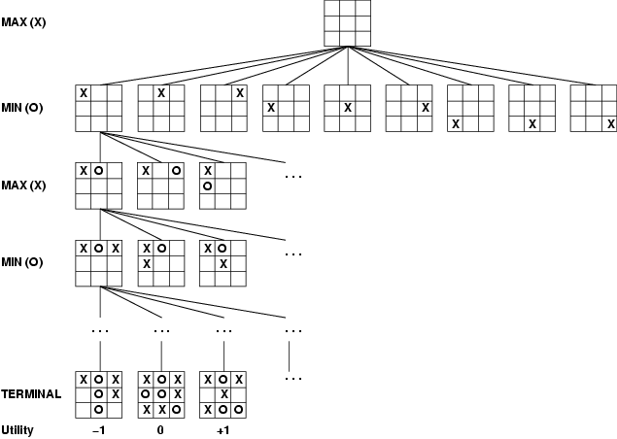
Game Tree (2-player, Deterministic, Turns)
computer’s
turn
opponent’s
turn
computer’s
turn
opponent’s
turn
leaf nodes
are evaluated
The computer is Max.
The opponent is Min.
At the leaf nodes, the
utility function
is employed. Big value
means good, small is bad.

Slide 6
Mini-Max Terminology
utility function: the function applied to leaf nodes
backed-up value
  of a max-position: the value of its largest successor
  of a min-position: the value of its smallest successor
minimax procedure: search down several levels; at the bottom level apply the utility function, back-up values all the way up to the root node, and that node selects the move.

Slide 7
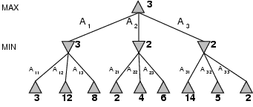
Minimax
Perfect play for deterministic games
Idea: choose move to position with highest minimax value
= best achievable payoff against best play
E.g., 2-ply game:

Slide 8
Minimax Strategy
Why do we take the min value every other level of the tree?
These nodes represent the opponent’s choice of move.
The computer assumes that the human will choose that move that is of least value to the computer.

Slide 9
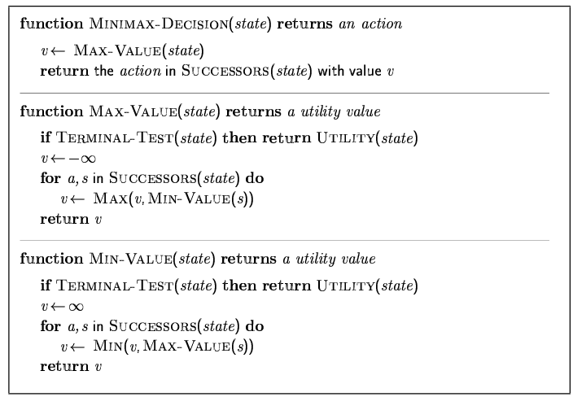
Minimax algorithm

Slide 10
Tic Tac Toe
Let p be a position in the game
Define the utility function f(p) by
  f(p) =
    largest positive number if p is a win for computer
    smallest negative number if p is a win for opponent
    RCDC – RCDO
  where RCDC is number of rows, columns and diagonals in which computer could still win
  and RCDO is number of rows, columns and diagonals in which opponent could still win.

Slide 11
Sample Evaluations
X = Computer; O = Opponent
O
X
O O X
X X
X O
rows
cols
diags
X O
rows
cols
diags

Slide 12
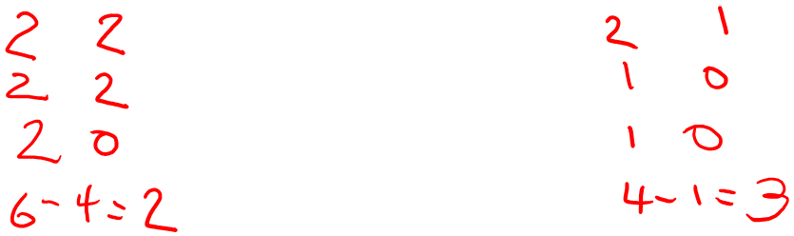
Sample Evaluations
X = Computer; O = Opponent
O
X
O O X
X X
X O
rows
cols
diags
X O
rows
cols
diags

Slide 13
Minimax is done depth-first
max
min
max
leaf
2 5 1

Slide 14
Properties of Minimax
Complete? Yes (if tree is finite)
Optimal? Yes (against an optimal opponent)
Time complexity? O(b^{m})
Space complexity? O(bm) (depth-first exploration)
For chess, b ≈ 35, m ≈100 for "reasonable" games
→ exact solution completely infeasible
Need to speed it up.

Slide 15
Alpha-Beta Procedure
The alpha-beta procedure can speed up a depth-first minimax search.
Alpha: a lower bound on the value that a max node may ultimately be assigned
Beta: an upper bound on the value that a minimizing node may ultimately be assigned
v > α
v < β

Slide 16
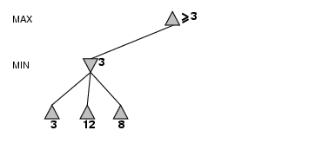
α-β pruning example

Slide 17
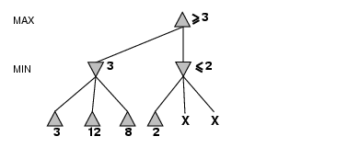
α-β pruning example
α = 3
alpha cutoff

Slide 18
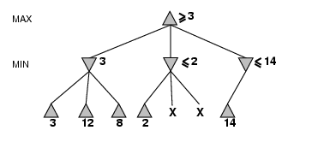
α-β pruning example

Slide 19
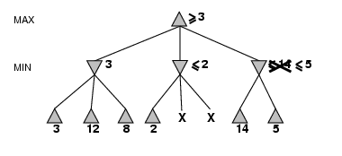
α-β pruning example

Slide 20
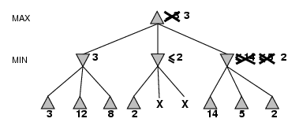
α-β pruning example

Slide 21
Alpha Cutoff
> 3
α = 3
3
8
10
What happens here? Is there an alpha cutoff?
NO

Slide 22
Beta Cutoff
β = 4
< 4
4
> 8
8
β cutoff

Slide 23
Alpha-Beta Pruning
max
min
max
eval
≥5
5
≤12
≤5
5
≤2
α cutoff
≤4
α cutoff
5
≥10
2
12
≥4
5 2 10 11 1 2 2 8 6 5 12 4 3 25 2
β cutoff

Slide 24
Properties of α-β
Pruning does not affect final result. This means that it gets the exact same result as does full minimax.
Good move ordering improves effectiveness of pruning
With "perfect ordering," time complexity = O(b^{m/2})
  → doubles depth of search
A simple example of the value of reasoning about which computations are relevant (a form of metareasoning)

Slide 25
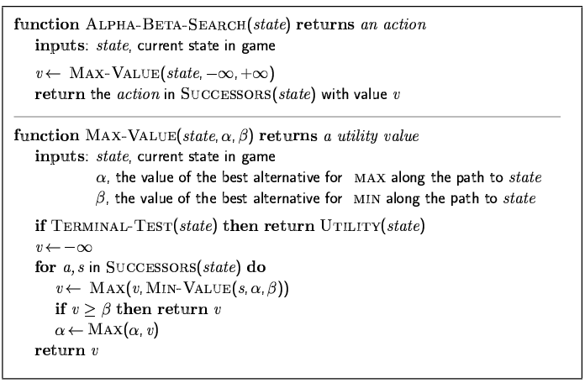
The α-β algorithm
cutoff

Slide 26
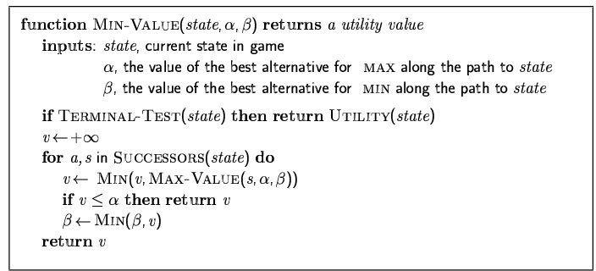
The α-β algorithm
cutoff

Slide 27
When do we get alpha cutoffs?
100
...
< 100
< 100

Slide 28
Shallow Search Techniques
1. limited search for a few levels
2. reorder the level-1 sucessors
3. proceed with α-β minimax search

Slide 29
Additional Refinements
Waiting for Quiescence: continue the search until no drastic change occurs from one level to the next.
Secondary Search: after choosing a move, search a few more levels beneath it to be sure it still looks good.
Book Moves: for some parts of the game (especially initial and end moves), keep a catalog of best moves to make.

Slide 30
Evaluation functions
For chess/checkers, typically linear weighted sum of features
Eval(s) = w₁ f₁(s) + w₂ f₂(s) + … + w_{n} f_{n}(s)
e.g., w₁ = 9 with
f₁(s) = (number of white queens) – (number of black queens), etc.

Slide 31
Example: Samuel’s Checker-Playing Program
It uses a linear evaluation function
f(n) = a₁x₁(n) + a₂x₂(n) + ... + a_{m}x_{m}(n)
For example: f = 6K + 4M + U
  K = King Advantage
  M = Man Advantage
  U = Undenied Mobility Advantage (number of moves that Max has that Min can’t jump after)

Slide 32
Samuel’s Checker Player
In learning mode
  Computer acts as 2 players: A and B
  A adjusts its coefficients after every move
  B uses the static utility function
  If A wins, its function is given to B

Slide 33
Samuel’s Checker Player
How does A change its function?
  Coefficent replacement
  (node ) = backed-up value(node) – initial value(node)
  if > 0 then terms that contributed positively are given more weight and terms that contributed negatively get less weight
  if < 0 then terms that contributed negatively are given more weight and terms that contributed positively get less weight

Slide 34
Samuel’s Checker Player
How does A change its function?
  2. Term Replacement
  38 terms altogether
  16 used in the utility function at any one time
  Terms that consistently correlate low with the function value are removed and added to the end of the term queue.
  They are replaced by terms from the front of the term queue.

Slide 35
Kalah
P’s holes
6 6 6 6 6 6
KP
Kp
0
0
counterclockwise
6 6 6 6 6 6
p’s holes
To move, pick up all the stones in one of your holes, and
put one stone in each hole, starting at the next one,
including your Kalah and skipping the opponent’s Kalah.

Slide 36
Kalah
If the last stone lands in your Kalah, you get another turn.
If the last stone lands in your empty hole, take all the stones from your opponent’s hole directly across from it and put them plus your last stone in your Kalah.
If all of your holes become empty, the opponent keeps the rest of the stones.
The winner is the player who has the most stones in his Kalah at the end of the game.

Slide 37
Kalah
P’s holes
6 6 6 6 6 6
KP
Kp
0
7
counterclockwise
0 7 7 7 7 7
p’s holes
To move, pick up all the stones in one of your holes, and
put one stone in each hole, starting at the next one,
including your Kalah and skipping the opponent’s Kalah.

Slide 38
Kalah
P’s holes
7 7 7 7 7 7
KP
Kp
0
8
counterclockwise
0 7 7 7 7 0
p’s holes
To move, pick up all the stones in one of your holes, and
put one stone in each hole, starting at the next one,
including your Kalah and skipping the opponent’s Kalah.

Slide 39
Kalah
P’s holes
N * * * * *
KP
Kp
*
*
counterclockwise
13 * * * * *
p’s holes
To move, pick up all the stones in one of your holes, and
put one stone in each hole, starting at the next one,
including your Kalah and skipping the opponent’s Kalah.

Slide 40
Kalah
P’s holes
N+1 *+1 *+1 *+1 *+1 *+1
KP
Kp
*
*+1
counterclockwise
1 *+1 *+1 *+1 *+1 *+1
p’s holes
To move, pick up all the stones in one of your holes, and
put one stone in each hole, starting at the next one,
including your Kalah and skipping the opponent’s Kalah.

Slide 41
Cutting off Search
MinimaxCutoff is identical to MinimaxValue except
  Terminal? is replaced by Cutoff?
  Utility is replaced by Eval
Does it work in practice?
b^{m} = 10⁶, b=35 → m=4
4-ply lookahead is a hopeless chess player!
  4-ply ≈ human novice
  8-ply ≈ typical PC, human master
  12-ply ≈ Deep Blue, Kasparov

Slide 42
Deterministic Games in Practice
Checkers: Chinook ended 40-year-reign of human world champion Marion Tinsley in 1994. Used a precomputed endgame database defining perfect play for all positions involving 8 or fewer pieces on the board, a total of 444 billion positions.
Chess: Deep Blue defeated human world champion Garry Kasparov in a six-game match in 1997. Deep Blue searches 200 million positions per second, uses very sophisticated evaluation, and undisclosed methods for extending some lines of search up to 40 ply.
Othello: human champions refuse to compete against computers, who are too good.
Go: human champions refuse to compete against computers, who are too bad. In go, b > 300, so most programs use pattern knowledge bases to suggest plausible moves.

Slide 43
Games of Chance
What about games that involve chance, such as
  rolling dice
  picking a card
Use three kinds of nodes:
  max nodes
  min nodes
  chance nodes
∇ ∇ ∇
min
chance
max

Slide 44
Games of Chance
c
chance node with
max children
d₁
d_{i}
d_{k}
S(c,d_{i})
expectimax(c) = ∑P(d_{i}) max(backed-up-value(s))
i s in S(c,d_{i})
expectimin(c’) = ∑P(d_{i}) min(backed-up-value(s))
i s in S(c,d_{i})

Slide 45
Example Tree with Chance
max
chance
min
chance
max
leaf
.4 .6
∇ ∇
1.2
.4 .6 .4 .6
3 5 1 4 1 2 4 5

Slide 46
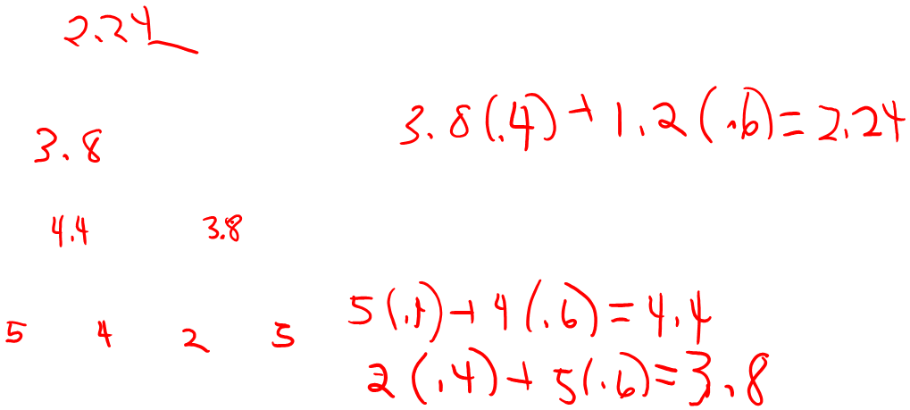
Example Tree with Chance
max
chance
min
chance
max
leaf
.4 .6
∇ ∇
1.2
.4 .6 .4 .6
3 5 1 4 1 2 4 5

Slide 47
Complexity
Instead of O(b^{m}), it is O(b^{m}n^{m}) where n is the number of chance outcomes.
Since the complexity is higher (both time and space), we cannot search as deeply.
Pruning algorithms may be applied.

Slide 48
Summary
Games are fun to work on!
They illustrate several important points about AI.
Perfection is unattainable → must approximate.
Game playing programs have shown the world what AI can do.

