Slide 1
HW2
EE 562

Slide 2
Basic Idea
Find the shortest path for a robot to move from start point to an end point, avoiding rectangular obstacles.
Use the A* algorithm with the heuristic function being the straight-line distance from a point being considered to the goal point.
State space is the set of all vertices of the rectangles.
Need to write a function that determines if a given line intersects a rectangle.

Slide 3
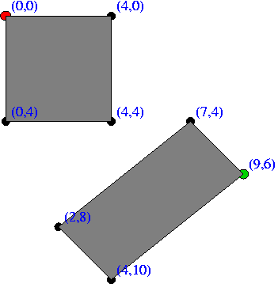
point, g, h, f
[(0,0),0,10.8166538264,10.8166538264]
[(4,0),4.0,7.81024967591,11.8102496759]
[(9,6),11.8102496759,0.0,11.8102496759]

Slide 4
