Slide 1

Inexact Consistent Labeling
The inexact consistent labeling problem is to find all mappings f: U→ L
so that the ERRORS incurred by f on all N-tuples of units that constrain
one another is less than a given ϵ0.
This can also be done by either backtracking or forward checking
using the FTAB to accumulate the error on each (unit,label) pair.
See paper by Shapiro and Haralick in Trans PAMI, Sept 1981.

Slide 2

Relational Distance
But what is more useful than having a threshold ϵ0, is to find the BEST match, and not have to determine a threshold.
For this, we developed a new graph matching measure called RELATIONAL DISTANCE.
Intuitively it finds the mapping between two graphs (generalized) that gives the lowest relational error.

Slide 3
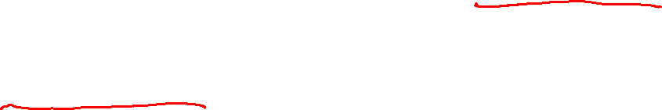
Relational Descriptions
A relational description D_{p} is a sequence of relations D_{X} = {R1,…,RI} where for each I = 1 to I, there exists a positive integer ni with Ri a subset of P^{ni} for some set P.
P is a set of parts of the entity being described and the relations Ri indicate various relationships among the parts.
A relational description may be used to described 2D shapes, 3D objects, regions on an image, etc.

Slide 4
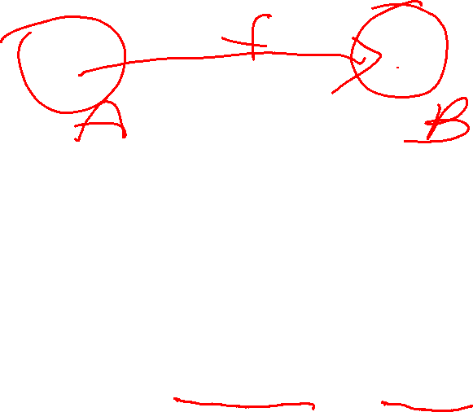
Mapping
Let D_{A} be a relational description with part set A and D_{B} be a relational description with part set B.
Let f be a 1-1 mapping from A to B.
Let R be a relation that is a subset of A^{N}.
The composition R ᴼ f of relation R with function f is given by
R ᴼ f = {(b₁,…,b_{N}) ϵ B^{N} | there exists (a₁,…a_{N}) ϵ R with f(a_{n})=b_{n},n=1 to N}
That is, start with a tuple of R and apply f to each component.

Slide 5

Structural Error
For each of the relations R_{i}, the structural error E^{i}_{s}(f) is given by
E^{i}_{s}(f) = |R_{i} ᴼ f – S_{i}| + |S_{i} ᴼ f – R_{i}|
Intuitively, how many constraints in the first graph are not satisfied in the second and vice versa.
The total error of f with respect to DA and Db is the sum
E(f) = ΣE^{i}_{s}(f) for all i

Slide 6
Relational Distance
Given the concept of total error of a mapping, we define the relational distance as the minimal relational error over ALL mappings f.
GD(DA,DB) = min E(f)
f:A→B
f: 1-1 and onto
We call a mapping f that minimizes relational distance, a BEST MAPPING from D_{A} to D_{B}.

Slide 7
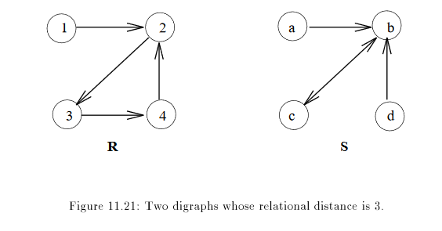
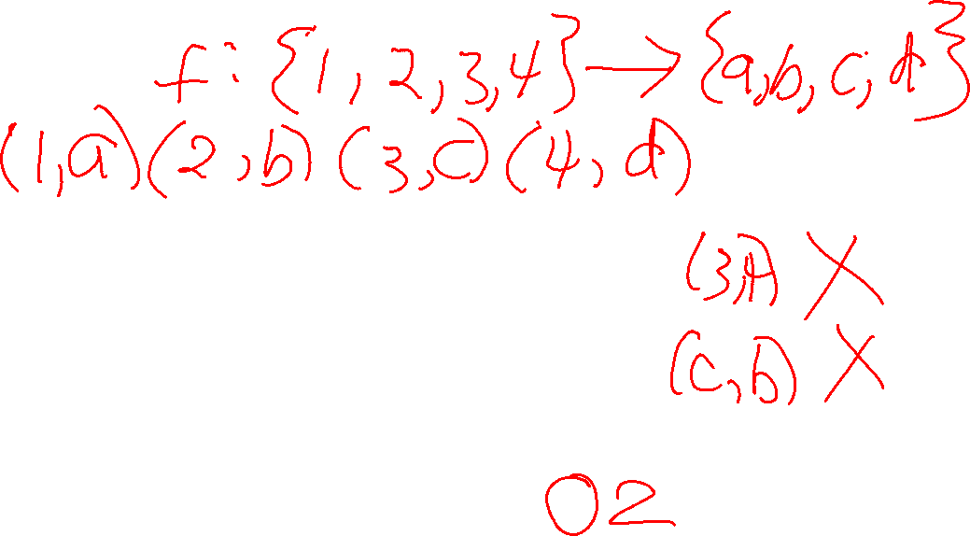
Example 1

Slide 8
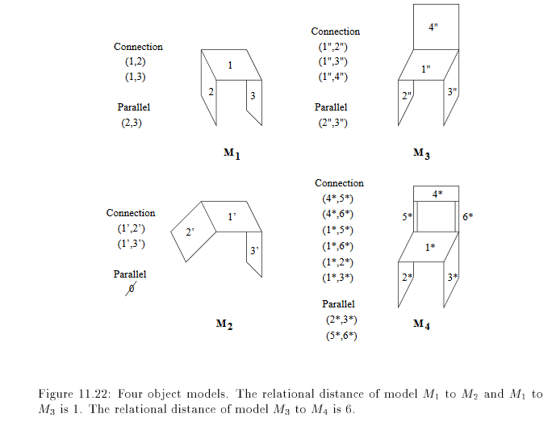
Example 2

