Slide 1
Informed (Heuristic) Search
Idea: be smart
about what paths
to try.

Slide 2
Blind Search vs. Informed Search
What’s the difference?
How do we formally specify this?
A node is selected for expansion based on an evaluation function that estimates cost to goal.

Slide 3
General Tree Search Paradigm
function tree-search(root-node)
fringe ← successors(root-node)
while ( notempty(fringe) )
{node ← remove-first(fringe)
state ← state(node)
if goal-test(state) return solution(node)
fringe ← insert-all(successors(node),fringe) }
return failure
end tree-search
root-node
successors list
How do we order the successor list?

Slide 4
Best-First Search
Use an evaluation function f(n) for node n.
Always choose the node from fringe that has the lowest f value.
3
5
1
4
6

Slide 5
Heuristics
What is a heuristic?
rule of thumb
What are some examples of heuristics we use?
We’ll call the heuristic function h(n).

Slide 6
Greedy Best-First Search
f(n) = h(n)
What does that mean?
What is it ignoring?
path cost so far

Slide 7
Romanian Route Finding
Problem
  Initial State: Arad
  Goal State: Bucharest
  c(s,a,s´) is the length of the road from s to s´
Heuristic function: h(s) = the straight line distance from s to Bucharest

Slide 8
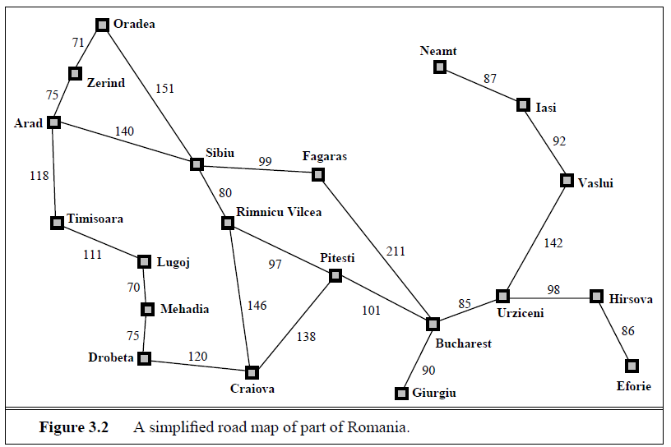
Original Road Map of Romania
What’s the real shortest path from Arad to Bucharest?
What’s the distance on that path?
418

Slide 9
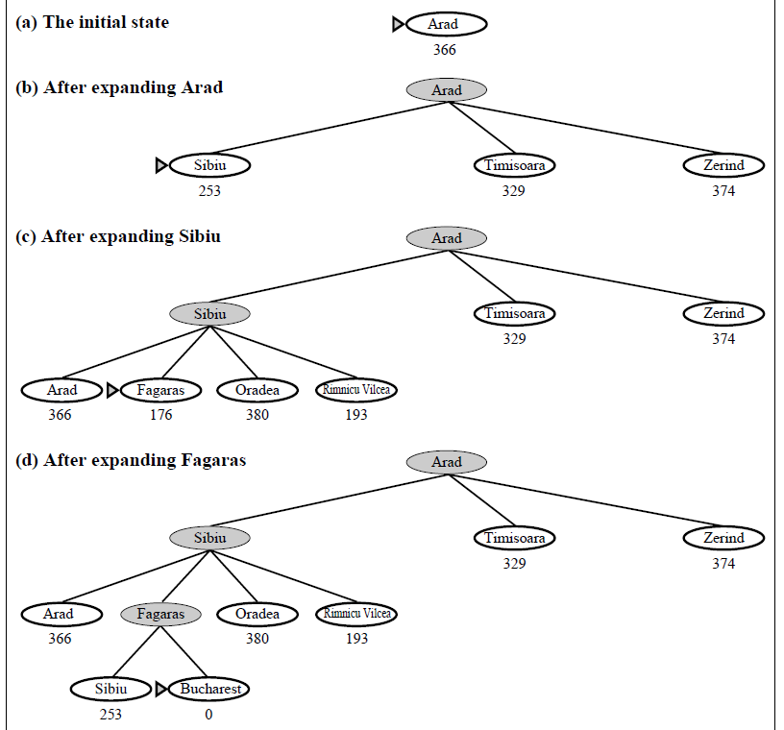
Greedy Search in Romania
140
99
211
Distance = 450

Slide 10
Greedy Best-First Search
Is greedy search optimal?
Is it complete?
No, can get into infinite loops in tree search.
Graph search is complete for finite spaces.
What is its worst-case complexity for a tree search with branching factor b and maximum depth m?
  time
  space
O(b^{m})
O(b^{m})

Slide 11
Greedy Best-First Search
When would we use greedy best-first search or greedy approaches in general?
  Fast
  Simple
  Approximate

Slide 12
A* Search
Hart, Nilsson & Rafael 1968
  Best-first search with f(n) = g(n) + h(n)
  where g(n) = sum of edge costs from start to n
  and h(n) = estimate of lowest cost path n-->goal
  If h(n) is admissible then search will find optimal solution.
{
Never overestimates the true
cost of any solution which
can be reached from a node.
Space bound since the queue must be maintained.

Slide 13
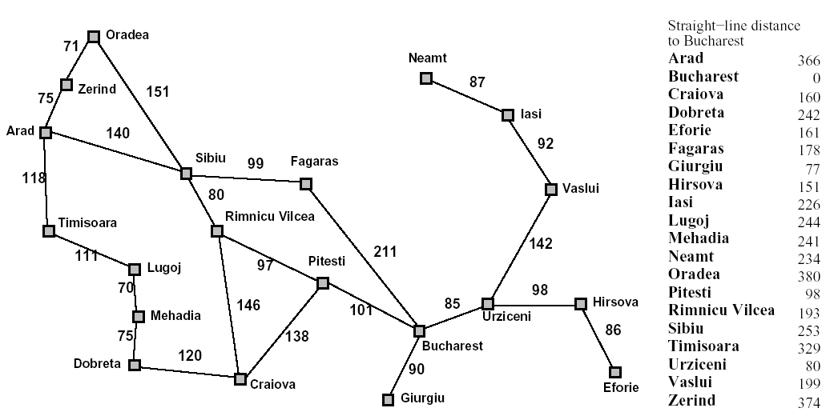
Back to Romania
start
end

Slide 14
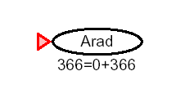
A* for Romanian Shortest Path

Slide 15
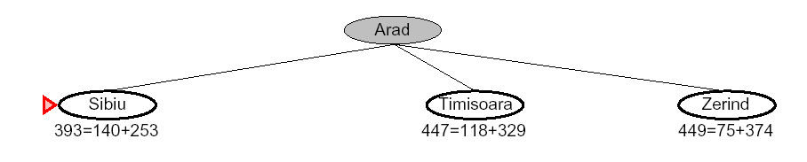
f(n) = g(n) + h(n)
140
75
118

Slide 16
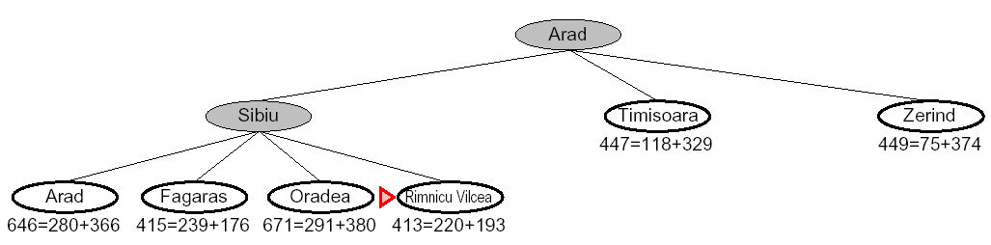

Slide 17
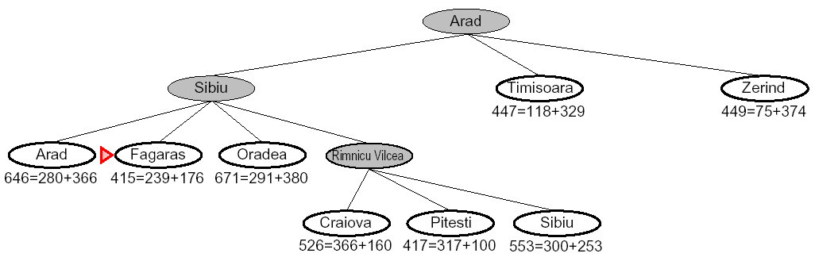

Slide 18
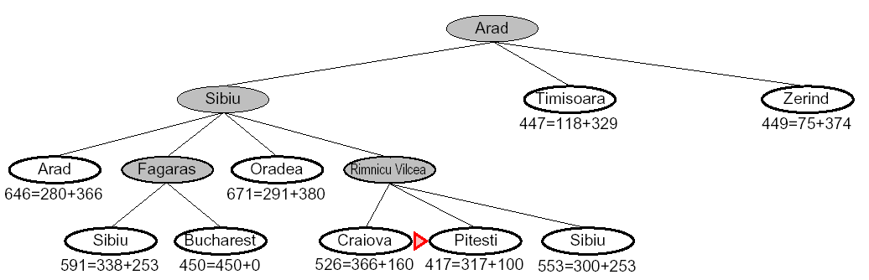

Slide 19
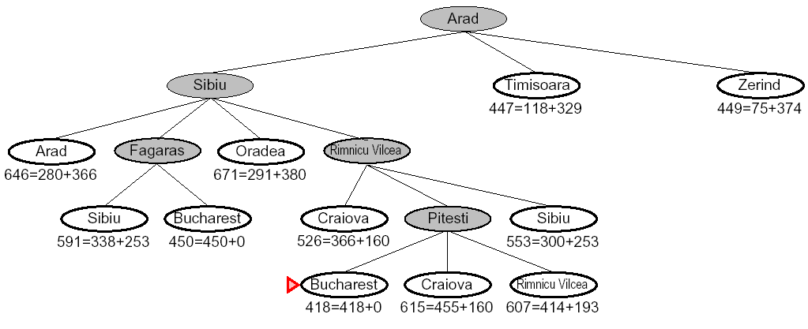

Slide 20
8 Puzzle Example
f(n) = g(n) + h(n)
What is the usual g(n)?
two well-known h(n)’s
  h1 = the number of misplaced tiles
  h2 = the sum of the distances of the tiles from their goal positions, using city block distance, which is the sum of the horizontal and vertical distances (Manhattan Distance)
1

Slide 21
8 Puzzle Using Number of Misplaced Tiles
2 3
4
7 6 5
g=0
h=4
f=4
8 3
6 4
7 5
goal
2 8 3
4
7 6 5
2 8 3
1 6 4
7 5
2 8 3
1 6 4
7 5

Slide 22
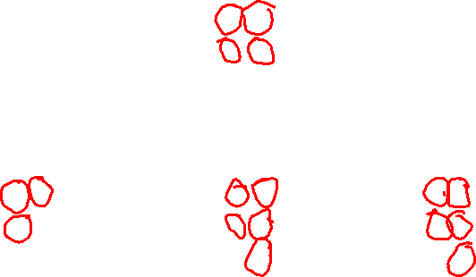
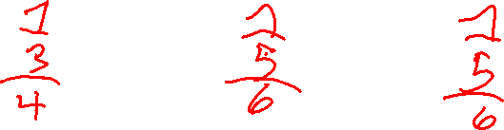
8 Puzzle Using Number of Misplaced Tiles
2 3
4
7 6 5
g=0
h=4
f=4
8 3
6 4
7 5
goal
2 8 3
4
7 6 5
2 8 3
1 6 4
7 5
2 8 3
1 6 4
7 5

Slide 23
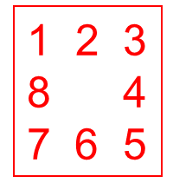
2 8 3
1 4
7 6 5
Exercise:
What are its children and their
f, g, h?

Slide 24
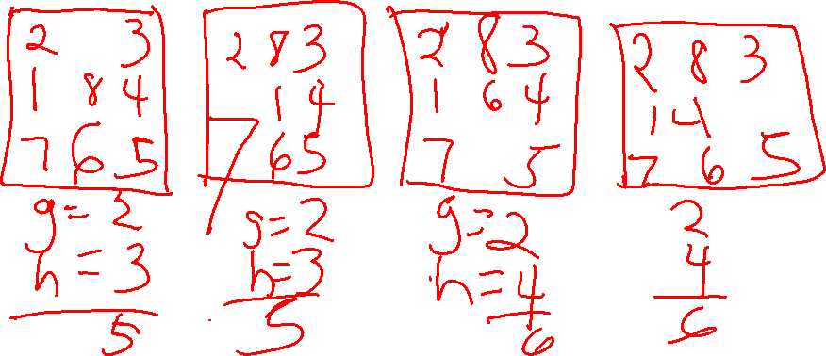
2 8 3
1 4
7 6 5
Exercise:
What are its children and their
f, g, h?

Slide 25
Optimality of A* with Admissibility
(h never overestimates the cost to the goal)
Suppose a suboptimal goal G2 has been generated and
is in the queue. Let n be an unexpanded node on the
shortest path to an optimal goal G1.
f(n) = g(n) + h(n)
< g(G1) Why?
< g(G2) G2 is suboptimal
= f(G2) f(G2) = g(G2)
So f(n) < f(G2) and A* will never select
G2 for expansion.
admissibility
n
G1
G2

Slide 26
Optimality of A* with
Consistency (stronger condition)
h(n) is consistent if
  for every node n
  for every successor n´ due to legal action a
  h(n) <= c(n,a,n´) + h(n´)
Every consistent heuristic is also admissible.
n
h(n)
c(n,a,n´)
h(n´)
n´
G

Slide 27
Algorithms for A*
Since Nillsson defined A* search, many different authors have suggested algorithms.
Using Tree-Search, the optimality argument holds, but you search too many states.
Using Graph-Search, it can break down, because an optimal path to a repeated state can be discarded if it is not the first one found.
One way to solve the problem is that whenever you come to a repeated node, discard the longer path to it.

Slide 28
The Rich/Knight Implementation
a node consists of
  state
  g, h, f values
  list of successors
  pointer to parent
OPEN is the list of nodes that have been generated and had h applied, but not expanded and can be implemented as a priority queue.
CLOSED is the list of nodes that have already been expanded.

Slide 29
Rich/Knight
/* Initialization */
OPEN <- start node
Initialize the start node
g:
h:
f:
CLOSED <- empty list

Slide 30
Rich/Knight
2) repeat until goal (or time limit or space limit)
if OPEN is empty, fail
BESTNODE <- node on OPEN with lowest f
if BESTNODE is a goal, exit and succeed
remove BESTNODE from OPEN and add it to CLOSED
generate successors of BESTNODE

Slide 31
Rich/Knight
for each successor s do
1. set its parent field
2. compute g(s)
3. if there is a node OLD on OPEN with the same state info as s
{ add OLD to successors(BESTNODE)
if g(s) < g(OLD), update OLD and
throw out s }

Slide 32
Rich/Knight/Tanimoto
4. if (s is not on OPEN and there is a node OLD on CLOSED with the same state
info as s
{ add OLD to successors(BESTNODE)
if g(s) < g(OLD), update OLD,
remove it from CLOSED
and put it on OPEN, throw out s
}

Slide 33
Rich/Knight
5. If s was not on OPEN or CLOSED
{ add s to OPEN
add s to successors(BESTNODE)
calculate g(s), h(s), f(s) }
end of repeat loop

Slide 34
NOTE
A student pointed out to me last time that with Prof. Tanimoto’s modification,
Keeping the lists successors(BESTNODE) for every node did not seem necessary
We went over it and decided it was only used in the Rich/Knight implementation when they modified a whole subtree under a node, which the Tanimoto modification avoids.
It could be used for debugging, however.
It does not hurt. I had it in my code; he did not.

Slide 35
The Heuristic Function h
If h is a perfect estimator of the true cost then A* will always pick the correct successor with no search.
If h is admissible, A* with TREE-SEARCH is guaranteed to give the optimal solution.
If h is consistent, too, then GRAPH-SEARCH is optimal.
If h is not admissable, no guarantees, but it can work well if h is not often greater than the true cost.

Slide 36
Complexity of A*
Time complexity is exponential in the length of the solution path unless for “true” distance h*
  |h(n) – h*(n)| < O(log h*(n))
  which we can’t guarantee.
But, this is AI, computers are fast, and a good heuristic helps a lot.
Space complexity is also exponential, because it keeps all generated nodes in memory.
Big Theta notation says 2 functions have about the same growth rate.

Slide 37
Why not always use A*?
Pros
  optimal solution
  easy to code
Cons
  space

Slide 38
Solving the Memory Problem
Iterative Deepening A*
Recursive Best-First Search
Depth-First Branch-and-Bound
Simplified Memory-Bounded A*

Slide 39
Iterative-Deepening A*
Like iterative-deepening depth-first, but...
Depth bound modified to be an f-limit
  Start with f-limit = h(start)
  Prune any node if f(node) > f-limit
  Next f-limit=min-cost of any node pruned
e
FL=21
FL=15
a
d
f
b
c

Slide 40
Recursive Best-First Search
Use a variable called f-limit to keep track of the best alternative path available from any ancestor of the current node
If f(current node) > f-limit, back up to try that alternative path
As the recursion unwinds, replace the f-value of each node along the path with the backed-up value: the best f-value of its children

Slide 41
Depth-First Branch & Bound
Single DF search
  → uses linear space
Keep track of best solution so far
If f(n) = g(n)+h(n) ≥ cost(best-soln)
  Then prune n
Requires
  Finite search tree, or
  Good upper bound on solution cost
Adapted from Richard Korf presentation

Slide 42
Simplified Memory-Bounded A*
Works like A* until memory is full
When memory is full, drop the leaf node with the highest f-value (the worst leaf), keeping track of that worst value in the parent
Complete if any solution is reachable
Optimal if any optimal solution is reachable
Otherwise, returns the best reachable solution

Slide 43
Performance of Heuristics
How do we evaluate a heuristic function?
effective branching factor b*
  If A* using h finds a solution at depth d using N nodes, then the effective branching factor is
  b* where N = 1 + b* + (b*)² + . . . + (b*)^{d}
Example: depth 0
d=2 depth 1
b=3 depth 2

Slide 44
Table of Effective Branching Factors
b d N
2 2 7
2 5 63
3 2 13
3 5 364
3 10 88573
6 2 43
6 5 9331
6 10 72,559,411
How might we use this idea to evaluate a heuristic?

Slide 45
How Can Heuristics be Generated?
From Relaxed Problems that have fewer constraints but give you ideas for the heuristic function.
From Subproblems that are easier to solve and whose exact cost solutions are known.
The cost of solving a relaxed problem or subproblem is not
greater than the cost of solving the full problem.

Slide 46
Still may not succeed
In spite of the use of heuristics and various smart search algorithms, not all problems can be solved.
Some search spaces are just too big for a classical search.
So we have to look at other kinds of tools.

