Slide 1
Artificial Intelligence for Engineers
ECE 562
Autumn 2023

Slide 2
Administrative Details
Instructor: Linda Shapiro, 634 CSE, shapiro@cs.washington.edu
TA: Nishat Khan, nkhan51@uw.edu
TA: Saygin Seyfioğlu, msaygin@uw.edu
Course Home Page: http://homes.cs.washington.edu/~shapiro/EE562
Text: Artificial Intelligence: A Modern Approach, Russell and Norvig, 3rd or 4th edition, see Canvas Discussion Board.

Slide 3
This Lecture
What is AI all about, roughly from Chapters 1 and 2.
Overview the Python language we will use.

Slide 4
What is intelligence?
What capabilities should a machine have for us to call it intelligent?

Slide 5
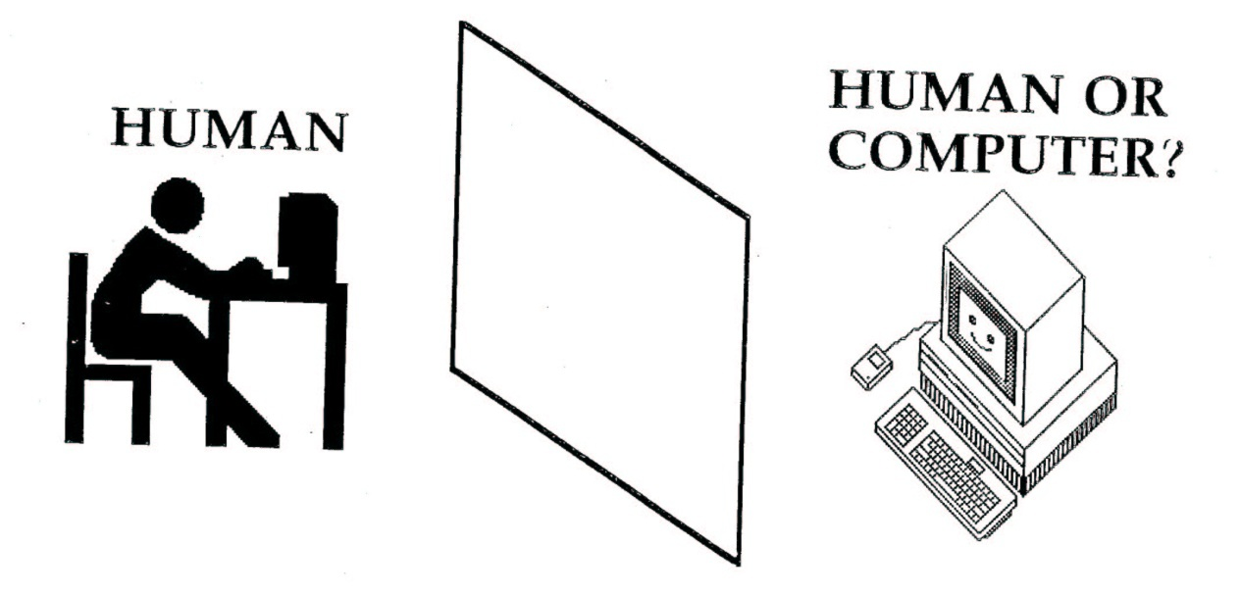
Turing’s Test
If the human cannot tell whether the responses from the other side of a wall are coming from a human or computer, then the computer is intelligent.

Slide 6
Performance vs. Humanlike
What is more important: how the program performs or how well it mimics a human?
Can you get a computer to do something that you don’t know how to do? Like what?
What about creativity?

Slide 7
Mundane Tasks
Perception
  Vision
  Speech
Natural Language
  Understanding
  Generation
  Translation
Reasoning
Robot Control

Slide 8
Formal Tasks
Games
  Chess
  Checkers
  Kalah, Othello
Mathematics
  Logic
  Geometry
  Calculus
  Proving properties of programs

Slide 9
Expert Tasks
Engineering
  Design
  Fault Finding
  Manufacturing planning
Medical
  Diagnosis
  Medical Image Analysis
Financial
  Stock market predictions

Slide 10
What is an intelligent agent?
What is an agent?
What does rational mean?
Are humans always rational?
Can a computer always do the right thing?
What can we substitute for the right thing?

Slide 11
Intelligent Agents
What kinds of agents already exist today?

Slide 12


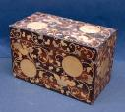
Problem Solving
C
A
B
Find a sequence of operations to produce the desired situation from the initial situation.

Slide 13

Game Playing
Given:
  An initial position in the game
  The rules of the game
  The criteria for winning the game
WIN!

Slide 14
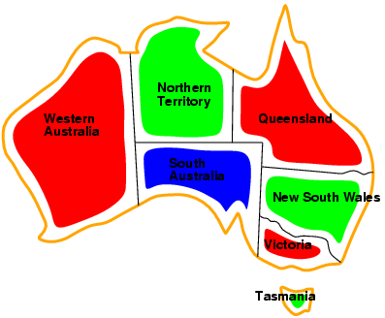
Constraint Satisfaction
Example: Map Coloring

Slide 15
Reasoning
Given:
  ∀x (human(x) -> animal(x))
  ∀x (animal(x) -> (eats(x) & drinks(x)))
Prove:
  ∀x (human(x) -> eats(x))

Slide 16
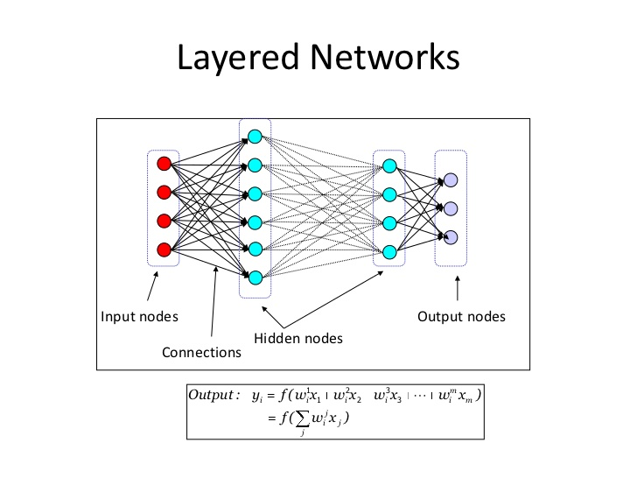
Learning
Example: Neural Network
+
+
+
+

Slide 17
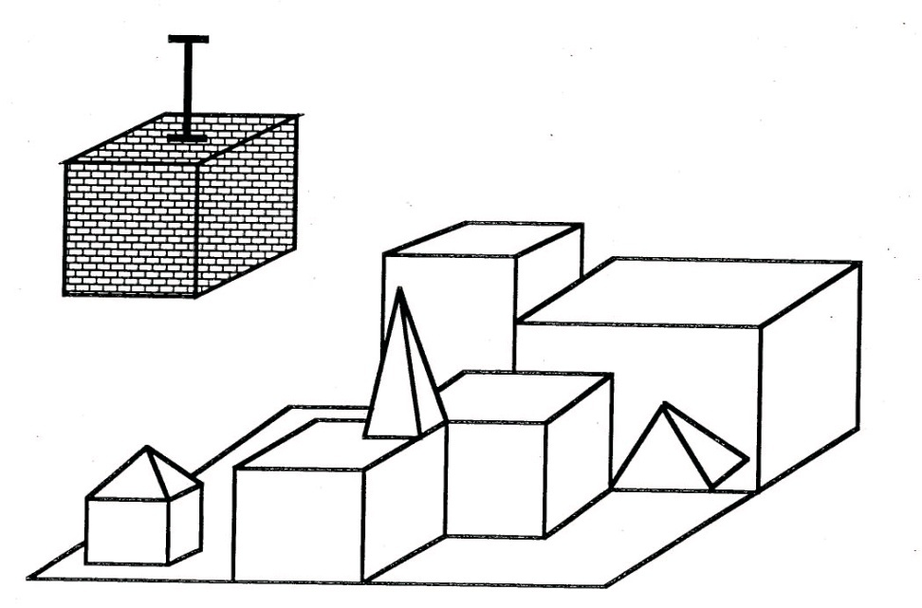
Natural Language Understanding
Pick up a big red block.
OK.
While hunting in
Africa, I shot an
elephant in my
pajamas.
I don’t understand.

Slide 18
Large Language Models
ChatGPT from OpenAI
Write a story about my new AI class
Make it one paragraph
Make it about a graduate course in a university.
Make the professor Linda Shapiro, who is an expert in computer vision

Slide 19
In the hallowed halls of a prestigious university, a cutting-edge graduate
course had just debuted: "Advanced Artificial Intelligence and its Impact."
Alex, a bright and tech-savvy student, eagerly enrolled, anticipating an
exciting journey into the depths of AI research and its societal implications,
all under the expert guidance of Professor Linda Shapiro, a renowned
authority in computer vision. With Dr. Shapiro at the helm, the class delved
deep into the history of AI, explored the intricacies of machine learning and
neural networks, and engaged in thought-provoking discussions on the ethical
dimensions of AI. Over the semester, Alex collaborated with their friend Mia on
a groundbreaking project, devising an AI-driven solution to assist individuals
with visual impairments. As the course concluded, they left with a profound
sense of responsibility and a determination to leverage AI's potential for positive
change in the world, inspired by the wisdom and expertise of Professor Shapiro.

Slide 20
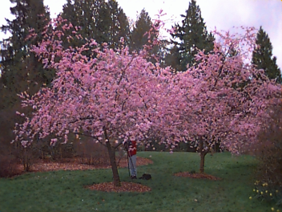

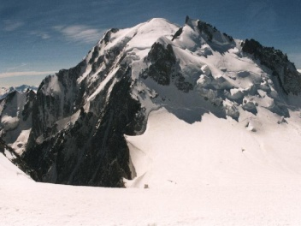

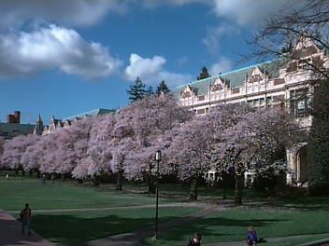
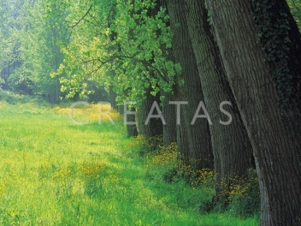
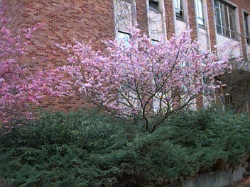
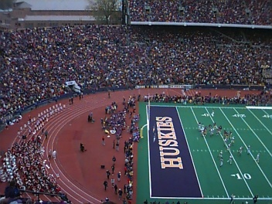
Computer Vision with Machine Learning
Given: Some images and their corresponding descriptions
•••
{trees, grass, cherry trees}
{cheetah, trunk}
{mountains, sky}
{beach, sky, trees, water}
To solve: What object classes are present in new images
•••
?
?
?
?
Notes:
Remove arrow
Dot!
Our
Give title/description of each system

Slide 21
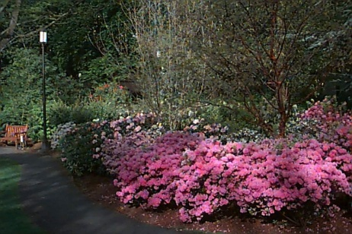
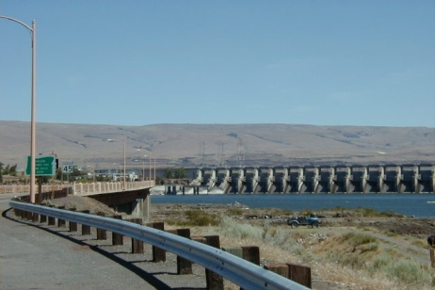
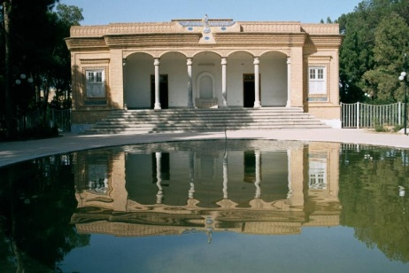
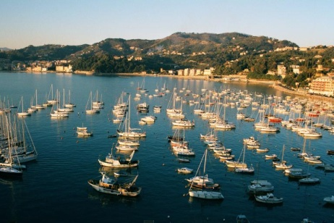
Groundtruth Data Set: Annotation Samples
tree(97.3), bush(91.6),
spring flowers(90.3),
flower(84.4), park(84.3),
sidewalk(67.5),
grass(52.5), pole(34.1)
sky(99.8),
Columbia gorge(98.8),
lantern(94.2), street(89.2),
house(85.8), bridge(80.8),
car(80.5), hill(78.3),
boat(73.1), pole(72.3),
water(64.3), mountain(63.8),
building(9.5)
sky(95.1), Iran(89.3),
house(88.6),
building(80.1),
boat(71.7), bridge(67.0),
water(13.5), tree(7.7)
Italy(99.9), grass(98.5),
sky(93.8), rock(88.8),
boat(80.1), water(77.1),
Iran(64.2), stone(63.9),
bridge(59.6), European(56.3),
sidewalk(51.1), house(5.3)

Slide 22
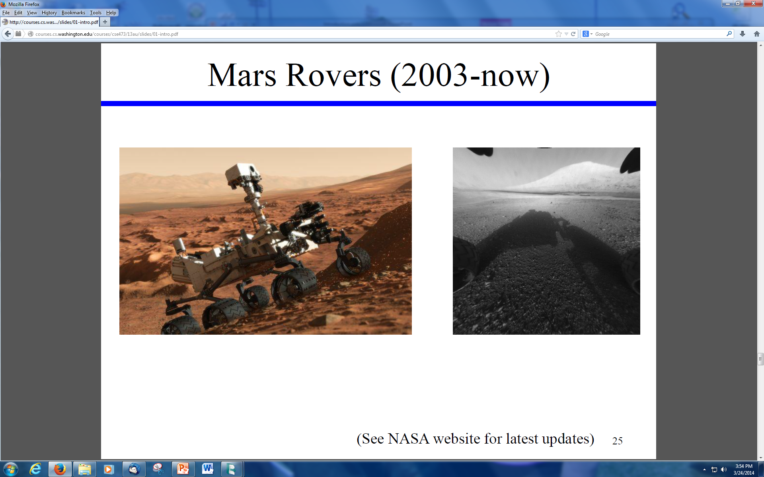

Slide 23
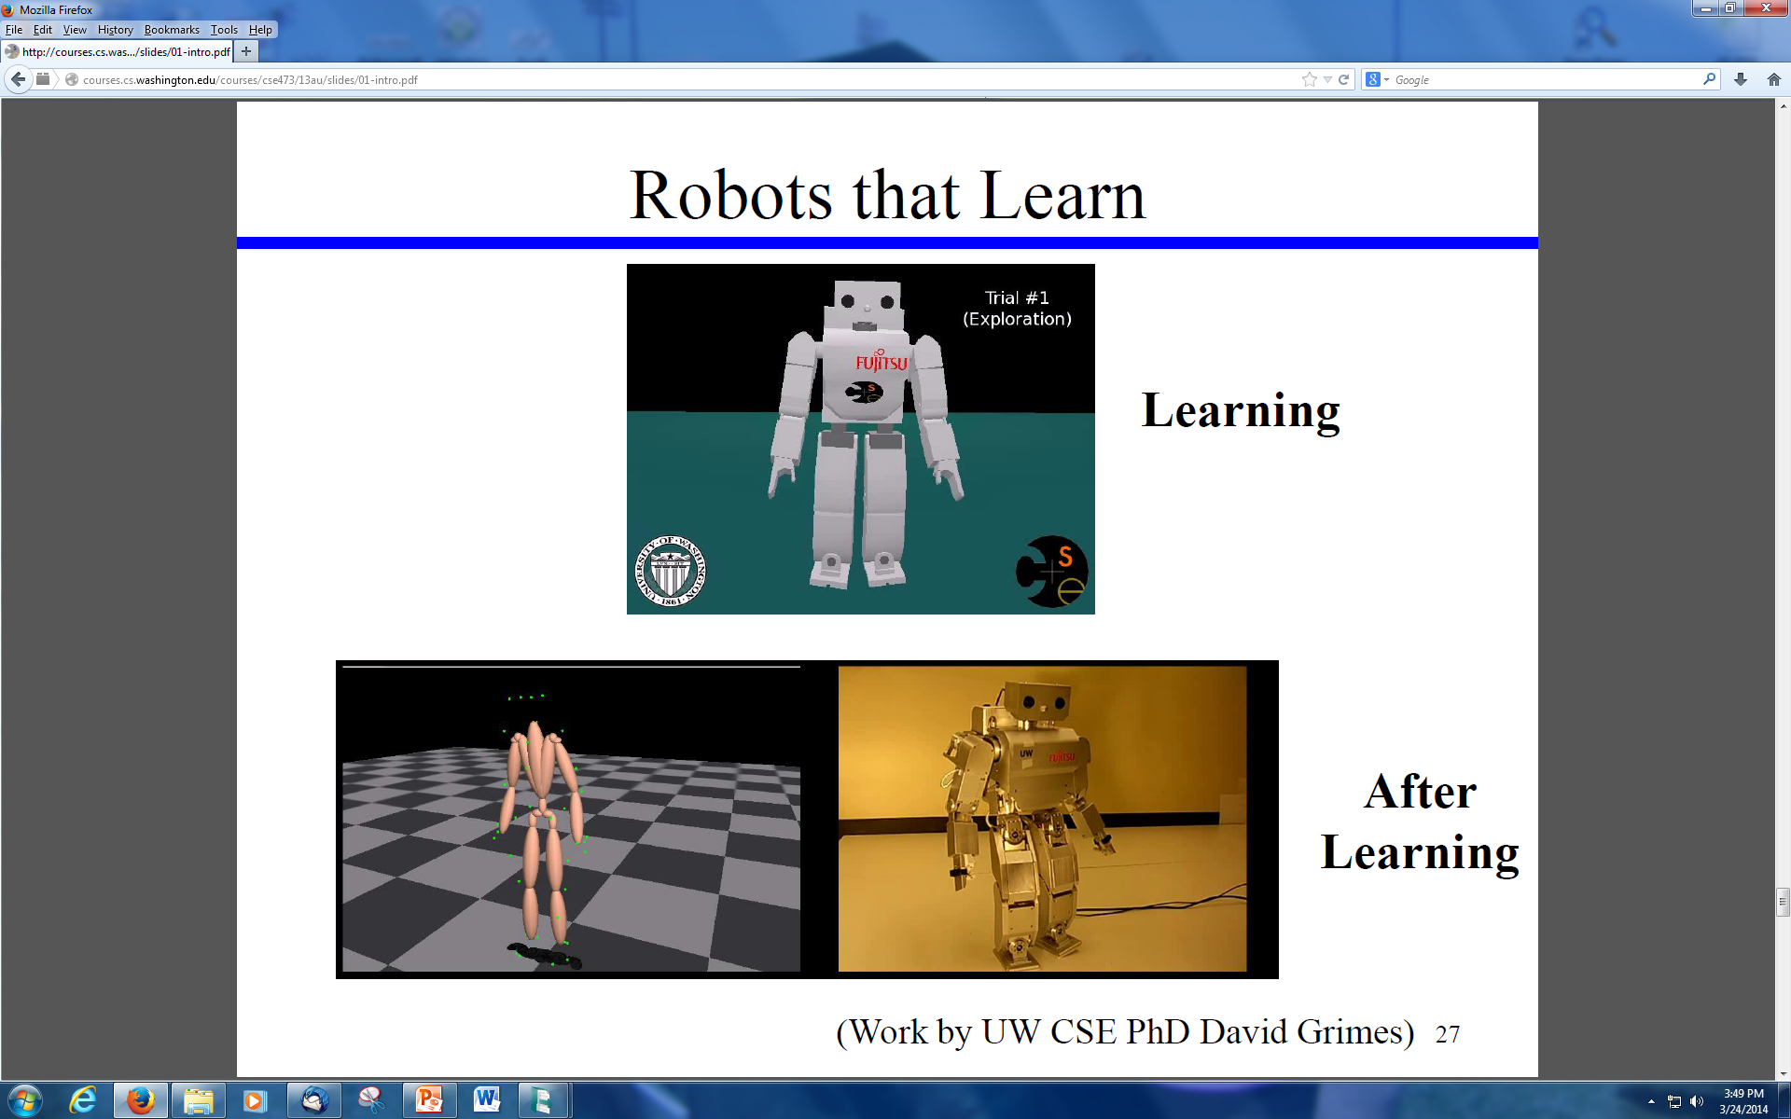

Slide 24
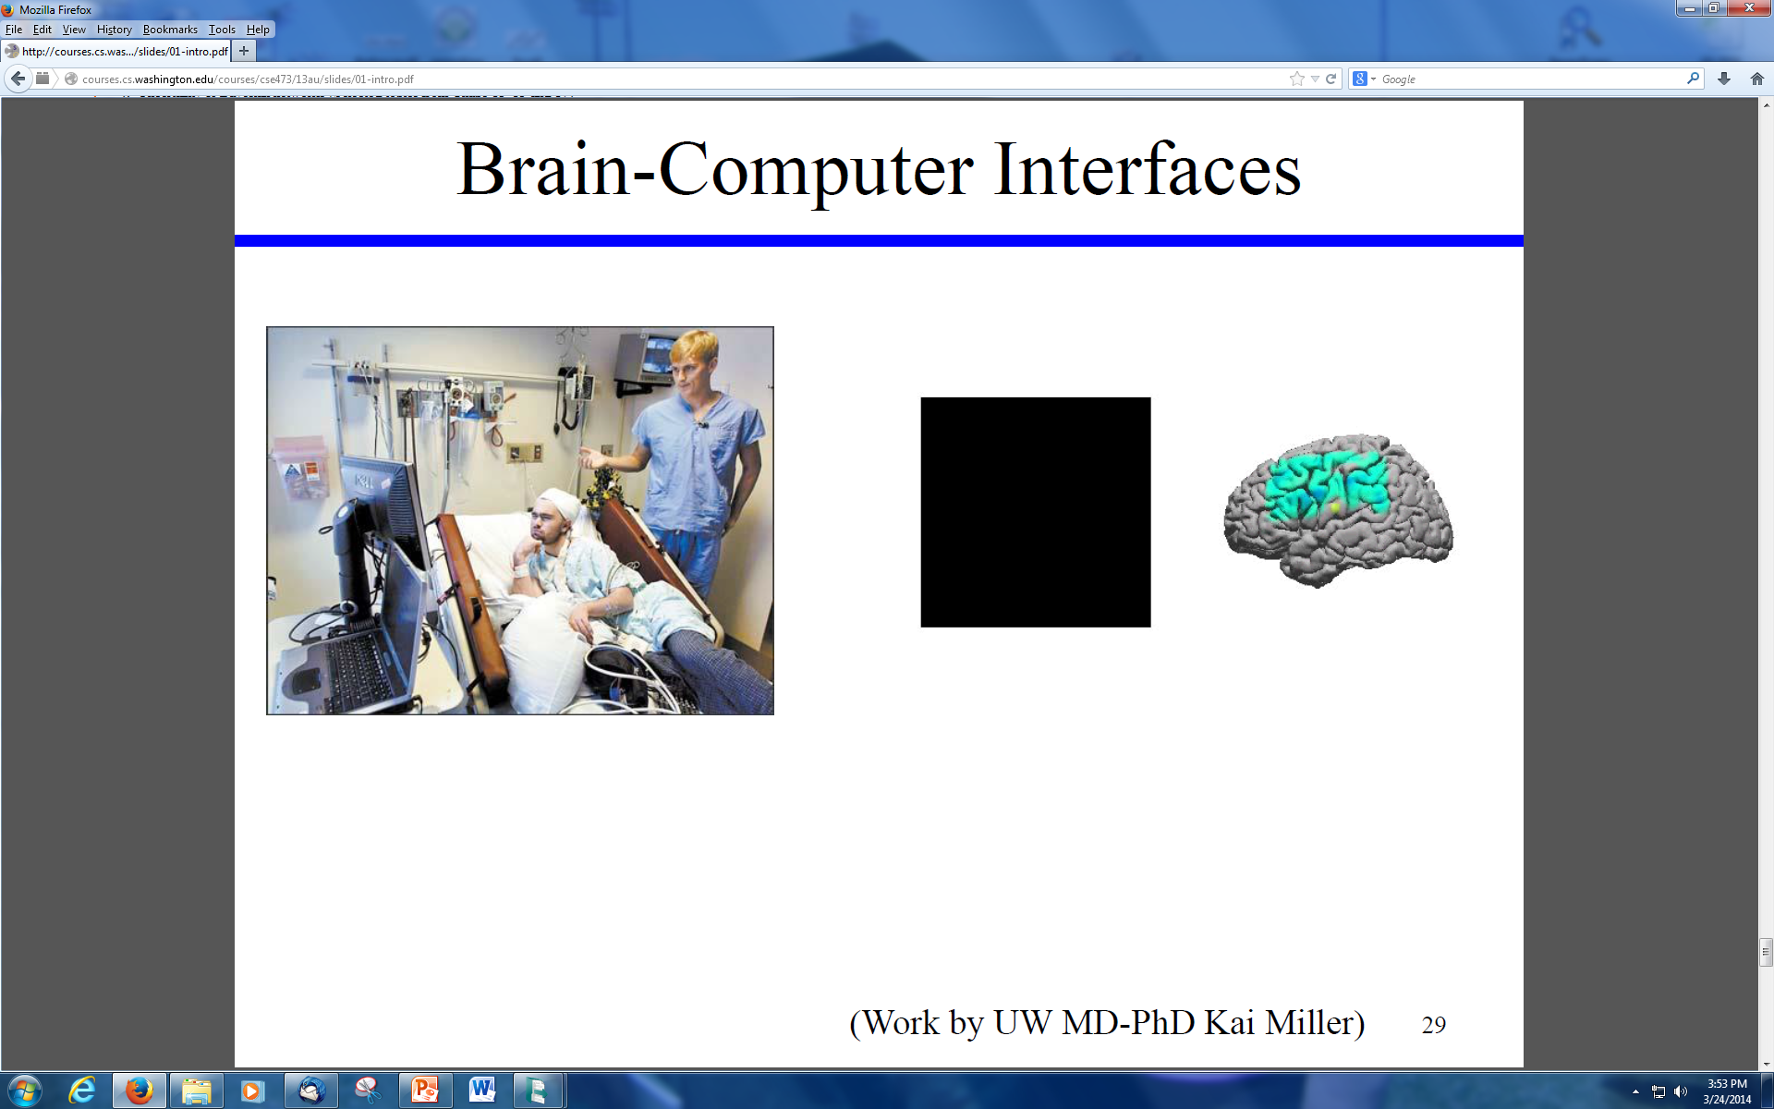

Slide 25
Stuart Russell’s “Potted History of AI”
1943 McCulloch & Pitts: neural nets model of the brain
1950 Turing’s “Computing Machinery and Intelligence”
1952-69 Look Ma, no hands
1950s Early AI Programs: Logic Theorist, Checker Player, Geom
1956 Term “Artificial Intelligence” adopted
1965 Robinson’s complete algorithm for logical reasoning
1966-74 AI discovers computational complexity; neural nets go
1969-79 Early development of knowledge-based “expert systems”
1980-88 Expert systems boom
1988-93 Expert systems bust: “AI Winter”
1985-95 Neural networks return
1988- AI and Statistics together
1995- Agents, agents everywhere
NOW- PROBABILITY EVERYWHERE!
NOW- Learning, Learning, Learning
NOW- DEEP Learning

Slide 26
Overview of Intended Topics
Introduction to AI (Chs. 1-2, done)
Python (Python as a Second Language, S. Tanimoto)
Problem Solving by Search (Ch 3) “Big Chapter”
Beyond Classical Search (Ch 4)
Adversarial Search (Ch 5) “Game Playing”
Constraint Satisfaction Problems (Ch 6)
Learning (related to Ch 18 and Ch 20)
Computer Vision with Learning (not from book)
Deep Learning (not from book)
Latest Advances in Deep Learning
Other Applications such as Medical, LLMs, Robotics

Slide 27
Tentative Assignments
Warmup Blind Search
Heuristic Search Python
Game Playing
PyTorch Deep Learning Exercise
Course Project of Your Choice using ML
Readings and Problem Set

