Slide 1
More on Learning
Neural Nets
Support Vectors Machines
Unsupervised Learning (Clustering)
  K-Means
  Expectation-Maximization

Slide 2
Neural Net Learning
Motivated by studies of the brain.
A network of “artificial neurons” that learns a function.
Doesn’t have clear decision rules like decision trees, but highly successful in many different applications. (e.g. face detection)
We use them frequently in our research.
I’ll be using algorithms from
http://www.cs.mtu.edu/~nilufer/classes/cs4811/2016-spring/lecture-slides/cs4811-neural-net-algorithms.pdf

Slide 3
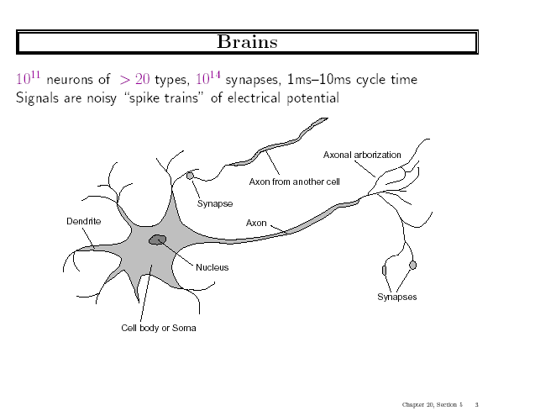
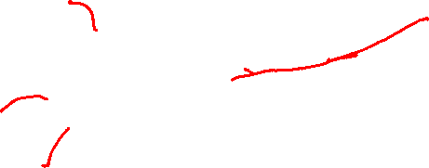

Slide 4
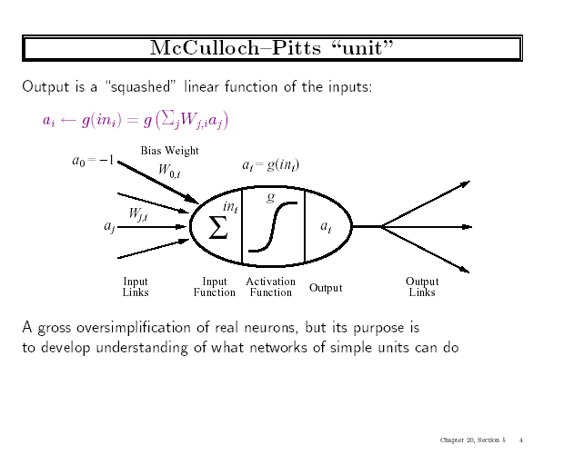


Slide 5
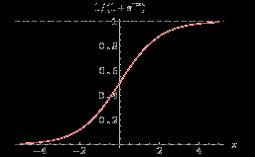
Simple Feed-Forward Perceptrons
in = (∑ W_{j} x_{j}) + θ
out = g[in]
x1
W1
g(in)
out
g is the activation function
It can be a step function:
g(x) = 1 if x >=0 and 0 (or -1) else.
It can be a sigmoid function:
g(x) = 1/(1+exp(-x)).
x2
W2
θ
The sigmoid function is differentiable
and can be used in a gradient descent
algorithm to update the weights.

Slide 6
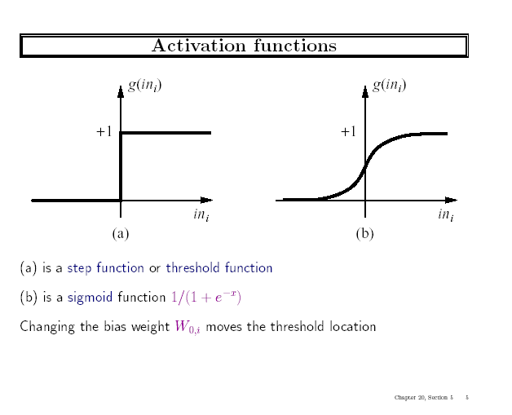

Slide 7
More Complete Functions (for Deep Learning)
Sigmoid: σ(x) = 1/(1 + e^{-x})
ReLU function (rectifiead linear unit)
ReLU(x) = max(0,x)
Softplus function is a smooth version of the ReLU function:
softplus(x) = log(1+e^{x})
The derivative of softplus is sigmoid.
Tanh function:
tanh(x) = (e^{2x}-1)/(e^{2x}+1)

Slide 8
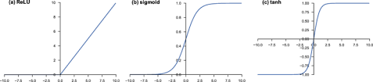
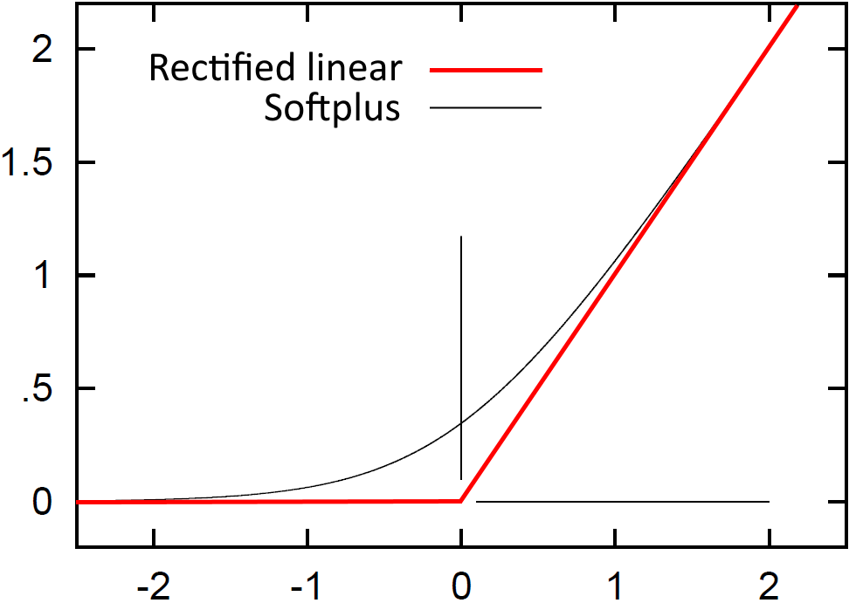
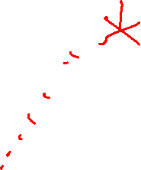

Slide 9
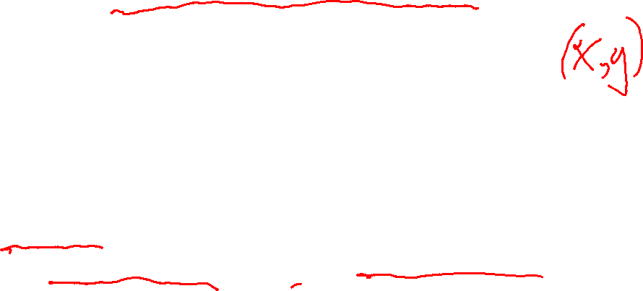
Gradient Descent takes steps proportional to the negative of the gradient of a function to find its local minimum
Let X be the inputs, y the class, W the weights
in = ∑ W_{j} x_{j}
Let’s minimize the loss. We’ll call it Err for short.
Err = y – g(in)
E = ½ Err² is the squared loss to minimize
∂E/∂W_{j} = Err * ∂Err/∂W_{j} = Err * ∂/∂W_{j}(g(in))(-1)
= -Err * g’(in) * x_{j}
The update is W_{j} <- W_{j} + α * Err * g’(in) * x_{j}
α is called the learning rate.

Slide 10

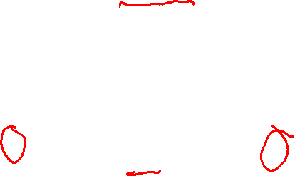
Simple Feed-Forward Perceptrons
x1
W1
repeat
for each e in examples do
in = (∑ W_{j} x_{j}) + θ
Err = y[e] – g[in]
W_{j} = W_{j} + α Err g’(in) x_{j}[e]
until done
g(in)
out
x2
W2
θ
Examples: A=[(.5,1.5),+1], B=[(-.5,.5),-1], C=[(.5,.5),+1]
Initialization: W₁ = 1, W₂ = 2, θ = -2
Note1: when g is a step function, the g’(in) is removed.
Note2: later in back propagation, Err * g’(in) will be called
We’ll let g(x) = 1 if x >=0 else -1

Slide 11
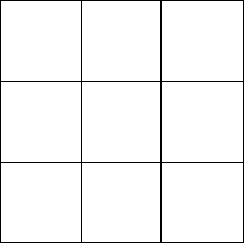
Graphically
Examples: A=[(.5,1.5),+1], B=[(-.5,.5),-1], C=[(.5,.5),+1]
Initialization: W₁ = 1, W₂ = 2, θ = -2
W₂
Boundary is W₁x₁ + W₂x₂ + θ = 0
wrong
boundary
A
B
C
W₁

Slide 12
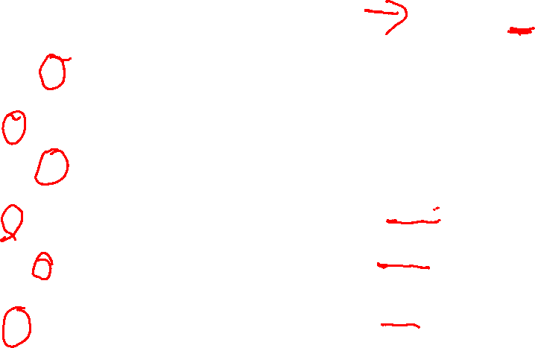
Learning
Examples:
A=[(.5,1.5),+1],
B=[(-.5,.5),-1],
C=[(.5,.5),+1]
Initialization: W₁ = 1, W₂ = 2, θ = -2
repeat
for each e in examples do
in = (∑ W_{j} x_{j}) + θ
Err = y[e] – g[in]
W_{j} = W_{j} + α Err g’(in) x_{j}[e]
until done
A=[(.5,1.5),+1]
in = .5(1) + (1.5)(2) -2 = 1.5
g(in) = 1; Err = 0; NO CHANGE
B=[(-.5,.5),-1]
In = (-.5)(1) + (.5)(2) -2 = -1.5
g(in) = -1; Err = 0; NO CHANGE
Let α=.5
W1 <- W1 + .5(2) (.5) leaving out g’
<- 1 + 1(.5) = 1.5
W2 <- W2 + .5(2) (.5)
<- 2 + 1(.5) = 2.5
<- θ + .5(+1 – (-1))
<- -2 + .5(2) = -1
C=[(.5,.5),+1]
in = (.5)(1) + (.5)(2) – 2 = -.5
g(in) = -1; Err = 1-(-1)=2

Slide 13
Graphically
Examples: A=[(.5,1.5),+1], B=[(-.5,.5),-1], C=[(.5,.5),+1]
Initialization: W₁ = 1, W₂ = 2, θ = -2
New: : W₁ = 1.5, W₂ = 2.5, θ = -1
W₂
_{a}
Boundary is W₁x₁ + W₂x₂ + θ = 0
wrong
boundary
A
B
C
W₁
approximately correct boundary

Slide 14
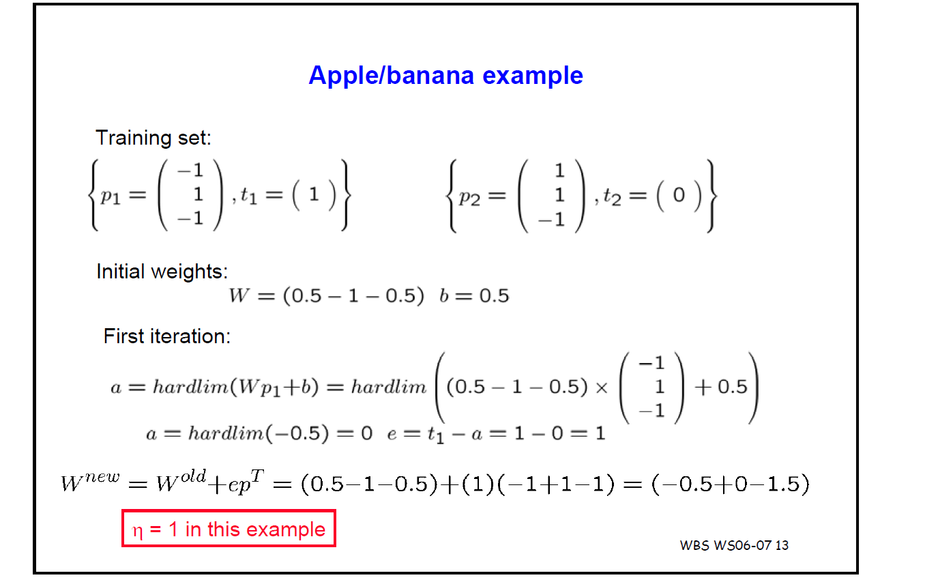
p₁
vector W
b
error
new W

Slide 15
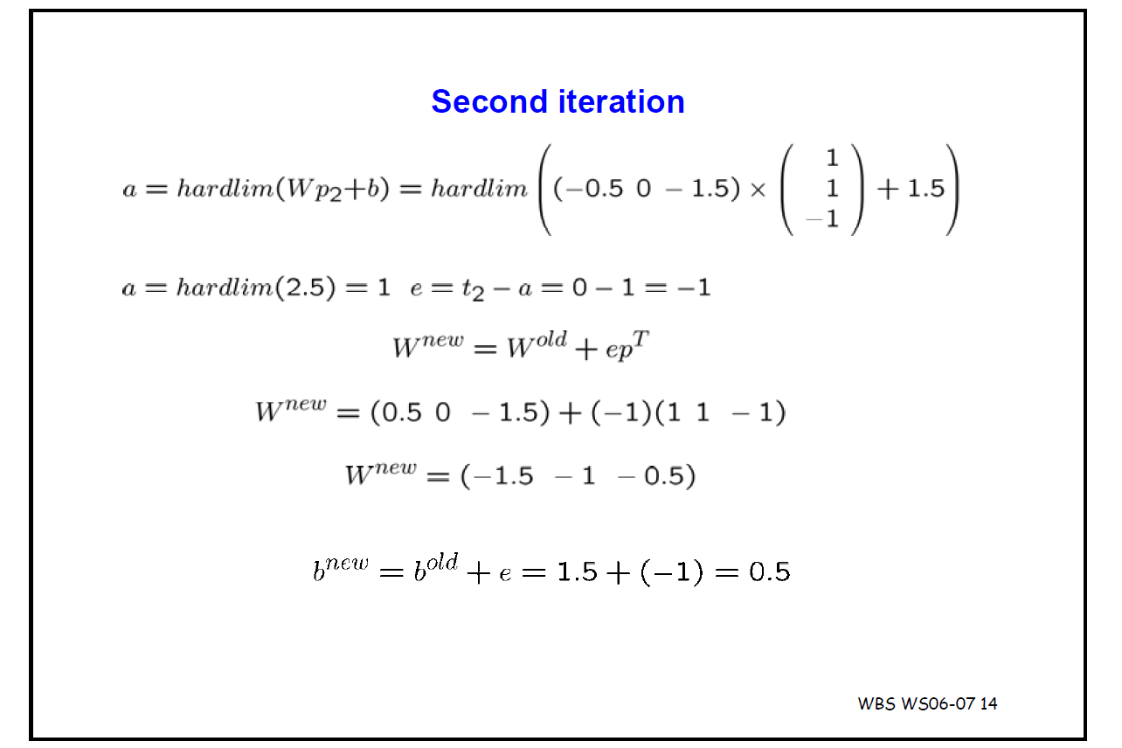
new W p₂

Slide 16
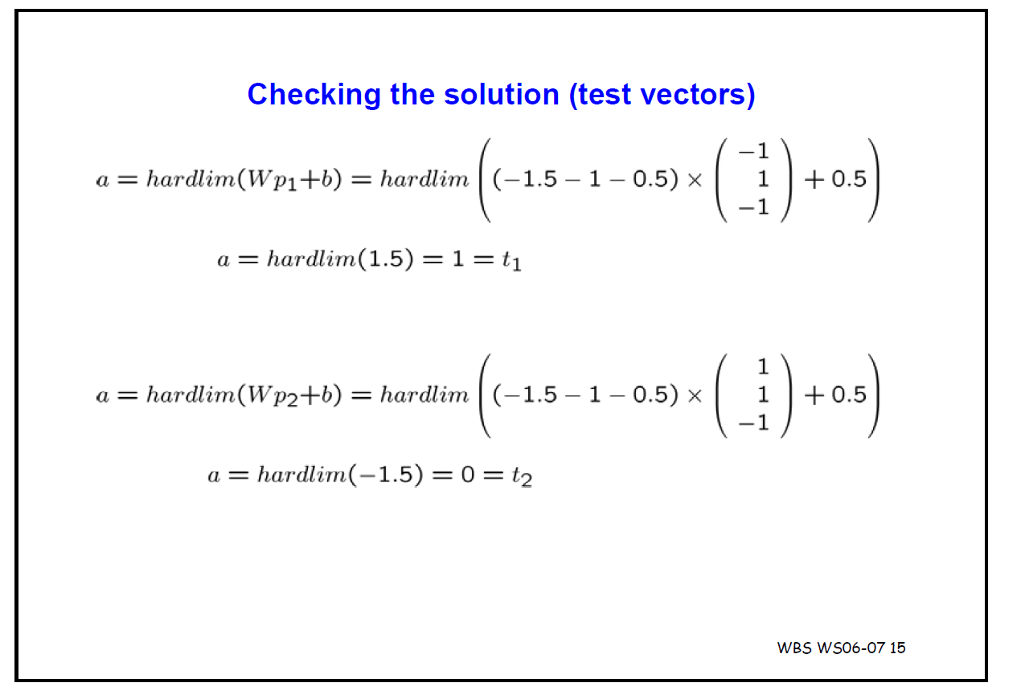

Slide 17
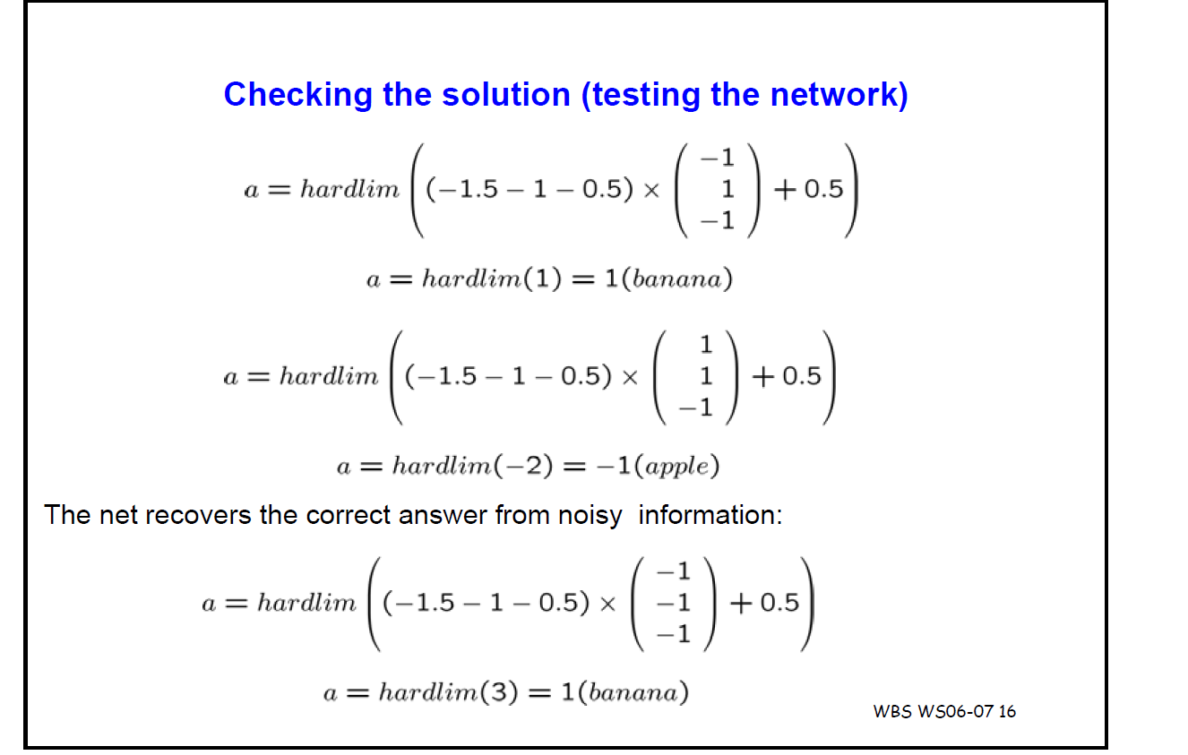

Slide 18
Back Propagation
Simple single layer networks with feed forward learning were not powerful enough.
Could only produce simple linear classifiers.
More powerful networks have multiple hidden layers.
The learning algorithm is called back propagation, because it computes the error at the end and propagates it back through the weights of the network to the beginning.

Slide 19
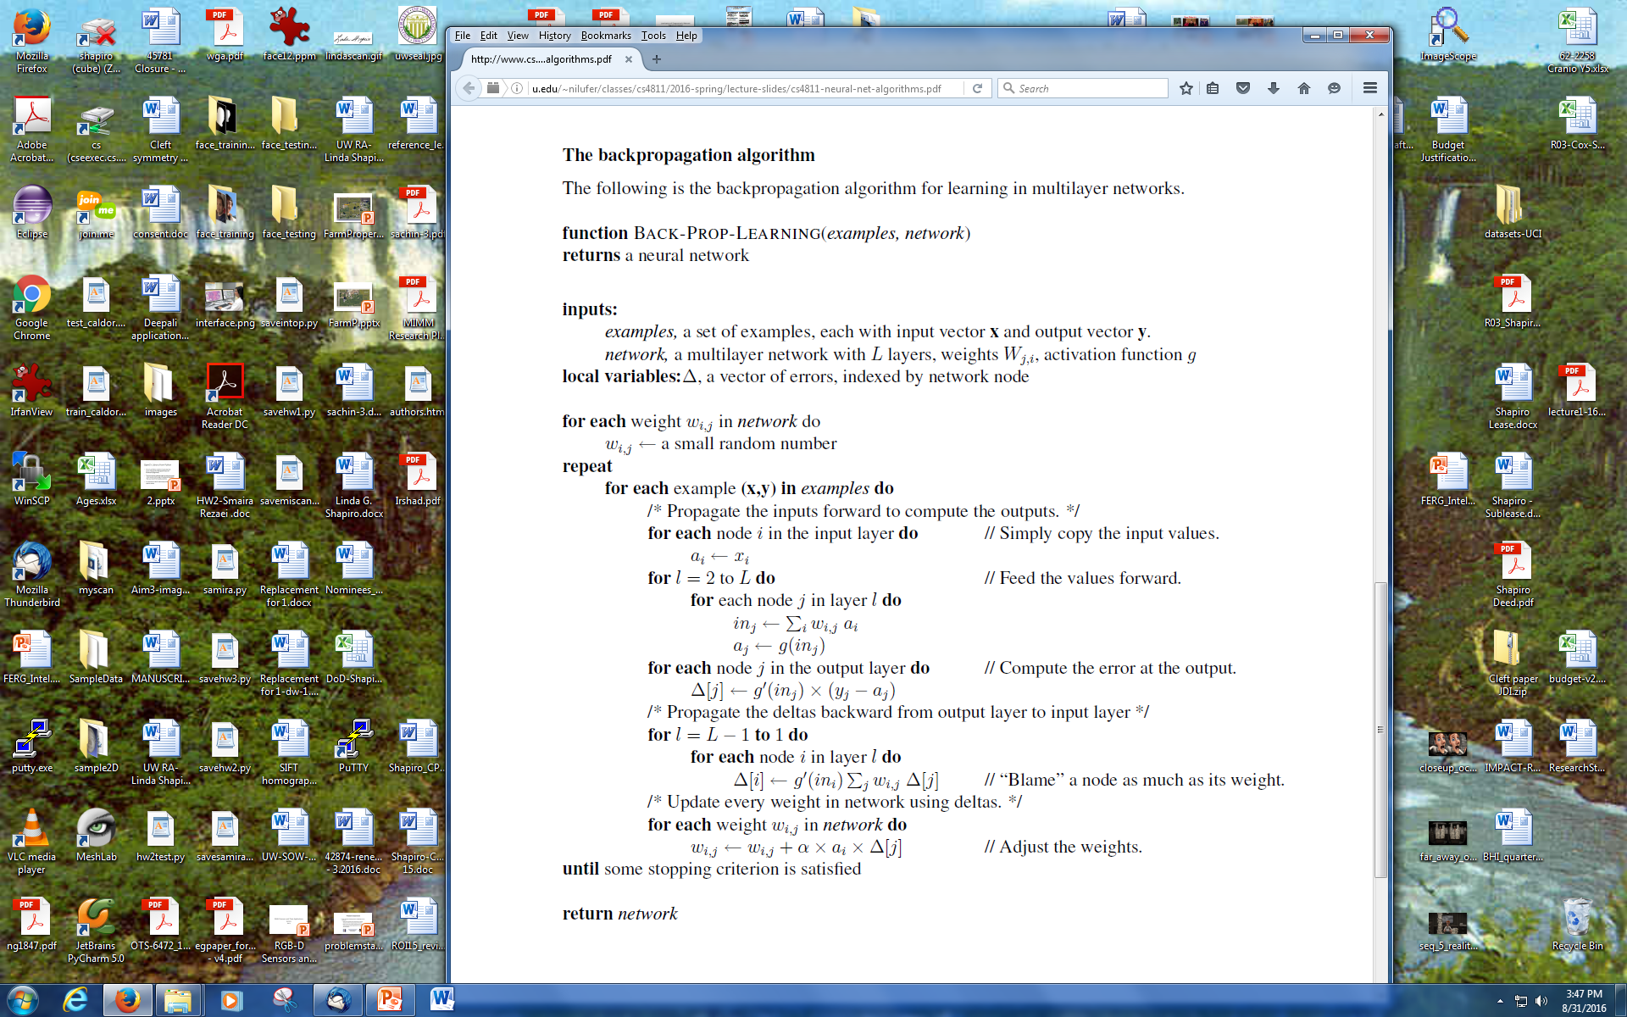
(slightly different from text)
Let’s break it
into steps.

Slide 20
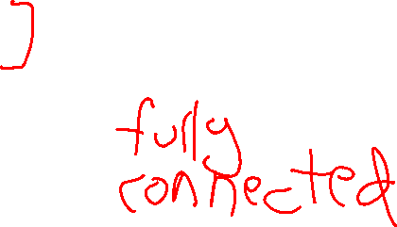
Let’s dissect it.
layer 1 2 3=L
x1
w11
w21
n1
w1f
nf
x2
w31
w2f
n2
x3

Slide 21
Forward Computation
a₁
layer 1 2 3=L
x1
w11
w21
n1
w1f
nf
a_{f}
x2
w31
w2f
n2
x3
a₂

Slide 22
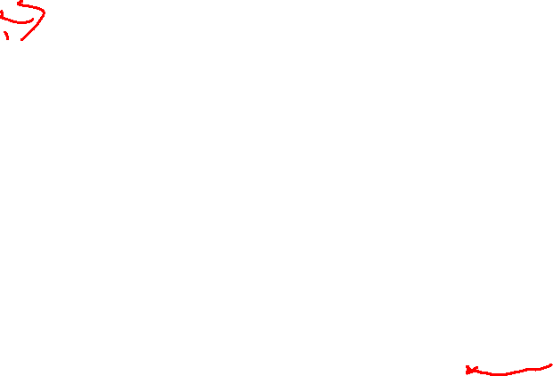
Backward Propagation 1
Node nf is the only node in our output layer.
Compute the error at that node and multiply by the derivative of the weighted
input sum to get the change delta.
layer 1 2 3=L
x1
w11
w21
n1
w1f
nf
a_{f}
x2
w31
w2f
n2
Δf = g’(in_{f}) x (y_{f} – a_{f})
x3

Slide 23
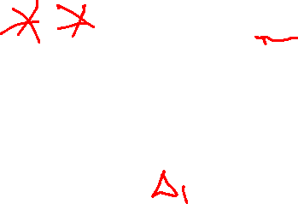
Backward Propagation 2
At each of the other layers, the deltas use
  the derivative of its input sum
  the sum of its output weights
  the delta computed for the output error
layer 1 2 3=L
x1
w11
w21
n1
w1f
nf
Δ_{f} is at output layer
x2
w31
w2f
n2
x3
Δ₂ ← g’(in₂) w_{2f} Δ_{f}

Slide 24
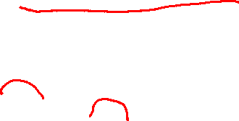
Backward Propagation 3
Now that all the deltas are defined, the weight updates just use them.
layer 1 2 3=L
x1
w11
w21
n1
w1f
nf
x2
w31
w2f
n2
x3

Slide 25
Back Propagation Summary
Compute delta values for the output units using observed errors.
Starting at the output-1 layer
  repeat
    propagate delta values back to previous layer
    update weights between the two layers
  till done with all layers
This is done for all examples and multiple epochs, till convergence or enough iterations.

Slide 26

Time taken to build model: 16.2 seconds
Correctly Classified Instances 307 80.3665 % (did not boost)
Incorrectly Classified Instances 75 19.6335 %
Kappa statistic 0.6056
Mean absolute error 0.1982
Root mean squared error 0.41
Relative absolute error 39.7113 %
Root relative squared error 81.9006 %
Total Number of Instances 382
TP Rate FP Rate Precision Recall F-Measure ROC Area Class
0.706 0.103 0.868 0.706 0.779 0.872 cal
0.897 0.294 0.761 0.897 0.824 0.872 dor
W Avg. 0.804 0.2 0.814 0.804 0.802 0.872
=== Confusion Matrix ===
a b <-- classified as
132 55 | a = cal
20 175 | b = dor

Slide 27
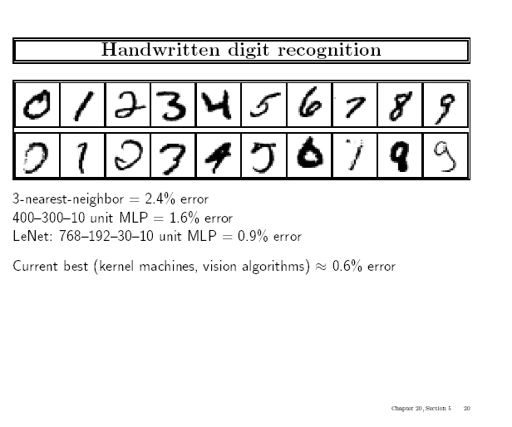


Slide 28
Kernel Machines
A relatively new learning methodology (1992) derived from statistical learning theory.
Became famous when it gave accuracy comparable to neural nets in a handwriting recognition class.
Was introduced to computer vision researchers by Tomaso Poggio at MIT who started using it for face detection and got better results than neural nets.
Has become very popular and widely used with packages available.

Slide 29
Support Vector Machines (SVM)
Support vector machines are learning algorithms
that try to find a hyperplane that separates
the different classes of data the most.
They are a specific kind of kernel machines based on
two key ideas:
  maximum margin hyperplanes
  a kernel ‘trick’

Slide 30
The SVM Equation
y_{SVM}(x_{q}) = argmax Σ α_{i,c} K(x_{i},x_{q})
x_{q} is a query or unknown object
c indexes the classes
there are m support vectors x_{i} with weights α_{i,c}, i=1 to m for class c
K is the kernel function that compares x_{i} to x_{q}
c i=1,m

Slide 31
Maximal Margin (2 class problem)
In 2D space,
a hyperplane is
a line.
In 3D space,
it is a plane.
margin
hyperplane
Find the hyperplane with maximal margin for all
the points. This originates an optimization problem
which has a unique solution.

Slide 32
Support Vectors
The weights α_{i} associated with data points are zero, except for those points closest to the separator.
The points with nonzero weights are called the support vectors (because they hold up the separating plane).
Because there are many fewer support vectors than total data points, the number of parameters defining the optimal separator is small.

Slide 33
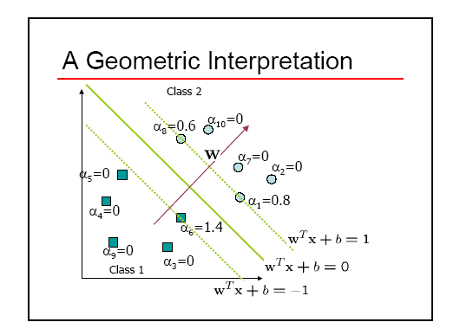
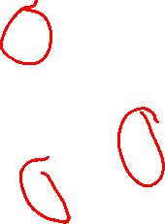

Slide 34
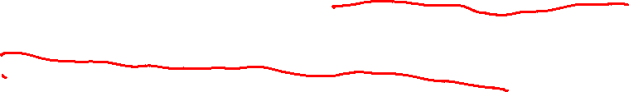
Kernels
A kernel is just a similarity function. It takes 2 inputs and decides how similar they are.
Kernels offer an alternative to standard feature vectors. Instead of using a bunch of features, you define a single kernel to decide the similarity between two objects.

Slide 35
Kernels and SVMs
Under some conditions, every kernel function can be expressed as a dot product in a (possibly infinite dimensional) feature space (Mercer’s theorem)
SVM machine learning can be expressed in terms of dot products.
So SVM machines can use kernels instead of feature vectors.

Slide 36
The Kernel Trick
The SVM algorithm implicitly maps the original
data to a feature space of possibly infinite dimension
in which data (which is not separable in the
original space) becomes separable in the feature space.
Original space R^{k}
Feature space R^{n}
1
0
1
1
0
0
1
0
0
1
0
Kernel
trick
0
1
0
0
0
1
1

Slide 37
Kernel Functions
The kernel function is designed by the developer of the SVM.
It is applied to pairs of input data to evaluate dot products in some corresponding feature space.
Kernels can be all sorts of functions including polynomials and exponentials.

Slide 38
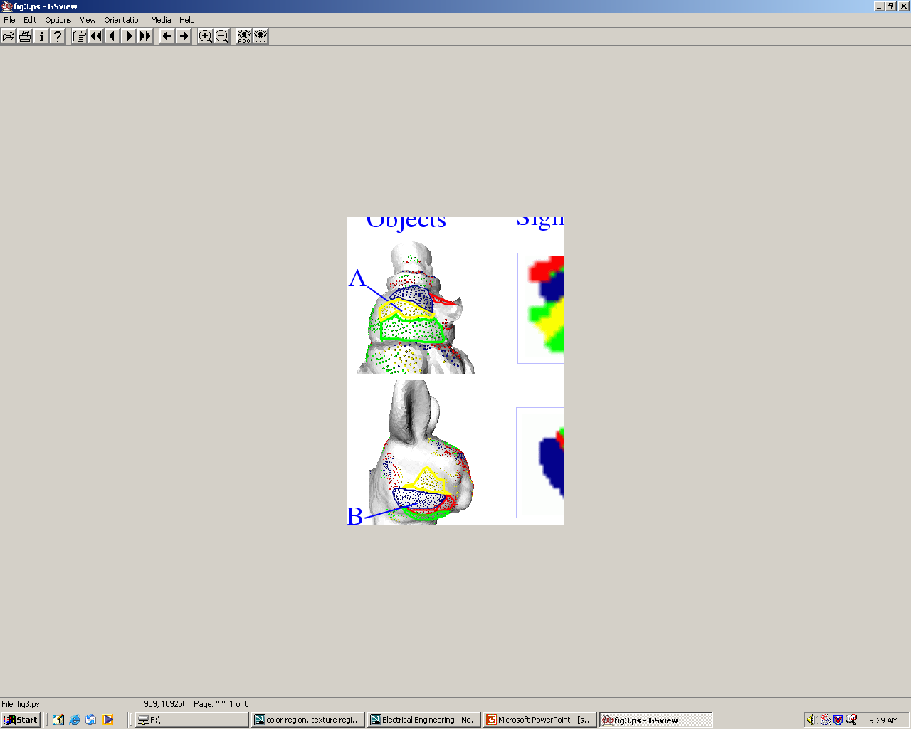
Kernel Function used in our 3D Computer Vision Work
k(A,B) = exp(-θ²_{AB}/σ²)
A and B are shape descriptors (big vectors).
θ is the angle between these vectors.
σ² is the “width” of the kernel.

Slide 39
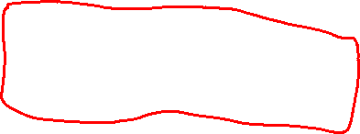
What does SVM learning solve?
The SVM is looking for the best separating plane in its alternate space.
It solves a quadratic programming optimization problem
argmax Σα_{j}-1/2 Σα_{j} α_{k} y_{j} y_{k} (x_{j}•x_{k})
subject to α_{j} > 0 and Σα_{j}y_{j} = 0.
The equation for the separator for these optimal α_{j} is
h(x) = sign(Σα_{j} y_{j} (x•x_{j}) – b)
α j j,k
j

Slide 40

Time taken to build model: 0.15 seconds
Correctly Classified Instances 319 83.5079 %
Incorrectly Classified Instances 63 16.4921 %
Kappa statistic 0.6685
Mean absolute error 0.1649
Root mean squared error 0.4061
Relative absolute error 33.0372 %
Root relative squared error 81.1136 %
Total Number of Instances 382
TP Rate FP Rate Precision Recall F-Measure ROC Area Class
0.722 0.056 0.925 0.722 0.811 0.833 cal
0.944 0.278 0.78 0.944 0.854 0.833 dor
W Avg. 0.835 0.17 0.851 0.835 0.833 0.833
=== Confusion Matrix ===
a b <-- classified as
135 52 | a = cal
11 184 | b = dor

Slide 41
Unsupervised Learning
Find patterns in the data.
Group the data into clusters.
Many clustering algorithms.
  K means clustering
  EM clustering
  Graph-Theoretic Clustering
  Clustering by Graph Cuts
  etc

Slide 42
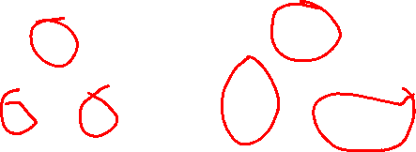
Clustering by K-means Algorithm
Form K-means clusters from a set of n-dimensional feature vectors
1. Set ic (iteration count) to 1
2. Choose randomly a set of K means m₁(1), …, m_{K}(1).
3. For each vector x_{i}, compute D(x_{i},m_{k}(ic)), k=1,…K
and assign x_{i} to the cluster C_{j} with nearest mean.
4. Increment ic by 1, update the means to get m₁(ic),…,m_{K}(ic).
5. Repeat steps 3 and 4 until C_{k}(ic) = C_{k}(ic+1) for all k.

Slide 43
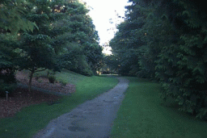

K-Means Classifier
(shown on RGB color data)
original data
one RGB per pixel
color clusters

Slide 44
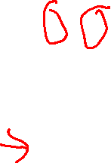
K-Means → EM
The clusters are usually Gaussian distributions.
Boot Step:
  Initialize K clusters: C₁, …, C_{K}
Iteration Step:
  Estimate the cluster of each datum
  Re-estimate the cluster parameters
(μ_{j,} Σ_{j}) and P(C_{j}) for each cluster j.
Expectation
Maximization
For each cluster j
The resultant set of clusters is called a mixture model;
if the distributions are Gaussian, it’s a Gaussian mixture.

Slide 45
EM Algorithm Summary
Boot Step:
  Initialize K clusters: C₁, …, C_{K}
Iteration Step:
  Expectation Step
  Maximization Step
(μ_{j,} Σ_{j}) and p(C_{j}) for each cluster j.

Slide 46

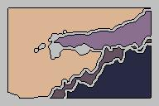
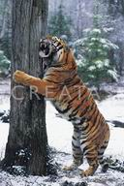
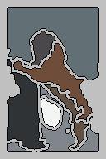
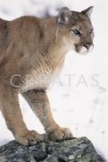
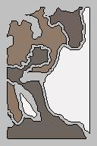
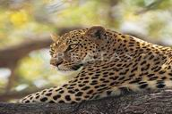
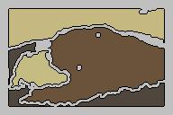
EM Clustering using color and texture information at each pixel
(from Blobworld)

Slide 47
EM for Classification of Images in Terms of their Color Regions
Initial Model for “trees”
Final Model for “trees”
EM
Initial Model for “sky”
Final Model for “sky”

Slide 48
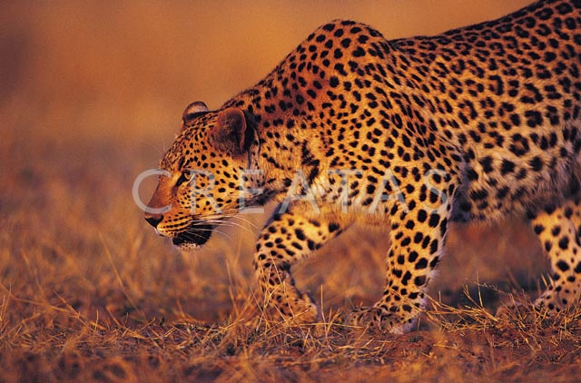
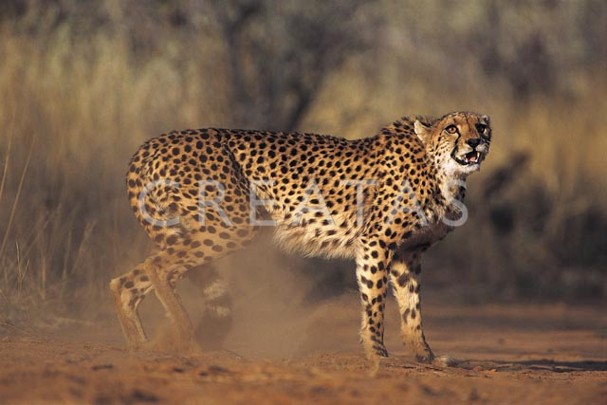
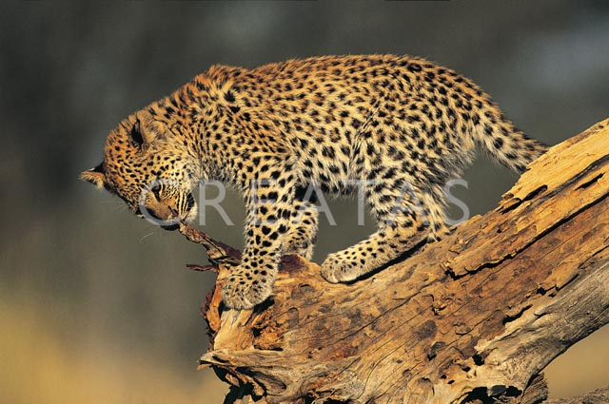
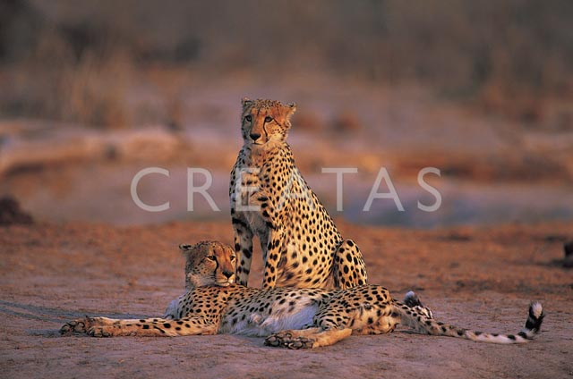
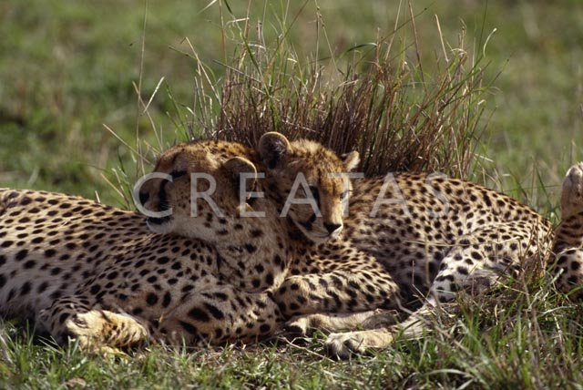
Sample Results
cheetah

Slide 49
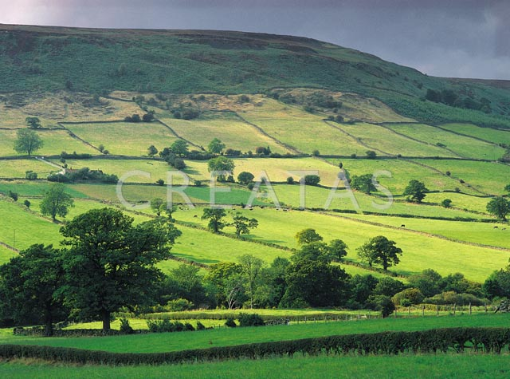
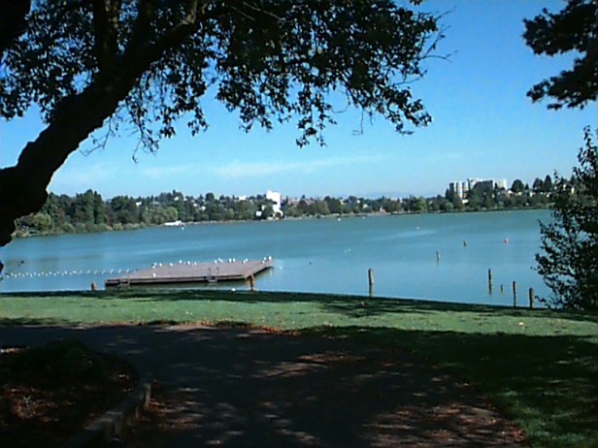
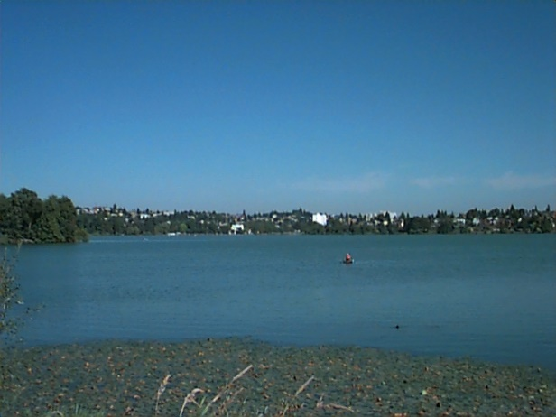
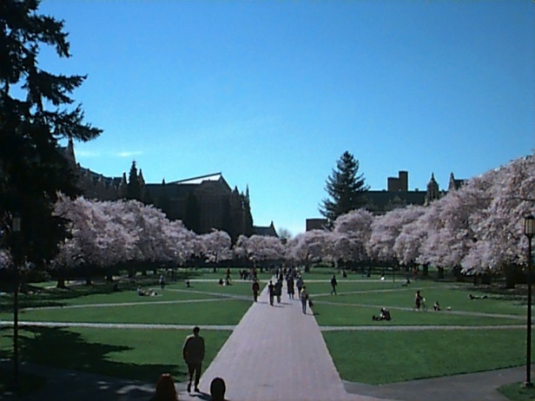
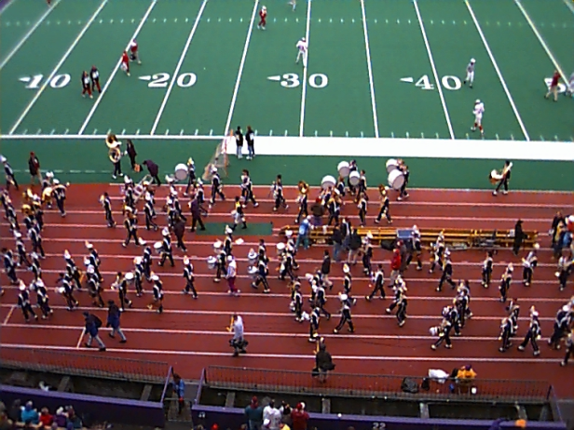
Sample Results (Cont.)
grass

Slide 50
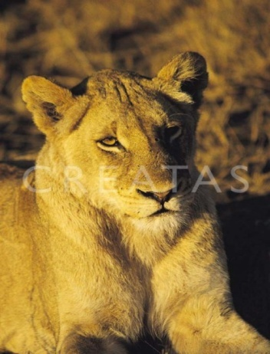
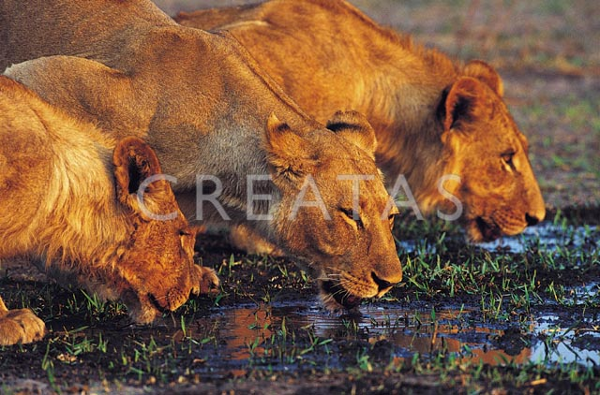
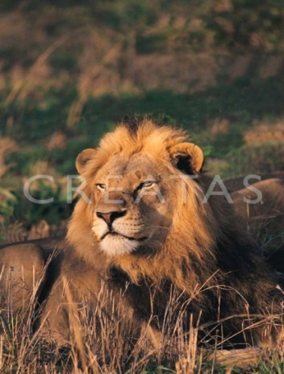


Sample Results (Cont.)
lion

Slide 51
Haar Random Forest Features Combined with a Spatial Matching Kernel for Stoneﬂy Species Identiﬁcation
Natalia Larios*
Bilge Soran*
Linda Shapiro*
Gonzalo Martinez-Munoz^
Jeffrey Lin+
Tom Dietterich+
*University of Washington
+Oregon State University
^Universidad Autónoma de Madrid

Slide 52
Goal: to identify the species of insect specimens rapidly and accurately

Slide 53

Haar-like Features
Value =
∑ (pixels in white area) –
∑ (pixels in black area)

Slide 54

Overview of our Classification Method
Training Image Set
Positive and Negative
Testing
Patch extraction
Test Image Patches
Forest Learning
Image Patches
HRF Feature Extraction
HRF
Test Image Features
HRF Feature Extraction
SVM
Classification
Training Vectors
SVM Learning
Prediction

Slide 55
RESULTS:
Stonefly Identification: Classification Error [%]
Task | SET | CIELAB color | CIELAB+G
Cal vs Dor | 6.26 | 10.16 | 4.60
Hes vs Iso | 3.74 | 9.05 | 3.55
Pte vs Swe | 2.71 | 8.75 | 2.80
Dor vs Hes | 2.25 | 8.09 | 2.20
Mos vs Pte | 2.06 | 7.95 | 1.92
Yor vs Zap | 1.52 | 6.89 | 1.60
Zap vs Cal | 1.52 | 7.02 | 1.76
Swe vs Yor | 1.44 | 6.85 | 1.50
Iso vs Mos | 1.29 | 6.90 | 1.30
Average | 2.53 | 7.96 | 2.25
96.4% accuracy

