Slide 1



Analysis of Whole Slide Images of Skin Biopsies
Linda G. Shapiro
Paul G. Allen School of Computer Science & Engineering
Department of Electrical & Computer Engineering
University of Washington
This work was sponsored by the National Cancer Institute under grants R01CA200690 andU01CA231782,
by the Melanoma Research Alliance under grant 622600, and by the Department of Defense under grant
W81XWH-20-1-0798.

Slide 2
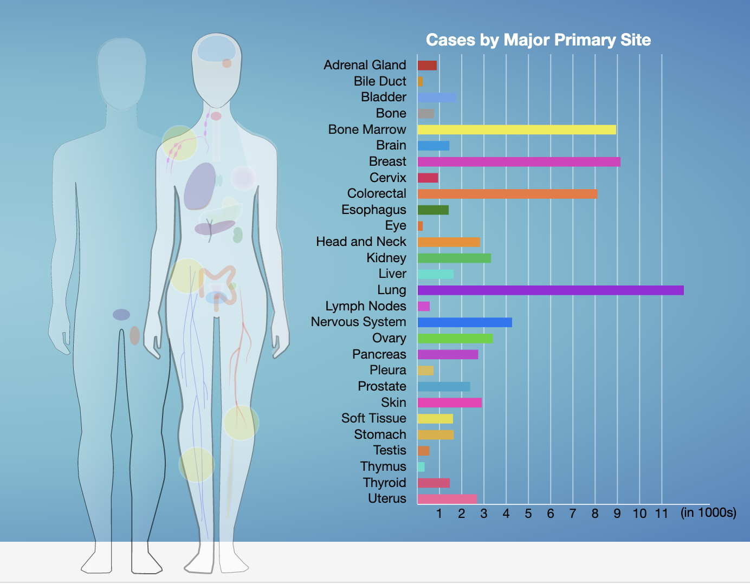
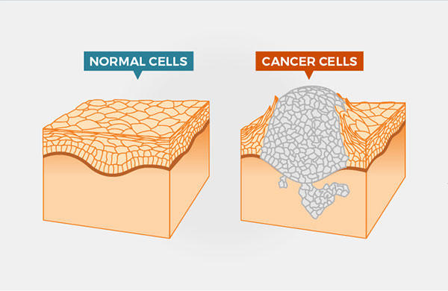
What is Cancer?
Cancer is a disease in which some of the body’s cells grow uncontrollably and spread to other parts of the body.
Figures are from National Institute of Cancer website.

Slide 3
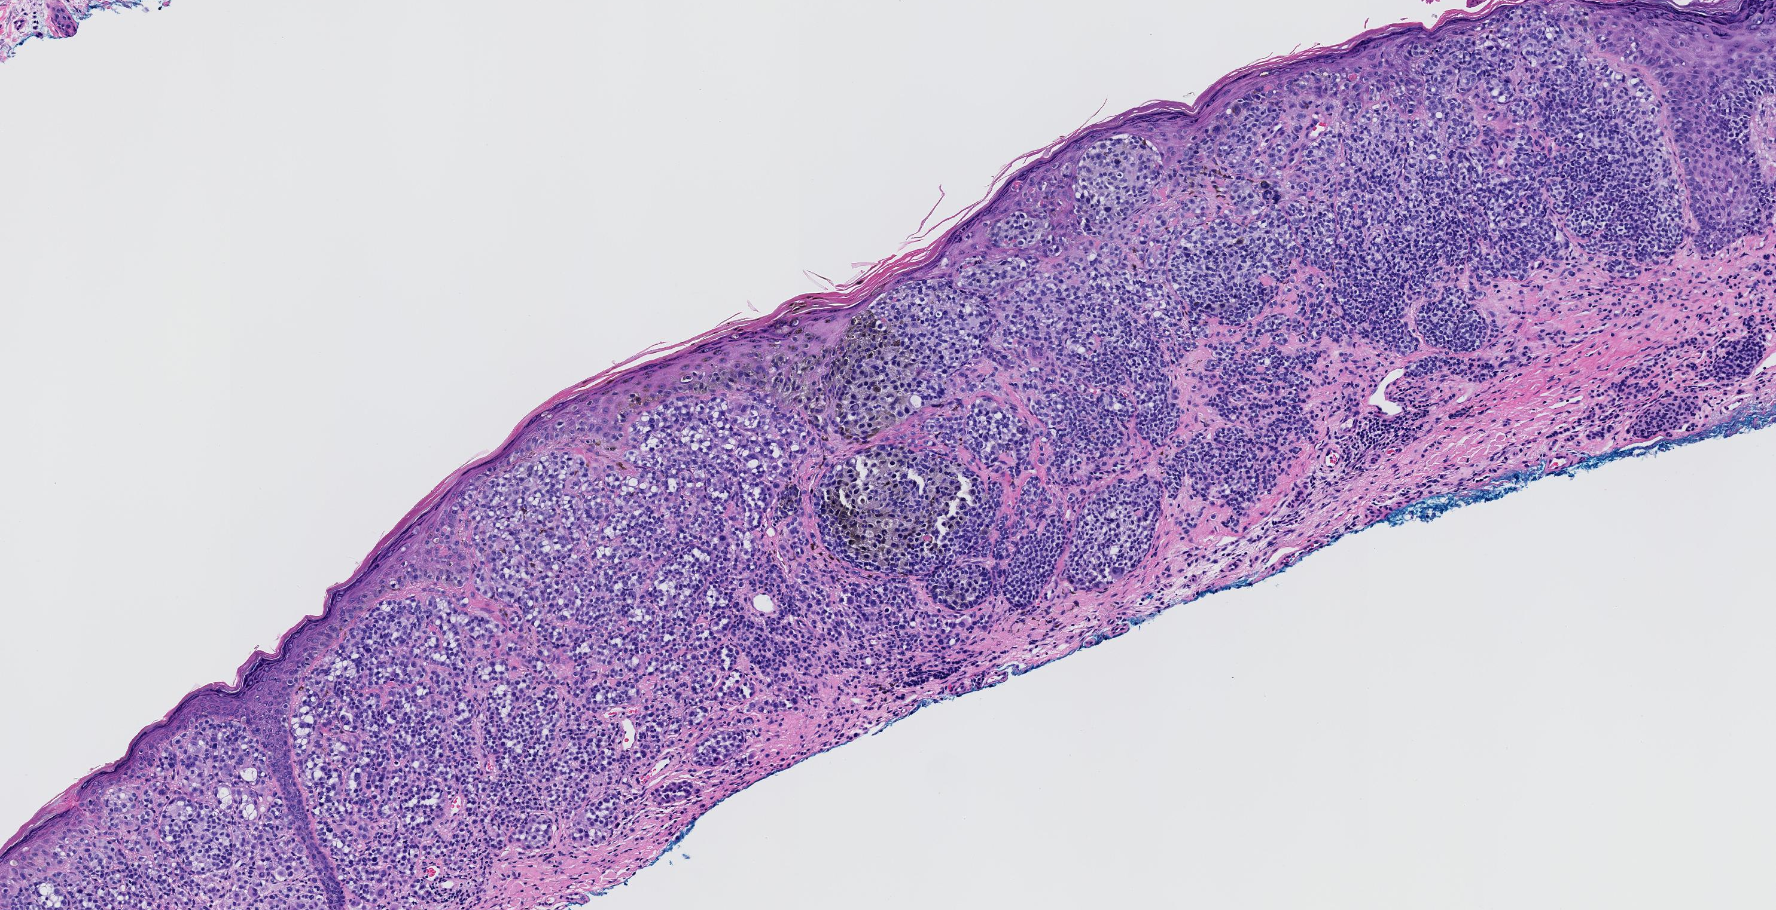
What is Melanoma?
Melanoma is the most aggressive type of skin cancer.
Pathologists look at a skin biopsy slide and determine if its overall structure is normal, abnormal, or malignant.
Diagnostic errors are much more frequently than in other tissues and can lead to under- and over-diagnosis of cancer.
Deep learning image analysis methods may improve and complement current diagnostic and prognostic capabilities.
An example of an Invasive Melanoma T1b in M-Path dataset.

Slide 4
Melanoma Diagnosis
Diagnoses:
Mild Dysplastic
Moderate Dysplastic
Melanoma in situ
Invasive T1a
Invasive T1b
Cellular entities:
- Nuclei
- Melanocyte
- Mitosis
Structural entities:
- Dermis
- Epidermis
- Nests
Raw WSI
Diagnosis model

Slide 5
Our Work
Cellular Level
  Finding Mitotic Figures
  Finding Melanocytes
Structural Level
  Segmenting into Epidermis/Dermis and Various Nest Structures
Diagnosis Level
  Diagnosing with a Multi-Resolution Transformer on Raw H&E (hematoxylin and eosin stained) images
  Diagnosing with the Addition of Structures
An example of an Invasive Melanoma T1b in M-Path dataset.

Slide 6
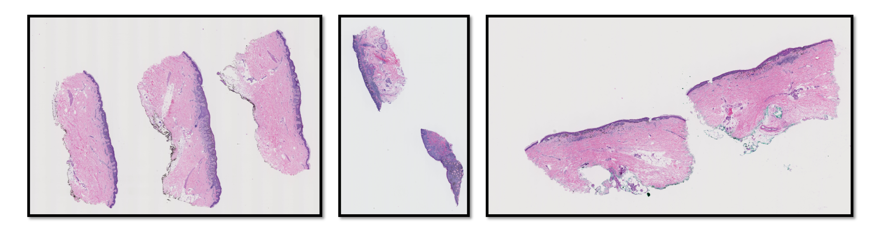
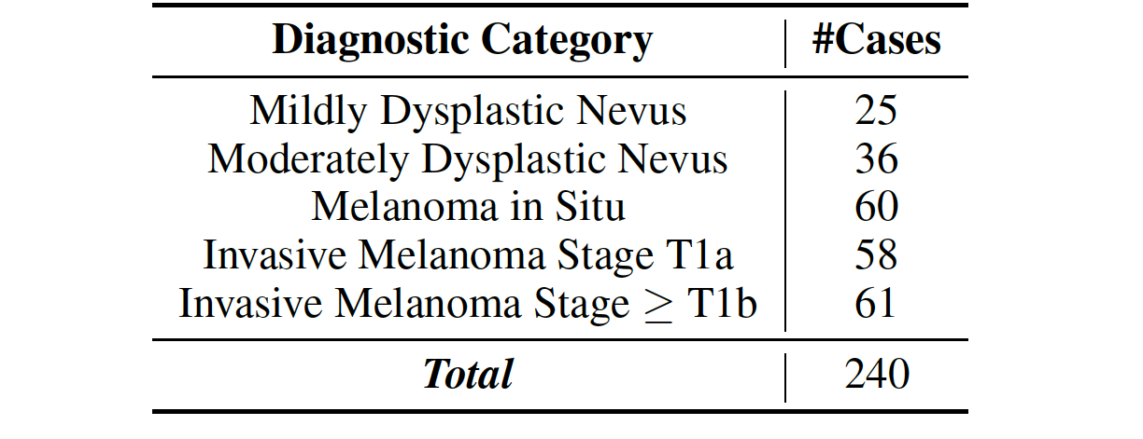
Dataset
Our dataset comes from 240 H&E stained slides of skin biopsy images, acquired by the University of Washington School of Medicine in the MPATH study (R01 CA151306, PI Dr. Joann Elmore, now at UCLA).

Slide 7
Machine learning techniques for mitoses classification
Shima Nofallah et al
Computerized Medical Imaging and Graphics
2021

Slide 8





Dataset for Mitosis Detection
Positive samples – class Mitosis
  About 600 mitoses marked by an expert pathologist (Dr. Stevan Knezevich).
  We cropped each mitosis in a 101*101 patch centered on the dot placing on the mitotic figure.
Example of expert pathologist markings of mitoses (Left) and sampled mitoses (Right)

Slide 9
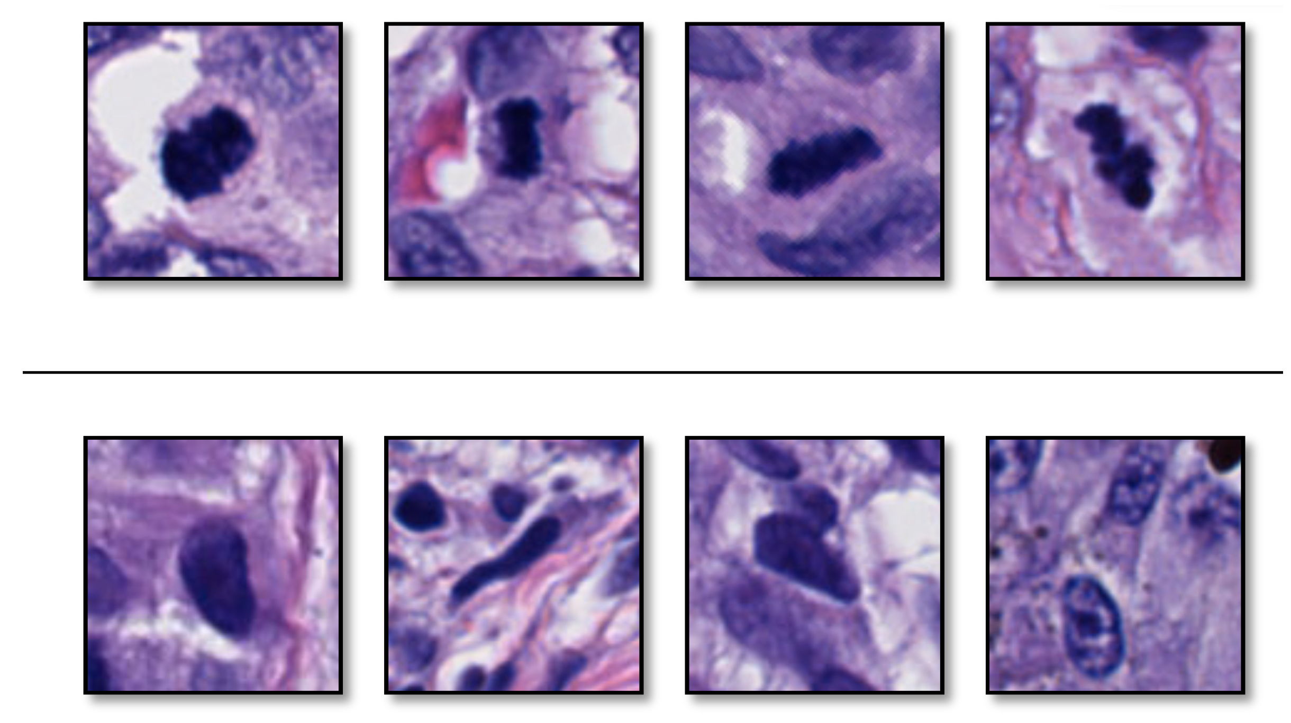
Dataset
Negative samples – class NonMitosis
Distinguishing mitoses from normal nuclei is a challenge.
Mitosis
Nuclei

Slide 10
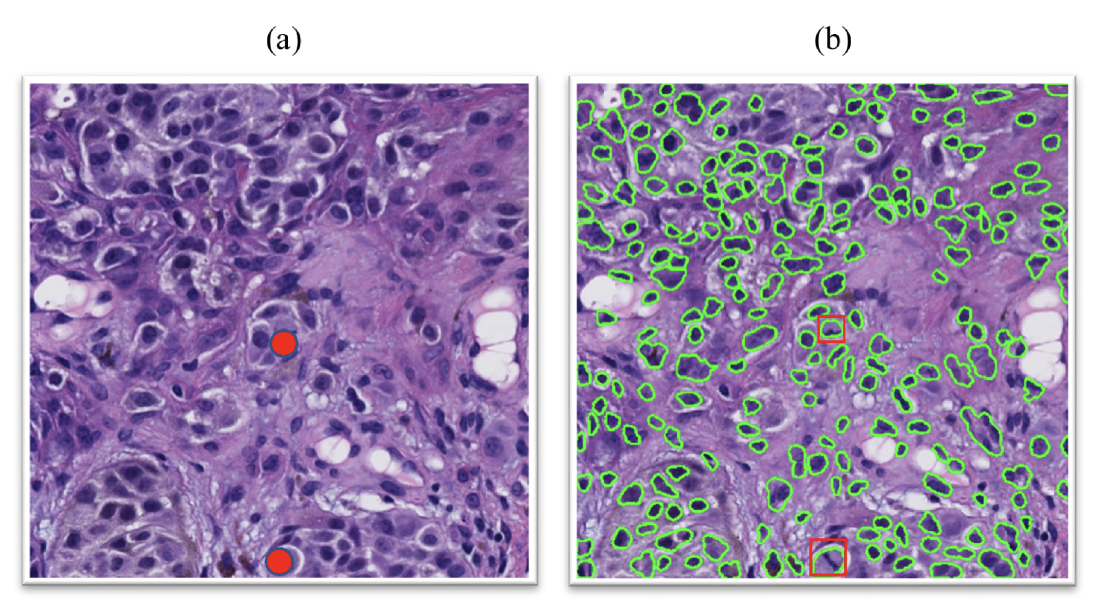
Dataset
Negative samples – class NonMitosis
  We used a feature-based nuclei detector to find nuclei.
  We sampled them as negative cases for our dataset.
Examples of applying the nuclei segmentation on a crop of skin biopsy image (a) original crop (b) nuclei segmentation result. Two mitoses that are present in the original crop are marked with red dots for Visualization.

Slide 11

Method and Model
We ran two separate experiments on two well-designed CNNs and compared their results:
  Efficient Spatial Pyramid of Dilated Convolutions (ESPNet) [13]
    A light model developed and published by a member of our group.
  Densely Connected Convolutional Networks (DenseNet161) [14]
    One of the well-known model in Deep Learning literature.

Slide 12
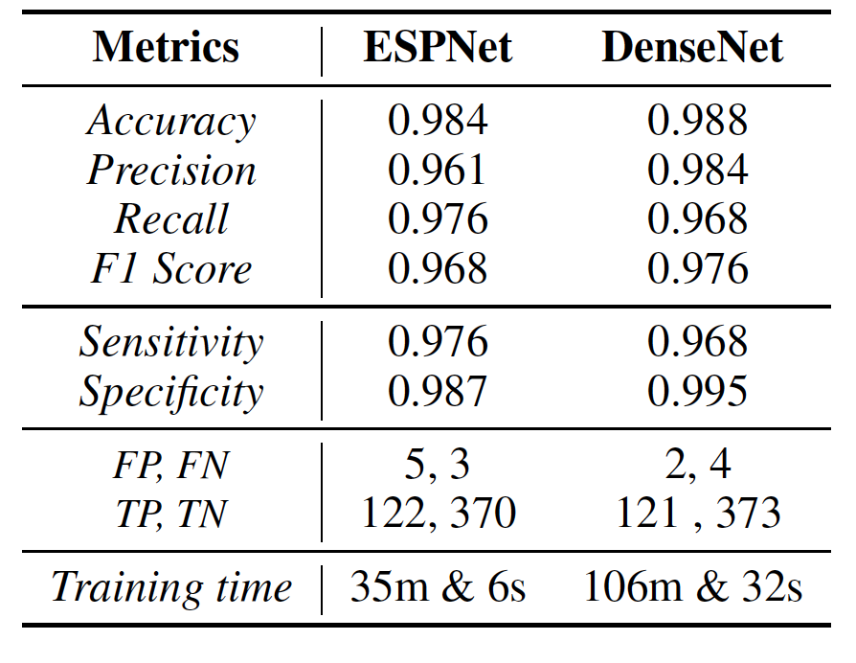

Results
Evaluation results of ESPNet and DenseNet161 on Melanoma

Slide 13
VSGD-Net: Virtual Staining Guided Melanocyte Detection on Histopathological Images
Kechun Liu et al
Submitted to WACV 2023

Slide 14
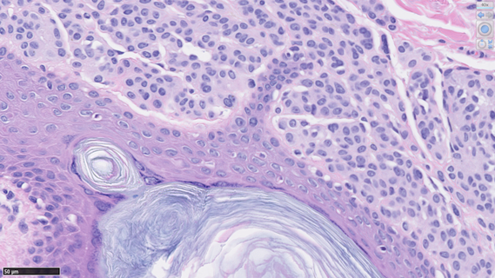
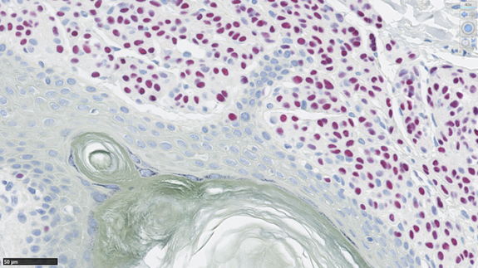
How to Detect Melanocytes
Sox10 staining can highlight melanocytes, but it’s not a routine procedure due to its high cost.
(a) H&E Staining
(b) Sox10 Staining – melanocytes are red
(c) Crop from Sox10
Notes:
Sox10 immunostaining

Slide 15

Goal
Can we automatically detect melanocytes on H&E images?
Address the limitations:
  -- Visual similarity of melanocytes to other cells in H&E images
  -- High cost of Sox10 staining
Reduce the burden on pathologists
Aid in melanoma diagnosis in the future

Slide 16
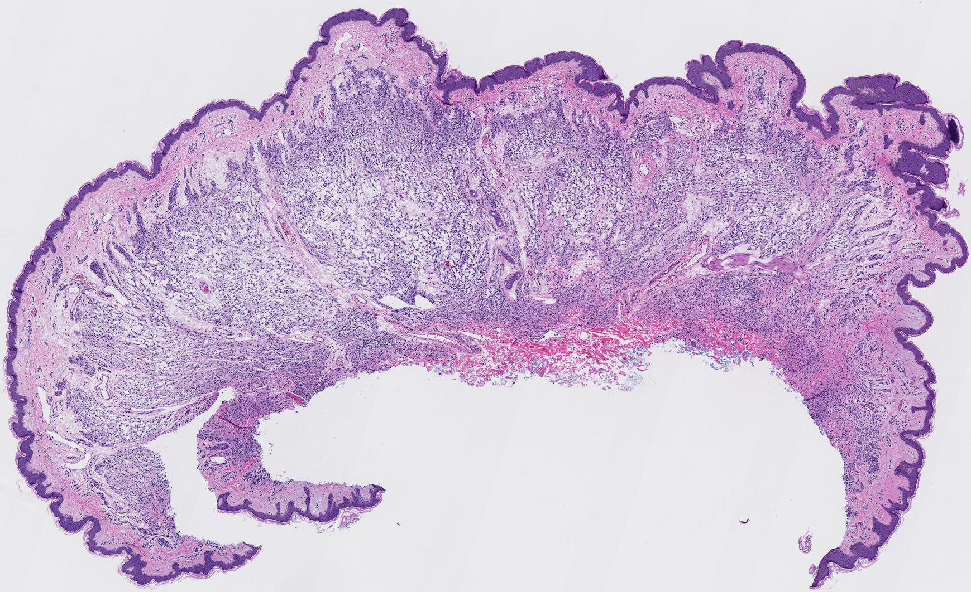
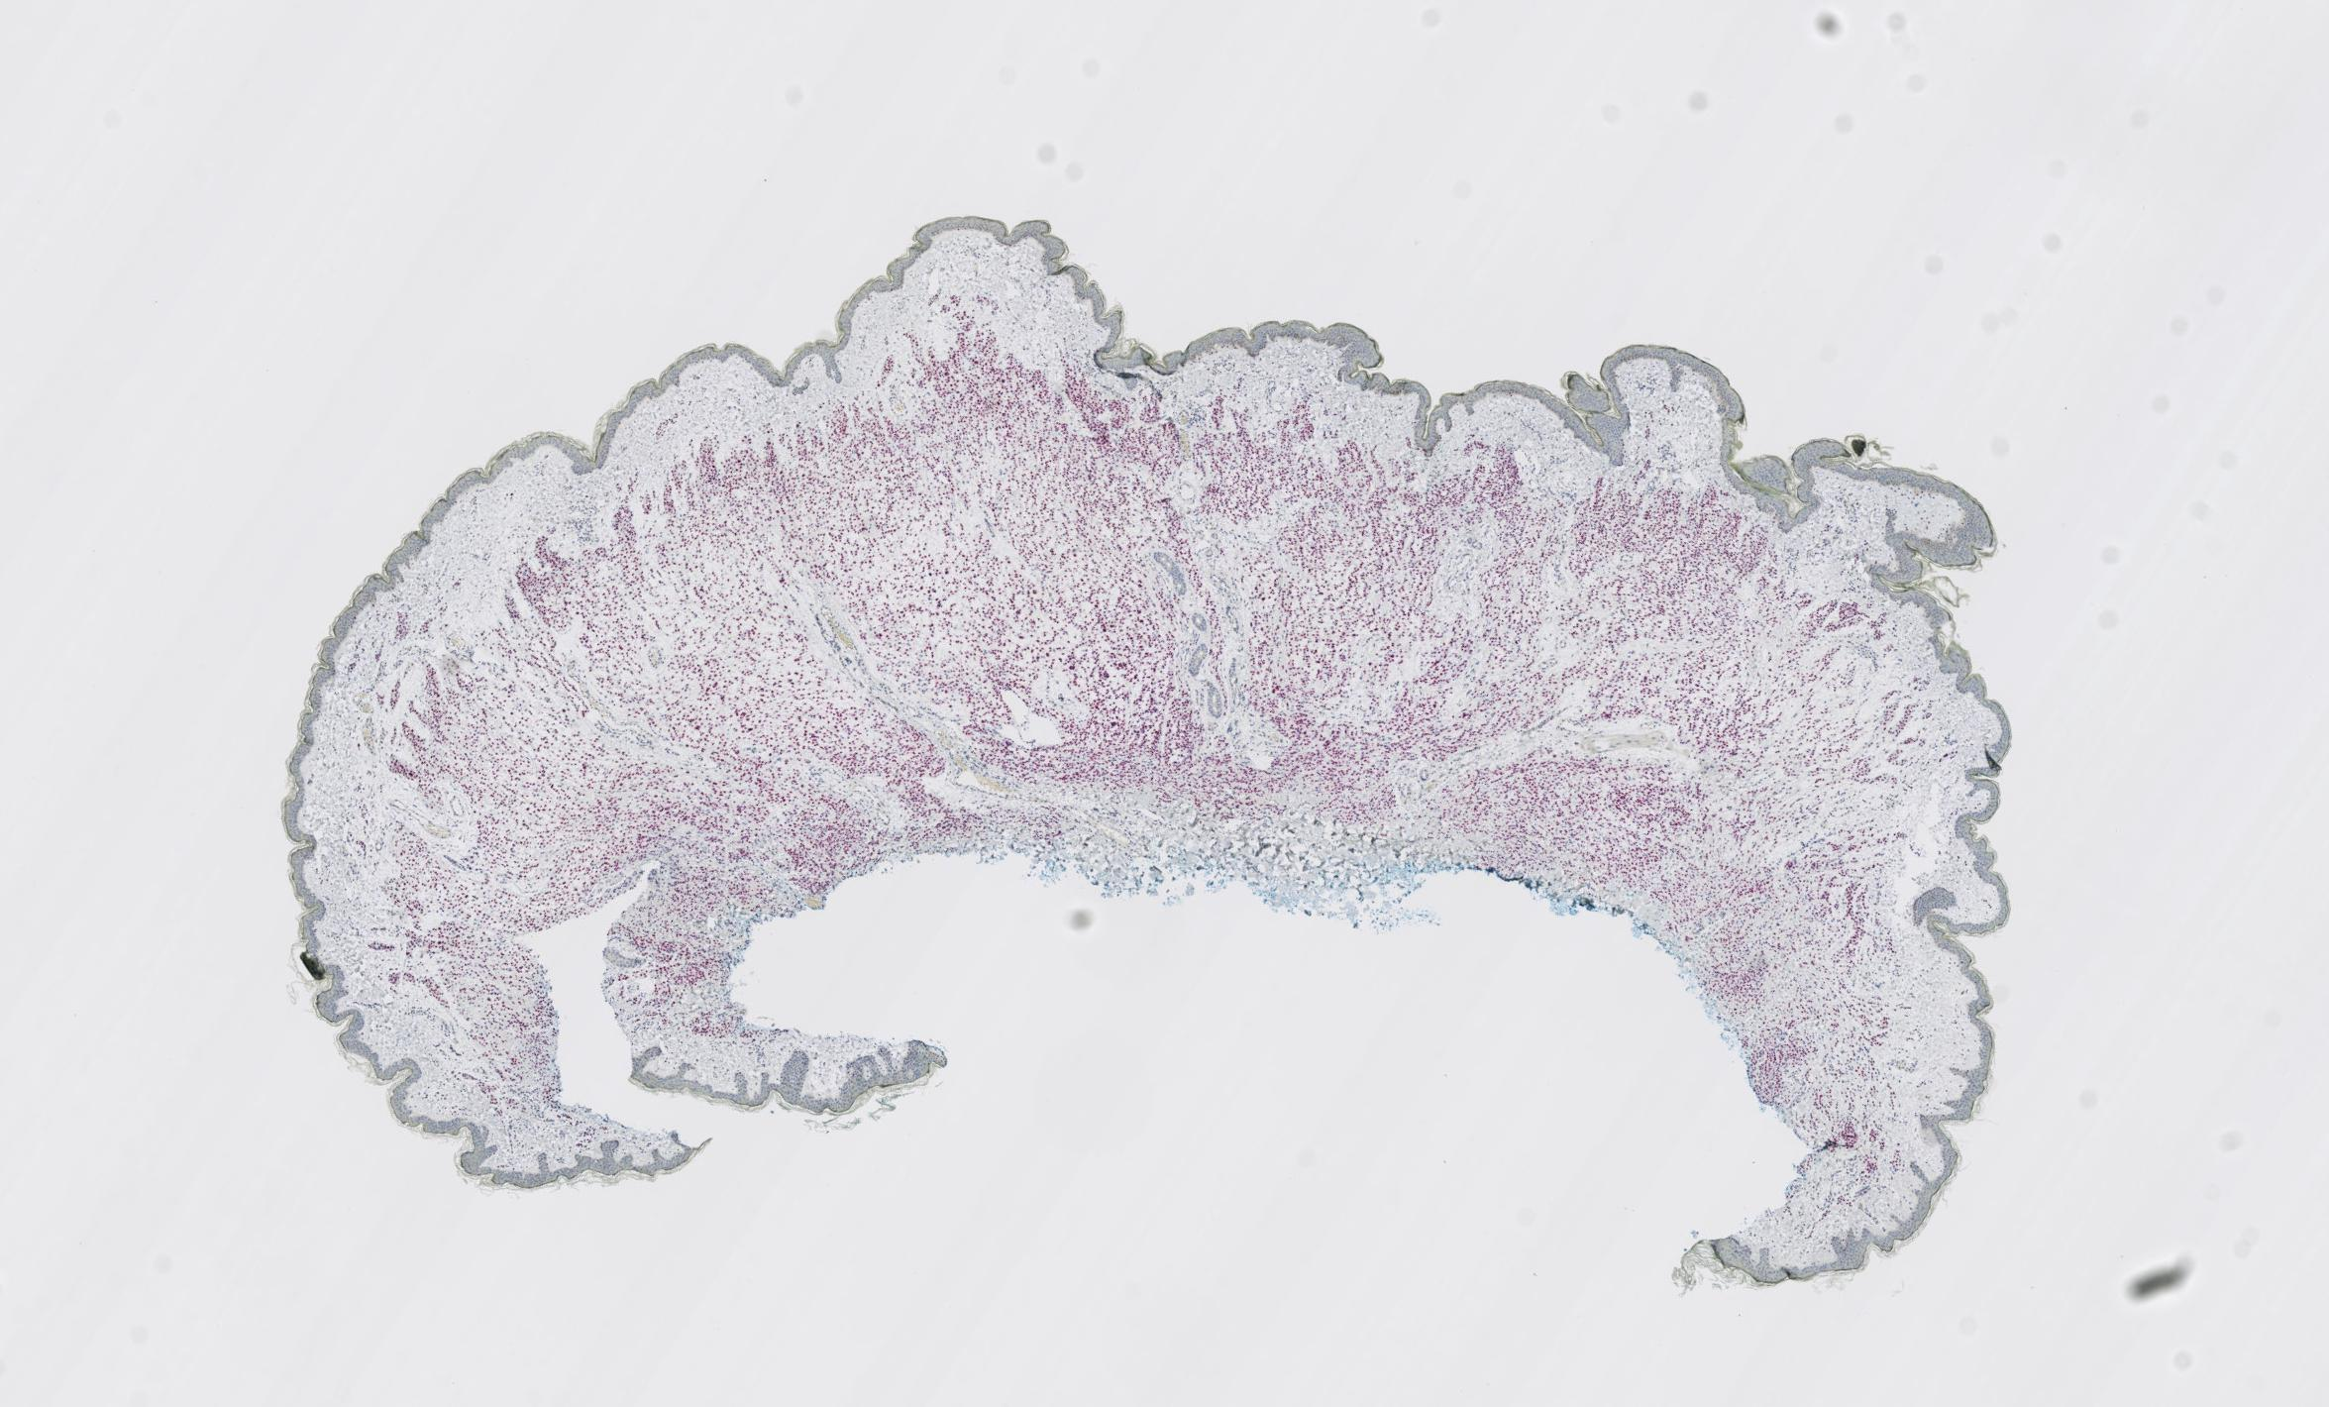

Dataset for Melanocyte Detection, including both H&E and Sox10 Staining
Our dataset consists of skin tissues of 15 cases from a private dermatopathology lab, including 3 cases for each MPATH diagnostic category¹ [8].
We stain each glass slide with H&E first, then de-stain and re-stain the same glass slide in Sox10.
Each skin tissue is cut into multiple (4-6) thin slices for microscopic examination, resulting in 75 slices at 20x magnification.
¹ Class 1-5: Benign mildly atypical nevi, Moderate dysplastic nevi, Melanoma in situ, Invasive melanoma T1a, and Invasive melanoma T1b.

Slide 17
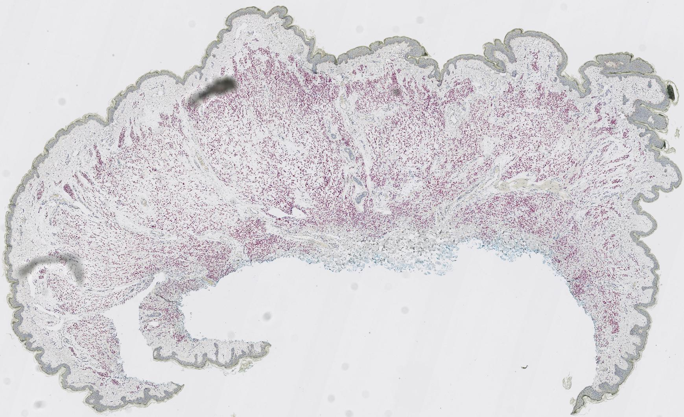
Dataset - Preprocessing
(a) Raw H&E stained image
(b) Raw Sox10 stained image
(c) Registered Sox10 stained image
First, we register raw Sox10 images (b) into aligned Sox10 images (c) using template
H&E images (a) with the Histokat software [1].
Then, we apply a Random Forest classifier to classify pixels into melanocyte or non-melanocyte.
At last, the pretrained NuSeT [2] separates touching nuclei and refine the masks.
Lotz, J., Weiss, N., van der Laak, J., StefanHeldmann: High-resolution Image Registration
of Consecutive and Re-stained Sections in Histopathology. arXiv:2106.13150 [cs, eess] (Jun 2021)
Yang, L., Ghosh, R.P., Franklin, J.M., Chen, S., You, C., Narayan, R.R., Melcher,
M.L., Liphardt, J.T.: NuSeT: A deep learning tool for reliably separating and
analyzing crowded cells. PLOS Computational Biology 16(9), e1008193 (Sep 2020), publisher: Public
Library of Science

Slide 18
Dataset
To fit images into memory as well as keep adequate information, we crop the registered paired images into 256x256 patches with 10x magnification and exclude the background patches, leaving 25,314 patches to use.
Sub-dataset | From ? cases | # Patches
Train | 10 cases | 14,630
Validation |  | 1,032
Test | 5 cases | 9,652

Slide 19
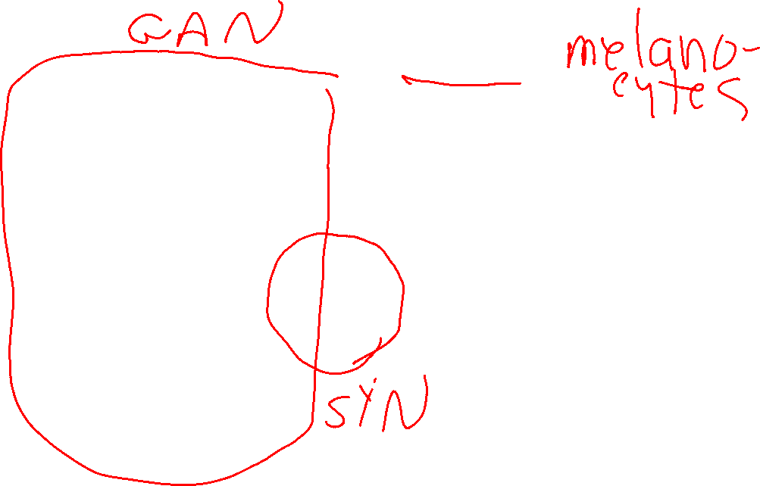
VSGD-Net
U-Net [2] with ResNet50
Inspired by Mask R-CNN [3]
Multi-scale discriminator
Notes:
Model structure
Generator: Unet with ResNet50 as backbone
Discriminator: multi-scale
Detection: feature pyramid, region proposal network, downstream heads

Slide 20
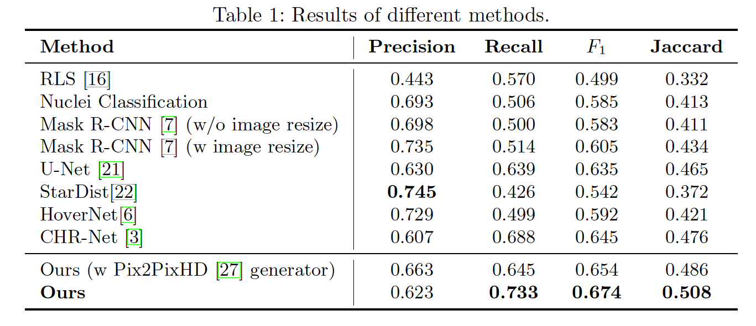
Main Results

Slide 21
Segmenting Skin Biopsy Images with Coarse and Sparse
Annotations using U-Net
Shima Nofallah et al.
Journal of Digital Imaging 2022

Slide 22
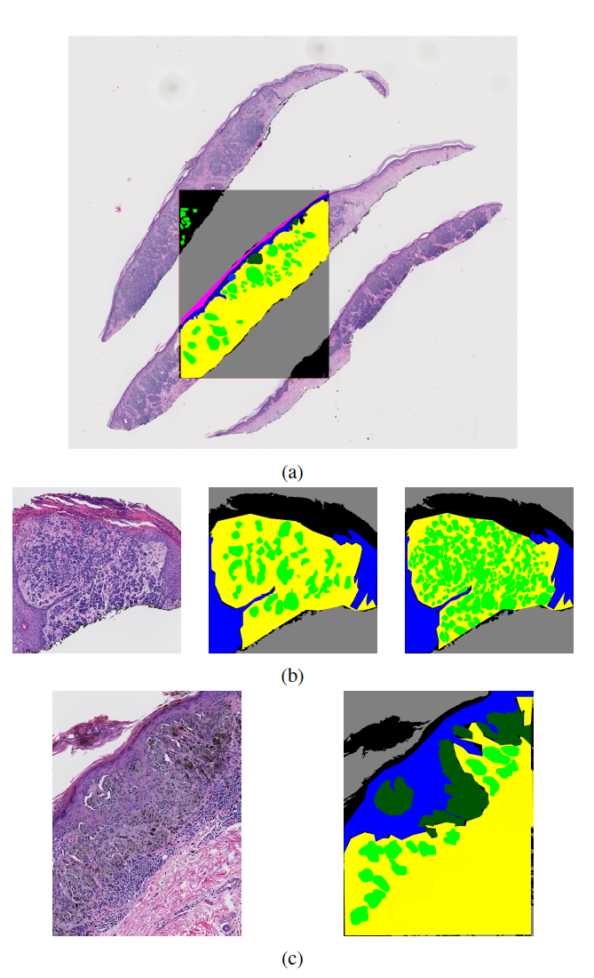
Dataset for Structure Detection
(Rough Semantic Segmentation)
We obtained coarse and sparse annotations only on the ROI (region of interest) images by an expert pathologist (Dr. Mojgan Mokhtari).
Not only are the annotations not on the full WSI, but they are also sparse within the annotated ROI.
Moreover, the annotations are coarse, i.e., they are not pixel-level accurate.

Slide 23
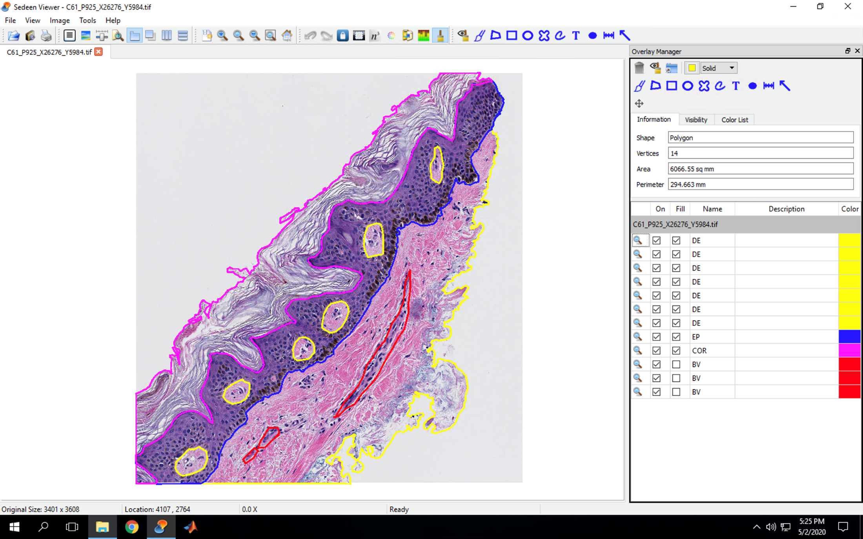

Benign

Slide 24
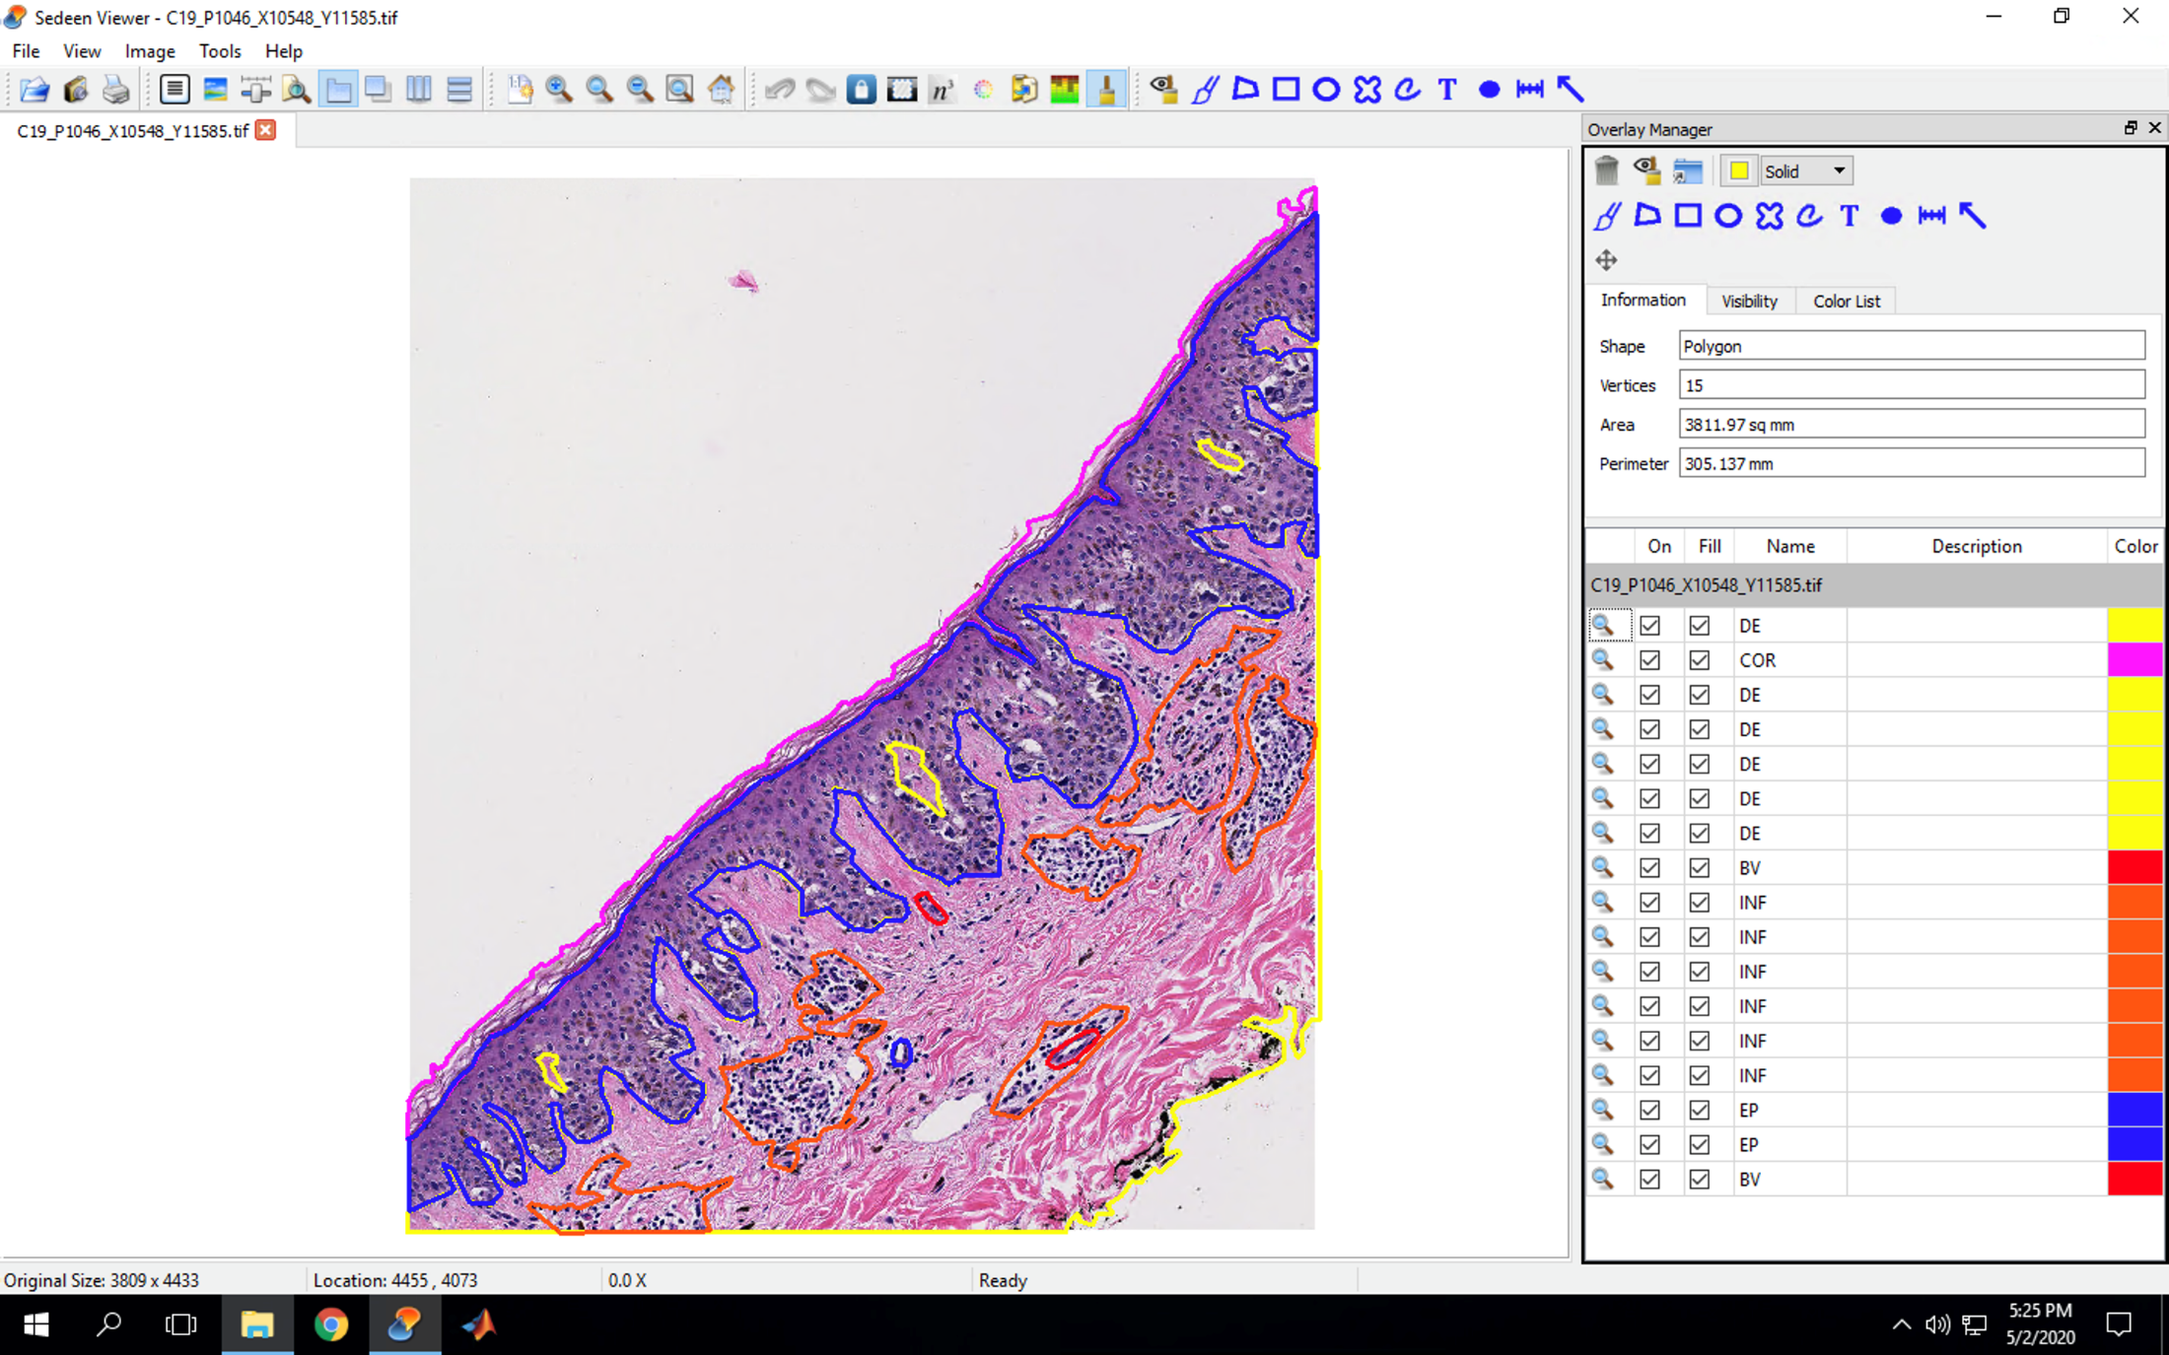
Atypia

Slide 25
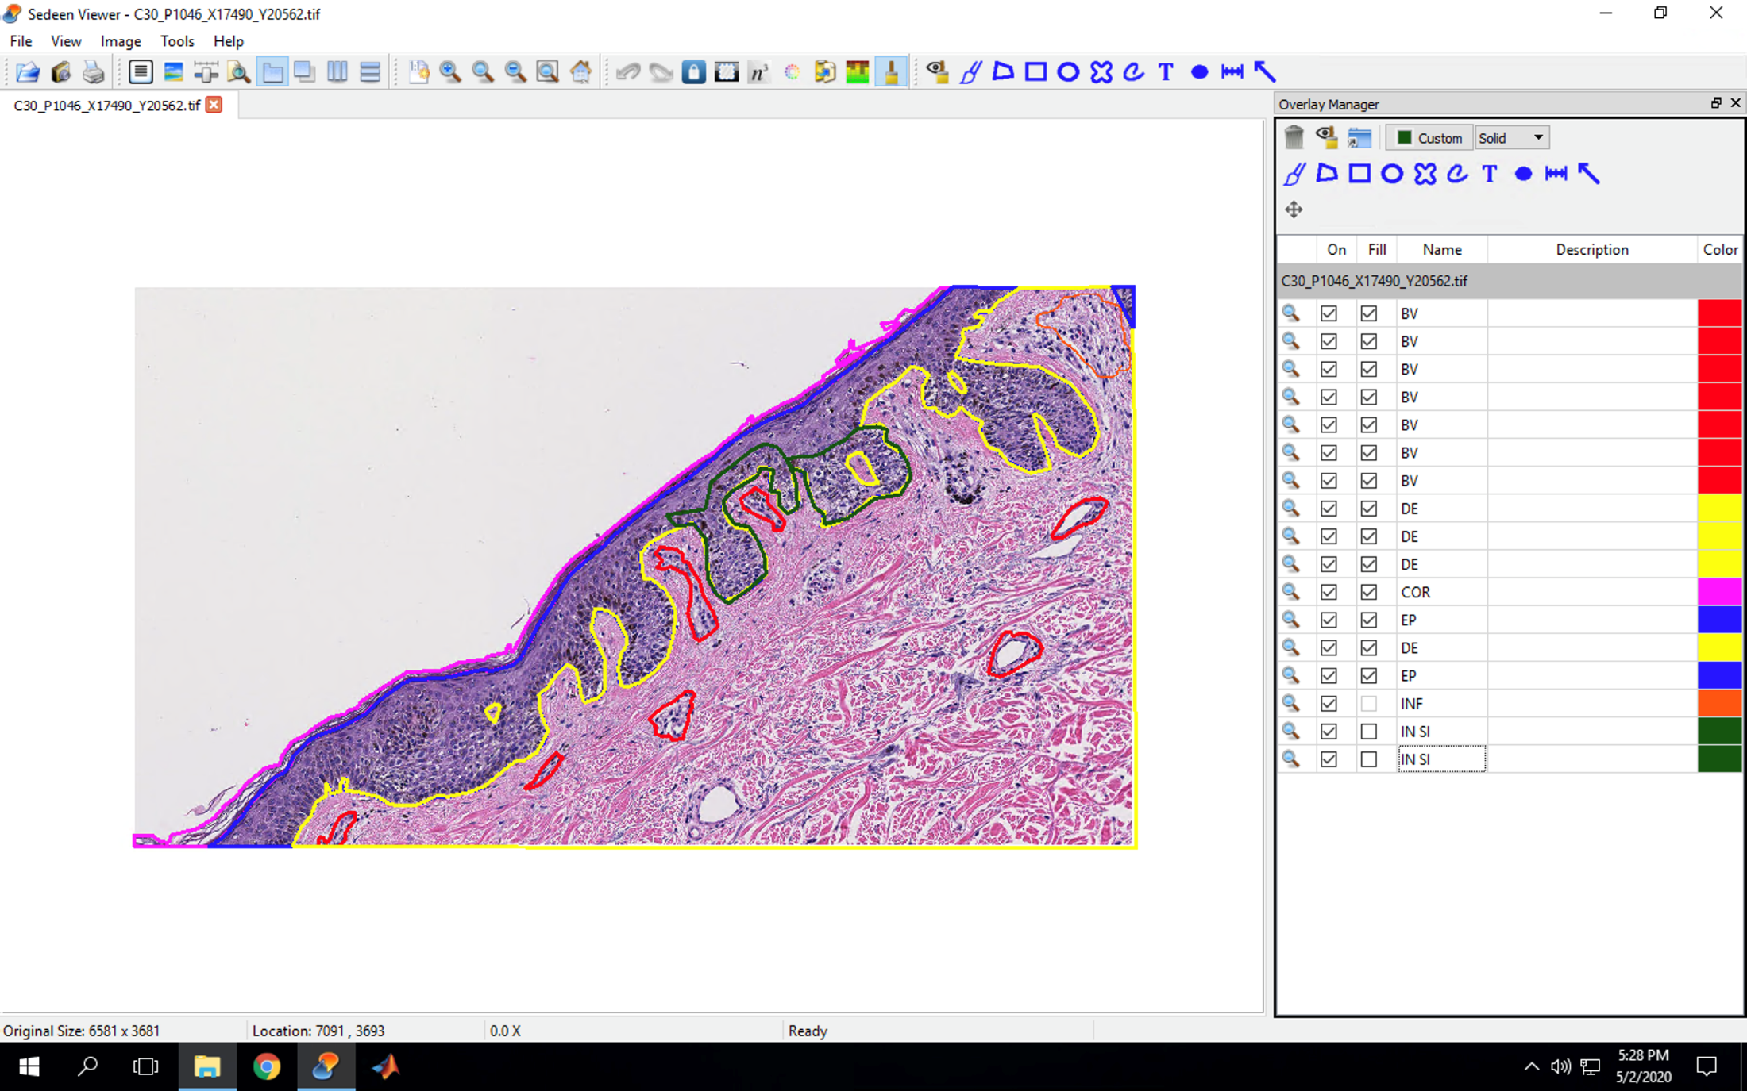

Melanoma In Situ

Slide 26
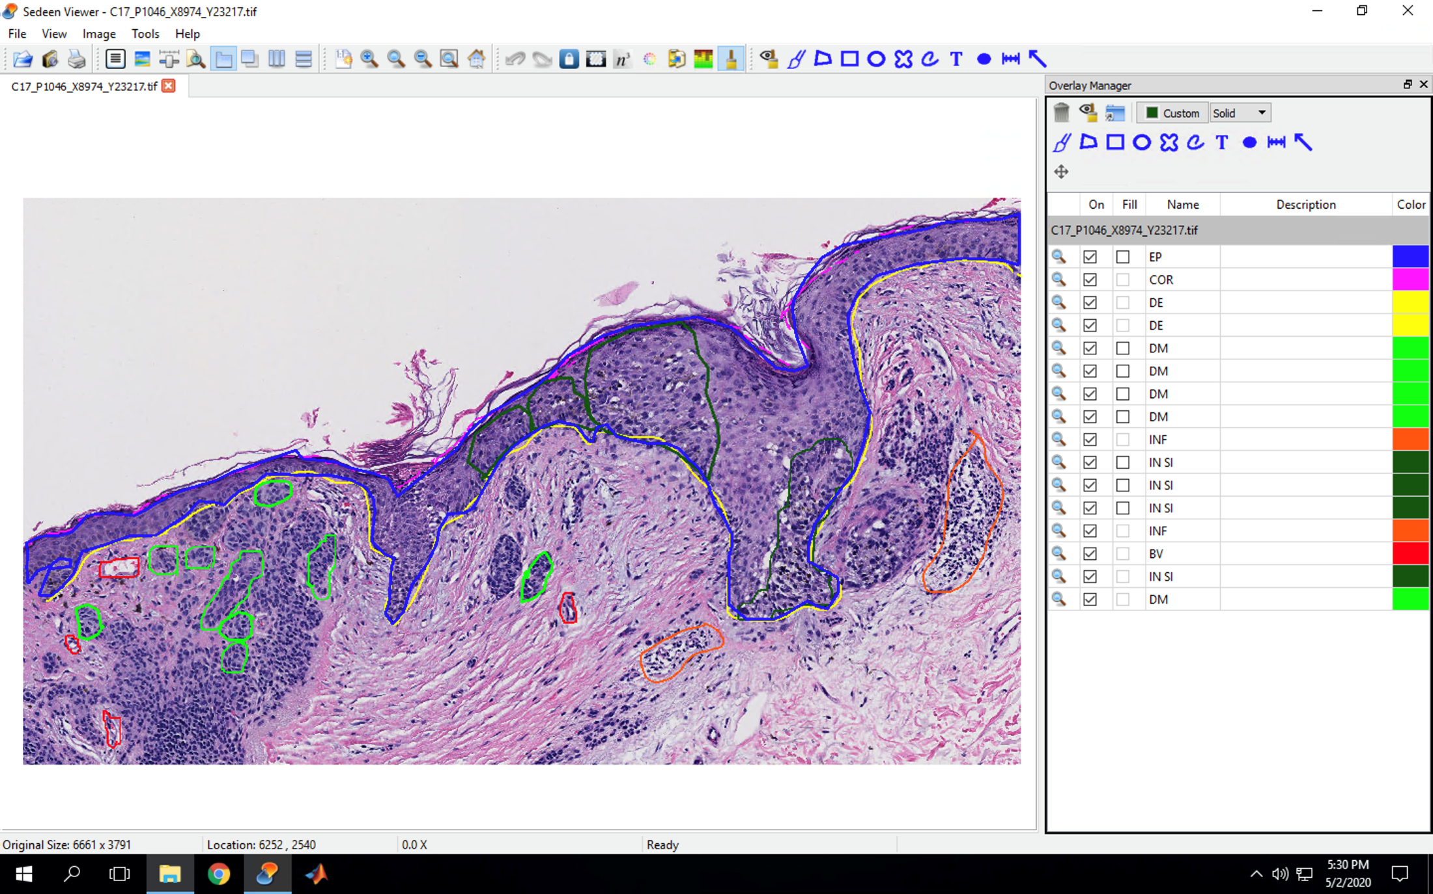

Invasive Cancer Class IA

Slide 27
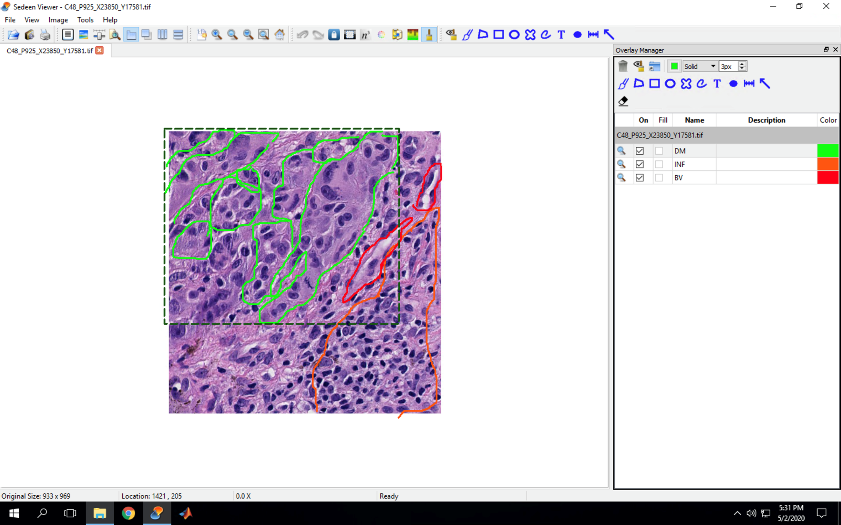
Invasive Cancer Class IB

Slide 28
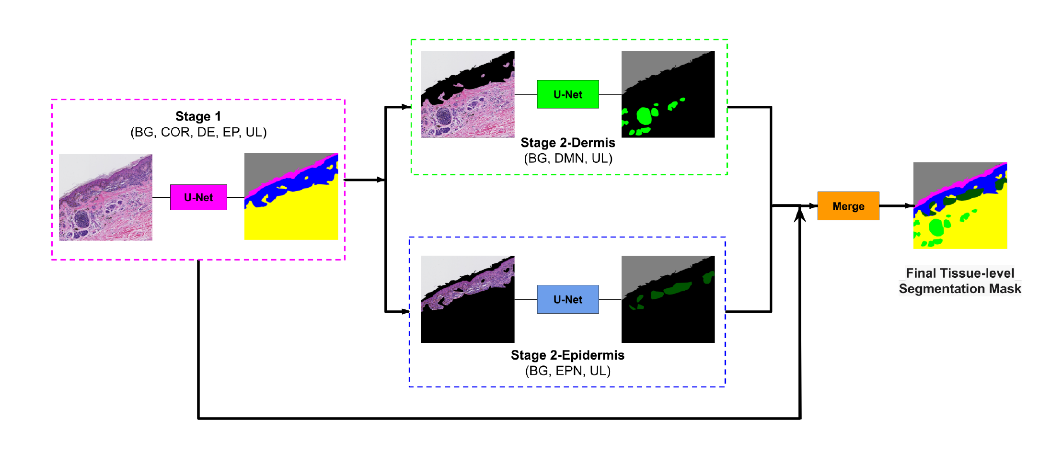
Method and Model
Two stage method: first big tissue structures, then smaller tissue structures.
BG=Background, COR=Stratum Corneum, DE=Dermis, EP=Epidermis, UL=Unlabeled, DMN=Dermal Nests, EPN= Epidermal Nests.

Slide 29
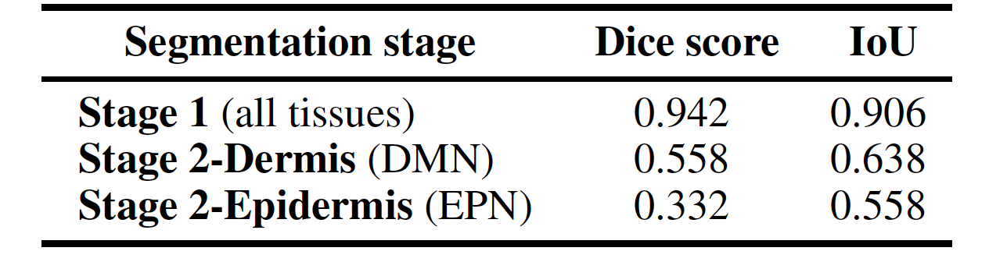



Results
Evaluation of the segmentation model on ROI testing set.

Slide 30
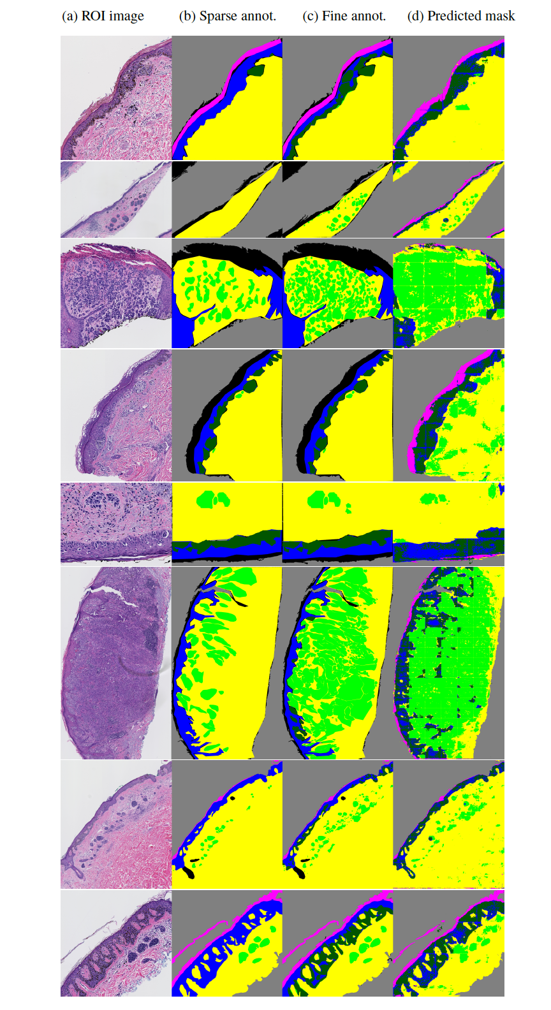

Some Results - ROI testing set

Slide 31
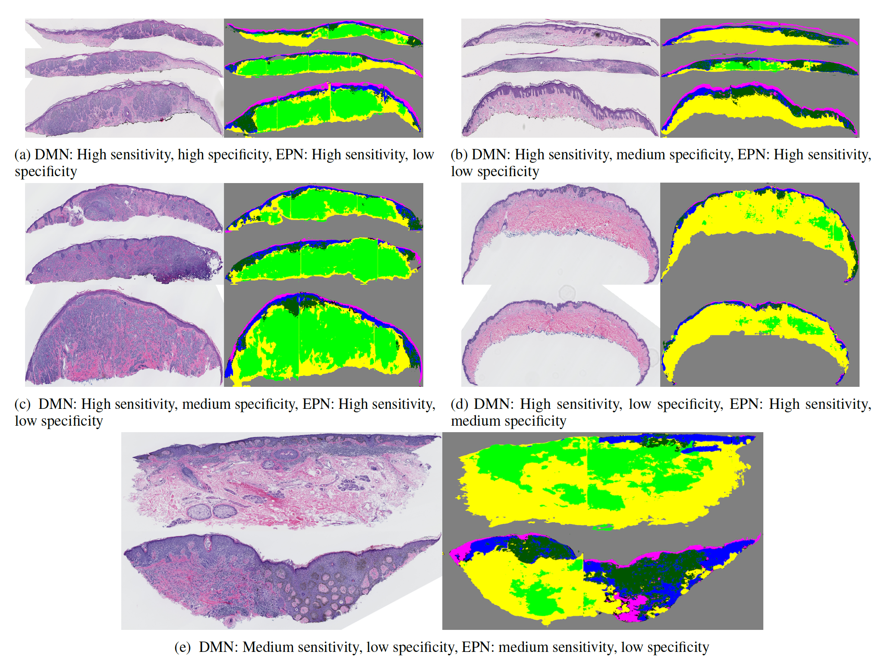



Results - Generating WSI Segmentation Masks

Slide 32
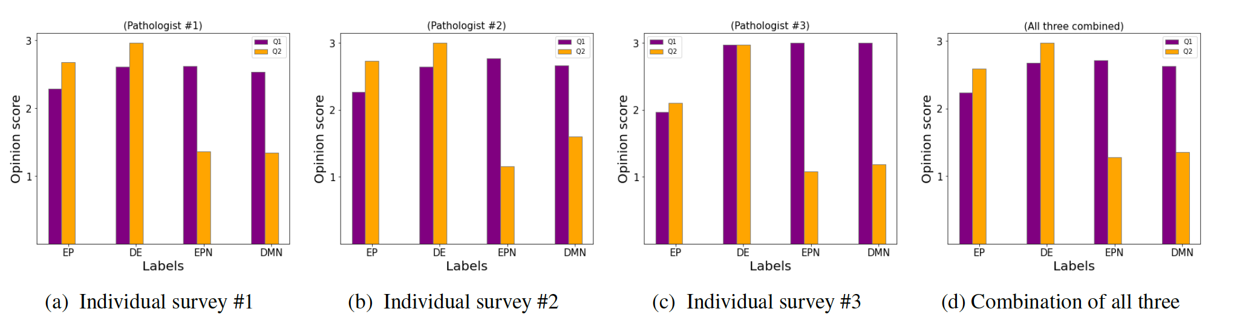

Subjective Assessment with Pathologists
Qualitatively evaluation the WSI segmentation, with these questions:
  Q1: How much of the tissue/area that is present in the corresponding WSI has been correctly identified by the model? Rate Low, Medium, or High.
  Q2: How much of the label identified by the model is the correct tissue/area? Rate Low, Medium, or High.

Slide 33
Scale-Aware Transformers for Diagnosing Melanocytic Lesions
Wenjun Wu et al.
IEEE Access 2021

Slide 34
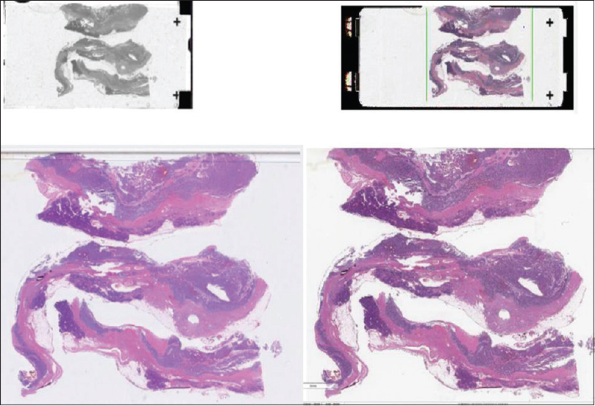
Diagnosing Whole Slide Images with Transformers
Multiple tissues
Notes:
As you have seen by now, the ultimate goal is to help with diagnosis from digitized whole slide images. You may say, isn’t that a solved problem? Just feed it to a CNN and problem solved. Of course, It’s not that easy. There are several difficulties…

Slide 35
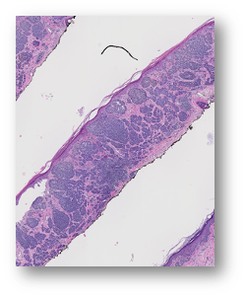
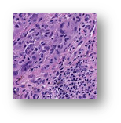
Difficulties in diagnosis
Mixed normal and cancerous tissue
?
Notes:
The first difficulty is that cancerous and non-cancerous regions are mixed in a WSI. Therefore, when pathologists actually conduct subtype classification, it is necessary to find out which part of the slide contains the relevant “interesting” regions, and perform subtype classification based on the features of the region of interest (ROI).

Slide 36
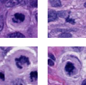
Difficulties in learning to diagnose
Mixed normal and cancerous tissue
Feature is dependent on resolution
Notes:
The second difficulty is that different features of tissues are observed when the magnification of the pathological image is changed. Pathologists conduct diagnosis by changing the magnification of a microscope repeatedly to find out various features of the tissues.

Slide 37
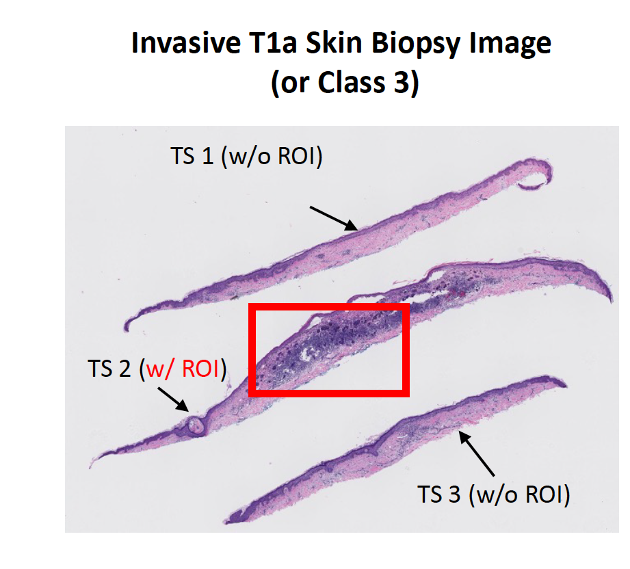
Dataset Problems
Notes:
Skin biopsy images often contain multiple tissue slices on a single WSI, as shown in Figure 4a. In general, the representative regions-of-interest (ROIs; shown in red in Figure) that helped pathologists in diagnosis belong to one or two tissue slices, while the other tissue slices may correspond to other diagnosis categories. Assigning the same diagnostic label to all tissue slices (similar to MIL-based approaches) results in more false tissue-label pairs and hinders learning representations.

Slide 38
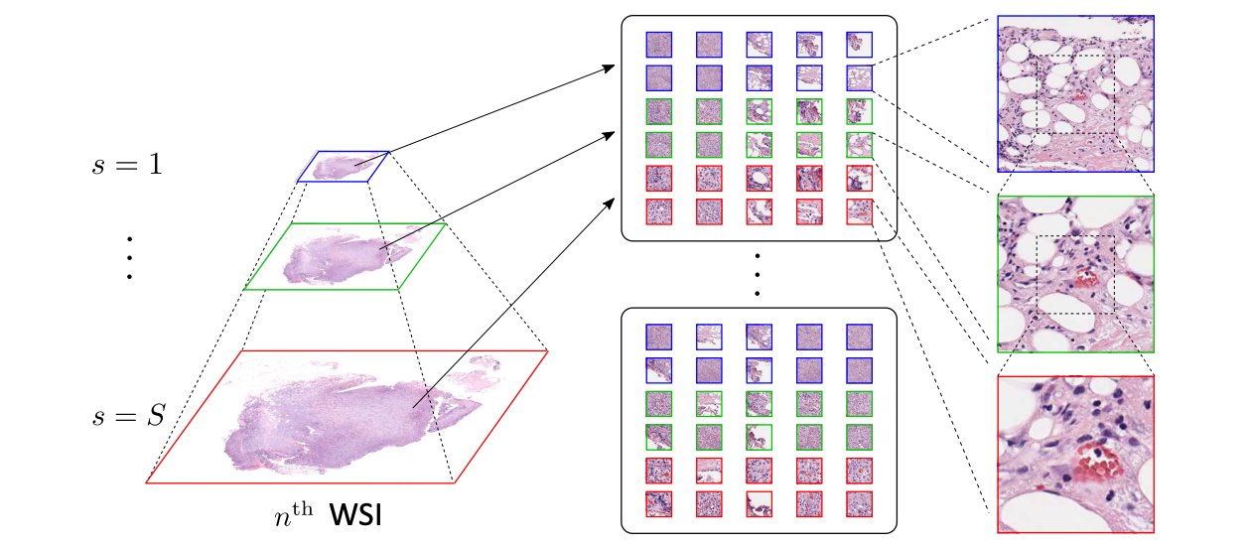
Key Ideas
Self-attention-based framework for classifying WSIs at multiple input scales
A soft label assignment method to reduce ambiguities

Slide 39
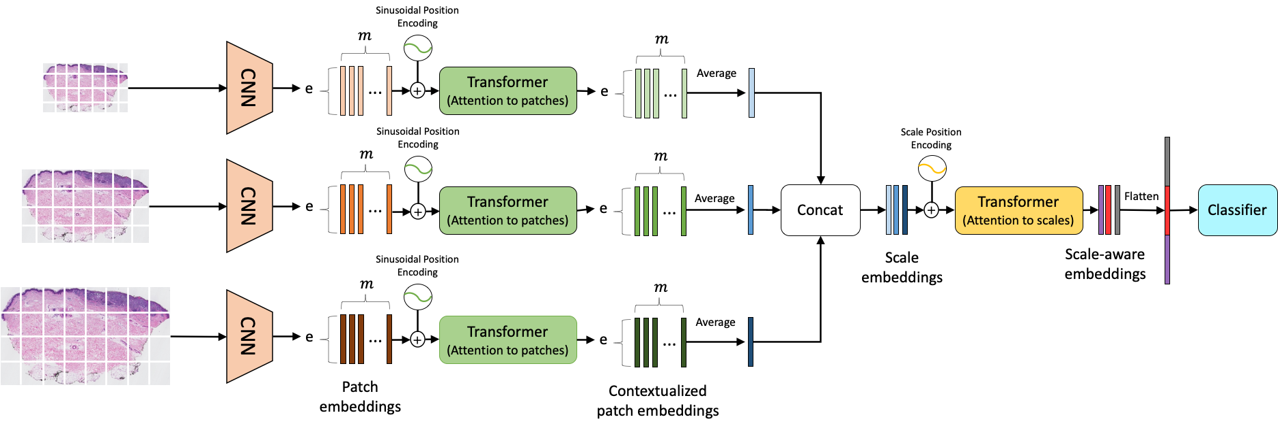

Scale-Aware Transformers for Diagnosing Melanocytic Lesions
Notes:
Overview of ScAtNet for classifying skin biopsy images. To learn representations from these large WSIs at multiple input scales in an end-to-end fashion, ScAtNet factorizes the classification pipeline into three steps. The first step involves learning local patch-wise embeddings using an off-the-shelf CNN for each input scale independently. In the second step, ScAtNet learns inter-patch representations using transformers and produces contextualized patch embeddings for each input scale. In the last step, ScAtNet learns inter-scale representations from concatenated multi-scale contextualized patch embeddings using another transformer network and produces scale-aware embeddings, which are then classified linearly into diagnostic categories. specific

Slide 40
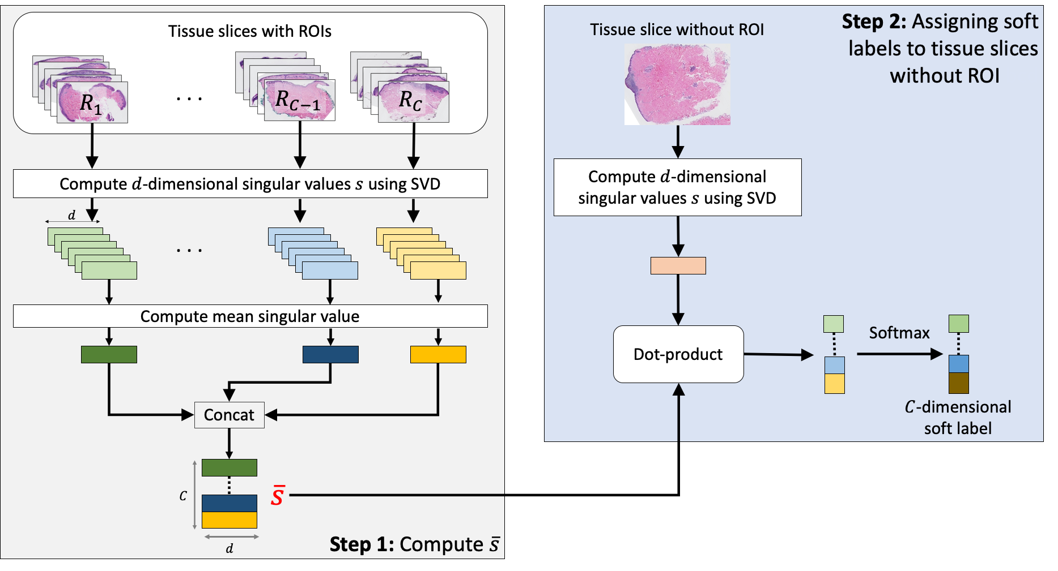
Soft labels
Tissues in each class C are represented by a mean singular value vector for that class obtained from tissue slices WITH ROIs.
For slices with no ROI, the dot product of its
SVD vector is taken with the mean vector from each class.
Notes:
To solve the multiple tissue ambiguity problem, we also proposed a way to compute soft labels for tissue slices without ROIs.
In short, we compute the class cluster singular values using slices with ROIs. Then, for each tissue slice that needs soft label, we compute the distance between its singular value vector and the class clusters. This distance is normalized to represents class probability.
We aim to assign soft labels to tissue slices without ROIs.
First we categorize WSI into two categorie: with ROI and without ROI.
Then, we further split the slides with ROI into R1, R2, R3 and R4 since we have 4 classes.
Next, we compute the mean singular value vector from all the images with ROI for each category. The idea is to use these vectors to represent the appearance of the diagnostic categories.
Now we have everything we need. We can start computing the soft labels for tissues we are uncertain about.
We compute the singular value vector representing a particular slice, then we calculate the dot product between that and the mean singular value that represents what each class look like. Applying softmax to the dot product, we get a score representing how likely this particular tissue slice belong to each of the 4 classes.

Slide 41
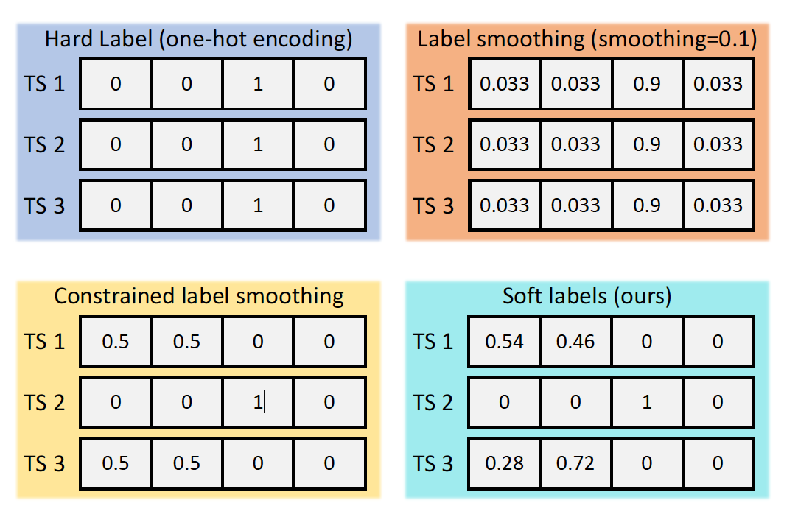

Soft labels

Slide 42
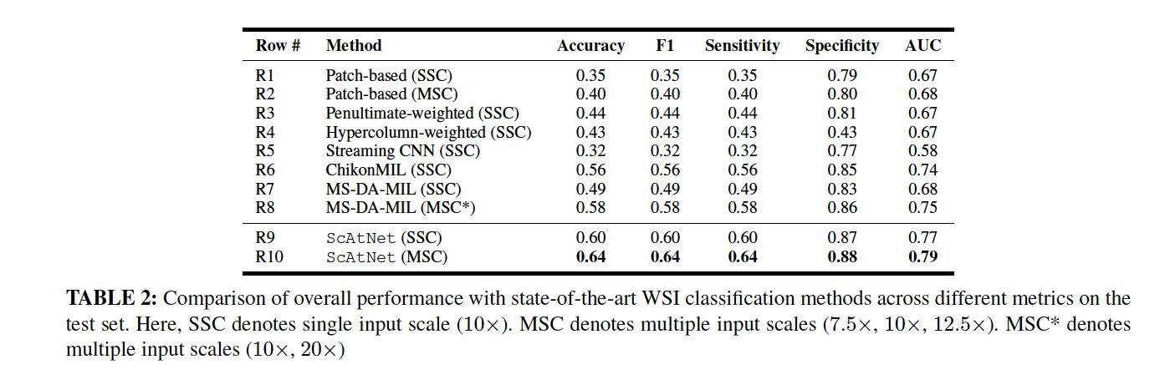
Experimental Result: baseline methods

Slide 43
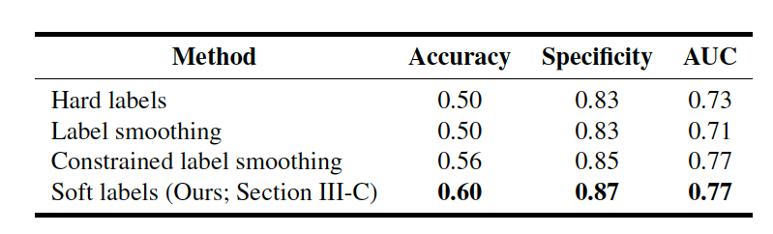
Experimental Result: soft label
Comparison of the performance of different labeling methods.
Notes:
Our soft labeling method is simple and effective; it reduces the ambiguity that arises during training because of multiple tissue slices in a WSI that do not have a ROI and helps improve the performance.

Slide 44
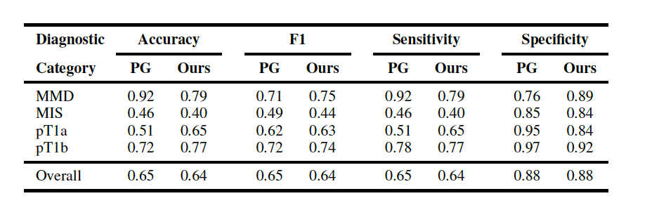

Experimental Result: pathologists performance
Comparisonto 187 practicing pathologists in a study
Comparison of ScAtNet with pathologists’ (PG) performance.
Notes:
Comparison of ScAtNet with pathologists’ (PG) performance. Pathologists’ performance data is from a prior independent clinical study of 187 pathologists [6] who interpreted these same 115 cases in our test set

Slide 45
Current Work
Using the segmentation labels to boost the performance of the
transformer classifiers to perform diagnosis
Using the size and shape pattern of the melanocytes to improve
diagnosis
Teaching transformers which patches are most important due
to their content

Slide 46
References
[1] Caner Mercan, Selim Aksoy, Ezgi Mercan, Linda G Shapiro, Donald L Weaver, and Joann G Elmore. Multi-instance multi-label learning for multi-class classification of whole slide breast histopathology images. IEEE transactions on medical imaging, 37(1):316–325, 2017.
[2] Haomiao Ni, Hong Liu, Kuansong Wang, Xiangdong Wang, Xunjian Zhou, and Yueliang Qian. Wsi-net: Branch-based and hierarchy-aware network for segmentation and classification of breast histopathological whole-slide images. In International Workshop on Machine Learning in Medical Imaging, pages 36–44. Springer, 2019.
[3] Salah Alheejawi, Richard Berendt, Naresh Jha, Santi P Maity, and Mrinal Mandal. Automated proliferation index calculation for skin melanoma biopsy images using machine learning. Computerized Medical Imaging and Graphics, 89:101893, 2021.
[4] Cheng Lu and Mrinal Mandal. Automated analysis and diagnosis of skin melanoma on whole slide histopathological images. Pattern Recognition, 48(8):2738–2750, 2015.
[5] Hongming Xu, Cheng Lu, Richard Berendt, Naresh Jha, and Mrinal Mandal. Automated analysis and classification of melanocytic tumor on skin whole slide images. Computerized medical imaging and graphics, 66:124–134, 2018.
[6] Mike Van Zon, Nikolas Stathonikos, Willeke AM Blokx, Selim Komina, Sybren LN Maas, Josien PW Pluim, Paul J Van Diest, and Mitko Veta. Segmentation and classification of melanoma and nevus in whole slide images. In 2020 IEEE 17th International Symposium on Biomedical Imaging (ISBI), pages 263–266. IEEE, 2020.
[7] Achim Hekler, Jochen Sven Utikal, Alexander H Enk, Carola Berking, Joachim Klode, Dirk Schadendorf, Philipp Jansen, Cindy Franklin, Tim Holland-Letz, Dieter Krahl, et al. Pathologist-level classification of histopathological melanoma images with deep neural networks. European Journal of Cancer, 115:79–83, 2019.

Slide 47
References
[8] John F Thompson, Seng-Jaw Soong, Charles M Balch, Jeffrey E Gershenwald, Shouluan Ding, Daniel G Coit, Keith T Flaherty, Phyllis A Gimotty, Timothy Johnson, Marcella M Johnson, et al. Prognostic significance of mitotic rate in localized primary cutaneous melanoma: an analysis of patients in the multi-institutional american joint committee on cancer melanoma staging database. Journal of Clinical Oncology, 29(16):2199, 2011.
[9] Olcay Sertel, Umit V Catalyurek, Hiroyuki Shimada, and Metin N Gurcan. Computer-aided prognosis of neuroblastoma: Detection of mitosis and karyorrhexis cells in digitized histological images. In 2009 Annual International Conference of the IEEE Engineering in Medicine and Biology Society, pages 1433–1436. IEEE, 2009.
[10] Ludovic Roux, Daniel Racoceanu, Nicolas Loménie, Maria Kulikova, Humayun Irshad, Jacques Klossa, Frédérique Capron, Catherine Genestie, Gilles Le Naour, and Metin N Gurcan. Mitosis detection in breast cancer histological images an icpr 2012 contest. Journal of pathology informatics, 4, 2013.
[11] Humayun Irshad, Ludovic Roux, and Daniel Racoceanu. Multi-channels statistical and morphological features based mitosis detection in breast cancer histopathology. In 2013 35th Annual International Conference of the IEEE Engineering in Medicine and Biology Society (EMBC), pages 6091–6094. IEEE, 2013.
[12] Dan C Cire¸san, Alessandro Giusti, Luca M Gambardella, and Jürgen Schmidhuber. Mitosis detection in breast cancer histology images with
deep neural networks. In International Conference on Medical Image Computing and Computer-assisted Intervention, pages 411–418.
Springer, 2013.
[13] Sachin Mehta, Mohammad Rastegari, Anat Caspi, Linda Shapiro, and Hannaneh Hajishirzi. Espnet: Efficient spatial pyramid of dilated convolutions for semantic segmentation. In ECCV, 2018b.

Slide 48
References
[14] Gao Huang, Zhuang Liu, Laurens van der Maaten, and Kilian Q Weinberger. Densely connected convolutional networks. In Proceedings of the IEEE Conference on Computer Vision and Pattern Recognition, 2017.
[15] Hao Zheng, Lin Yang, Jianxu Chen, Jun Han, Yizhe Zhang, Peixian Liang, Zhuo Zhao, Chaoli Wang, and Danny Z Chen. Biomedical image segmentation via representative annotation. In Proceedings of the AAAI Conference on Artificial Intelligence, volume 33, pages 5901–5908, 2019.
[16] Zeju Li, Konstantinos Kamnitsas, and Ben Glocker. Overfitting of neural nets under class imbalance: Analysis and improvements for segmentation. In International Conference on Medical Image Computing and Computer-Assisted Intervention, pages 402–410. Springer, 2019.
[17] Jamshid Sourati, Ali Gholipour, Jennifer G Dy, Sila Kurugol, and Simon K Warfield. Active deep learning with fisher information for patch-wise semantic segmentation. In Deep Learning in Medical Image Analysis and Multimodal Learning for Clinical Decision Support, pages 83–91. Springer, 2018.
[18] Dwarikanath Mahapatra, Behzad Bozorgtabar, Jean-Philippe Thiran, and Mauricio Reyes. Efficient active learning for image classification and segmentation using a sample selection and conditional generative adversarial network. In International Conference on Medical Image Computing and Computer-Assisted Intervention, pages 580–588. Springer, 2018.
[19] Yishuo Zhang and Albert CS Chung. Deep supervision with additional labels for retinal vessel segmentation task. In International conference on medical image computing and computer-assisted intervention, pages 83–91. Springer, 2018.

Slide 49




Acknowledgment
Research reported in this study was supported by grants R01CA200690 and U01CA231782 from the National Cancer Institute of the National Institutes of Health, 622600 from Melanoma Research Alliance, and W81XWH-20-1-0798 from the United States Department of Defense.
PI:
Dr. Linda Shapiro
PI:
Dr. Joann Elmore
Pathologists:
Dr. Stevan Knezevich
Dr. Caitlin May
Dr. Oliver Chang
Dr. Mojgan Mokhtari
Collaborators:
Wenjun Wu
Dr. Sachin Mehta
Dr. Annie Lee
Dr. Daniella Witten
Dr. Ezgi Mercan
Lab mates:
Nicholas Nuechterlein
Dr. Beibin Li
Kechun Liu
Dr. Shima Nofallah
Fatemeh Ghezloo

