Slide 1
Computer-Aided Diagnosis Using Whole Slide Images
Linda G. Shapiro, Ph.D.
Paul G. Allen School of Computer Science & Enginnering
Department of Electrical and Computer Engineering
Department of Biomedical Informatics and Medical Education
University of Washington

Slide 2
Breast Cancer Research
With PI Dr. Joann Elmore under the “Digipath” grant, R01-CA172343
Most of the work performed by Dr. Ezgi Mercan, now at Children’s Hospital and Research Institute.
Ezgi’s dissertation covered multiple aspects of our study including:
  Region of interest detection
  Semantic segmentation into histopathological classes
  Feature extraction and diagnosis
  Region of interest identification and diagnostic concordance
  Characterization of diagnostic search patterns: drillers vs. scanners

Slide 3
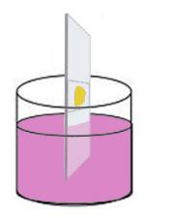

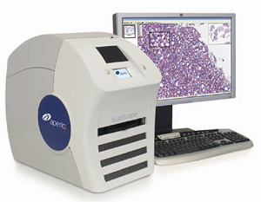
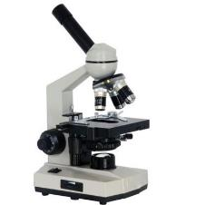
Medical Diagnosis of Cancer
1. Introduction 2. ROI Localization 3. Tissue Segmentation 4. Automated Diagnosis 5.Viewing Behavior Analysis 6. Conclusions
tissue specimen
H&E staining
glass slide
light microscope
whole slide imaging

Slide 4
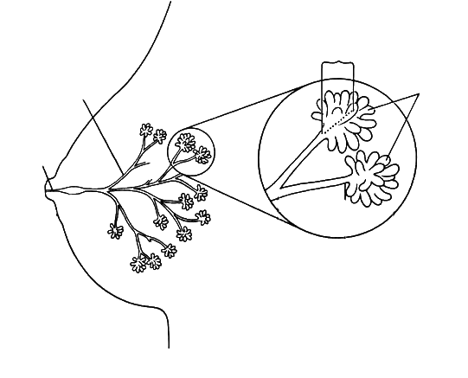
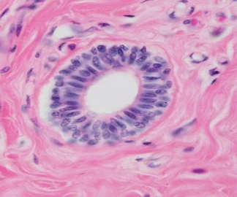
Breast Histopathology
1. Introduction 2. ROI Localization 3. Tissue Segmentation 4. Automated Diagnosis 5.Viewing Behavior Analysis 6. Conclusions
terminal ducts
segmental ducts
ductules
duct
(epithelium)
stroma
(connective tissue)
female breast
a duct
lumen

Slide 5
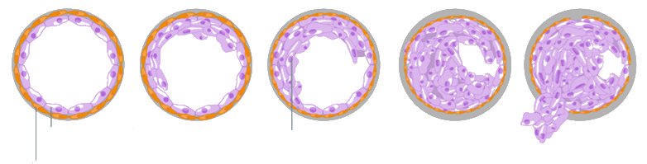
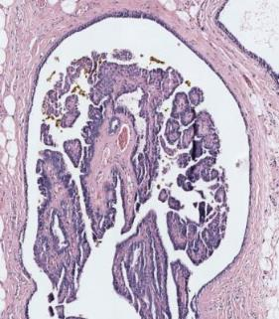
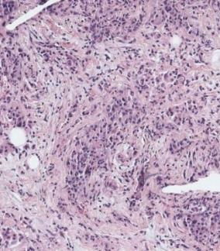
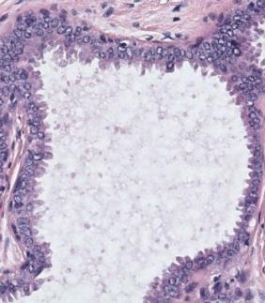
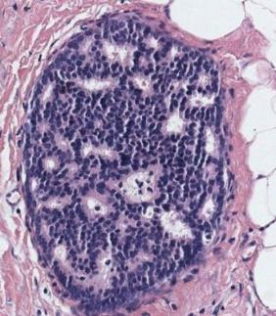
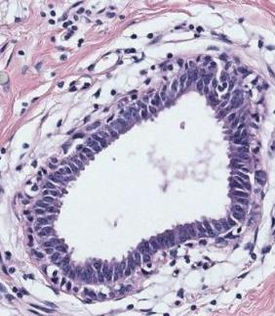
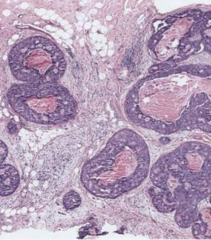
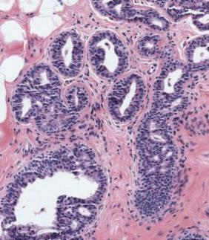
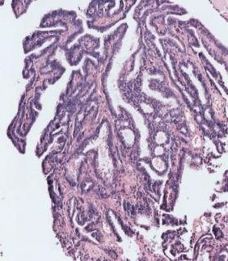
Diagnostic Categories
1. Introduction 2. ROI Localization 3. Tissue Segmentation 4. Automated Diagnosis 5.Viewing Behavior Analysis 6. Conclusions
normal duct
benign
atypia
ductal carcinoma in situ (DCIS)
invasive
normal epithelial cells
cancer cells
atypical ductal hyperplasia
flat epithelial atypia
papilloma w/atypia
invasive carcinoma
columnar cell change
usual ductal hyperplasia
intraductal papilloma
ductal carcinoma in situ (DCIS)

Slide 6
Tissue Label Segmentation
1. Introduction 2. ROI Localization 3. Tissue Segmentation 4. Automated Diagnosis 5.Viewing Behavior Analysis 6. Conclusions
For an automated diagnosis system, we need to describe the structural changes that lead to cancer.
Segmentation is a powerful that provides information about the distribution and arrangement of different tissue types.
S. Mehta, E. Mercan, et al., British Machine Vision Conference, 2017 (submitted).

Slide 7
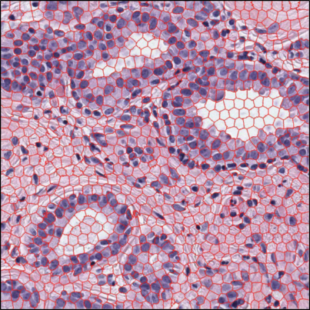








































1. Introduction 2. ROI Localization 3. Tissue Segmentation 4. Automated Diagnosis 5.Viewing Behavior Analysis 6. Conclusions
Superpixel Clustering
empty space
k-means
clustering
blood cells
color (L*a*b) and
texture (LBP)
histograms
loose stroma
dense stroma
superpixel segmentation of an ROI
normal nuclei
Each superpixel cluster can be identified as a biologically meaningful building block of the tissue.
abnormal nuclei
superpixel clusters

Slide 8
Superpixel Clustering
1. Introduction 2. ROI Localization 3. Tissue Segmentation 4. Automated Diagnosis 5.Viewing Behavior Analysis 6. Conclusions
benign
atypia
DCIS
Patterns emerge when we label the superpixels in an unsupervised manner.

Slide 9

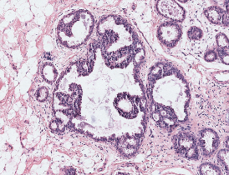
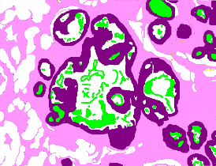
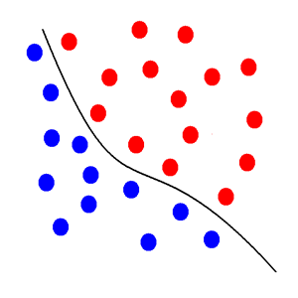
Supervised Tissue Label Segmentation
1. Introduction 2. ROI Localization 3. Tissue Segmentation 4. Automated Diagnosis 5.Viewing Behavior Analysis 6. Conclusions
ground truth
label image
classifier
original image
We tested two models using a subset of ROIs (N=58):
Support Vector Machines (SVM)
Convolutional Neural Nets (CNN)

Slide 10
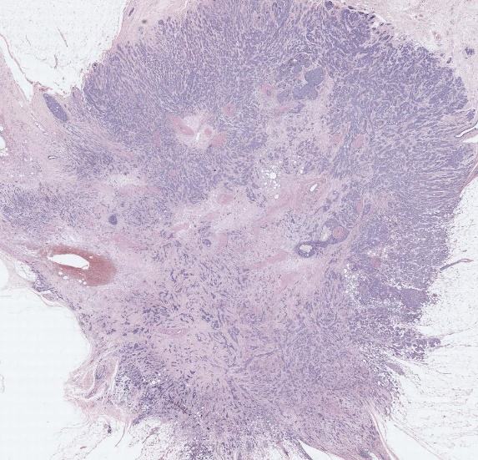
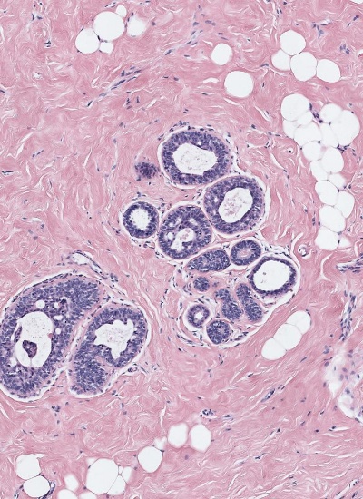
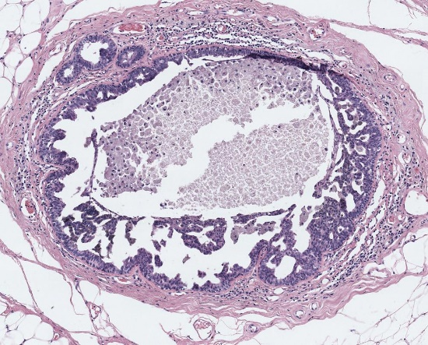
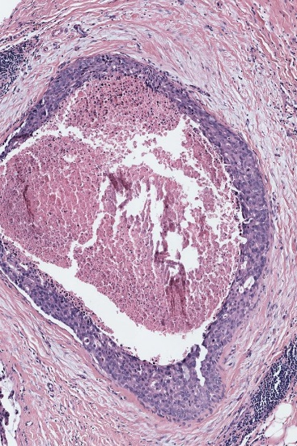
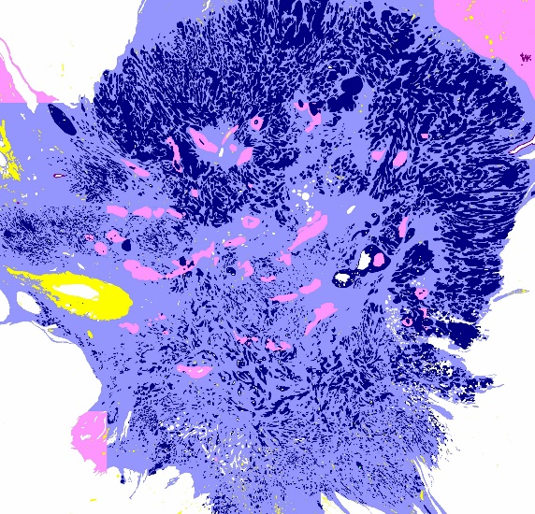
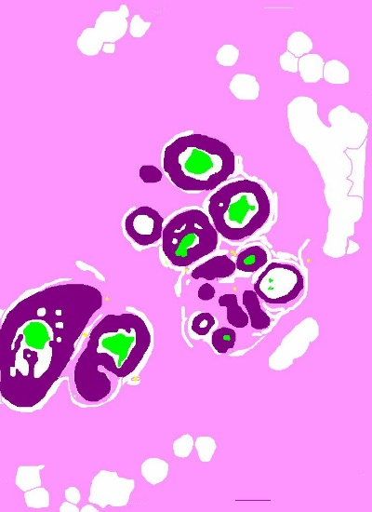
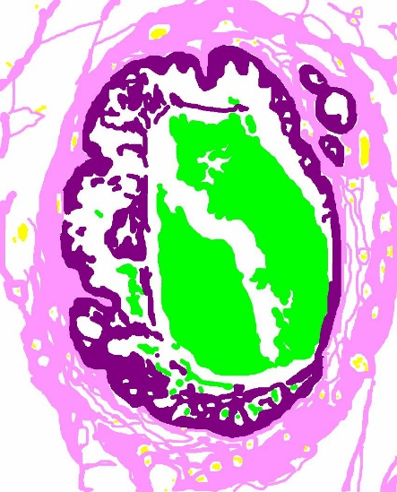
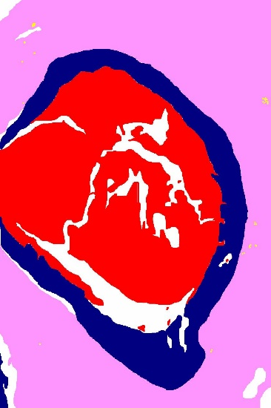

Training Labels
1. Introduction 2. ROI Localization 3. Tissue Segmentation 4. Automated Diagnosis 5.Viewing Behavior Analysis 6. Conclusions
background
benign epithelium
normal stroma
secretion
necrosis
malignant epithelium
desmoplastic stroma
blood

Slide 11
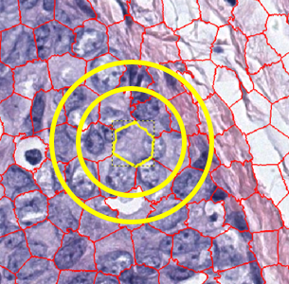
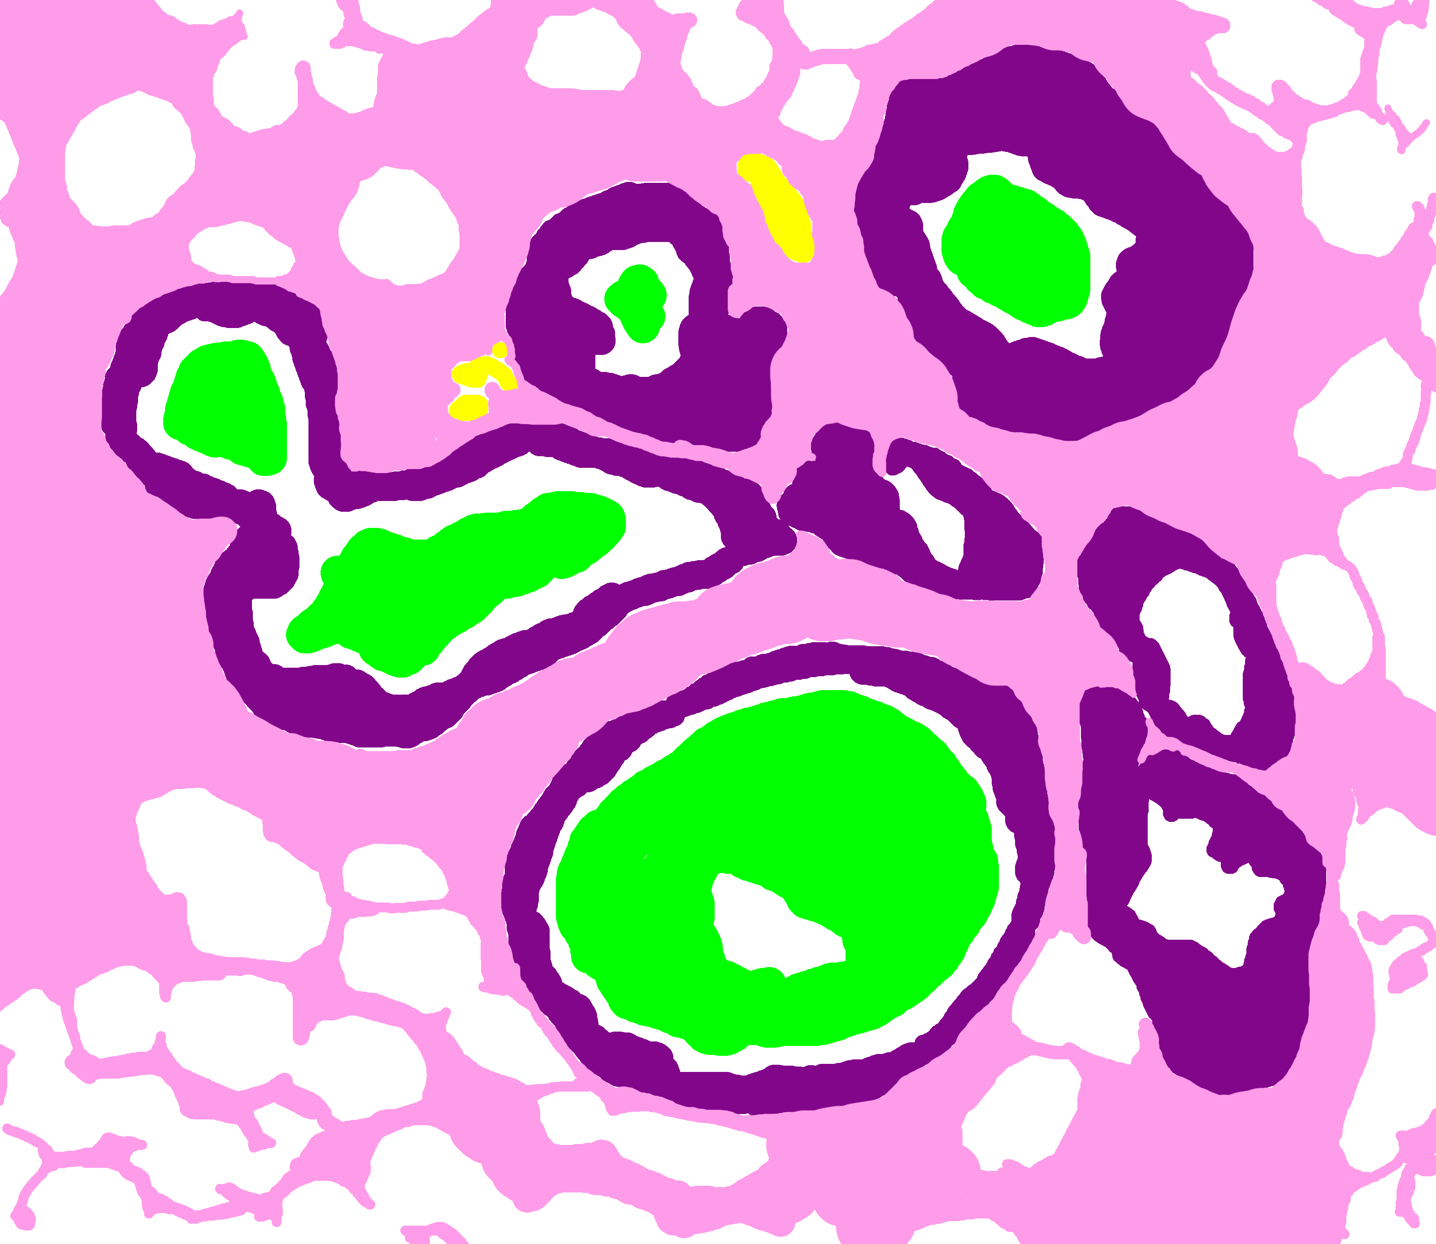
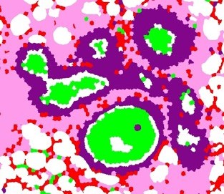
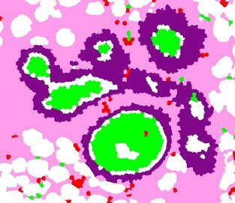
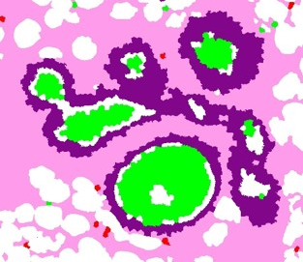
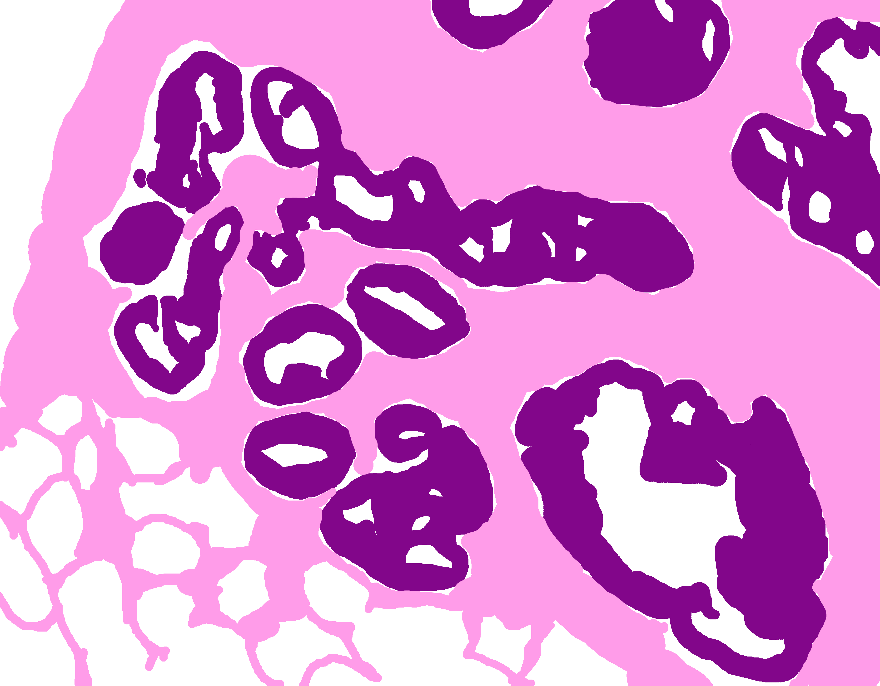
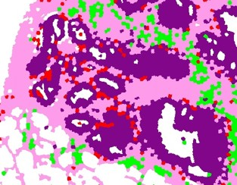
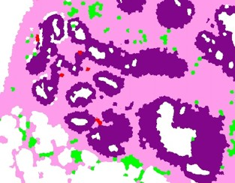
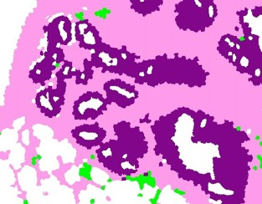
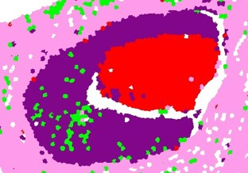
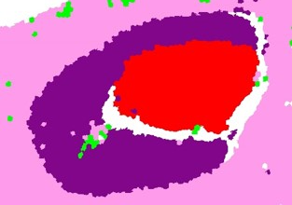

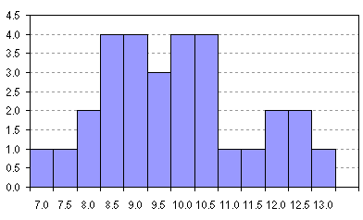
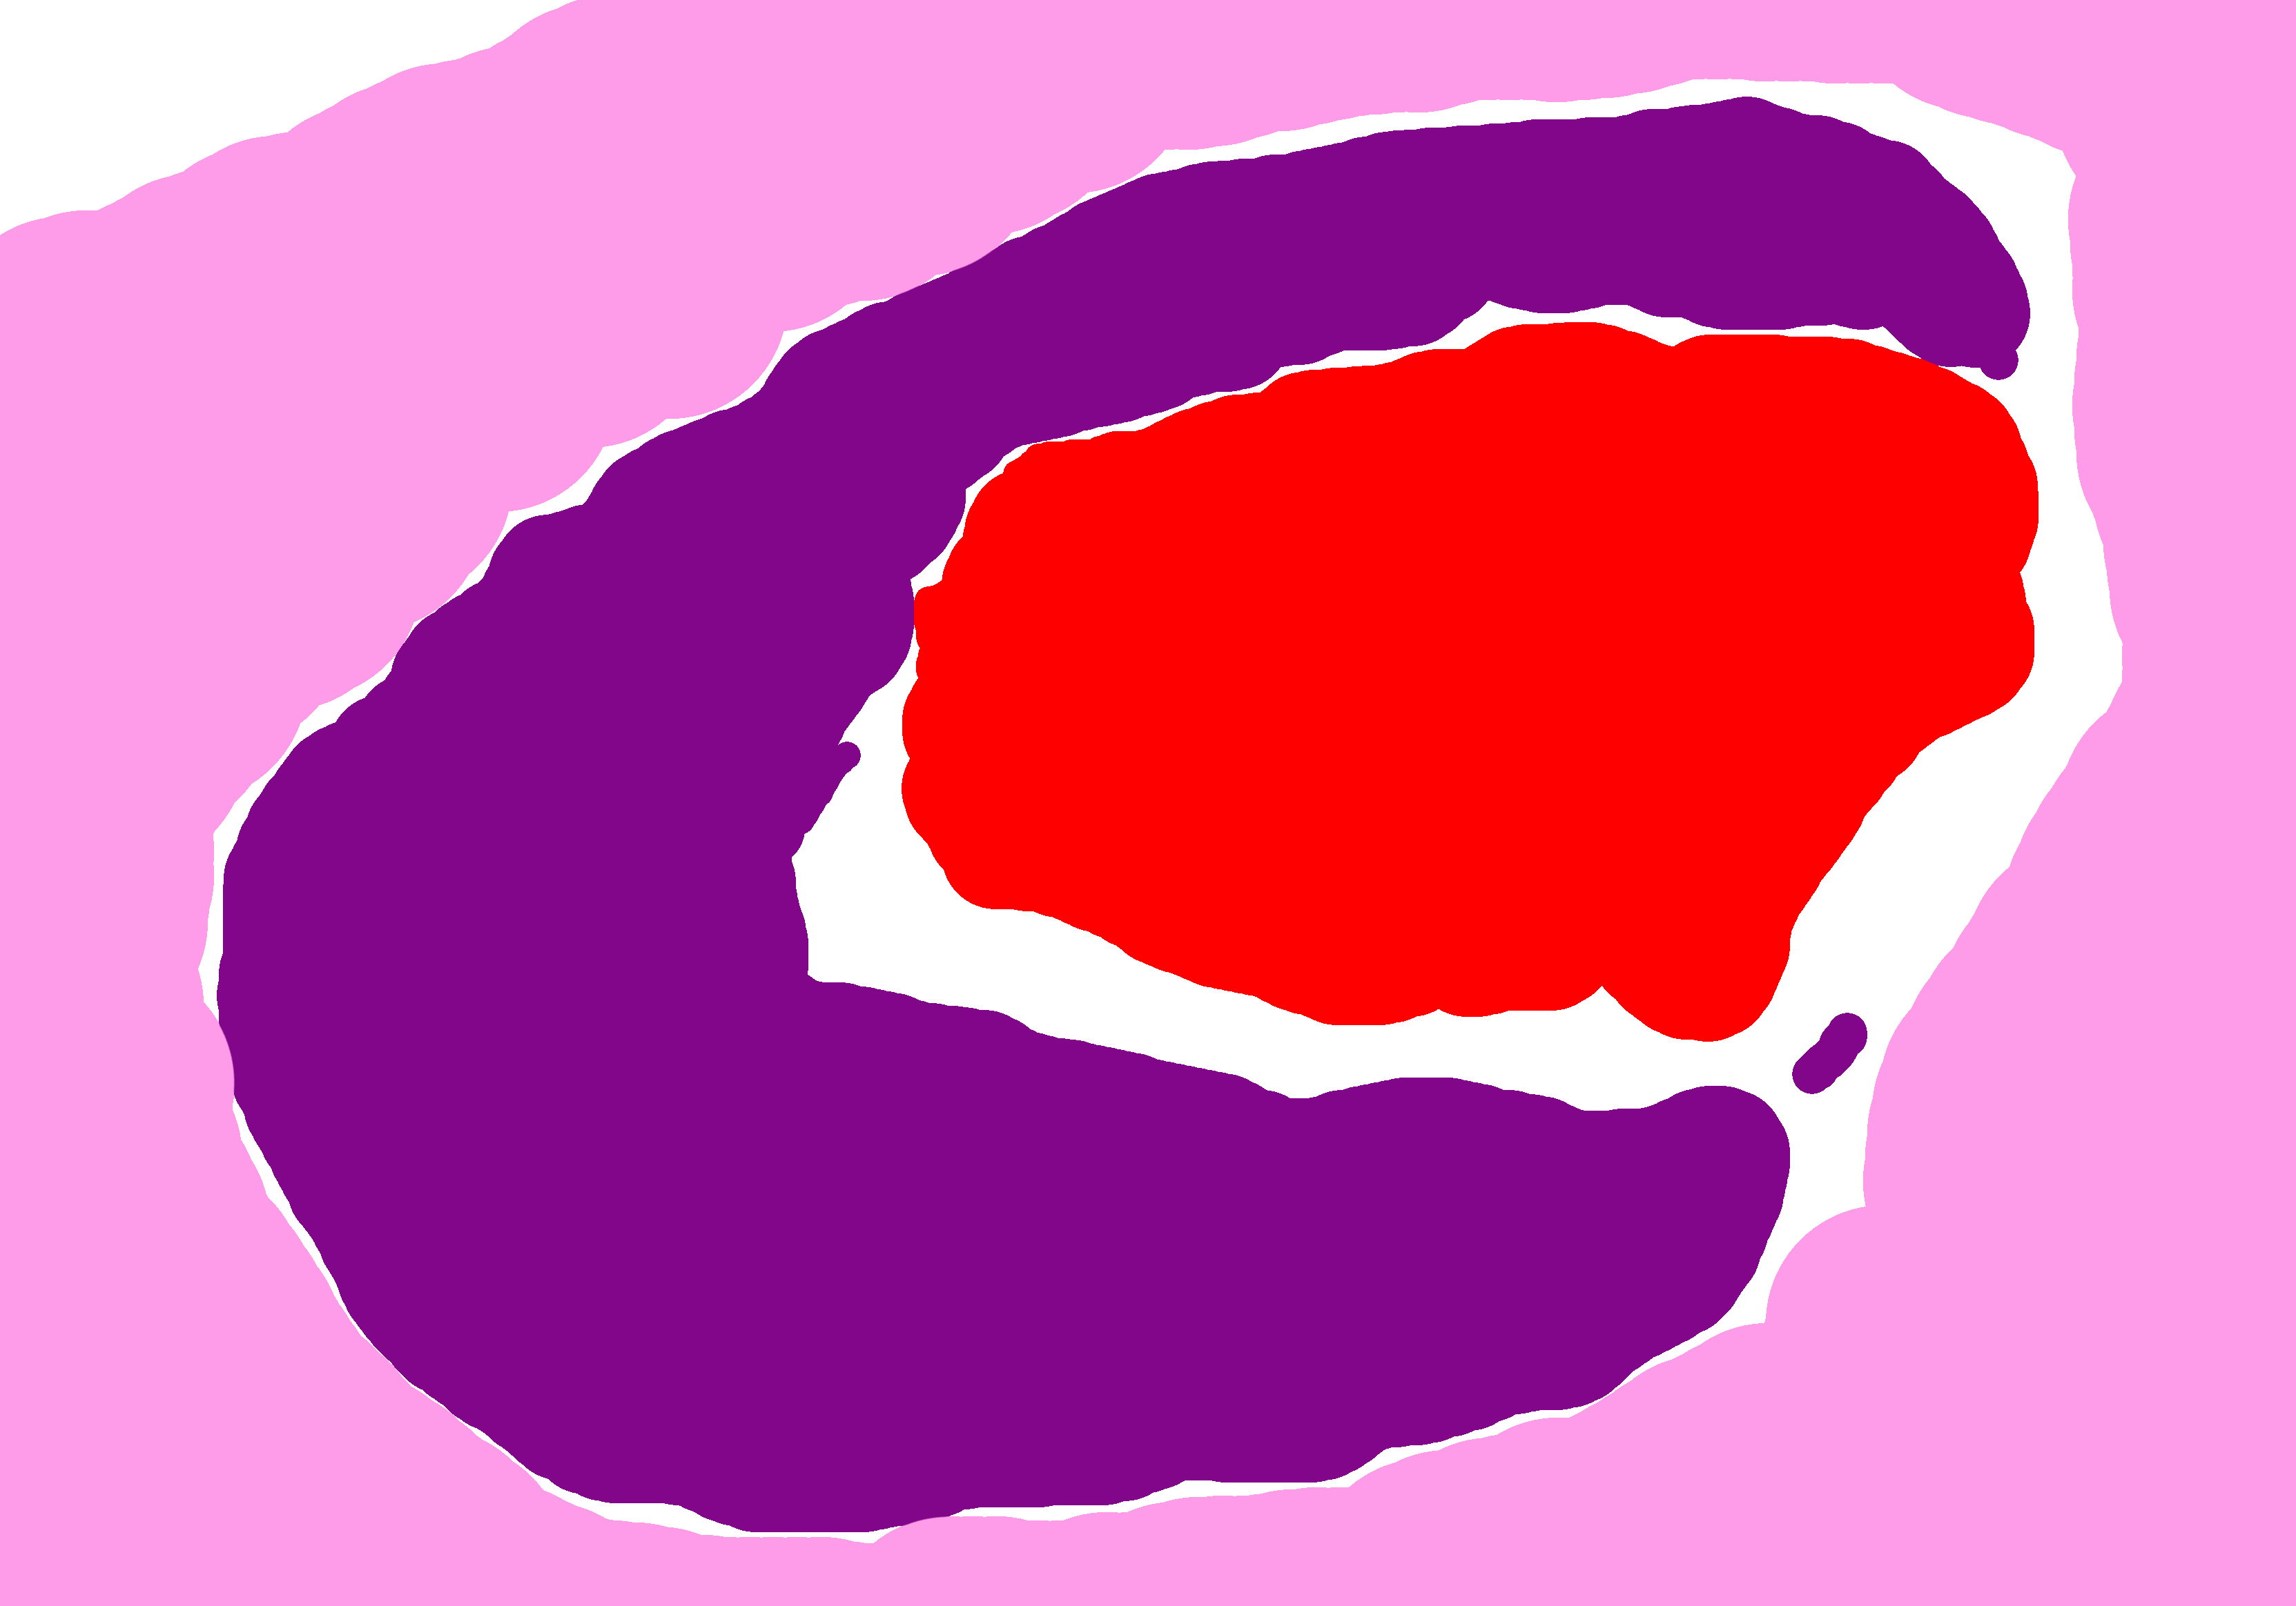
Superpixel + SVM-based Segmentation
1. Introduction 2. ROI Localization 3. Tissue Segmentation 4. Automated Diagnosis 5.Viewing Behavior Analysis 6. Conclusions
Ground Truth
no neighborhood
1 neighborhood
2 neighborhoods
color and texture
histograms
background
benign epithelium
normal stroma
secretion
necrosis
malignant epithelium
desmoplastic stroma
blood

Slide 12
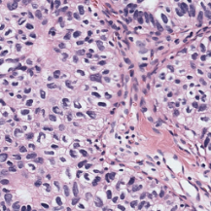
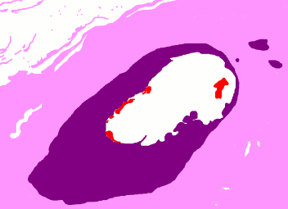
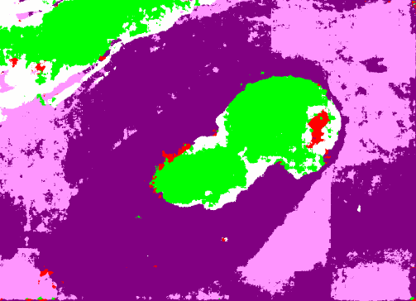

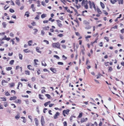
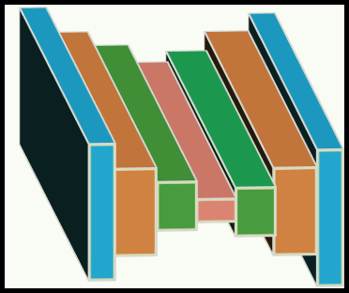
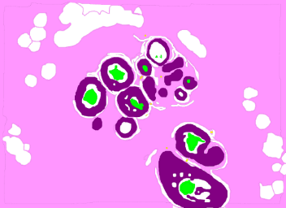
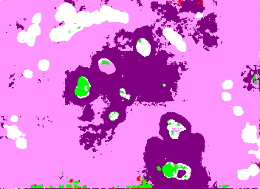
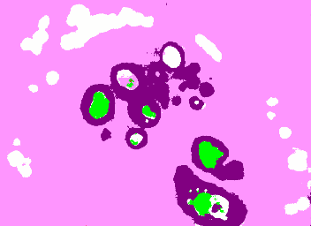

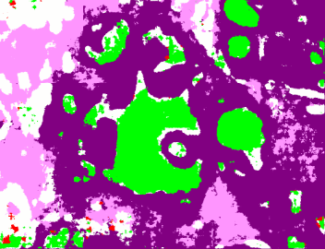
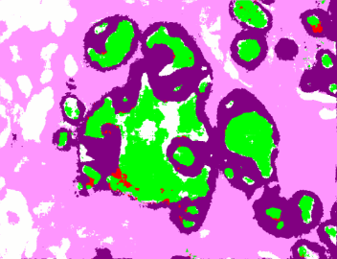






1. Introduction 2. ROI Localization 3. Tissue Segmentation 4. Automated Diagnosis 5.Viewing Behavior Analysis 6. Conclusions
CNN-based Segmentation
Input Image
$$384×384$$
Ground Truth
Plain
Multi-Resolution
$$256×256$$
Encoder-Decoder
Encoder-Decoder
background
benign epithelium
normal stroma
secretion
necrosis
malignant epithelium
desmoplastic stroma
blood
Segmentation
$256×$256
Segmentation
joint work with Sachin Mehta
$256×$256

Slide 13
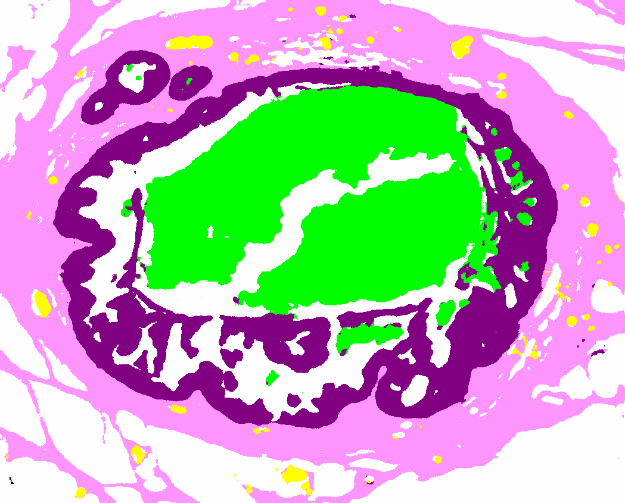









































1. Introduction 2. ROI Localization 3. Tissue Segmentation 4. Automated Diagnosis 5.Viewing Behavior Analysis 6. Conclusions
CNN-based Segmentation
Training set: 38 ROIs
Test set: 20 ROIs
ROI
Segmented ROI
CNN
Overlapping Patches
256x256 pixel
Segmented Patches

Slide 14



Supervised Tissue Label Segmentation
1. Introduction 2. ROI Localization 3. Tissue Segmentation 4. Automated Diagnosis 5.Viewing Behavior Analysis 6. Conclusions
Superpixel + SVM
CNN
Each superpixel is assigned a class label.
Context: Two circular neighborhoods
Relatively simple model
Faster to train (~3 hours)
Each pixel is assigned a class label.
Context: 256x256 and 384x384 pixel patches
More complex model
~1 week to train on special hardware

Slide 15
Results
1. Introduction 2. ROI Localization 3. Tissue Segmentation 4. Automated Diagnosis 5.Viewing Behavior Analysis 6. Conclusions
Mean F₁-score
SP+SVM | 0.40
CNN | 0.50

Slide 16

Semantic Segmentation of Tissue Classes

Slide 17
Automated Diagnosis of ROIs
1. Introduction 2. ROI Localization 3. Tissue Segmentation 4. Automated Diagnosis 5.Viewing Behavior Analysis 6. Conclusions
Diagnostic errors are alarmingly high for pre-invasive lesions of the breast.
In the digiPATH study, the agreement between pathologists and experts for the atypia cases is only 48%.
Novel image features for diagnosis can help
  develop computer aided diagnosis systems, and
  study the reasons for diagnostic errors.

Slide 18

Features of the whole ROI: Frequency and
Co-occurrence of tissue labels

Slide 19



Structure Feature
1. Introduction 2. ROI Localization 3. Tissue Segmentation 4. Automated Diagnosis 5.Viewing Behavior Analysis 6. Conclusions
benign
atypia
(DCIS)
invasive
background
benign epi
duct layer
malignant epi
normal stroma
desmoplastic str
secretion
blood
necrosis

Slide 20






1. Introduction 2. ROI Localization 3. Tissue Segmentation 4. Automated Diagnosis 5.Viewing Behavior Analysis 6. Conclusions
Inner Layers
Outer Layers
background
malignant epithelium
desmoplastic stroma
blood
benign epithelium
normal stroma
secretion
necrosis

Slide 21

Concentration of areas around and inside of ducts for breast cancer analysis

Slide 22




Structure Feature
1. Introduction 2. ROI Localization 3. Tissue Segmentation 4. Automated Diagnosis 5.Viewing Behavior Analysis 6. Conclusions
duct layer
inner layer 1
inner layer 2
inner layer 3
inner layer 4
inner layer 5
outer layer 1
outer layer 2
outer layer 3
outer layer 4
outer layer 5
duct layer
inner layer 1
inner layer 2
inner layer 3
inner layer 4
inner layer 5
outer layer 1
outer layer 2
outer layer 3
outer layer 4
outer layer 5
background | benign epi | malign. epi | normal str | desmo. str | secretion | blood | necrosis
background | benign epi | malign. epi | normal str | desmo. str | secretion | blood | necrosis

Slide 23



1. Introduction 2. ROI Localization 3. Tissue Segmentation 4. Automated Diagnosis 5.Viewing Behavior Analysis 6. Conclusions
RGB image of an ROI
unsupervised
supervised
k-means clustering
SVM / CNN
Low-Level
Color & Texture
Features
Superpixel
Label
Freq. & Cooc. Histograms
Superpixel
Label
Freq. & Cooc. Histograms
Structure
Feature

Slide 24




1. Introduction 2. ROI Localization 3. Tissue Segmentation 4. Automated Diagnosis 5.Viewing Behavior Analysis 6. Conclusions
Diagnostic Classification
Benign
Atypia
DCIS
Invasive
N=428
Invasive
Benign
Atypia
DCIS
N=392
N=36
Atypia
DCIS
Benign
N=290
N=102
1-diagnosis-at-a-time
mimicking pathologists
DCIS
Atypia
N=162
N=128

Slide 25




Evaluation
1. Introduction 2. ROI Localization 3. Tissue Segmentation 4. Automated Diagnosis 5.Viewing Behavior Analysis 6. Conclusions
Each ROI is a sample.
false
negatives
+
-
true
negatives
accuracy
sensitivity
specificity
+
-
+
+
-
true
positives
-
-
false
positives
+
-
-
+
+
-
+
+
-
-
$$\frac{\# tp+\# tn}{ all}$$
$$\frac{\# tp}{\# tp+\# fn}$$
$$\frac{\# tn}{\# tn+\# fp}$$
$$\# tp=true positive$$
$$\# tn=true negative$$
$$\# fp=false positive$$
$$\# fn=false negative$$

Slide 26
Experiments
1. Introduction 2. ROI Localization 3. Tissue Segmentation 4. Automated Diagnosis 5.Viewing Behavior Analysis 6. Conclusions
We subsampled the training data for a uniform distribution of all classes.
We trained SVMs with different features
We ran 10-fold cross-validation experiments for the 4 classification tasks:
All
All
All
All
Benign
Invasive
Invasive
Non-invasive
Invasive
Non-invasive
Invasive
Non-invasive
Atypia
DCIS
Atypia or DCIS
Benign
Atypia or DCIS
Benign
Atypia or DCIS
Benign
DCIS
Atypia
DCIS
Atypia
DCIS
Atypia

Slide 27

Results – Accuracies
1. Introduction 2. ROI Localization 3. Tissue Segmentation 4. Automated Diagnosis 5.Viewing Behavior Analysis 6. Conclusions
 | Average Accuracy
 | Invasive vs. Non-invasive | Atypia & DCIS vs. Benign | DCIS vs. Atypia | 4-class
Participant Pathologists | .98 | .81 | .80 | .70
Freq. and Cooc. Hist. | .94 | .70 | .83 | .46
Structure Feature | .91 | .70 | .85 | .56
sensitivity
specificity
.84
.99
.72
.62
.70
.82
sensitivity
specificity
.70
.95
.83
.42
sensitivity
specificity
.85
.45
.89
.80

Slide 29
HatNet
We have one completed program that was developed for breast cancer, and was just published in a journal for that, but is now starting to show its first results on melanoma cancer.
HatNet is the work of Sachin Mehta, a senior Ph.D. student in ECE, who is jointly advised by Hannenah Hajishirzi and me. He specializes in convolutional neural networks.
HatNet is based on the concept of transformers, which comes from natural language processing.
Sachin has extended it to medical images in a hierarchical approach.

Slide 30
HatNet Overview
Bag into words
Image into bags
The biopsy image is broken into bags and the bags into words.
The words are input to a convolutional neural network (CNN) which converts the raw words to features.
Next, transformers are used at multiple levels to look at word-word attention, word-bag attention, bag-bag attention, and finally bag-image attention.
At the bag-to-image level, a simple vector of weights is produced and from it, classification is performed.

Slide 31


The HatNet Architecture

Slide 32


Transformer
The transformer takes the input (words and bags, in this case) and applies three
projections to obtain query (Q), key (K), and value (V ) representations.
The query and key representations are used to compute the score for each input
with respect to other inputs using a dot-product (QK^{T} ) and a softmax operation.
The resultant scores are then combined with the value representation (V ) to produce
the weighted sum, which is of the same dimensionality as the input.
transformer
all words
all weighted words

Slide 33

First three steps of HatNet
For each
bag so n
of them

Slide 34
Last 3 steps
Step 4. The Bag-Bag Attention Module, uses a transformer to assign weights to the bags.
Step 5. The Bag-Image Attention module begins with the n x d attention matrix output by the Bag-Bag Module and, like the Word-Bag Module, performs projections on two different dimensions (n and d) and produces a vector of d weights as the image-level representation.
Step 6. A fully-connected layer takes in this vector and outputs the diagnosis.

Slide 35

Examples of selected bags and words

Slide 36

Examples of HatNet identifying Stroma Tissue
Top 50% words shown in pink (stroma) and blue (other) on the right. Pathologists labeling of stroma shown at center.

Slide 37

Hatnet Accuracies
Breast Cancer—our 4 class data set, accuracy on 4-class problem
Melanoma Cancer – 5 classes reduced to 4 with I and II combined is up to about .53 accuracy currently.

Slide 38
Summary
We have done a LOT of work on breast cancer and are just starting to get results on melanoma cancer
Our HatNet breast cancer on the 4-class problem is at .70.
Our HatNet melanoma on the full 4-class problem is at .53- but is only getting started.

