Slide 1
Solving Problems by Searching

Slide 2
Terminology
State
State Space
Initial State
Goal Test
Action
Step Cost
Path Cost
State Change Function
State-Space Search

Slide 3
Formal State-Space Model
Problem = (S, s, A, f, g, c)
S = state space
s = initial state
A = set of actions
f = state change function
g = goal test function
c = cost function
a
c(a)
x
y

Slide 4
State-Space Model (cont) Problem = (S, s, A, f, g, c)
How do we define a solution?
How about an optimal solution?
path to goal
s → s₁ → s₂ → … … → s_{n} = g
It has minimal cost.

Slide 5
3 Coins Problem A Very Small State Space Problem
There are 3 (distinct) coins: coin1, coin2, coin3.
The initial state is H H T
The legal operations are to turn over exactly one coin.
1 (flip coin1), 2 (flip coin2), 3 (flip coin3)
There are two goal states: H H H
T T T
What are S, s, A, f, g, c ?

Slide 6
3 Coins Problem: Get from HHT to either HHH or TTT via operators: flip coin 1, flip coin 2, and flip coin 3 (flip = turn over)
S = {(x,y,z) | x, y, z in {H,T}}
s = (H,H,T)
A = (1,2,3)
f = {f((H,H,T),1) = (T,H,T), etc}
g = {(H,H,H),(T,T,T)}
c = 1

Slide 7
State-Space Graph
1
HHT
THT
3
2
3
THH
HTT
2
1
1
3
2
HHH
TTT
3
2
TTH
HTH
1
What are some solutions?
What if the problem is changed to allow only 3 actions?

Slide 8
Modified State-Space Problem
How would you define a state for the new problem requiring exactly 3 actions?
How do you define the operations (1, 2, 3) with this new state definition?
(C₁,C₂,C₃,count)
Add count = count + 1 to the previous operations.

Slide 9
Modified State-Space Problem
What do the paths to the goal states look like now?
(H,H,T,0) ->
(H,H,T,2) -> (T,H,T,3) -> (H,H,T,4) ??

Slide 10
How do we build a search tree for the modified 3 coins problem?
initial
state
(H,H,T,0)
1 2 3
(T,H,T,1)
(H,T,T,1)
(H,H,H,1)
1
(H,H,T,2)

Slide 11
The 8-Puzzle Problem
one
initial
state
1 2 3
8 B 4
7 6 5
B 1 2
3 4 5
6 7 8
goal
state
B=blank
What data structure easily represents a state?
How many possible states are there?
How would you specify the state-change function?
What is the path cost function?
uniform cost (=1)
5. What is the complexity of the search?
9 x 8 x 7 x 6 x 5 x 4 x 3 x 2 x 1 = 9!
Exponential

Slide 12
Search Tree Example: Fragment of 8-Puzzle Problem Space

Slide 13
Another Example: N Queens Place exactly one Q in each column so that no two Q’s are in the same row or diagonal
Input:
Set of states
Operators [and costs]
Start state
Goal state (test)
Output
Q
Q
Q
Q

Slide 14
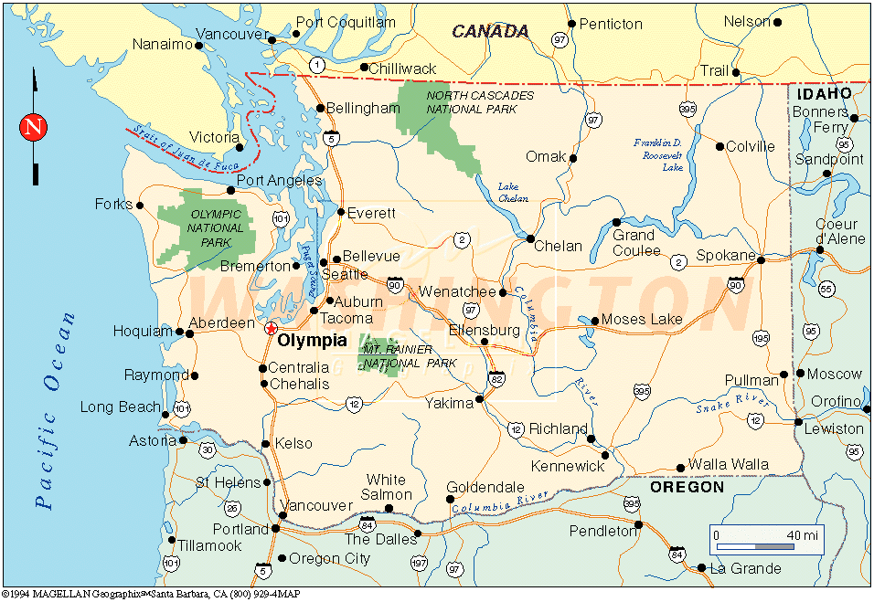
Example: Route Planning Find the shortest route from the starting city to the goal city given roads and distances.
Input:
Set of states
Operators [and costs]
Start state
Goal state (test)
Output:
city plus path so far
a move with its distance
Notes:
States = cities
Start state = starting city
Goal state test = is state the destination city?
Operators = move to an adjacent city; cost = distance
Output: a shortest path from start state to goal state
SUPPOSE WE REVERSE START AND GOAL STATES?

Slide 15
Search in AI
Search in Data Structures
You’re given an existent tree.
You search it in different orders.
It resides in memory.
Search in Artificial Intelligence
The tree does not exist.
You have to generate it as you go.
For realistic problems, it does not fit in memory.

Slide 16
Search Strategies (Ch 3)
Uninformed Search
The search is blind, only the order of search is important.
Informed Search
The search uses a heuristic function to estimate the goodness of each state.

Slide 17
Depth-First Search by Recursion* You will use this for Missionary-Cannibal Problem.
Search is a recursive procedure that is called with the start node and has arg s.
It checks first if s is the goal.
It also checks if s is illegal or too deep.
If neither, it generates the list L of successors of its argument s.
It iterates through list L, calling itself recursively for each state in L.

Slide 18
Depth-First Search by Recursion
start state (root)
successor
list of root
successor
list of
first successor
of root

Slide 19
The Missionaries and Cannibals Problem (from text problem 3.9)
Three missionaries and three cannibals are on one side (left) of a river, along with a boat that can hold one or two people.
If there are ever more cannibals than missionaries on one side of the river, the cannibals will eat the missionaries. (We call this a “dead” state.)
Find a way to get everyone to the other side (right), without ever leaving a group of missionaries in one place (left or right) outnumbered by the cannibals in that place, ie. without anyone getting eaten.

Slide 20
Missionaries and Cannibals Problem

Slide 21
Missionaries and Cannibals Problem
Left Bank Right Bank
River

Slide 22
Missionary and Cannibals Notes
Define your state as (M,C,S)
M: number of missionaries on left bank
C: number of cannibals on left bank
S: side of the river that the boat is on
When the boat is moving, we are in between states. When it arrives, everyone gets out.
CCR
(3,3,L) → (3,1,R)
What action did I apply?

Slide 23
What are all the actions?
Left to right
MCR
MMR
?
?
?
Right to left
MCL
MML
?
?
?
CCR
MR
CR

Slide 24
When is a state considered “DEAD”?
There are more cannibals than missionaries on the left bank. (Bunga-Bunga)
There are more cannibals than missionaries on the right bank. (Bunga-Bunga)
There is an ancestor state of this state that is exactly the same as this state. (Why?)

Slide 25
Same Ancestor State
Stack
(3,3,L)
(3,1,R)
(3,3,L)
CCR
(3,1,R)
CCL
(3,3,L)
X

Slide 26
Assignment
Implement and solve the problem
You MUST use recursive depth-first blind search.
You must detect illegal states (cannibals can eat missionaries) and repeated states along a path.
You must keep going and print out all four solutions.
You must use Python
Full instructions will be on the assignment page.

Slide 27
Warning
The material that follows is NOT for HW1.
HW1 is to be done with a recursive, depth-first search.
It does not use the general paradigm we are about to go into.
It is a beginning exercise.
You will use the more general framework along with a heuristic in HW2.

Slide 28
General Search Paradigm (Figure 3.7 in text)
function TREE-SEARCH(problem) returns solution or failure
initialize frontier using the initial state of problem
loop do
if frontier is empty then return failure
choose a leaf node and remove it from frontier
if the node contains a goal state then return the solution
expand the node, adding the resulting nodes to frontier
What is the frontier?
How do we choose?
What does expand mean?

Slide 29
General Search Paradigm (Figure 3.7 in text)
function GRAPH-SEARCH(problem) returns solution or failure
initialize frontier using the initial state of problem
initialize the explored set to be empty
loop do
if frontier is empty then return failure
choose a leaf node and remove it from frontier
if the node contains a goal state then return the solution
add the node to the explored set
expand the node, adding the resulting nodes to frontier
only if they are not in the frontier or the explored set
OPEN CLOSED

Slide 30
Basic Idea
Start with the initial state
Maintain a (general) queue of states to visit
Depth-First search: the queue is LIFO (stack)
Breadth-First search: the queue is FIFO (queue)
Uniform-Cost search: the queue is ordered by lowest path cost g (path from start to node)
Depth-Limited search: DFS with a depth limit
Iterative-Deepening search: DFS with depth limit sequence 1, 2, 3, …. till memory runs out
Bidirectional Search

Slide 31
Performance Criteria
Completeness: Does it find a solution when there is one?
Optimality: Does it find the optimal solution in terms of cost?
Time complexity: How long does it take to find a solution
Space Complexity: How much memory is needed?

Slide 32
Breadth-First Search
Maintain FIFO queue of nodes to visit
Evaluation (branching factor b; solution at depth d)
Complete?
Time Complexity?
Space?
a
Yes (if enough memory)
b
c
O(b^d)
d
e
f
g
h
O(b^d)

Slide 33
Depth-First Search
Maintain stack of nodes to visit
Evaluation (branching factor b; solution at depth d)
Complete?
Time Complexity?
Space ?
a
Not for infinite spaces
b
e
O(b^d)
c
d
f
g
h
O(d)

Slide 34
Iterative Deepening Search
DFS with depth limit; incrementally grow limit l = 0, 1, 2, ...
Evaluation (for solution at depth d)
Complete?
Time Complexity?
Space Complexity?
a
b
e
Yes, if l >= d
c
f
d
i
O(b^d)
l
g
h
j
k
O(d)

Slide 35
Cost of Iterative Deepening
b | ratio IDS to DFS
2 | 3:1
3 | 2:1
5 | 1.5:1
10 | 1.2:1
25 | 1.08:1
100 | 1.02:1

Slide 36
Forwards vs. Backwards
start
end

Slide 37
vs. Bidirectional
Replace the goal test with a check to see if the
frontiers of the two searches intersect.
How might this be done efficiently?

Slide 38
Uniform-Cost Search
Expand the node n with the lowest path cost g(n)
Implement by storing the frontier as a priority queue
ordered by g(n).
Apply the goal test when the node is selected for
expansion
If a newly generated node n is already on the
frontier as node n´ and if pathcost(n) < pathcost(n´),
then replace n’ with n.

Slide 39
Comparison of Blind Methods

Slide 40
Problem
All these blind methods are too slow for real applications
Solution → add guidance
→ “informed search”

