Slide 1
Object detection, deep learning, and R-CNNs
Partly from Ross Girshick
Microsoft Research
Now at Facebook

Slide 2
Outline
Object detection
  the task, evaluation, datasets
Convolutional Neural Networks (CNNs)
  overview and history
Region-based Convolutional Networks (R-CNNs)

Slide 3
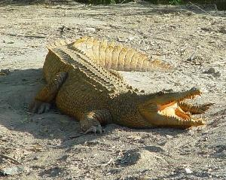
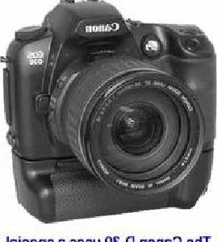
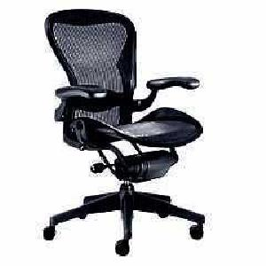
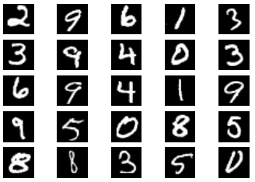
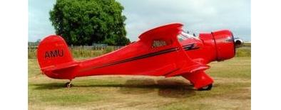
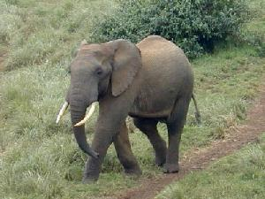
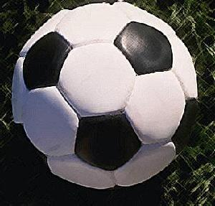

Image classification
$K$ classes
Task: assign correct class label to the whole image
Digit classification (MNIST)
Object recognition (Caltech-101)

Slide 4
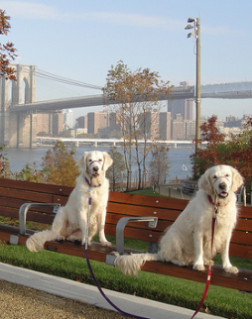
Classification vs. Detection
Dog
Dog
Dog

Slide 5
Problem formulation
{ airplane, bird, motorbike, person, sofa }
person
motorbike
Input
Desired output

Slide 6
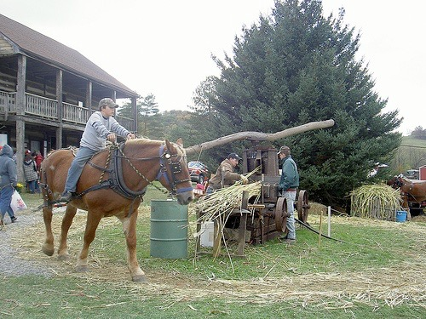
Evaluating a detector
Test image (previously unseen)

Slide 7
First detection ...
0.9
‘person’ detector predictions

Slide 8
Second detection ...
0.9
0.6
‘person’ detector predictions

Slide 9
Third detection ...
0.2
0.9
0.6
‘person’ detector predictions

Slide 10
Compare to ground truth
0.2
0.9
0.6
‘person’ detector predictions
ground truth ‘person’ boxes

Slide 11
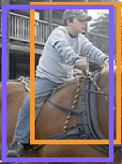


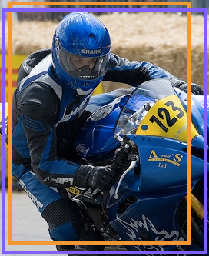


Sort by confidence
0.9
0.8
0.6
0.5
0.2
0.1
...
...
...
...
...
✓
X
✓
✓
X
X
true
positive
(high overlap)
false
positive
(no overlap,
low overlap, or
duplicate)
Notes:
Let’s define the problem a bit more so we’re all on the same page.

Slide 12

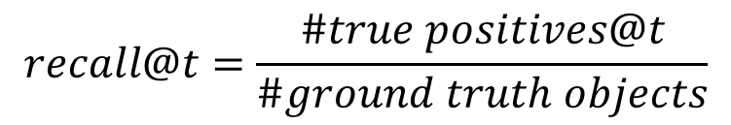
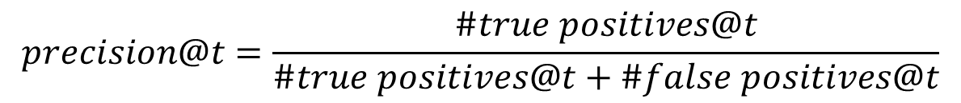
Evaluation metric
0.9
0.8
0.6
0.5
0.2
0.1
...
...
...
...
...
✓
X
✓
✓
X
X
$$t$$
$$precision@t=\frac{\#true positives@t}{\#true positives@t+\#false positives@t}$$
✓
✓ +
X
$$recall@t=\frac{\#true positives@t}{\#ground truth objects}$$
Notes:
Let’s define the problem a bit more so we’re all on the same page.

Slide 13
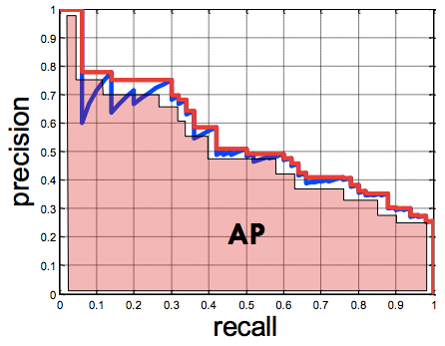
Evaluation metric
0.9
0.8
0.6
0.5
0.2
0.1
...
...
...
...
...
✓
X
✓
✓
X
X
Average Precision (AP)
0% is worst
100% is best
mean AP over classes
(mAP)
Notes:
Let’s define the problem a bit more so we’re all on the same page.

Slide 14
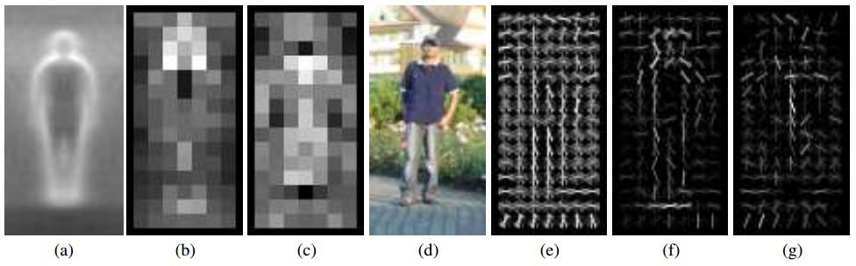
Pedestrians
Histograms of Oriented Gradients for Human Detection, Dalal and Triggs, CVPR 2005
AP ~77%
More sophisticated methods: AP ~90%
(a) average gradient image over training examples
(b) each “pixel” shows max positive SVM weight in the block centered on that pixel
(c) same as (b) for negative SVM weights
(d) test image
(e) its R-HOG descriptor
(f) R-HOG descriptor weighted by positive SVM weights
(g) R-HOG descriptor weighted by negative SVM weights

Slide 15
Overview of HOG Method
1. Compute gradients in the region to be described
2. Put them in bins according to orientation
3. Group the cells into large blocks
4. Normalize each block
5. Train classifiers to decide if these are parts of a human

Slide 16

Details
Gradients
[-1 0 1] and [-1 0 1]^{T} were good enough filters.
Cell Histograms
Each pixel within the cell casts a weighted vote for an
orientation-based histogram channel based on the values
found in the gradient computation. (9 channels worked)
Blocks
Group the cells together into larger blocks, either R-HOG
blocks (rectangular) or C-HOG blocks (circular).

Slide 17
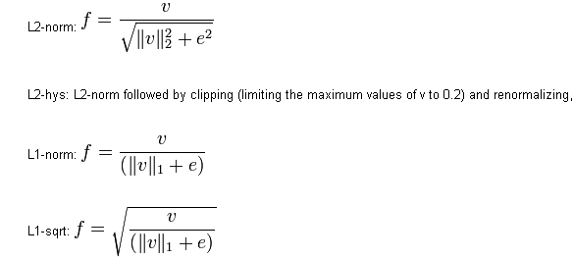
More Details
Block Normalization
They tried 4 different kinds of normalization.
Let υ be the block to be normalized and e be a small constant.

Slide 18
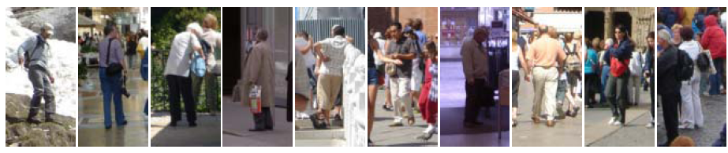
Example: Dalal-Triggs pedestrian detector
Extract fixed-sized (64x128 pixel) window at each position and scale
Compute HOG (histogram of gradient) features within each window
Score the window with a linear SVM classifier
Perform non-maxima suppression to remove overlapping detections with lower scores
Navneet Dalal and Bill Triggs, Histograms of Oriented Gradients for Human Detection, CVPR05

Slide 19
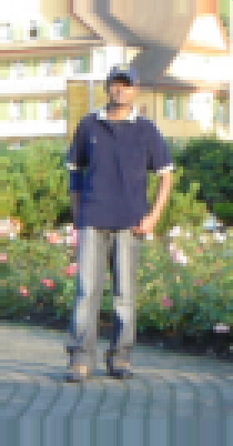
Slides by Pete Barnum
Navneet Dalal and Bill Triggs, Histograms of Oriented Gradients for Human Detection, CVPR05

Slide 20
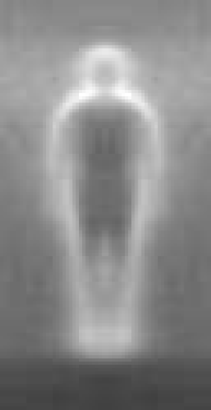

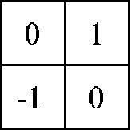

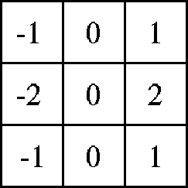

Outperforms
centered
diagonal
uncentered
cubic-corrected
Sobel
Slides by Pete Barnum
Navneet Dalal and Bill Triggs, Histograms of Oriented Gradients for Human Detection, CVPR05

Slide 21
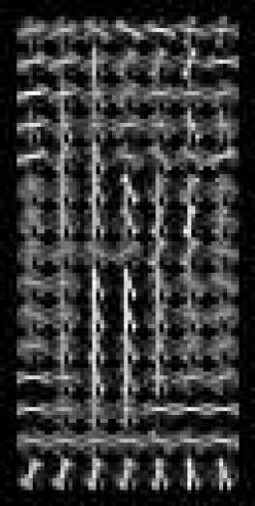
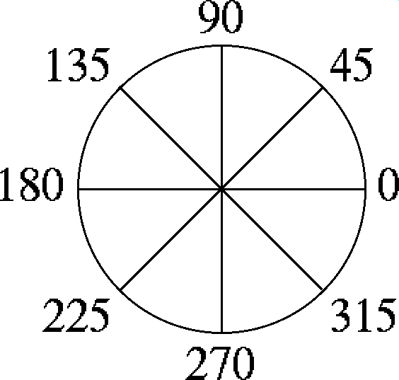
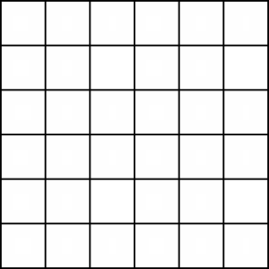

Histogram of gradient orientations
  Votes weighted by magnitude
  Bilinear interpolation between cells
Orientation: 9 bins (for unsigned angles)
Histograms in 8x8 pixel cells
Slides by Pete Barnum
Navneet Dalal and Bill Triggs, Histograms of Oriented Gradients for Human Detection, CVPR05

Slide 22
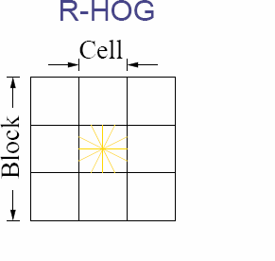
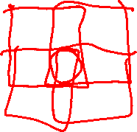
Normalize with respect to surrounding cells
Slides by Pete Barnum
Navneet Dalal and Bill Triggs, Histograms of Oriented Gradients for Human Detection, CVPR05

Slide 23
# orientations
# features = 15 x 7 x 9 x 4 = 3780
X=
# cells
# normalizations by neighboring cells
Slides by Pete Barnum
Navneet Dalal and Bill Triggs, Histograms of Oriented Gradients for Human Detection, CVPR05

Slide 24
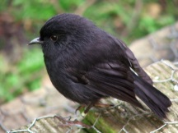
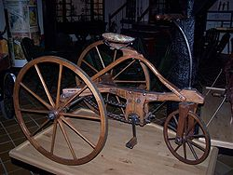
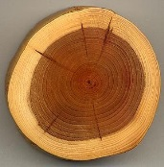
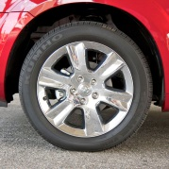
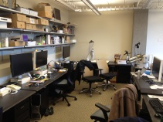
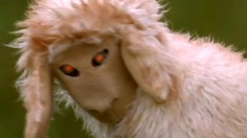
Training set

Slide 25
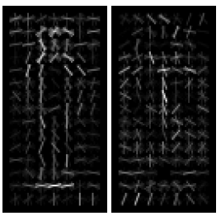
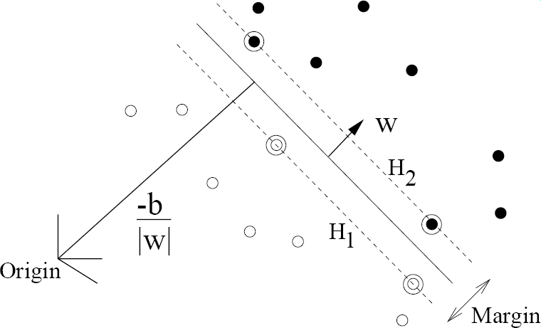
pos w
neg w
Slides by Pete Barnum
Navneet Dalal and Bill Triggs, Histograms of Oriented Gradients for Human Detection, CVPR05

Slide 26
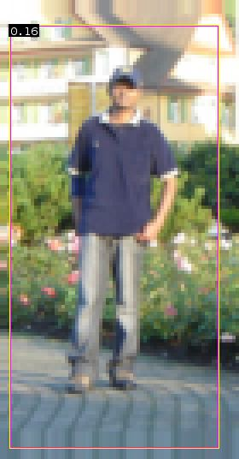



pedestrian
Slides by Pete Barnum
Navneet Dalal and Bill Triggs, Histograms of Oriented Gradients for Human Detection, CVPR05

Slide 27
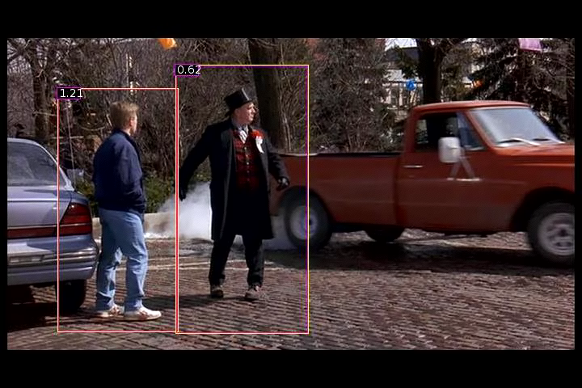
Detection examples

Slide 28
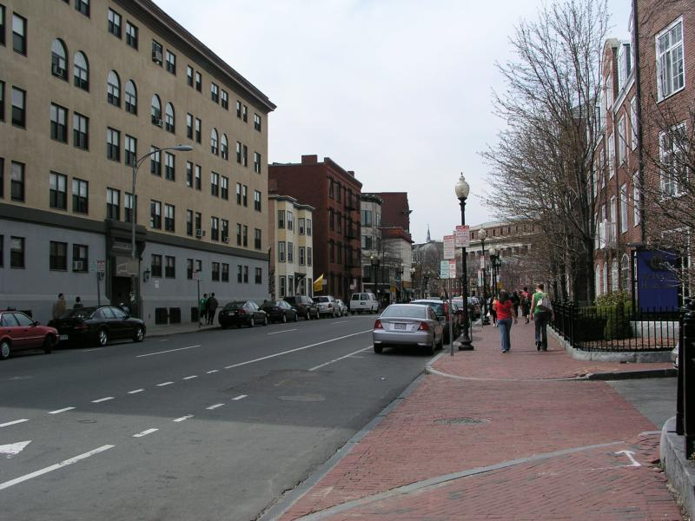

Slide 29
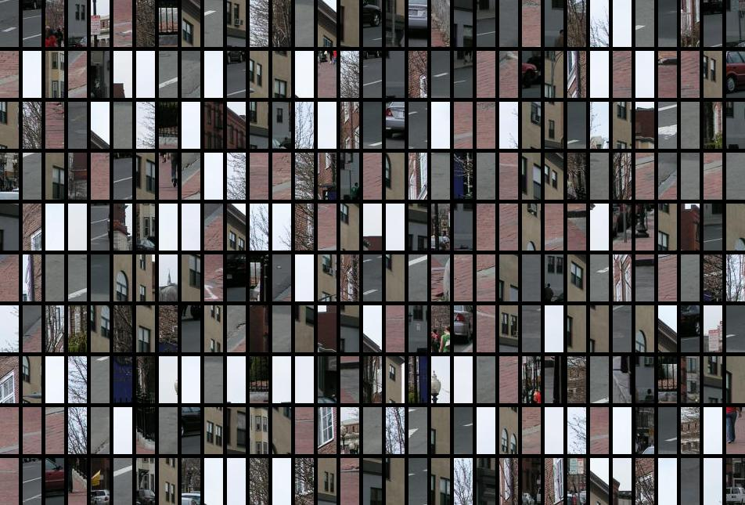
Each window is separately classified

Slide 31
Deformable Parts Model
Takes the idea a little further
Instead of one rigid HOG model, we have multiple HOG models in a spatial arrangement
One root part to find first and multiple other parts in a tree structure.

Slide 32
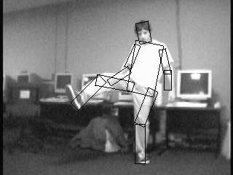
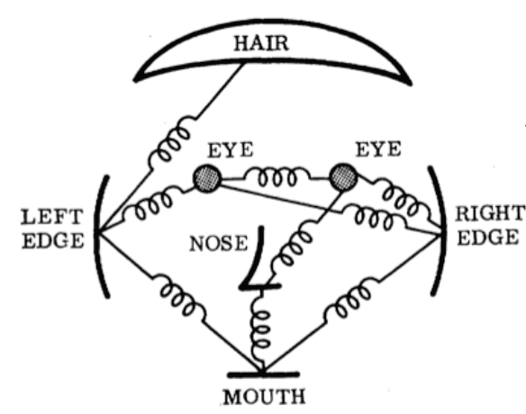
The Idea
Articulated parts model
  Object is configuration of parts
  Each part is detectable
Images from Felzenszwalb

Slide 33
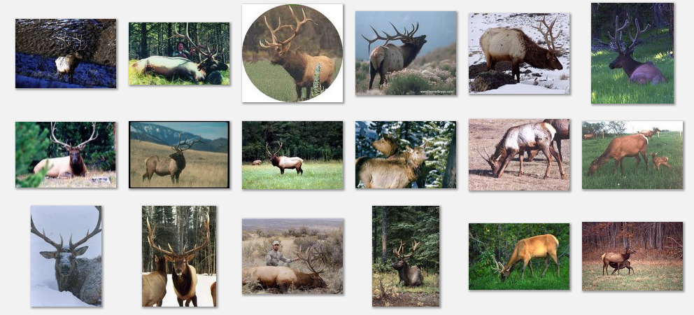
Deformable objects
Images from Caltech-256
Slide Credit: Duan Tran

Slide 34
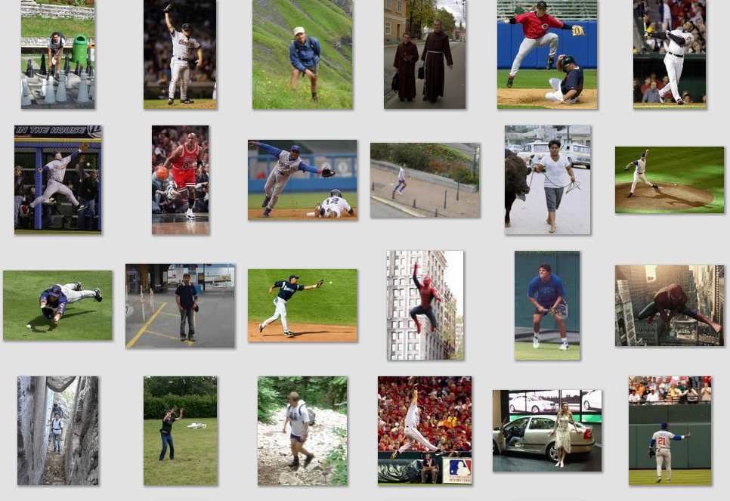
Deformable objects
Images from D. Ramanan’s dataset
Slide Credit: Duan Tran

Slide 35
How to model spatial relations?
Tree-shaped model

Slide 36
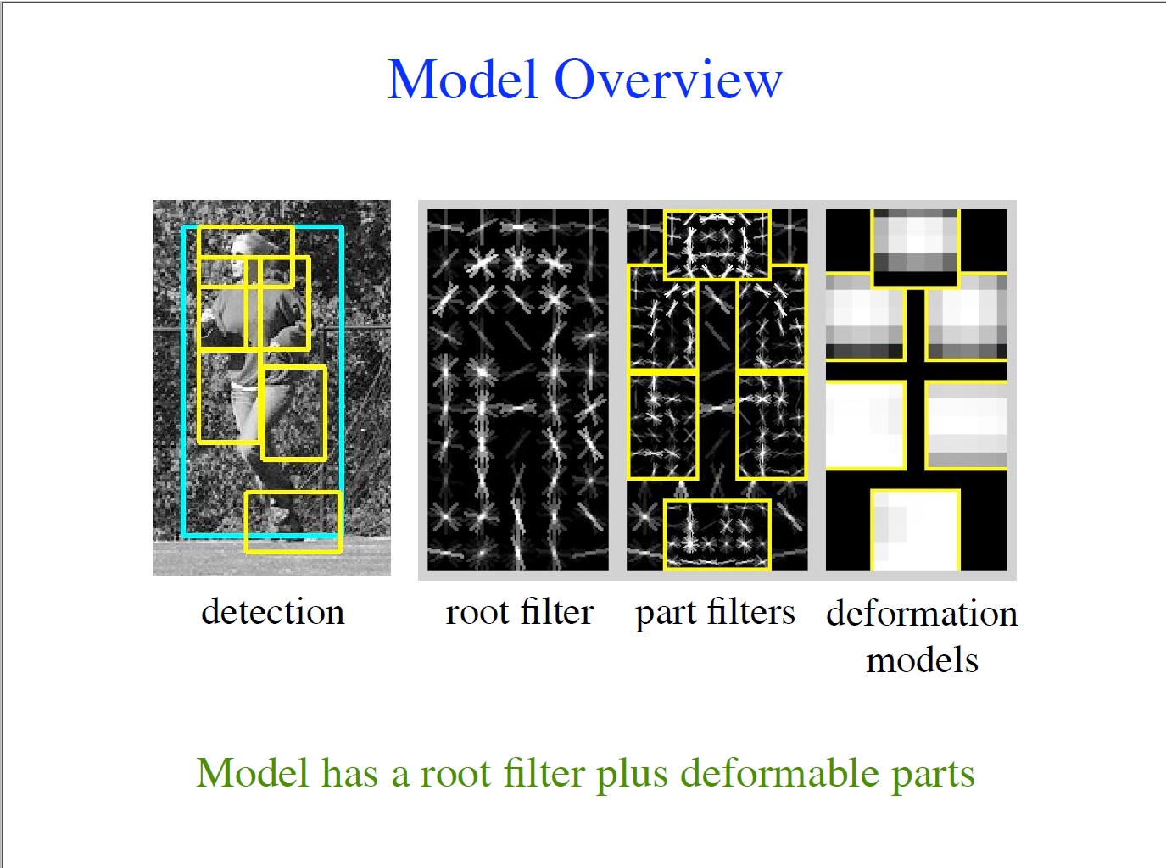

Slide 37
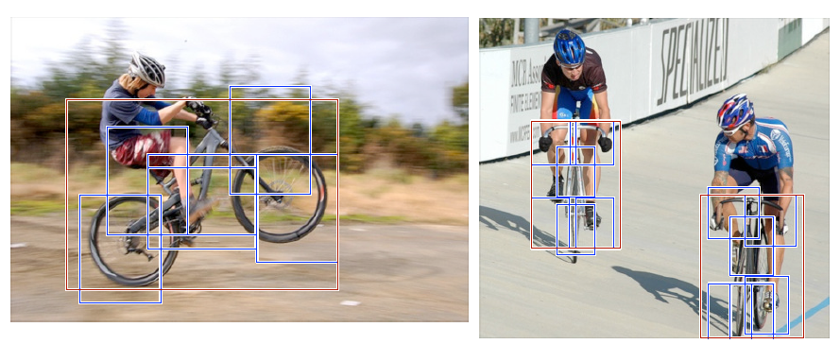
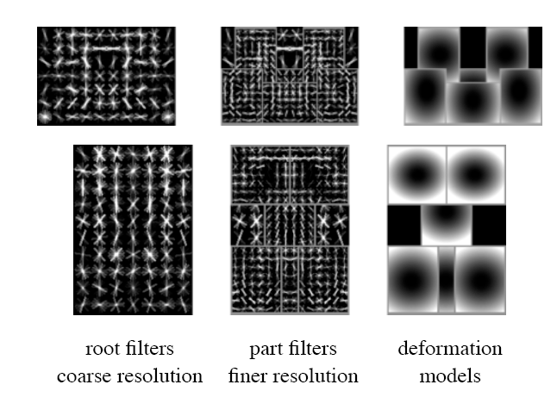
Hybrid template/parts model
Detections
Template Visualization
Felzenszwalb et al. 2008

Slide 38
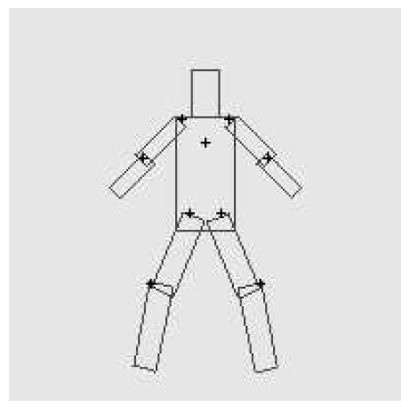
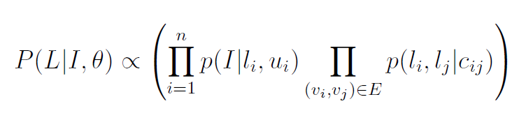
Pictorial Structures Model
Appearance likelihood
Geometry likelihood

Slide 39
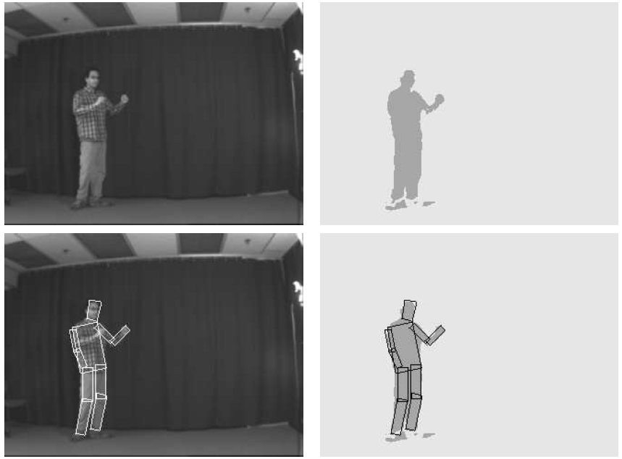
Results for person matching

Slide 40
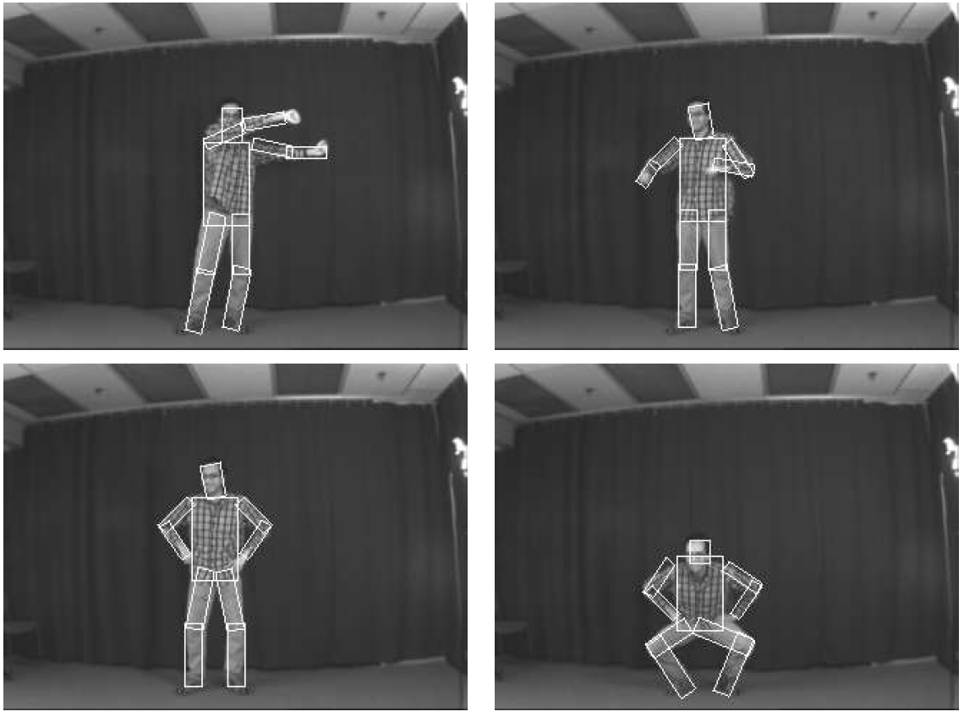
Results for person matching

Slide 41

BMVC 2009

Slide 42



2012 State-of-the-art Detector:
Deformable Parts Model (DPM)
Lifetime
Achievement
Strong low-level features based on HOG
Efficient matching algorithms for deformable part-based models (pictorial structures)
Discriminative learning with latent variables (latent SVM)
Felzenszwalb et al., 2008, 2010, 2011, 2012
Notes:
For the local window detector implementation, we used the publicly available implementation of the DPM detector. This is the best performing sliding window implementation and has consistently performed well in the VOC challenge receiving the lifetime achievement award.

Slide 43

Why did gradient-based models work?
Average gradient image

Slide 44








Generic categories
Can we detect people, chairs, horses, cars, dogs, buses, bottles, sheep …?
PASCAL Visual Object Categories (VOC) dataset

Slide 45
Generic categories
Why doesn’t this work (as well)?
Can we detect people, chairs, horses, cars, dogs, buses, bottles, sheep …?
PASCAL Visual Object Categories (VOC) dataset

Slide 46
Quiz time
(Back to Girshick)

Slide 47

Warm up
This is an average image of which object class?

Slide 48
Warm up
pedestrian

Slide 49

A little harder
?

Slide 50
A little harder
?
Hint: airplane, bicycle, bus, car, cat, chair, cow, dog, dining table

Slide 51
A little harder
bicycle (PASCAL)

Slide 52

A little harder, yet
?

Slide 53
A little harder, yet
?
Hint: white blob on a green background

Slide 54
A little harder, yet
sheep (PASCAL)

Slide 55

Impossible?
?

Slide 56
Impossible?
dog (PASCAL)

Slide 57
Impossible?
dog (PASCAL)
Why does the mean look like this?
There’s no alignment between the examples!
How do we combat this?

Slide 58
PASCAL VOC detection history
41%
41%
37%
DPM++,
MKL,
Selective
Search
Selective
Search,
DPM++,
MKL
28%
DPM++
23%
DPM,
MKL
17%
DPM,
HOG+
BOW
DPM

Slide 59
Part-based models & multiple features (MKL)
41%
41%
37%
rapid performance improvements
DPM++,
MKL,
Selective
Search
Selective
Search,
DPM++,
MKL
28%
DPM++
23%
DPM,
MKL
17%
DPM,
HOG+
BOW
DPM

Slide 60
Kitchen-sink approaches
increasing complexity & plateau
41%
41%
37%
DPM++,
MKL,
Selective
Search
Selective
Search,
DPM++,
MKL
28%
DPM++
23%
DPM,
MKL
17%
DPM,
HOG+
BOW
DPM

Slide 61
Region-based Convolutional Networks (R-CNNs)
62%
53%
R-CNN v2
R-CNN v1
41%
41%
37%
DPM++,
MKL,
Selective
Search
Selective
Search,
DPM++,
MKL
28%
DPM++
23%
DPM,
MKL
17%
DPM,
HOG+
BOW
DPM
[R-CNN. Girshick et al. CVPR 2014]

Slide 62
Region-based Convolutional Networks (R-CNNs)
~1 year
~5 years
[R-CNN. Girshick et al. CVPR 2014]

Slide 63
Convolutional Neural Networks
Overview

Slide 64





Standard Neural Networks
“Fully connected”
$$x={\left(x_{1},…,x_{784}\right)}^{T}$$
$$z_{j}={g(w}_{j }^{T}x)$$
$$g\left(t\right)=\frac{1}{1+e^{−t}}$$

Slide 65
From NNs to Convolutional NNs
Local connectivity
Shared (“tied”) weights
Multiple feature maps
Pooling

Slide 66

Convolutional NNs
Local connectivity
compare
Each green unit is only connected to (3)
neighboring blue units

Slide 67







Convolutional NNs
Shared (“tied”) weights
$$w_{1}$$
$$w_{2}$$
$$w_{3}$$
All green units share the same parameters $w$
Each green unit computes the same function,
but with a different input window
$$w_{1}$$
$$w_{2}$$
$$w_{3}$$

Slide 68

Convolutional NNs
Convolution with 1-D filter: $[w_{3},w_{2},w_{1}]$
$$w_{1}$$
$$w_{2}$$
$$w_{3}$$
All green units share the same parameters $w$
Each green unit computes the same function,
but with a different input window

Slide 69



Convolutional NNs
Convolution with 1-D filter: $[w_{3},w_{2},w_{1}]$
$$w_{1}$$
$$w_{2}$$
All green units share the same parameters $w$
Each green unit computes the same function,
but with a different input window
$$w_{3}$$

Slide 70



Convolutional NNs
Convolution with 1-D filter: $[w_{3},w_{2},w_{1}]$
All green units share the same parameters $w$
Each green unit computes the same function,
but with a different input window
$$w_{1}$$
$$w_{2}$$
$$w_{3}$$

Slide 71



Convolutional NNs
Convolution with 1-D filter: $[w_{3},w_{2},w_{1}]$
All green units share the same parameters $w$
Each green unit computes the same function,
but with a different input window
$$w_{1}$$
$$w_{2}$$
$$w_{3}$$

Slide 72



Convolutional NNs
Convolution with 1-D filter: $[w_{3},w_{2},w_{1}]$
All green units share the same parameters $w$
Each green unit computes the same function,
but with a different input window
$$w_{1}$$
$$w_{2}$$
$$w_{3}$$

Slide 73



Convolutional NNs
Multiple feature maps
$${w′}_{1}$$
$${w′}_{2}$$
All orange units compute the same function
but with a different input windows
Orange and green units compute
different functions
$${w′}_{3}$$
$$w_{1}$$
Feature map 2
(array of orange
units)
$$w_{2}$$
$$w_{3}$$
Feature map 1
(array of green
units)

Slide 74

Convolutional NNs
Pooling (max, average)
1
4
Pooling area: 2 units
Pooling stride: 2 units
Subsamples feature maps
4
0
3
3

Slide 75



2D input
Pooling
Convolution
Image

Slide 76

1989
Backpropagation applied to handwritten zip code recognition, Lecun et al., 1989

Slide 77

Historical perspective – 1980

Slide 78

Historical perspective – 1980
Hubel and Wiesel
1962
Included basic ingredients of ConvNets, but no supervised learning algorithm

Slide 79

Supervised learning – 1986
Gradient descent training with error backpropagation
Early demonstration that error backpropagation can be used
for supervised training of neural nets (including ConvNets)

Slide 80


Supervised learning – 1986
“T” vs. “C” problem
Simple ConvNet

Slide 81

Practical ConvNets
Gradient-Based Learning Applied to Document Recognition,
Lecun et al., 1998

Slide 82
Demo
http://cs.stanford.edu/people/karpathy/convnetjs/demo/mnist.html
ConvNetJS by Andrej Karpathy (Ph.D. student at Stanford)
Software libraries
Caffe (C++, python, matlab)
Torch7 (C++, lua)
Theano (python)

Slide 83
The fall of ConvNets
The rise of Support Vector Machines (SVMs)
Mathematical advantages (theory, convex optimization)
Competitive performance on tasks such as digit classification
Neural nets became unpopular in the mid 1990s

Slide 84
The key to SVMs
It’s all about the features
HOG features
SVM weights
(+) (-)
Histograms of Oriented Gradients for Human Detection, Dalal and Triggs, CVPR 2005

Slide 85

Core idea of “deep learning”
Input: the “raw” signal (image, waveform, …)
Features: hierarchy of features is learned from the raw input

Slide 86
If SVMs killed neural nets, how did they come back (in computer vision)?

Slide 87




What’s new since the 1980s?
More layers
  LeNet-3 and LeNet-5 had 3 and 5 learnable layers
  Current models have 8 – 20+
“ReLU” non-linearities (Rectified Linear Unit)
  $g\left(x\right)=\max\left(0, x\right)$
  Gradient doesn’t vanish
“Dropout” regularization
Fast GPU implementations
More data
$$g(x)$$
$$x$$

Slide 88


What else? Object Proposals
Sliding window based object detection
Object proposals
  Fast execution
  High recall with low # of candidate boxes
Iterate over window size, aspect ratio, and location

Slide 89


The number of contours wholly enclosed by a bounding box is indicative of
the likelihood of the box containing an object.

Slide 90

Ross’s Own System: Region CNNs

Slide 91


Competitive Results

Slide 92

Top Regions for Six Object Classes

Slide 93

What did Girshick do next?
Fast RCNN trains the very deep VGG16 network 9x faster than R-CNN, is 213x faster at test-time, and achieves a higher mAP on PASCAL VOC 2012.
Mask RCNN extends Faster R-CNN by adding a branch for predicting an object mask in parallel with the existing branch for bounding box recognition.

Slide 94

What did we develop at UW?
YOLO (and variants): Joseph Redmon, UW CSE
(unified framework for real-time object recognition)
https://www.cv-foundation.org/openaccess/content_cvpr_2016/papers/Redmon_You_Only_Look_CVPR_2016_paper.pdf
HATNeT: Sachin Mehta, UW ECE
(transformer-based object recognition, originally for
breast biopsies) https://homes.cs.washington.edu/~shapiro/hatnetfin.pdf

