Slide 1



Analysis of Whole Slide Images of Skin and Breast Biopsies
Linda G. Shapiro
Paul G. Allen School of Computer Science & Engineering
Department of Electrical & Computer Engineering
University of Washington
This work was sponsored by the National Cancer Institute under grants R01CA200690 andU01CA231782,
by the Melanoma Research Alliance under grant 622600, and by the Department of Defense under grant
W81XWH-20-1-0798.

Slide 2
Computer-Aided Melanoma Diagnosis
Diagnoses:
Mild Dysplastic
Moderate Dysplastic
Melanoma in situ
Invasive T1a
Invasive T1b
Cellular entities:
- Nuclei
- Melanocyte
- Mitosis
Structural entities:
- Dermis
- Epidermis
- Nests
Raw WSI
Diagnosis model

Slide 3
Our Work
Cellular Level
  Finding Mitotic Figures
  Finding Melanocytes
Structural Level
  Segmenting into Epidermis/Dermis and Various Nest Structures
Understanding the diagnosis process
Diagnosis Level
  Diagnosing with a Single-Resolution Transformer on Raw H&E images (designed for breast images)
  Diagnosing with a Multi-Resolution Transformer on Raw H&E images
An example of an Invasive Melanoma T1b in M-Path dataset.

Slide 4
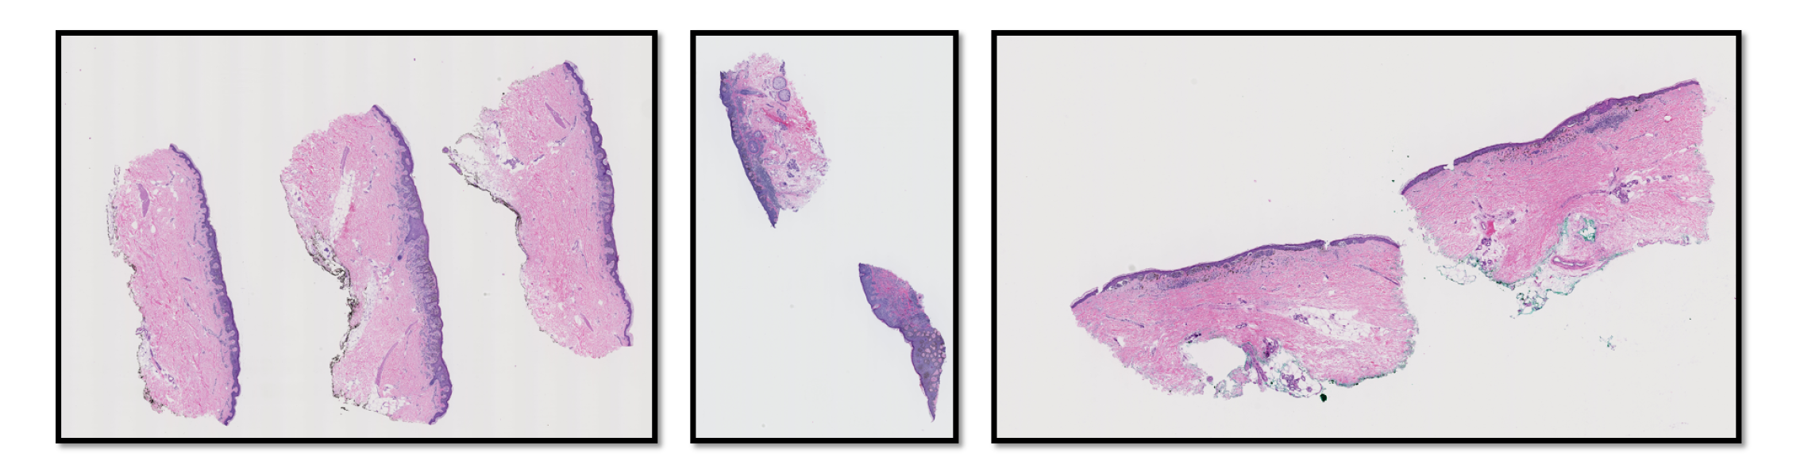
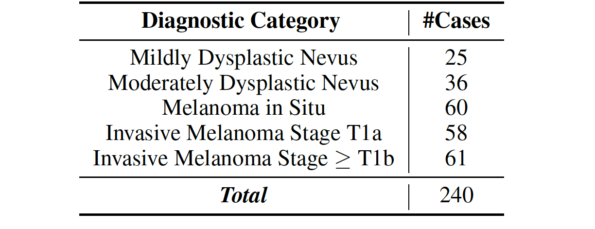
Dataset
Our dataset comes from 240 H&E stained slides of skin biopsy images, acquired by the University of Washington School of Medicine in the MPATH study (R01 CA151306, PI Dr. Joann Elmore, now at UCLA).

Slide 5
Machine learning techniques for mitoses classification
Shima Nofallah et al
Computerized Medical Imaging and Graphics
2021

Slide 6





Dataset for Mitosis Detection
Positive samples – class Mitosis
  About 600 mitoses marked by an expert pathologist (Dr. Stevan Knezevich).
  We cropped each mitosis in a 101*101 patch centered on the dot placing on the mitotic figure.
Example of expert pathologist markings of mitoses (Left) and sampled mitoses (Right)

Slide 7
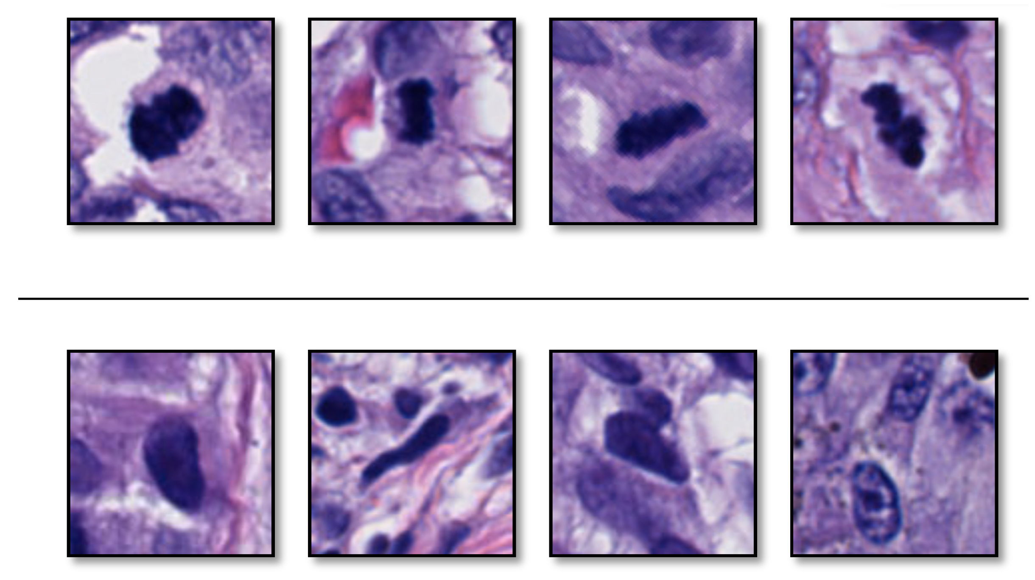
Dataset
Negative samples – class NonMitosis
Distinguishing mitoses from normal nuclei is a challenge.
Mitosis
Nuclei

Slide 8
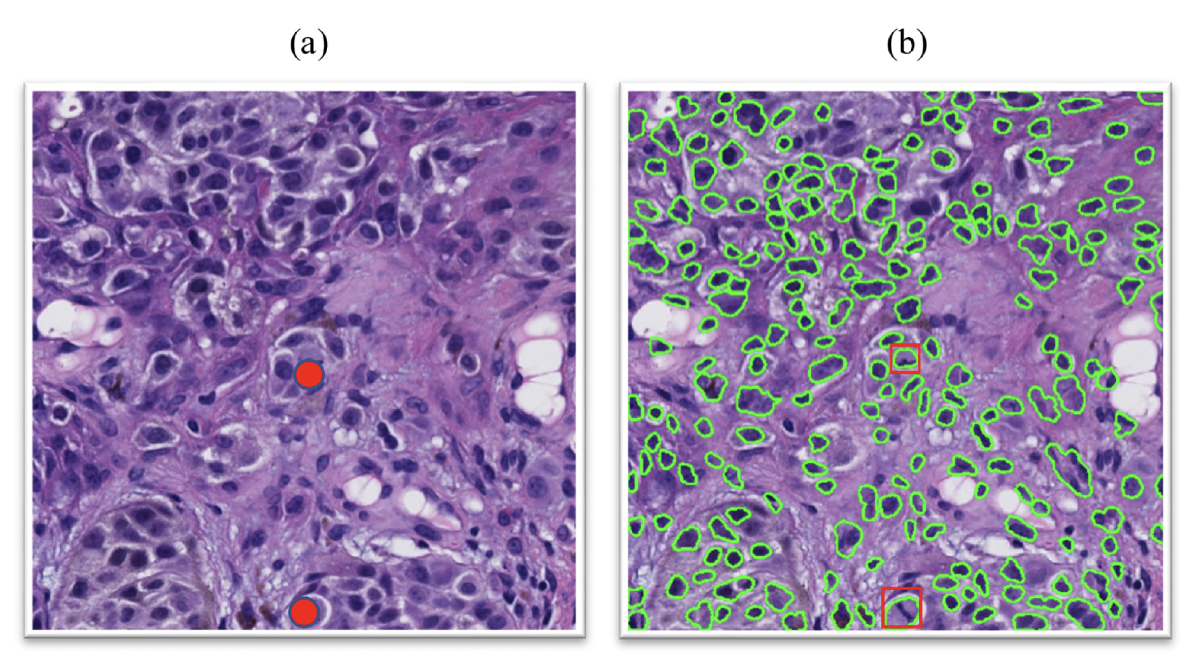
Dataset
Negative samples – class NonMitosis
  We used a feature-based nuclei detector to find nuclei.
  We sampled them as negative cases for our dataset.
Examples of applying the nuclei segmentation on a crop of skin biopsy image (a) original crop (b) nuclei segmentation result. Two mitoses that are present in the original crop are marked with red dots for Visualization.

Slide 9
Method and Model
We ran two separate experiments on two well-designed CNNs and compared their results:
  Efficient Spatial Pyramid of Dilated Convolutions (ESPNet) [13]
    A light model developed and published by a member of our group.
  Densely Connected Convolutional Networks (DenseNet161) [14]
    One of the well-known model in Deep Learning literature.

Slide 10
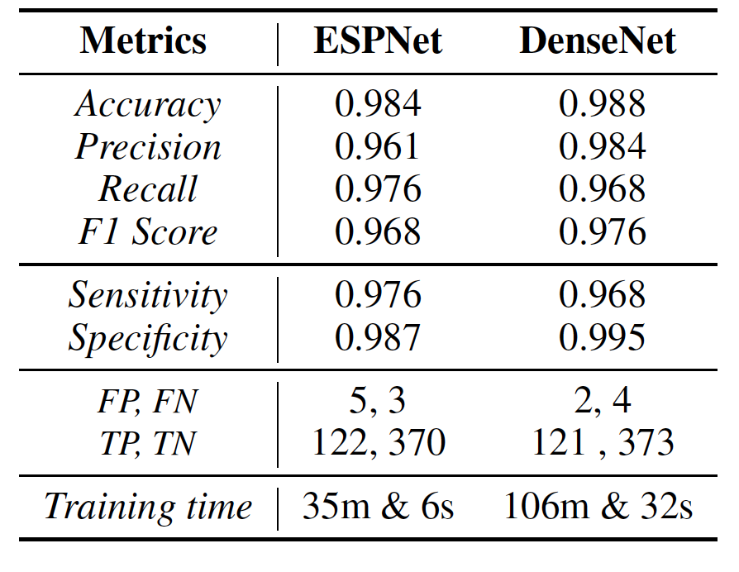
Results
Evaluation results of ESPNet and DenseNet161 on Melanoma

Slide 11
VSGD-Net: Virtual Staining Guided Melanocyte Detection on Histopathological Images
Kechun Liu et al
WACV 2023

Slide 12
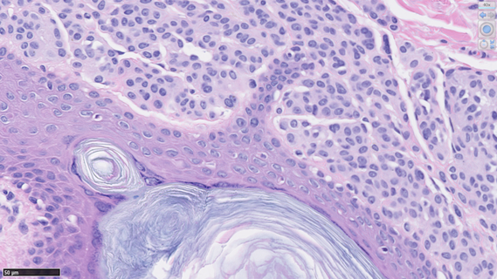
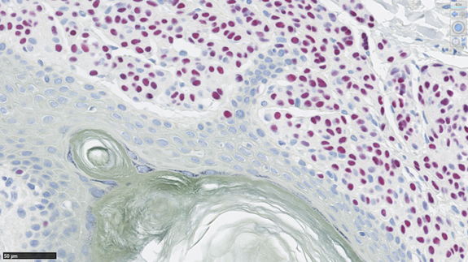
How to Detect Melanocytes
Sox10 staining can highlight melanocytes, but it’s not a routine procedure due to its high cost.
(a) H&E Staining
(b) Sox10 Staining – melanocytes are red
(c) Crop from Sox10
Notes:
Sox10 immunostaining

Slide 13

Goal
Can we automatically detect melanocytes on H&E images?
Address the limitations:
  -- Visual similarity of melanocytes to other cells in H&E images
  -- High cost of Sox10 staining
Reduce the burden on pathologists
Aid in melanoma diagnosis in the future

Slide 14
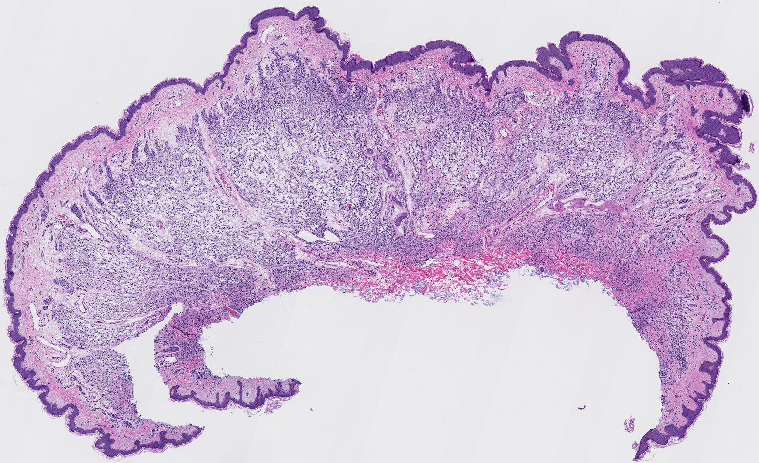
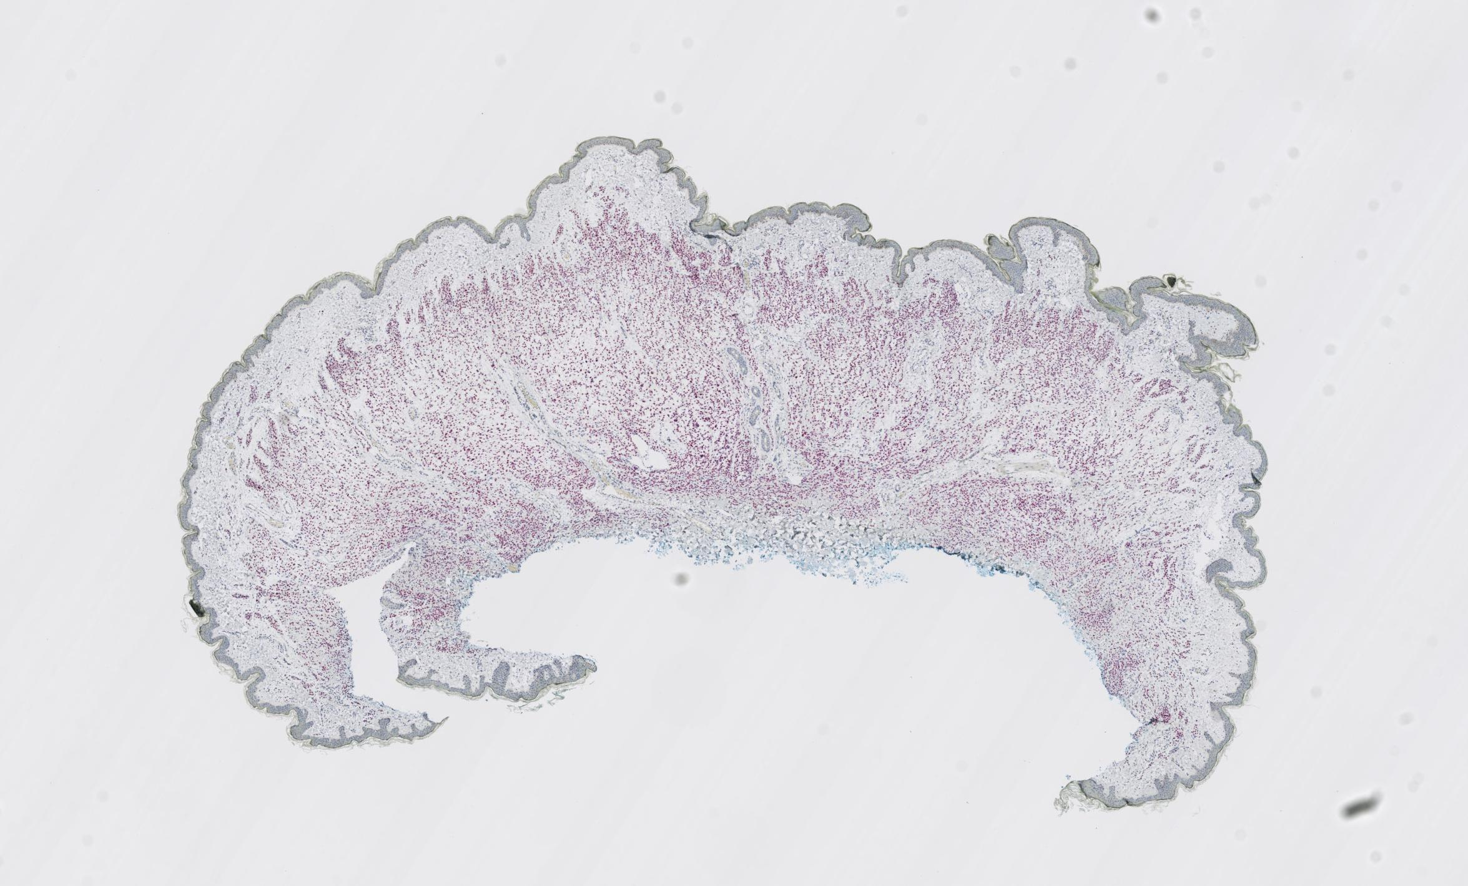
Dataset for Melanocyte Detection, including both H&E and Sox10 Staining
Our dataset consists of skin tissues of 15 cases from a private dermatopathology lab, including 3 cases for each MPATH diagnostic category¹ [8].
We stain each glass slide with H&E first, then de-stain and re-stain the same glass slide in Sox10.
Each skin tissue is cut into multiple (4-6) thin slices for microscopic examination, resulting in 75 slices at 20x magnification.
¹ Class 1-5: Benign mildly atypical nevi, Moderate dysplastic nevi, Melanoma in situ, Invasive melanoma T1a, and Invasive melanoma T1b.

Slide 15
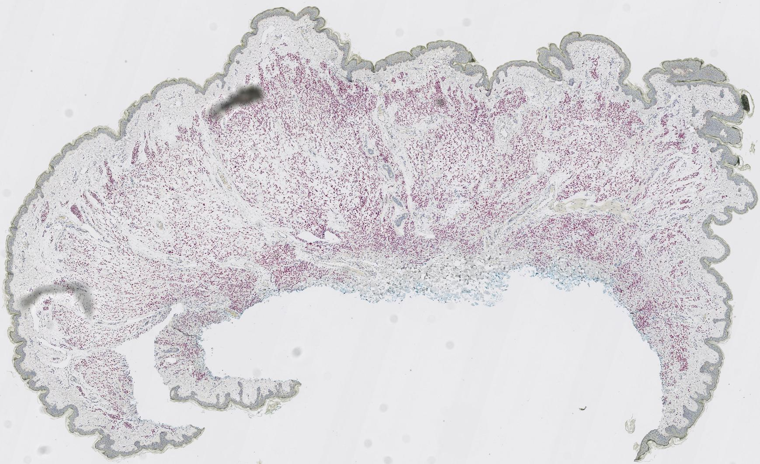
Dataset - Preprocessing
(a) Raw H&E stained image
(b) Raw Sox10 stained image
(c) Registered Sox10 stained image
First, we register raw Sox10 images (b) into aligned Sox10 images (c) using template
H&E images (a) with the Histokat software [1].
Then, we apply a Random Forest classifier to classify pixels into melanocyte or non-melanocyte.
At last, the pretrained NuSeT [2] separates touching nuclei and refine the masks.
Lotz, J., Weiss, N., van der Laak, J., StefanHeldmann: High-resolution Image Registration
of Consecutive and Re-stained Sections in Histopathology. arXiv:2106.13150 [cs, eess] (Jun 2021)
Yang, L., Ghosh, R.P., Franklin, J.M., Chen, S., You, C., Narayan, R.R., Melcher,
M.L., Liphardt, J.T.: NuSeT: A deep learning tool for reliably separating and
analyzing crowded cells. PLOS Computational Biology 16(9), e1008193 (Sep 2020), publisher: Public
Library of Science

Slide 16
Dataset
To fit images into memory as well as keep adequate information, we crop the registered paired images into 256x256 patches with 10x magnification and exclude the background patches, leaving 25,314 patches to use.
Sub-dataset | From ? cases | # Patches
Train | 10 cases | 14,630
Validation |  | 1,032
Test | 5 cases | 9,652

Slide 17
VSGD-Net
U-Net [2] with ResNet50
Inspired by Mask R-CNN [3]
Encoder Decoder
Multi-scale discriminator
Notes:
Model structure
Generator: Unet with ResNet50 as backbone
Discriminator: multi-scale
Detection: feature pyramid, region proposal network, downstream heads

Slide 18
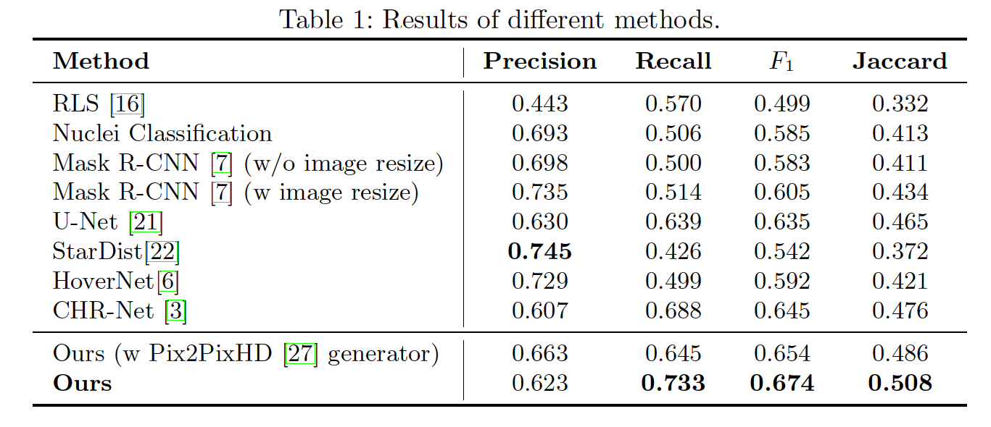
Main Results
Precision = TP / (TP + FP)
Recall = TP / (TP + FN)
F1 = 2 (Precision*Recall)/(Precision+Recall)
Jaccard(A,B) = (A∩B)/(A∪B)

Slide 19
Segmenting Skin Biopsy Images with Coarse and Sparse
Annotations using U-Net
Shima Nofallah et al.
Journal of Digital Imaging 2022

Slide 20
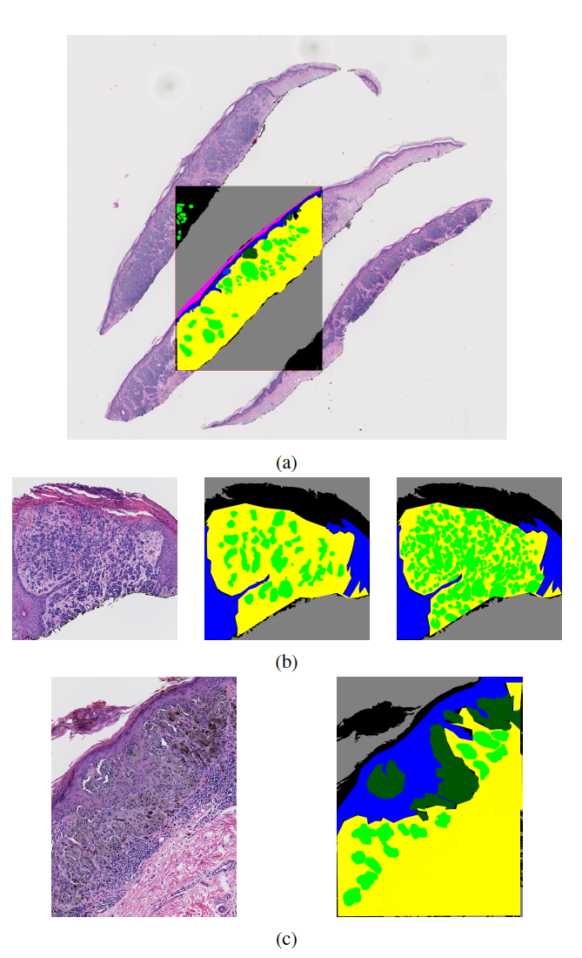
Dataset for Structure Detection
(Rough Semantic Segmentation)
We obtained coarse and sparse annotations only on the ROI (region of interest) images by an expert pathologist (Dr. Mojgan Mokhtari).
Not only are the annotations not on the full WSI, but they are also sparse within the annotated ROI.
Moreover, the annotations are coarse, i.e., they are not pixel-level accurate.

Slide 21
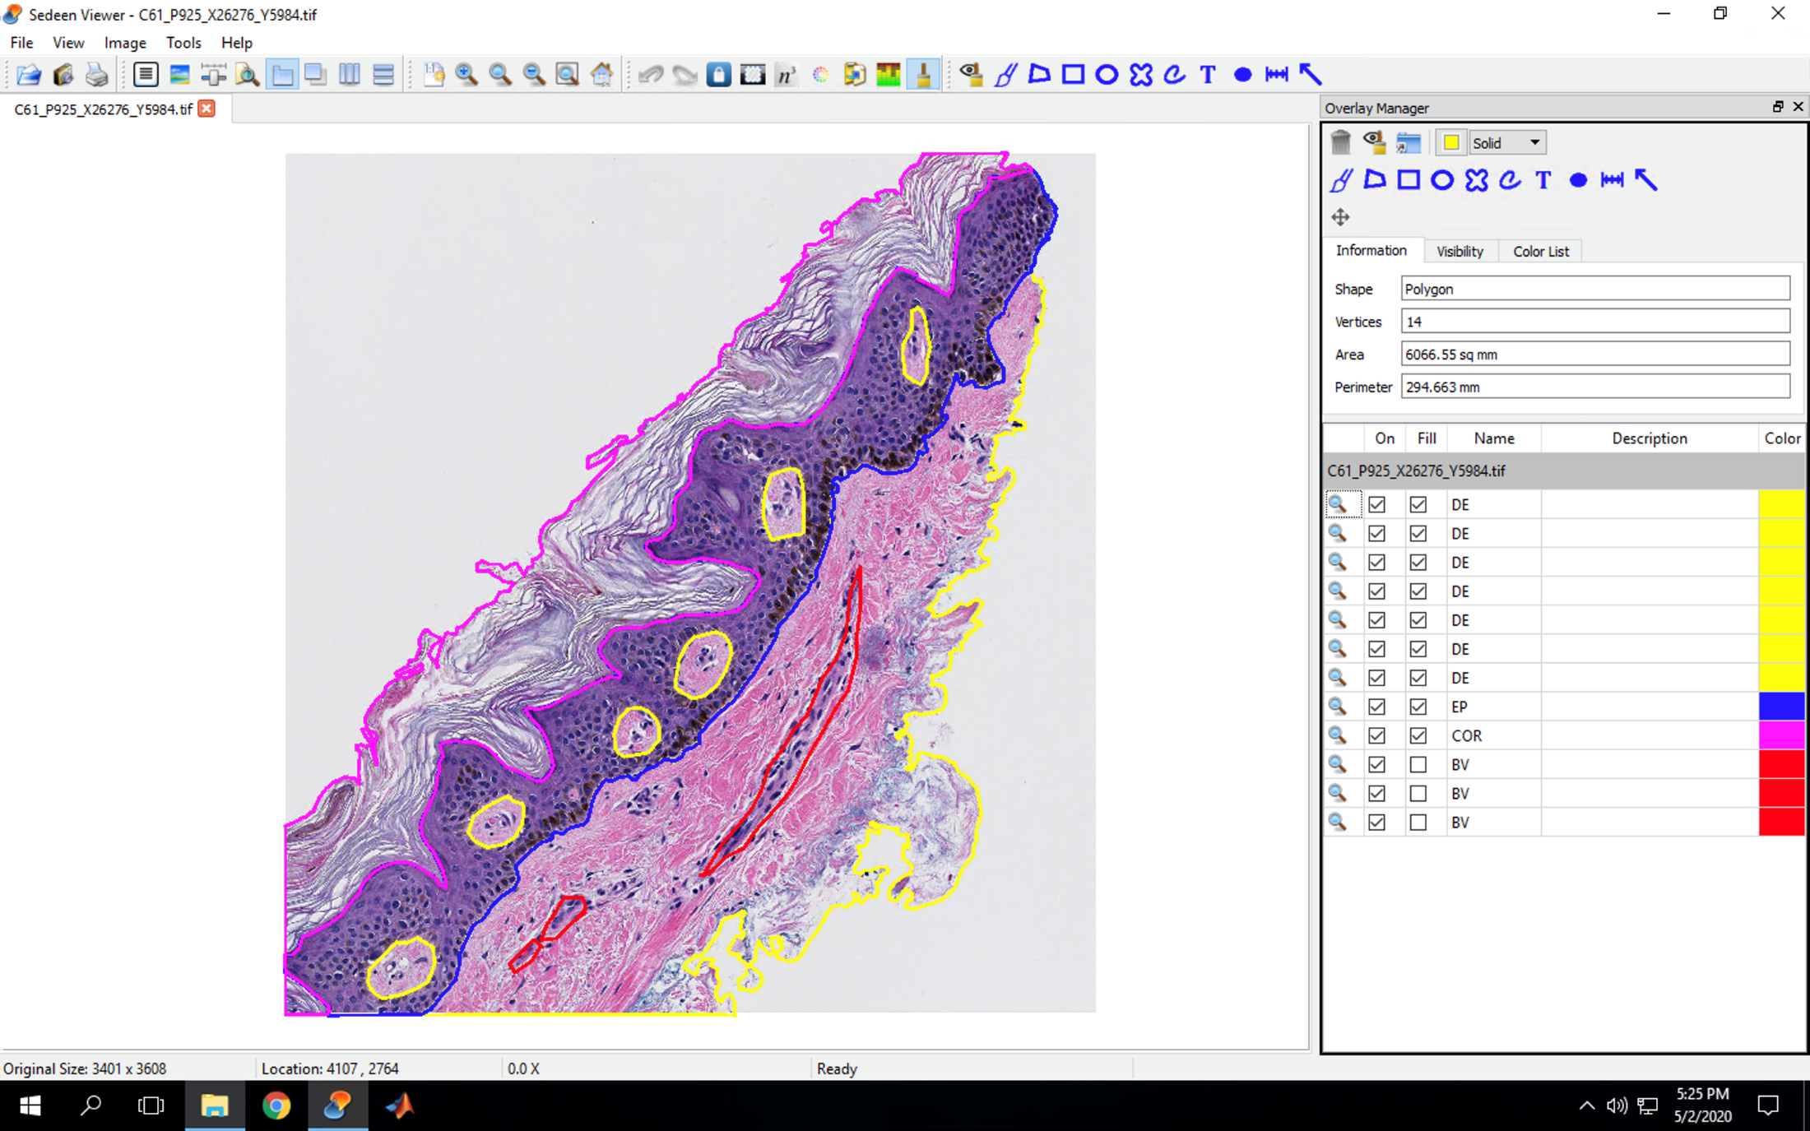
Benign

Slide 22
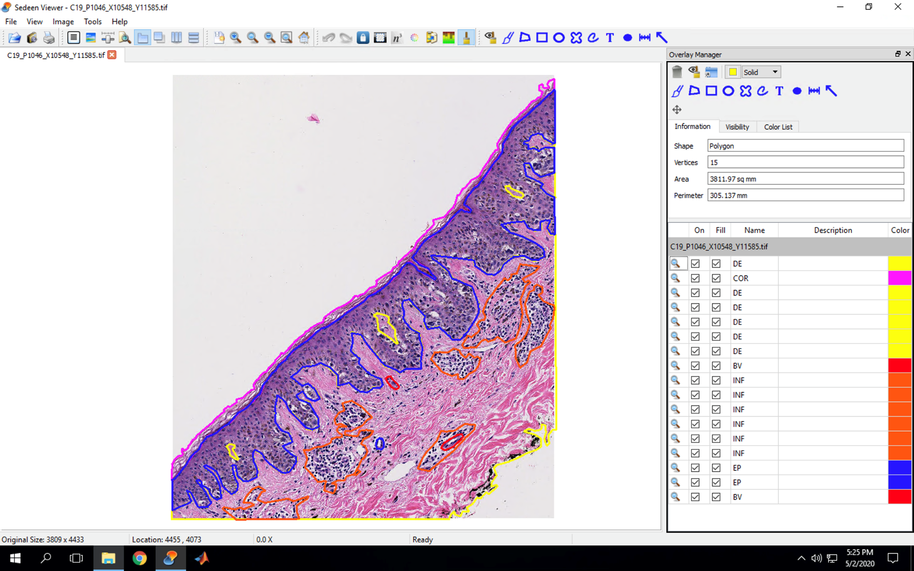
Atypia

Slide 23
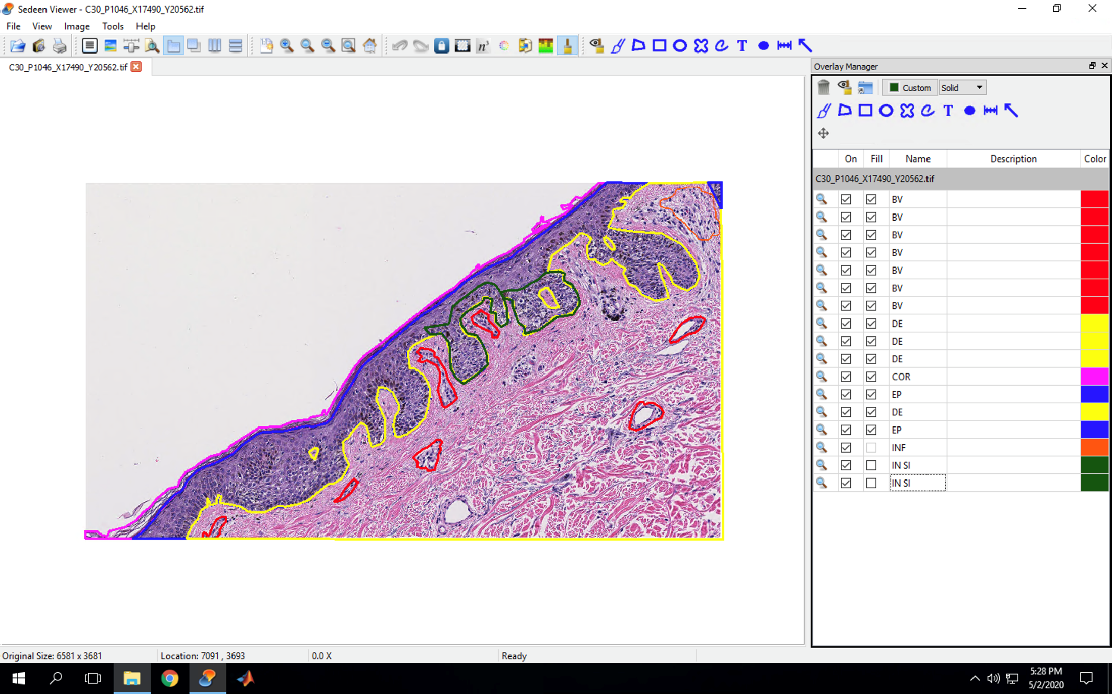
Melanoma In Situ

Slide 24
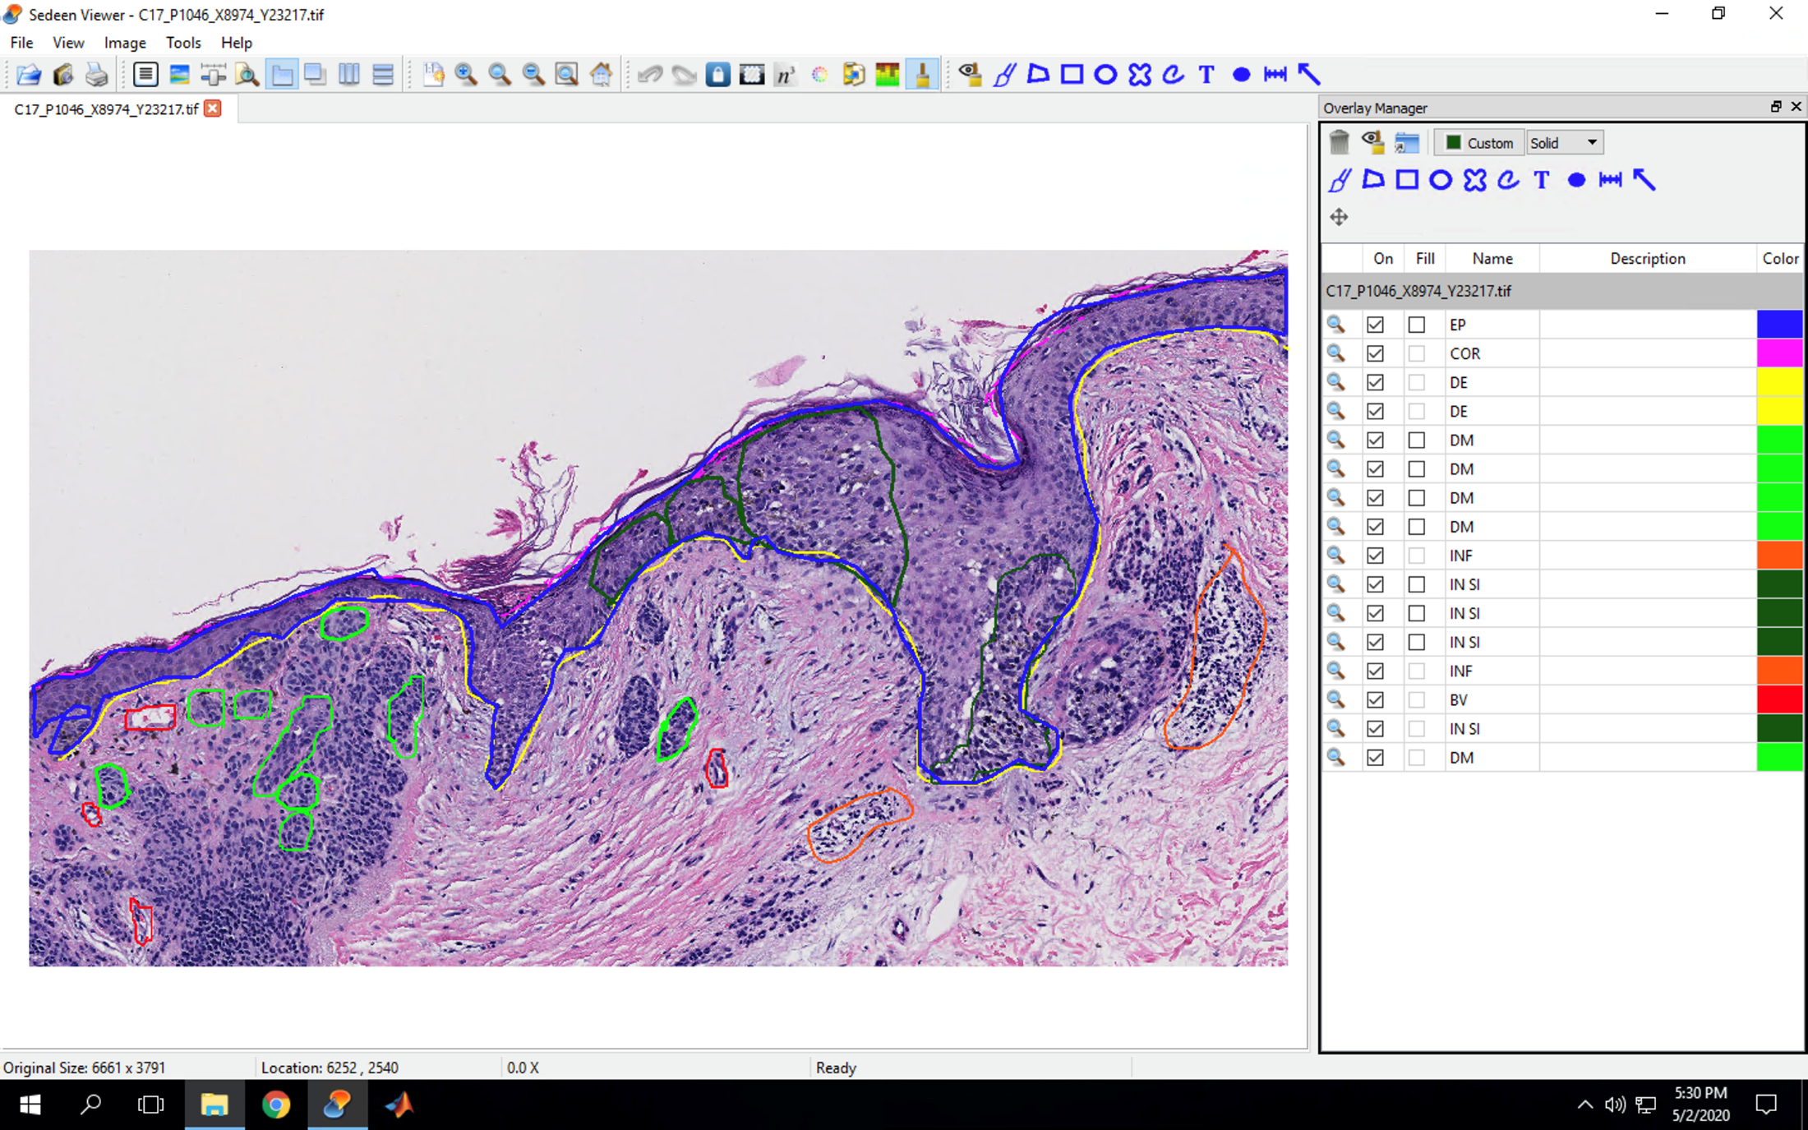
Invasive Cancer Class IA

Slide 25
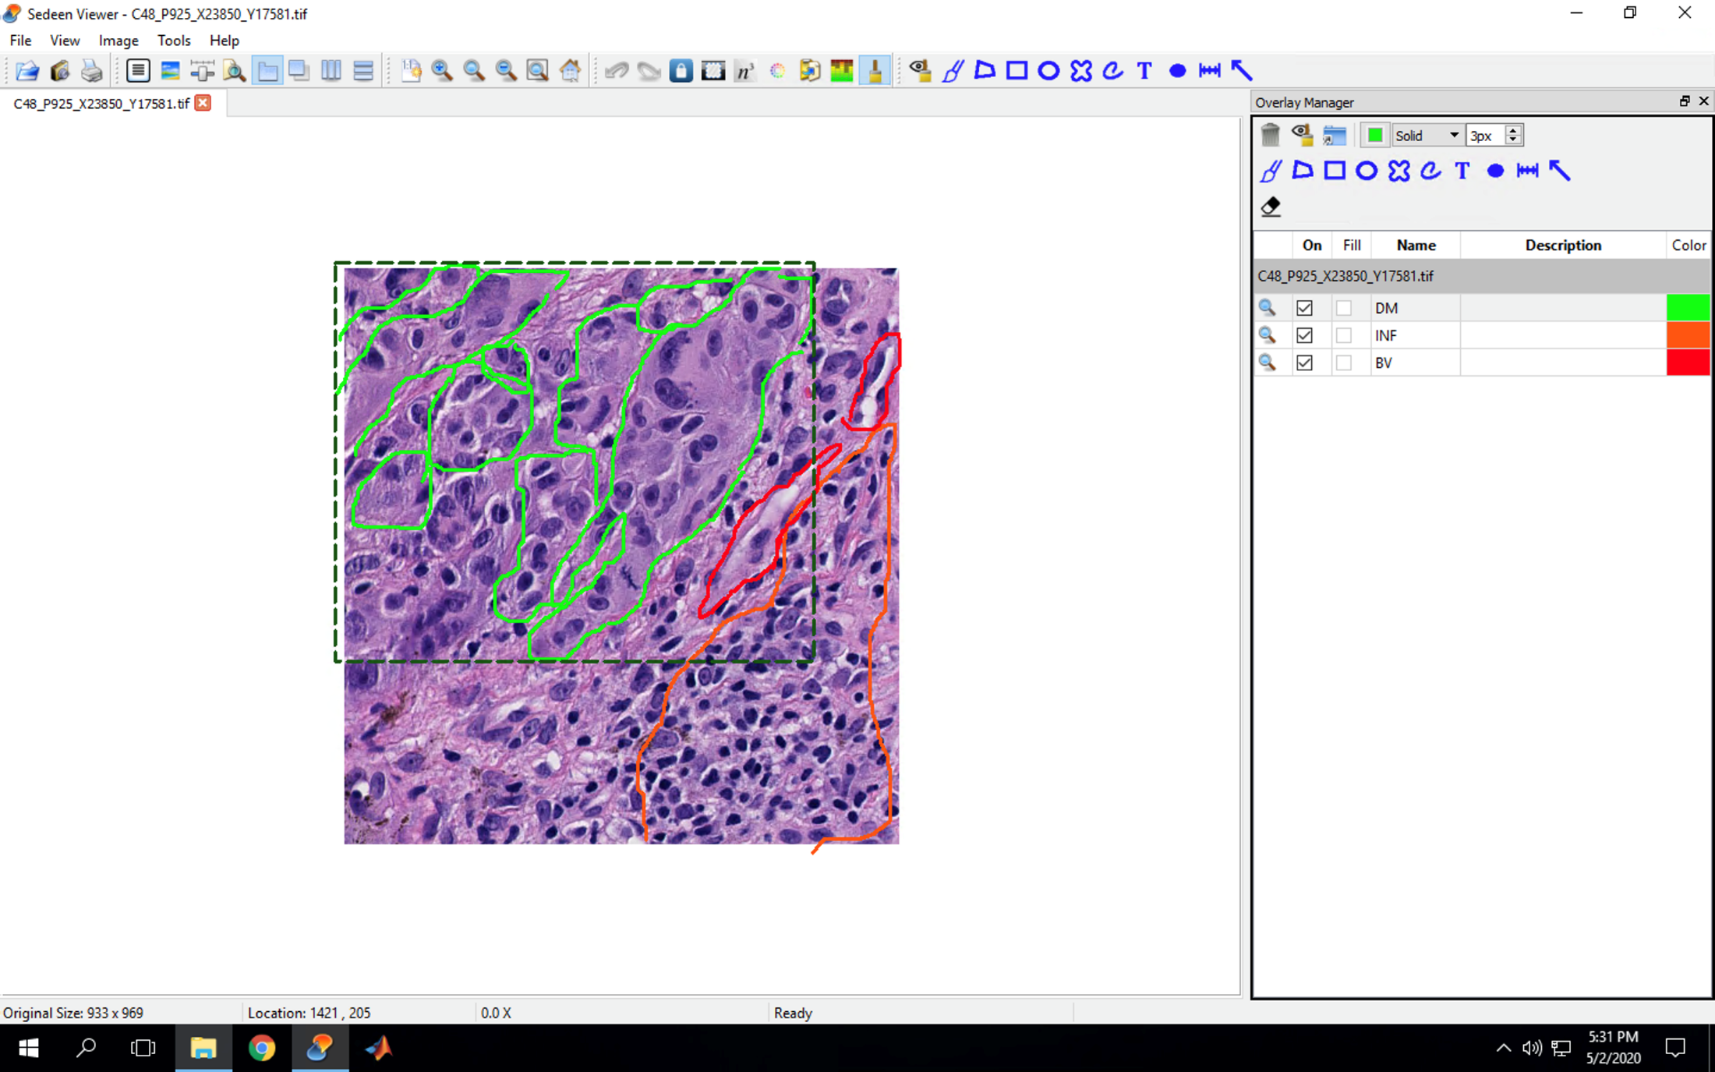
Invasive Cancer Class IB

Slide 26
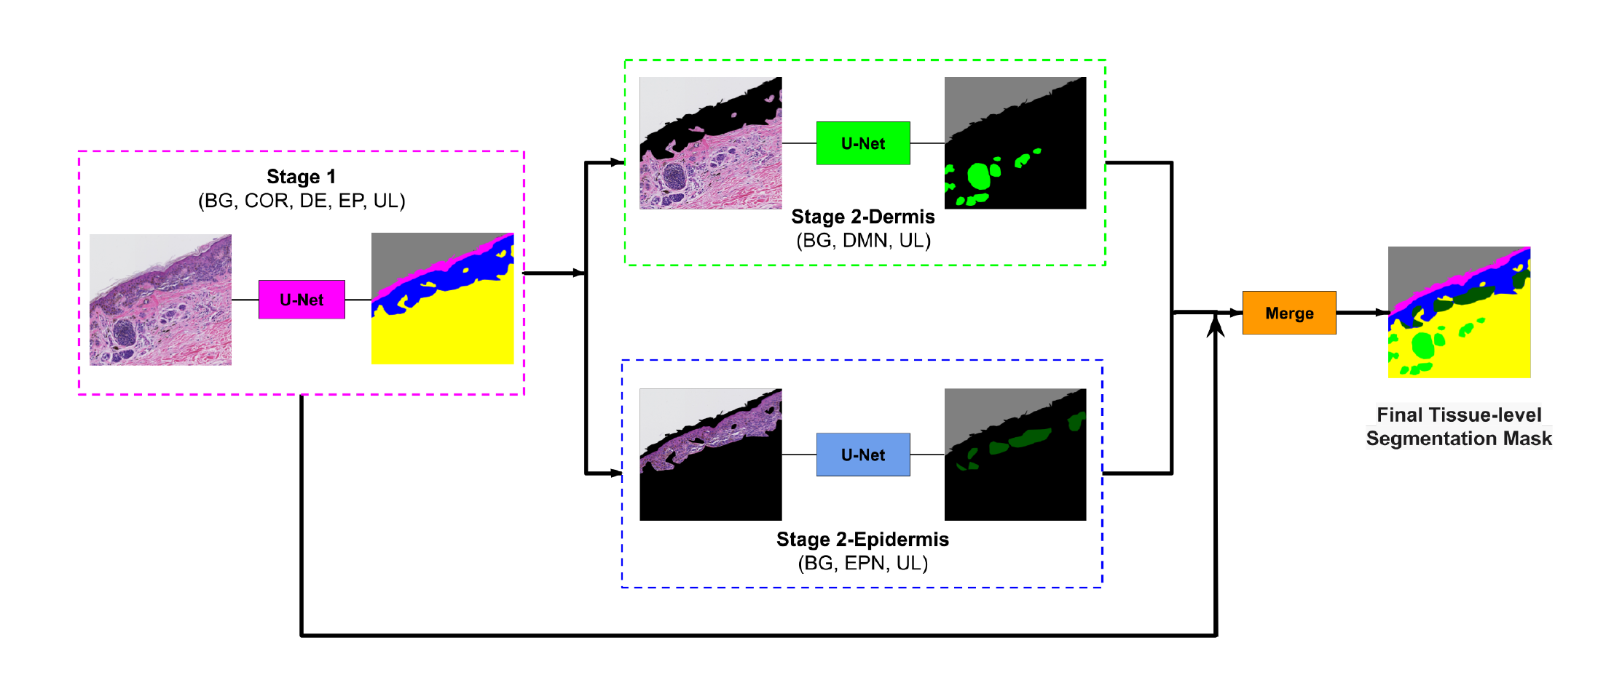
Method and Model
Two stage method: first big tissue structures, then smaller tissue structures.
BG=Background, COR=Stratum Corneum, DE=Dermis, EP=Epidermis, UL=Unlabeled, DMN=Dermal Nests, EPN= Epidermal Nests.

Slide 27
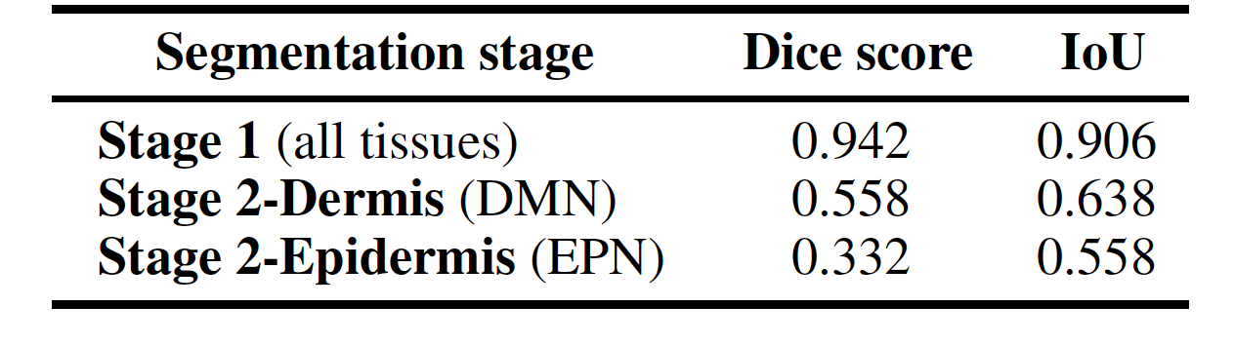


Results
Evaluation of the segmentation model on ROI testing set.

Slide 28
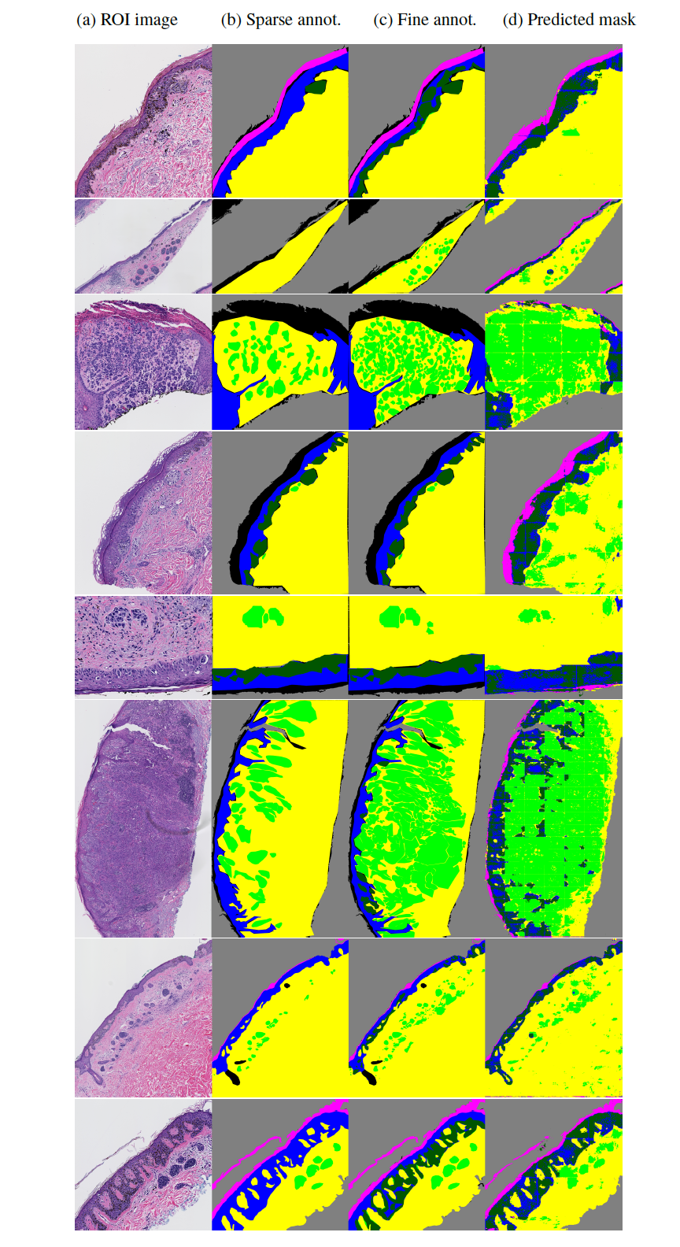
Some Results - ROI testing set

Slide 29
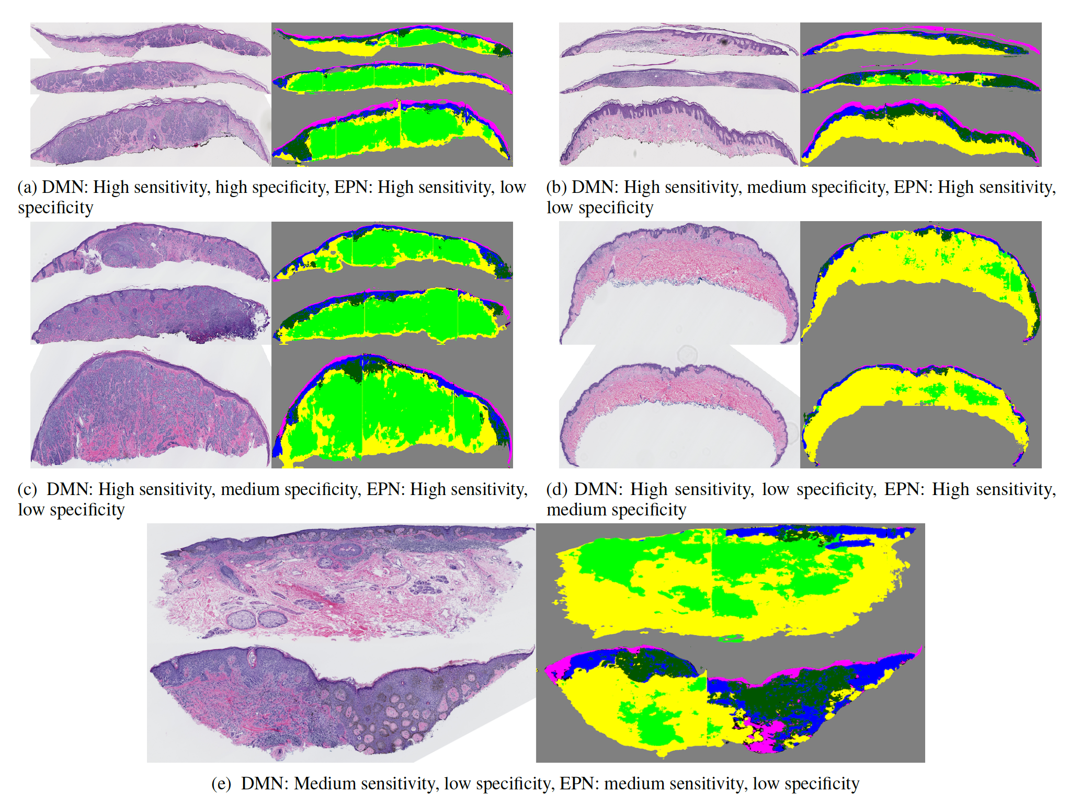



Results - Generating WSI Segmentation Masks

Slide 30
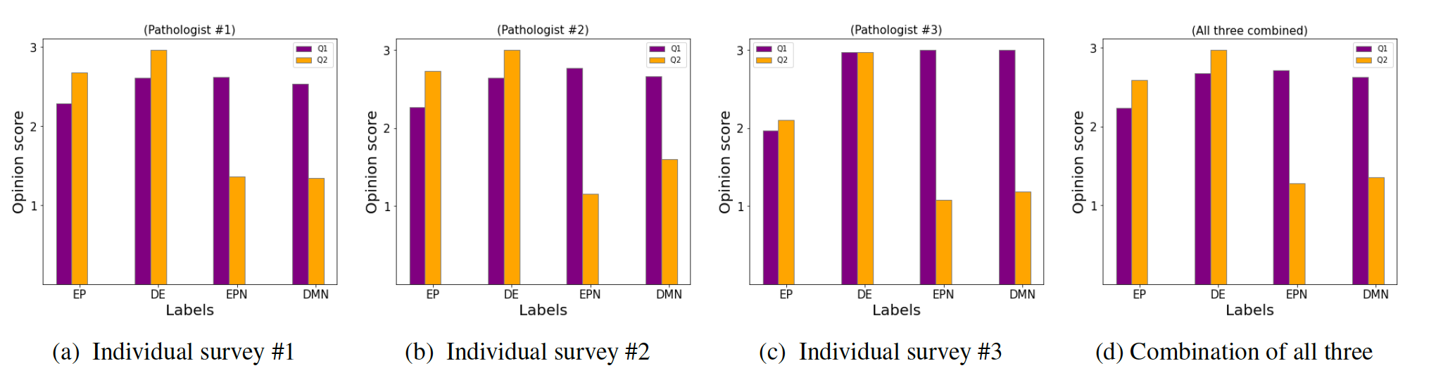
Subjective Assessment with Pathologists
Qualitatively evaluation the WSI segmentation, with these questions:
  Q1: How much of the tissue/area that is present in the corresponding WSI has been correctly identified by the model? Rate Low, Medium, or High.
  Q2: How much of the label identified by the model is the correct tissue/area? Rate Low, Medium, or High.

Slide 31

A Statistical data analysis of pathologists’ viewing behavior while diagnosing digital skin biopsy WSIs
Fatemeh Ghezloo

Slide 32


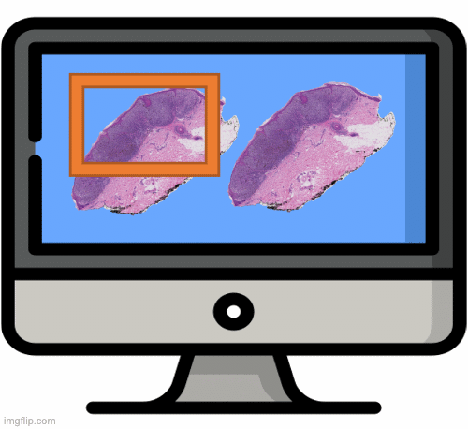




Pathologists’ Viewing behavior:
Why is it important?
With advances in digital pathology and Whole Slide Imaging:
More cases are being interpreted in digital format.
Computer-aided diagnosis models are being developed.
However:
Pathological examination remains the gold standard.
There is discordance among pathologists' diagnoses even when they observe similar features on a slide.
Diagnostic accuracy varies due to the interaction among:
Case characteristics
Pathologist characteristics
Visual search process¹
Brunyé, T.T., et al., Accuracy is in the eyes of the pathologist: the visual interpretive process and diagnostic accuracy
with digital whole slide images. Journal of biomedical informatics, 2017. 66: p. 171-179.

Slide 33




Study workflow
Collected Data:
Timestamp
Zoom level
Screen viewport
Tracking Devices
Interpretation session
Data Analysis

Slide 34




Data collection
Digital skin biopsy images
3 Experts in dermatopathology
Consensus ROI and diagnosis
Viewport log
32 Pathologists
180 Cases
Divided into 5 groups of 36
Interpretation
Survey
Diagnosis

Slide 35
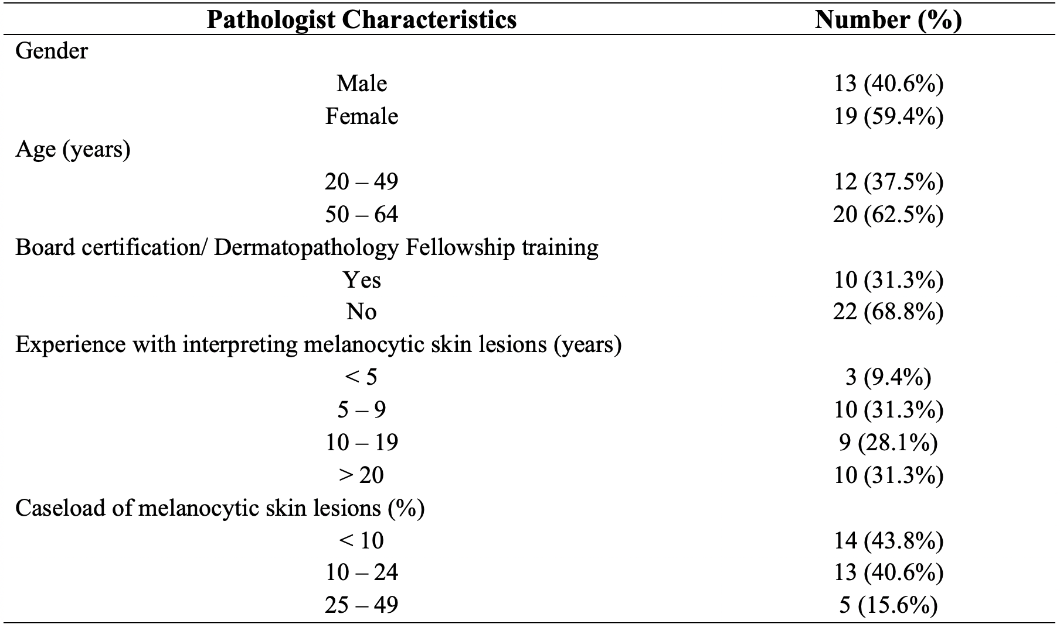
Pathologists’ characteristics

Slide 36
M-PATH data
1
2
3
4
5
Class |  | Count
Class 1 | ﻿Nevus | 15
Class 2 | ﻿Moderate atypia | 30
class 3 | ﻿Melanoma in situ | 45
Class 4 | ﻿Stage pT1a invasive melanoma | 45
Class 5 | ﻿Stage pT1b invasive melanoma | 45

Slide 37
Study Goals
We outline the types of data points that can be gathered to describe pathologists’ viewing behavior using viewport data
How do specific viewing behaviors contribute to diagnostic accuracy?
How are pathologists’ characteristics associated with specific viewing patterns?
How do viewing patterns change as pathologists gain more expertise in diagnosing melanocytic lesions?

Slide 38



Viewing behaviors
Total interpretation time Duration of Interpretation
Average zoom level Average of zoom levels used during an interpretation
Maximum zoom level Maximum of zoom levels used during an interpretation
Zoom level variance Variance of zoom levels used during an interpretation
Magnification Percentage of viewports associated with consecutive zooming in
ROI time Percentage Percentage of time spent viewing consensus ROI to the total time
Scanning Percentage Percentage of viewports associated with fixed zoom level and panning

Slide 39
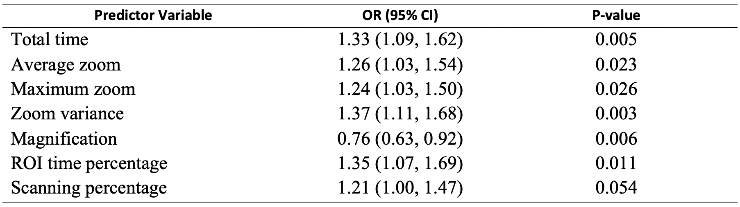
Statistical analysis:
Diagnostic accuracy
How do specific viewing behaviors contribute to diagnostic accuracy?
Diagnostic accuracy is the agreement of a pathologist's diagnosis with the consensus diagnosis
Separate models with each viewing behavior as the predictor variable
Diagnostic accuracy is the outcome
All models are adjusted for pathologists’ experience level and fellowship training
P-value < 0.05
OR > 1
P-value < 0.05
OR < 1
0.05 < P-value < 0.1
OR > 1

Slide 40
Important findings¹
How do specific viewing behaviors and search patterns contribute to diagnostic accuracy?
How are pathologists’ characteristics associated with specific viewing patterns?
How do viewing patterns change as pathologists gain more expertise in diagnosing melanocytic lesions?
More total time, zoom variables, and ROI time, and scanning percentage
Less magnification
Higher accuracy
Higher age category
Lower confidence level
Higher zoom variance
Higher average zoom, maximum zoom, and zoom variance
Having Board certification and/or fellowship training
Higher caseload of melanocytic skin lesions
Lower average zoom, maximum zoom, and zoom variance
1 Ghezloo, Fatemeh, et al. "An analysis of pathologists’ viewing processes as they diagnose whole slide digital images." Journal of Pathology Informatics 13 (2022): 100104

Slide 41
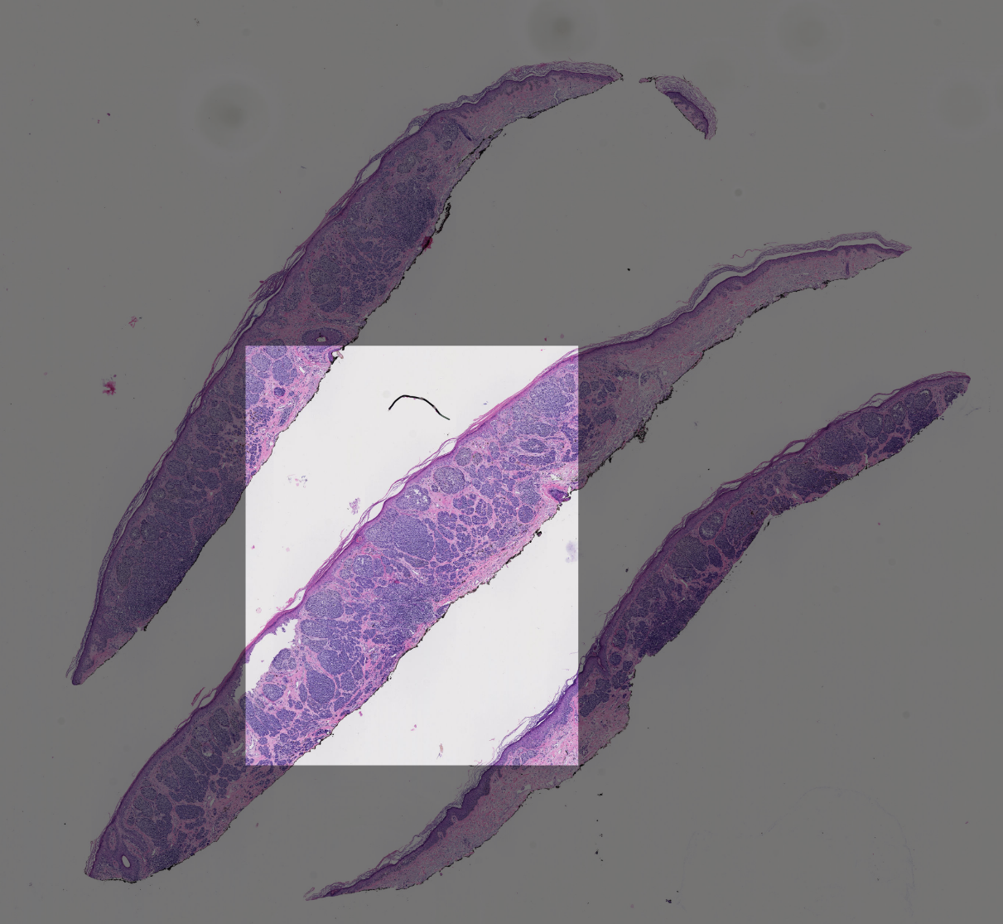
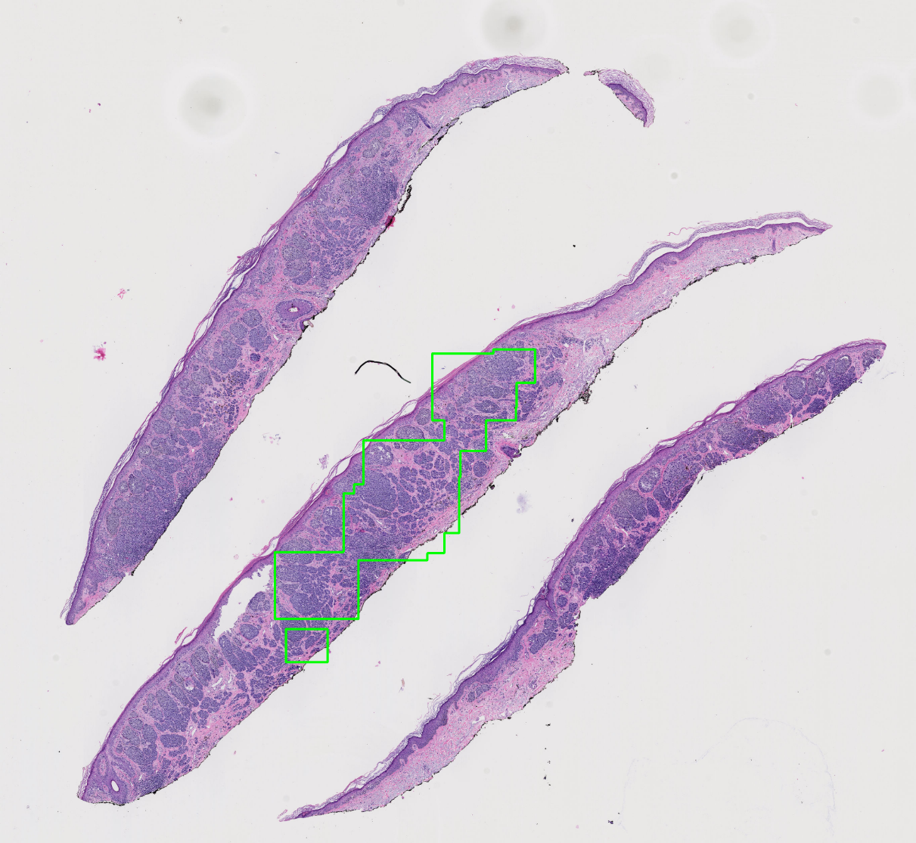
Extracting Viewing ROIs
We extract important viewports based on the following factors:
1. Zoom peaks
Log entries where the zoom level is higher than the previous and the next entries.
2. Slow pannings
Log entries where the zoom level is the same as the previous entry, and the displacement is small.
3. Fixations
Log entries where the duration is longer than 2 seconds.
Consensus ROI
Manually marked
Viewing ROI
Zoom peak + Fixation + Slow panning
Notes:
We extract important viewports based on the following factors:
Zoom peaks are the log entries where the zoom level is higher than the previous and the next entries. A zoom peak identifies a region where the pathologist intentionally zoomed to look at a higher magnification.
Slow pannings are the log entries where the zoom level is the same as the previous entry, and the displacement is small. Slow pannings are intended for investigating a slightly larger and closer area without completely moving the viewport.
Fixations are the log entries where the duration is longer than 2 seconds. Fixations identify the areas to which a pathologist focused extra attention by looking at them longer.

Slide 42
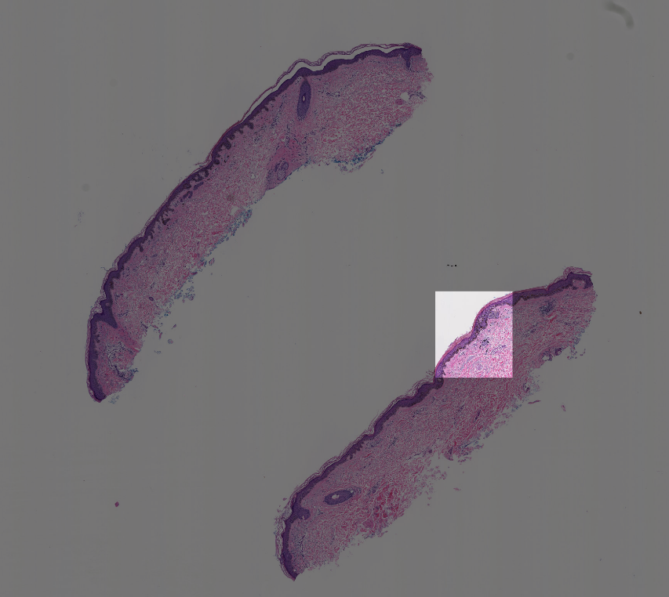
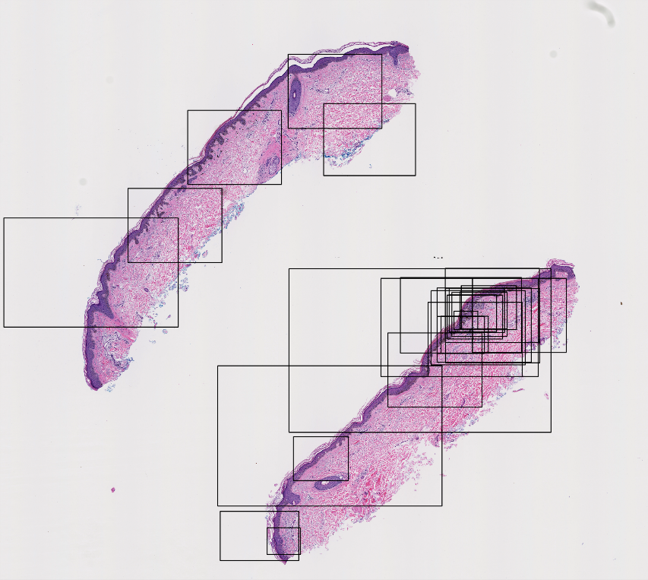
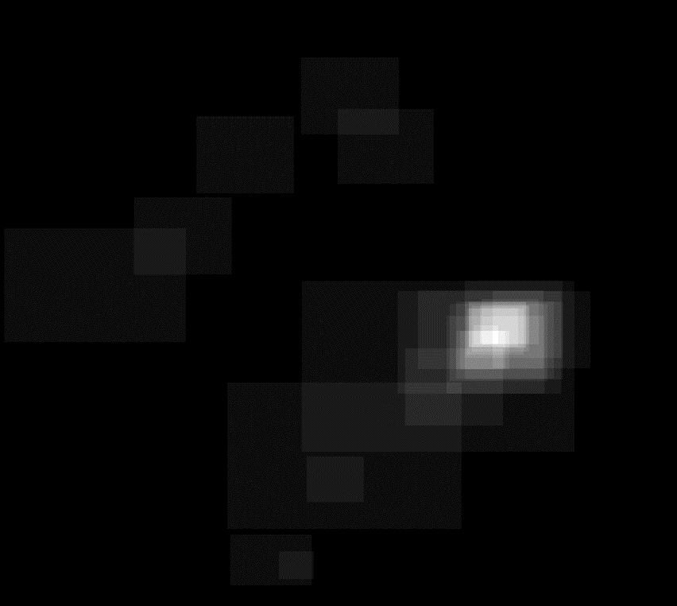
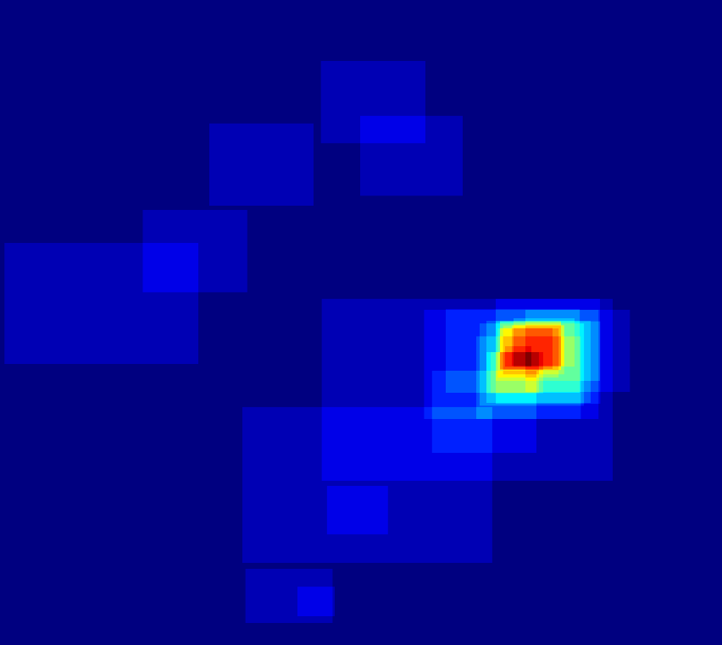
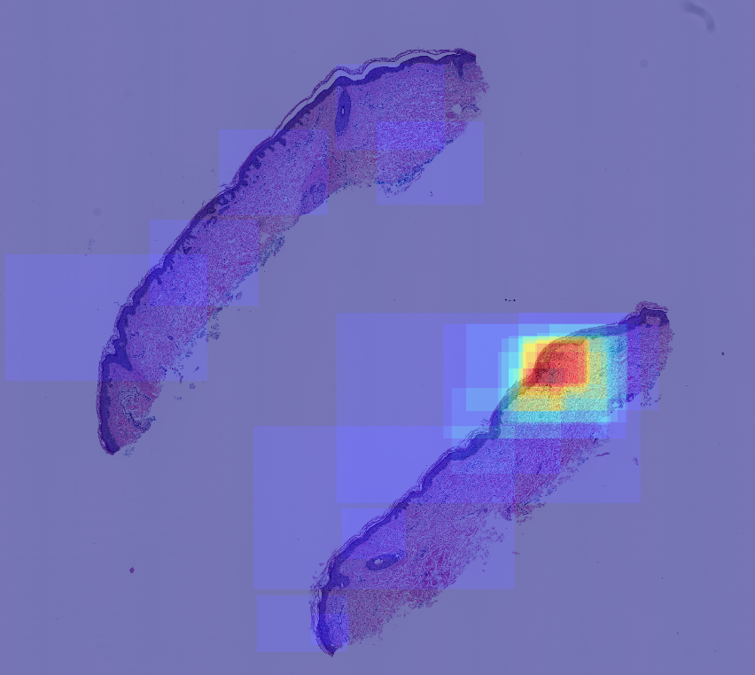
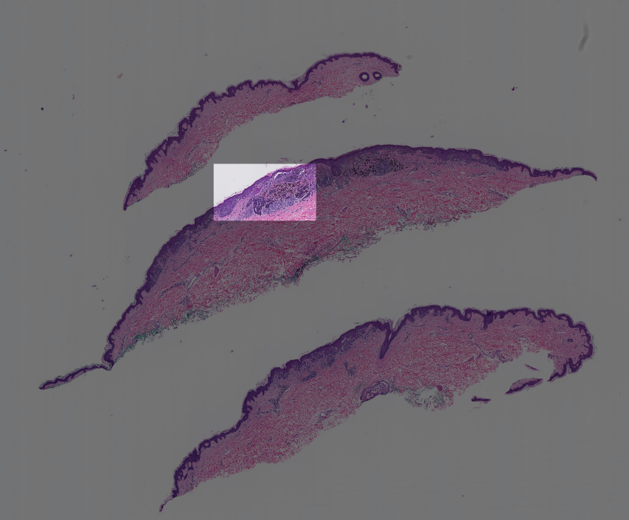
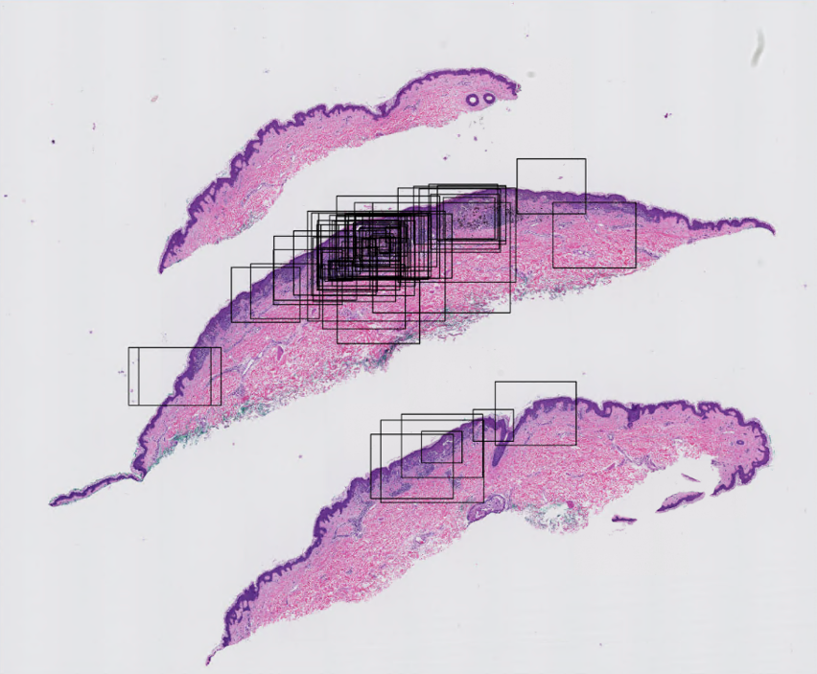
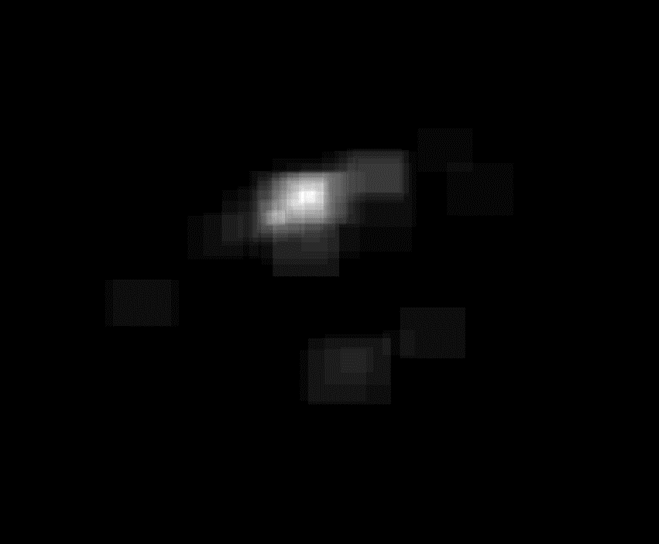
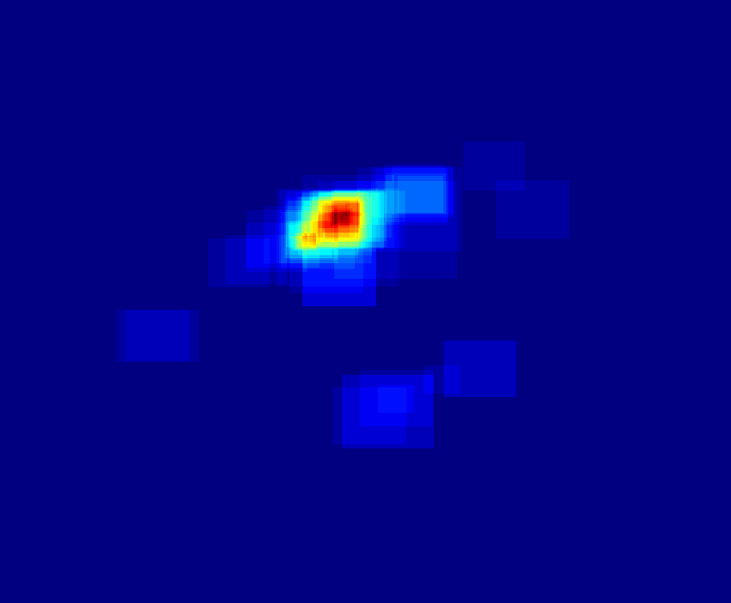
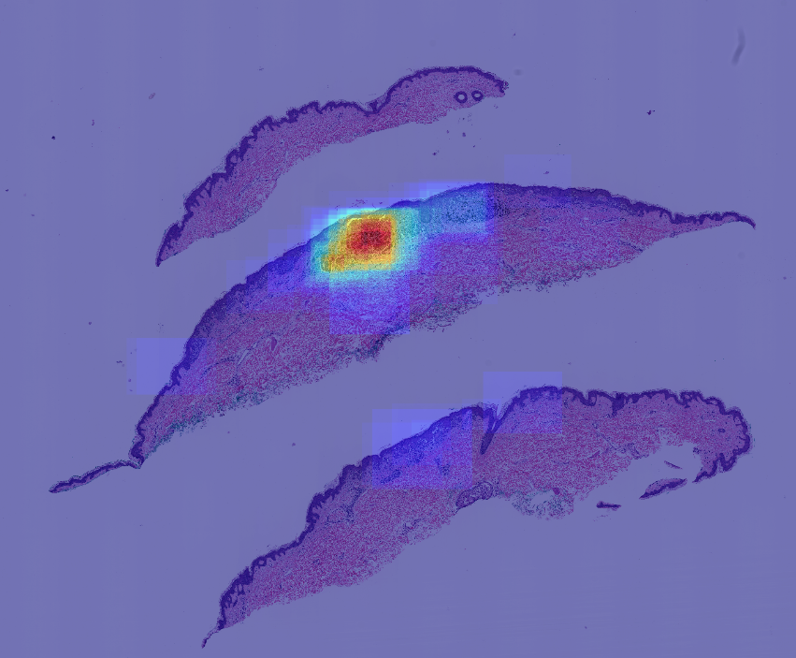
Heatmaps of viewing ROIs
Consensus ROI
Viewing ROIs
Grayscale heatmap
Colored heatmap
Overlay on WSI
Consensus ROI
Viewing ROIs
Grayscale heatmap
Colored heatmap
Overlay on WSI

Slide 43
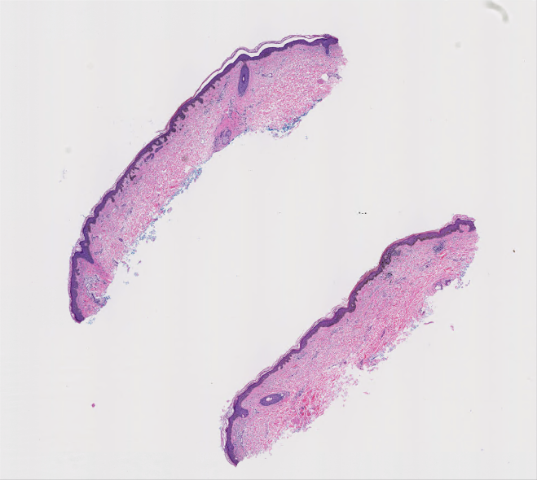
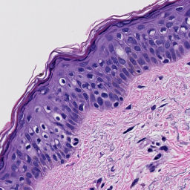
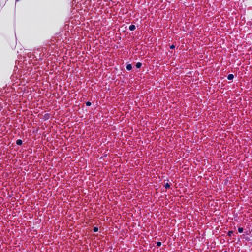
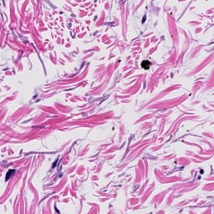
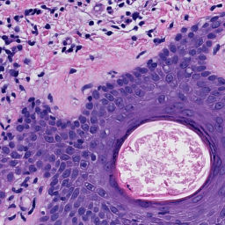
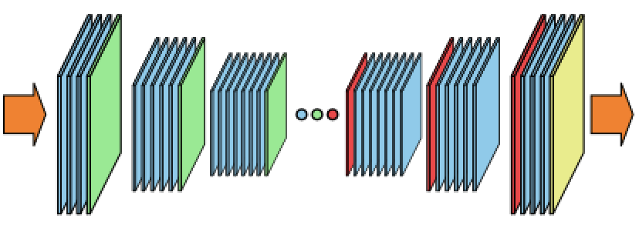





Our approach
Input image
and
heatmap
Patches
Autoencoder (U-Net)
Reconstructed
patches
Reconstructed
heatmap

Slide 44
End-to-End Diagnosis of Breast Biopsy Images with Transformers
Sachin Mehta, Ximing Lu, Wenjun Wu, Donald Weaver, Hannaneh Hajishirzi, Joann Elmore, Linda Shapiro
Appeared in Medical Image Analysis (2022)

Slide 45
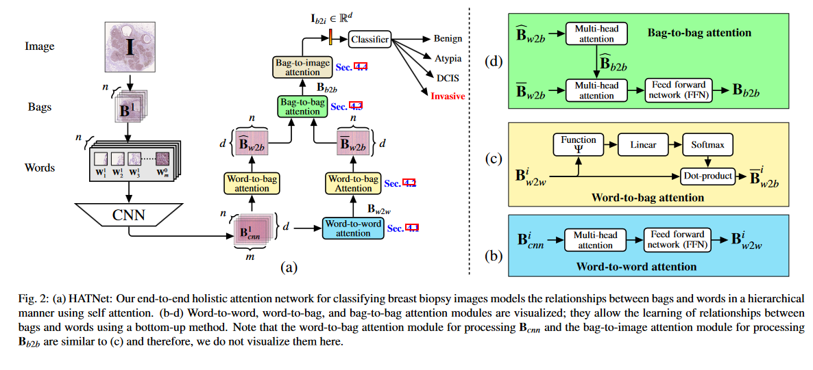
Images are divided into patches called “bags”, which are divided into smaller patches called “words”.
The CNN computes a representation for each word. The transformer then computes word-to-word
attention, word-to-bag attention, bag-to-bag attention and finally a bag-to-image attention that creates
a representation (vector) that is used in the final 4-class classification.

Slide 46
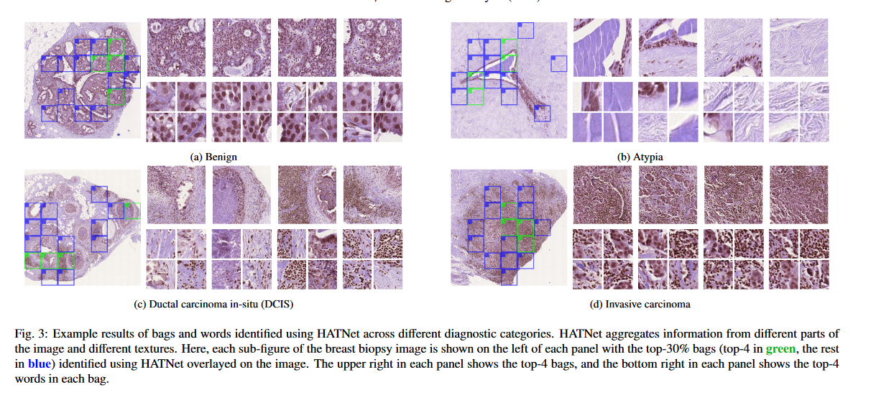

Slide 47
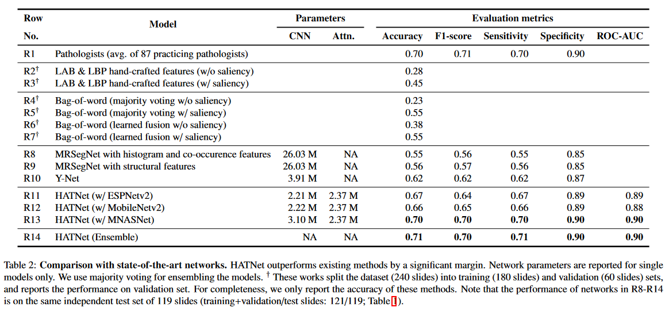
On melanoma data set, accuracy = F1 = .555.

Slide 48
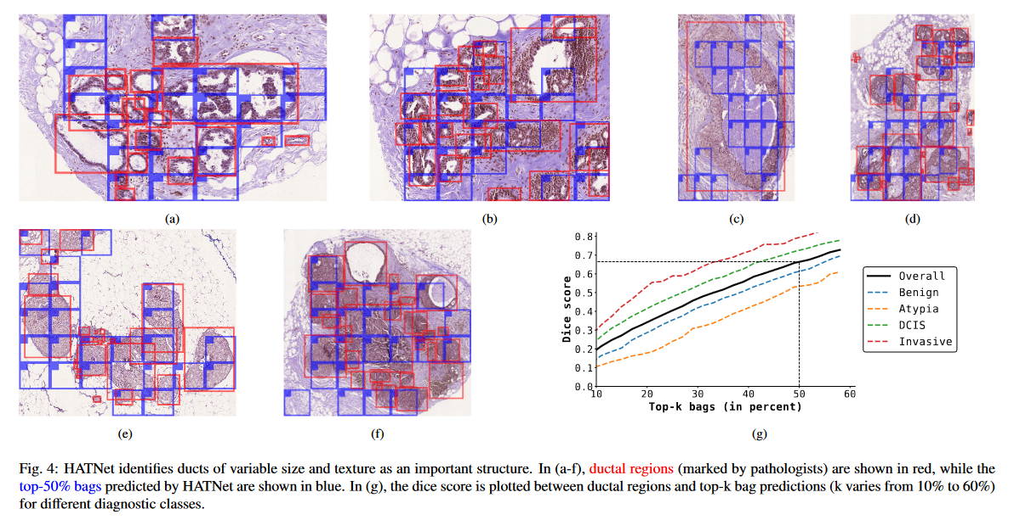

Slide 49
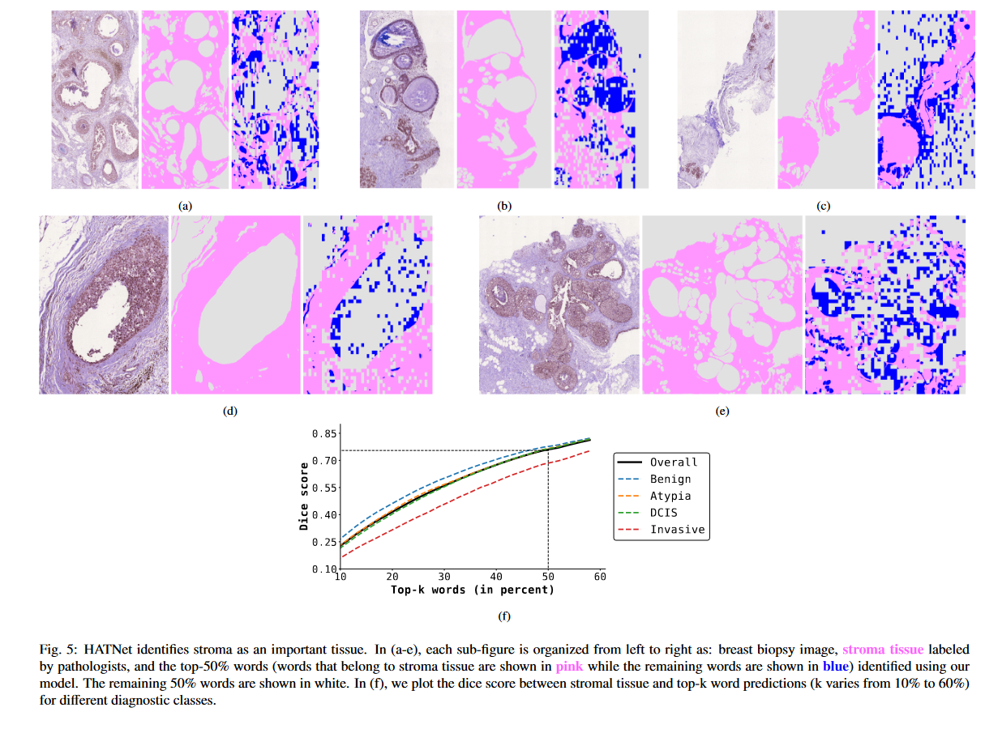

Slide 50
Scale-Aware Transformers for Diagnosing Melanocytic Lesions
Wenjun Wu et al.
IEEE Access 2021
Wenjun will present her own work.

Slide 51



Acknowledgment
Research reported in this study was supported by grants R01CA200690 and U01CA231782 from the National Cancer Institute of the National Institutes of Health, 622600 from Melanoma Research Alliance, and W81XWH-20-1-0798 from the United States Department of Defense.
PI:
Dr. Linda Shapiro
PI:
Dr. Joann Elmore
Pathologists:
Dr. Stevan Knezevich
Dr. Caitlin May
Dr. Oliver Chang
Dr. Mojgan Mokhtari
Collaborators:
Wenjun Wu
Dr. Sachin Mehta
Dr. Annie Lee
Dr. Daniella Witten
Dr. Ezgi Mercan
Lab mates:
Nicholas Nuechterlein
Dr. Beibin Li
Kechun Liu
Dr. Shima Nofallah
Fatemeh Ghezloo

