Slide 1


3D Localization for Sub-Centimeter Sized Devices
Rajalakshmi Nandakumar,
Vikram Iyer, Shyam Gollakota

Slide 2

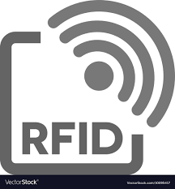

Recent localization work on improving accuracy
UWB
[1] D. Vasisht, et al. NSDI’16
[2] M. Kotaru, et al. SIGCOMM’15
[3] L. Yang, et al. MobiCom ’14
[4] J. Wang, et al. SIGCOMM ’14
[5] B. Kempke, IPSN’16.
[6] L. Chuo, Mobicom’17.
Do not meet the needs of small IoT devices

Slide 3
No technology to track mobile IoT devices through
walls on button cell batteries

Slide 4
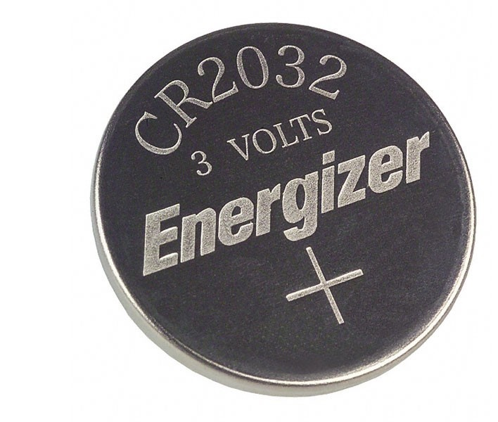
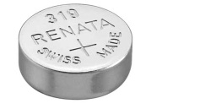

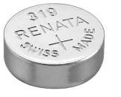

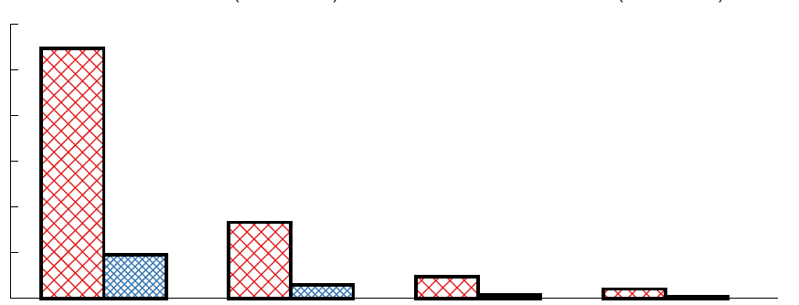
Battery life with radios is very limited
Coin cell (CR2032)
2x Button cell
(LR64)
6
4
2
0
Bluetooth
Battery life (months)
1% duty cycle
BLE
(CC2640)
LoRa
(SX1276)
UWB
(DW1000)
Wi-Fi
(CC3100)

Slide 5
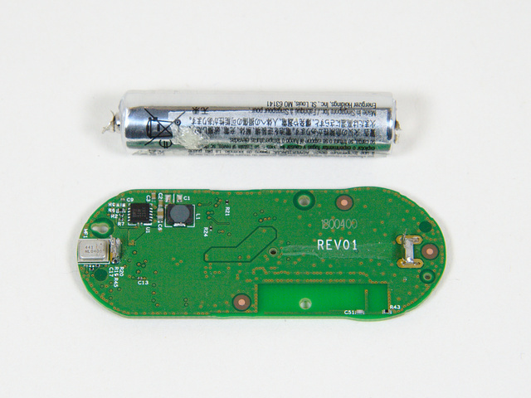
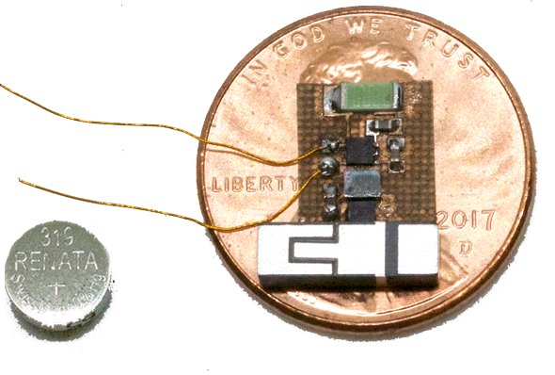
Existing tech: Trade off between size and battery life
44.5 mm
5.8 mm

Slide 6
uLocate
First uW localization system for mobile IoT devices that works across multiple rooms
Sub centimeter programmable microcontroller based prototype that can be integrated with sensors
Real world deployments across 5 homes and a hospital

Slide 7
uLocate
Capabilities
Power 93 uW
Range 60 m
Accuracy 50 cm @ 30 m
Latency < 70 ms
Lifetime >5 years @ 1 %

Slide 8
Outline
Long range communication at low power for sub-centimeter devices
Phase extraction algorithm below noise floor
Addressing multipath to compute 3D location

Slide 9

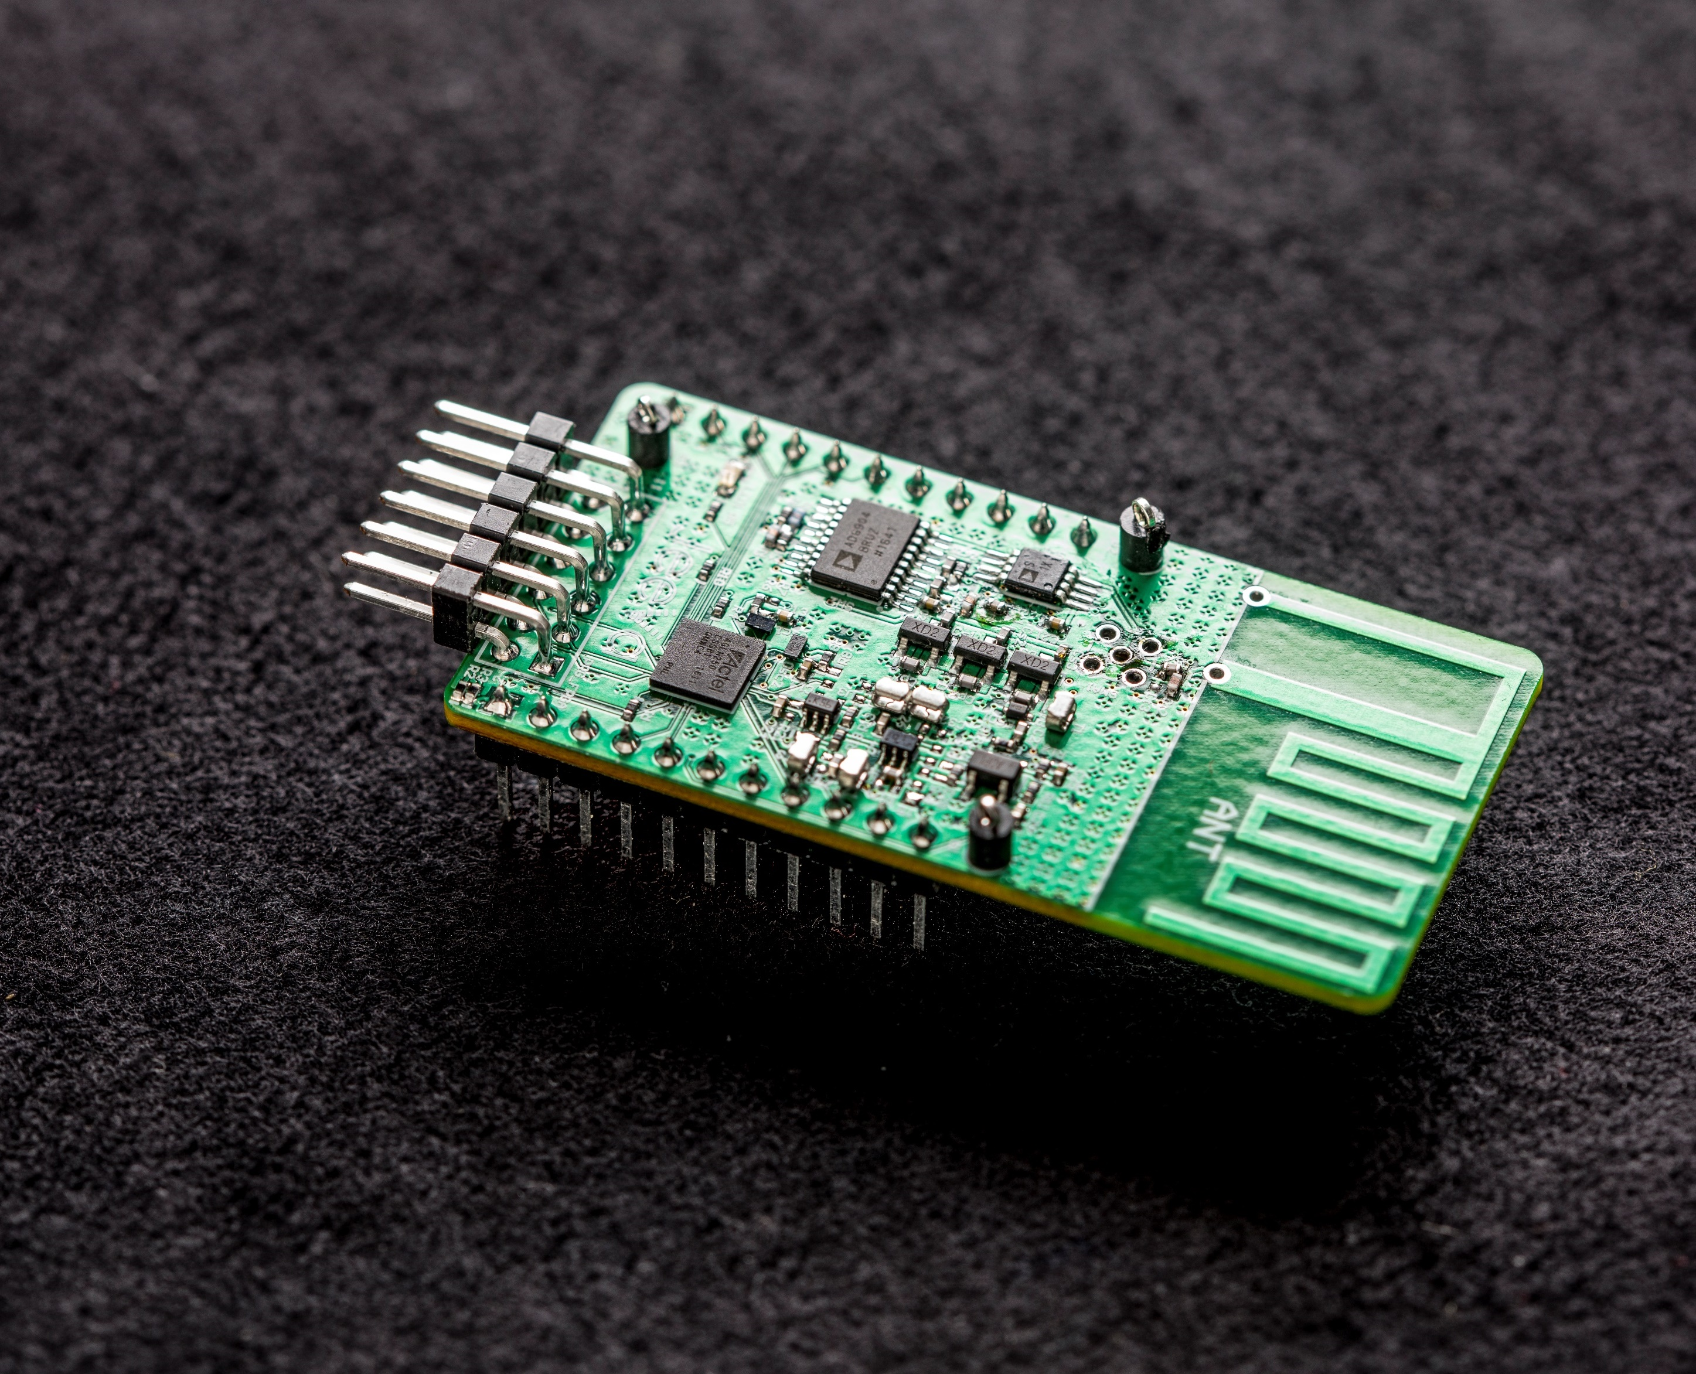

How do we communicate at long ranges?
Naïve Solution: Use LoRa backscatter^{[7]}
Single tone
from AP
Backscattered
chirp
f
f
45 mm
Coding requires large FPGAs → size and power too high
[7] V. Talla, et al. LoRa Backscatter: Enabling The Vision of Ubiquitous Connectivity IMWUT, 2017

Slide 10
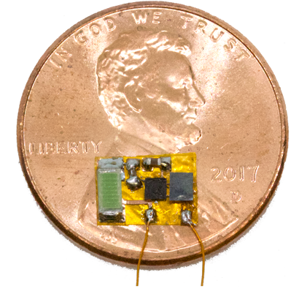
Key Idea: Outsource coding to the access point
Chirp from AP
TX
f
f
AP
RX
IoT Device
f
Backscattered chirp
Oscillator
Architecture enables small, low power, long range communication

Slide 11
Outline
Long range communication at low power for sub-centeimeter devices
Phase extraction algorithm below noise floor
Addressing multipath to compute 3D location

Slide 12
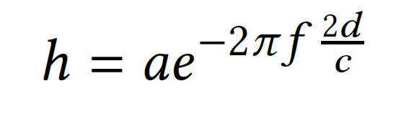
Why do we need the phase?
Wireless Channel
Extracting Phase
Need to find exactly when chirp arrives
Signal is below the noise floor
Microcontroller isn’t synchronized
Extract channel phase from chirp phase
Channel phase
∝ distance

Slide 13
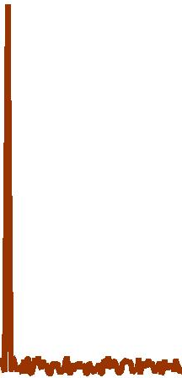
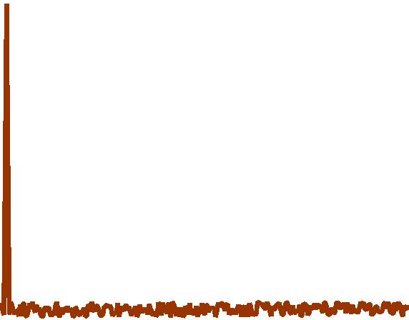
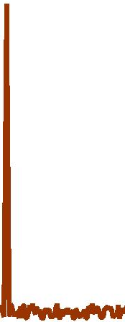

How do we decode chirps below the noise floor?
Solution: Use correlation to get coding gain
Upchirp
FFT
Amplitude
x
Downchirp
$$0$$
FFT Bin
Carrier frequency offset (CFO) also shifts the FFT peak
Use shift in FFT peak to find start time

Slide 14
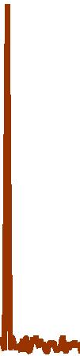

How do we correct for CFO?
Key Idea: CFO stays constant when shifting chirp
Upchirp
CFO
f_{n}
f_{n+1}
f₁
f₀
FFT
x
Amplitude
Downchirp
$$0$$
FFT Bin

Slide 15
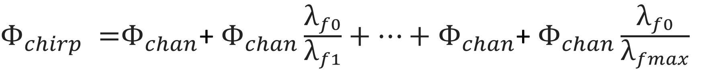

How do we extract the channel phase?
${\text{Φ}}_{chirp} {\text{=}\text{Φ}}_{chan}$+ ${\text{Φ}}_{chan}\frac{{\text{λ}}_{f0}}{{\text{λ}}_{f1}}+…+$ ${\text{Φ}}_{chan}$+ ${\text{Φ}}_{chan}\frac{{\text{λ}}_{f0}}{{\text{λ}}_{fmax}}$
$${\text{=}\text{Φ}}_{chan}$$
Solve for Φ_{chan} → solve for d

Slide 16
Outline
Long range communication at low power for sub-centeimeter devices
Phase extraction algorithm below noise floor
Addressing multipath to compute 3D location

Slide 17
How do we deal with multipath?
Solution: Design multi-band backscatter system
26 MHz
80 MHz
180 MHz
900
MHz
2.4 GHz
5.2 GHz
5.8 GHz
Frequency
Problem: 500 kHz chirp → 572 frequencies x 7 ms > 4 s

Slide 18
Faster solution: Dynamic frequency selection
Leverage path loss to only query the frequencies we need
Maximize the difference between queried frequencies
Perform queries in parallel
900
MHz
2.4 GHz
5.2 GHz
5.8 GHz
Frequency

Slide 19
Putting it all together: Solving for location
How do we use this to help with multipath?
Take IFFT of queries and threshold to pick the closest reflection
How do we know when to stop?
→ Only query when |Loc₁-Loc₂|> ε
How do we get 3D location?
→ Nonlinear least squares to intersect 3 estimates
> ε
Loc₁
Loc₂
Estimate

Slide 20
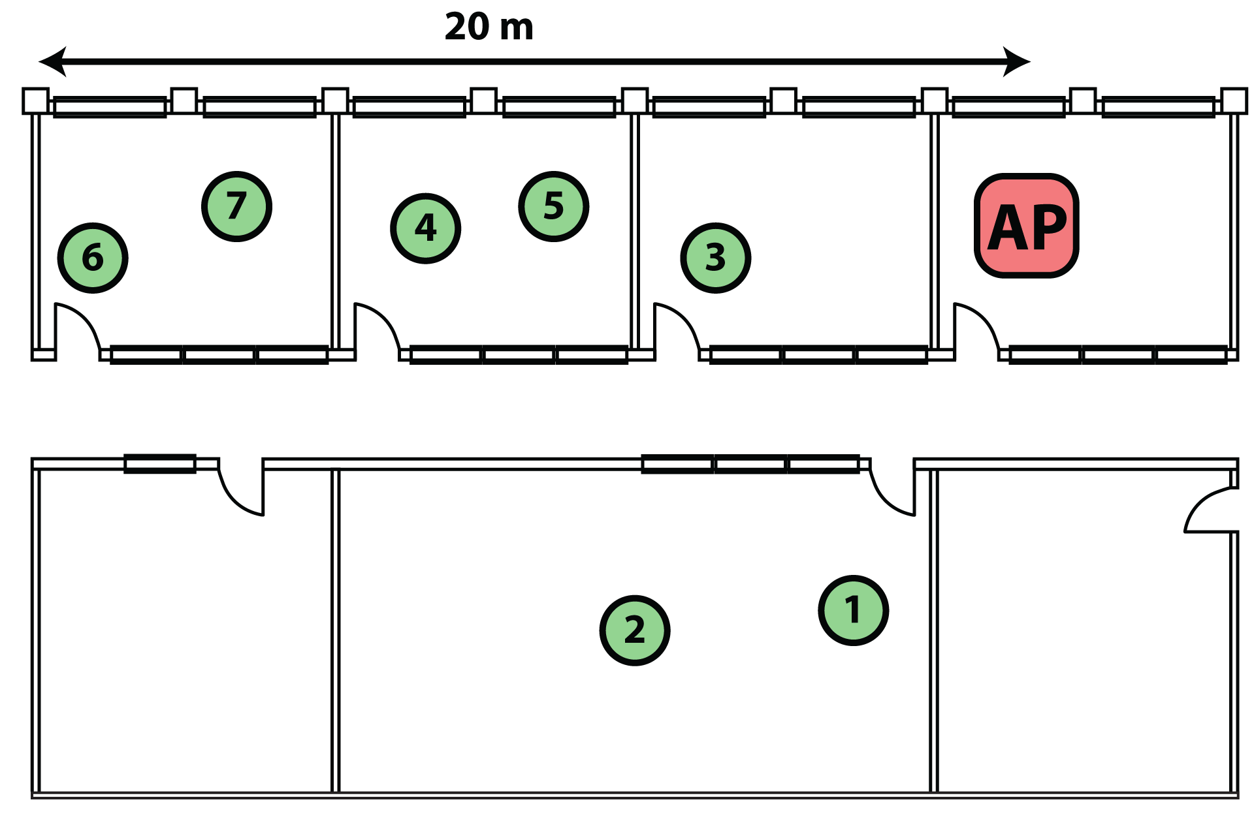
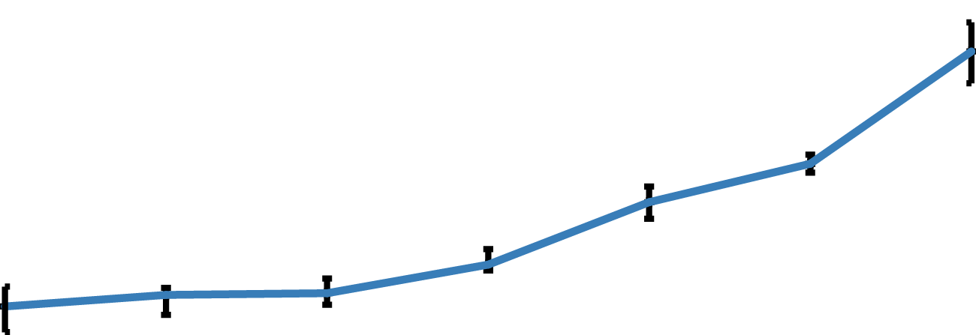
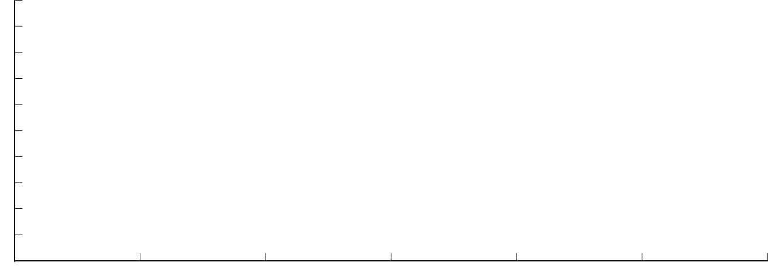
What is our localization accuracy?
Office Deployment
20 m
55
45
35
25
15
5
3D Location Error (cm)
2 3 4 5 6 7
Location
Error <15 cm in next room, < 50 cm through down the hall

Slide 21
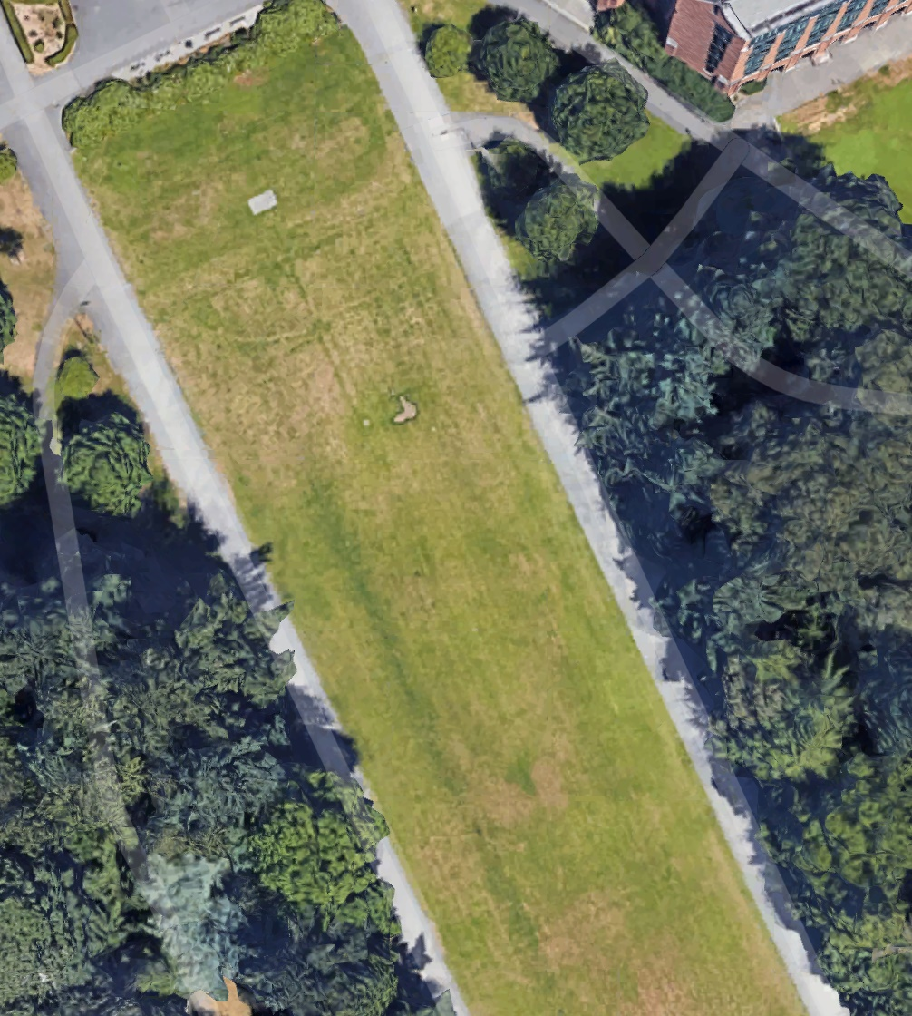
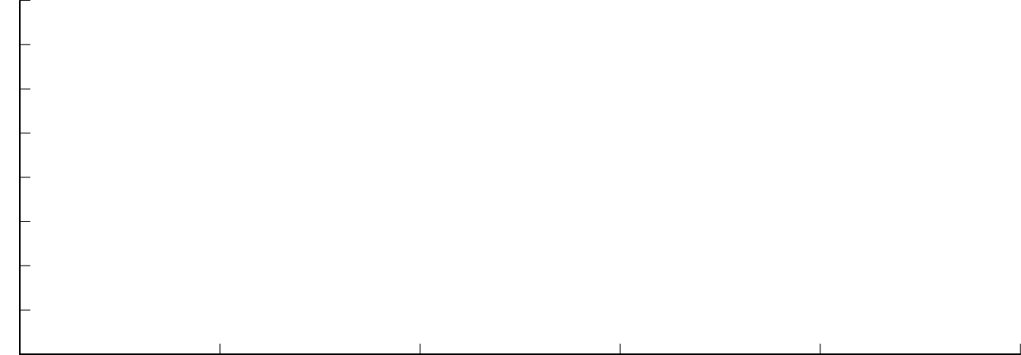
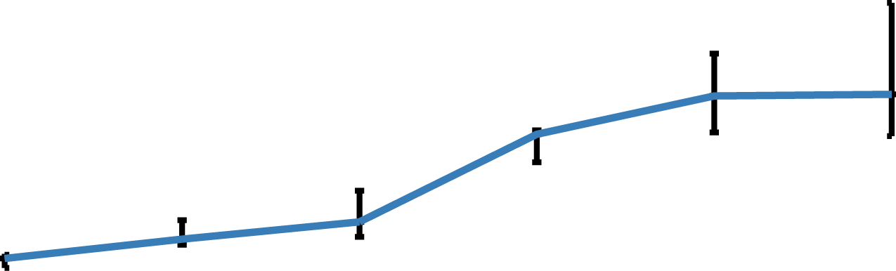
What is our localization accuracy?
Open field experiments
160
120
80
40
0
AP
3D Location Error (cm)
10 20 30 40 50 60
Range (m)
60 m
Localization error: 25 cm @ 20 m
78 cm @ 40 m

Slide 22
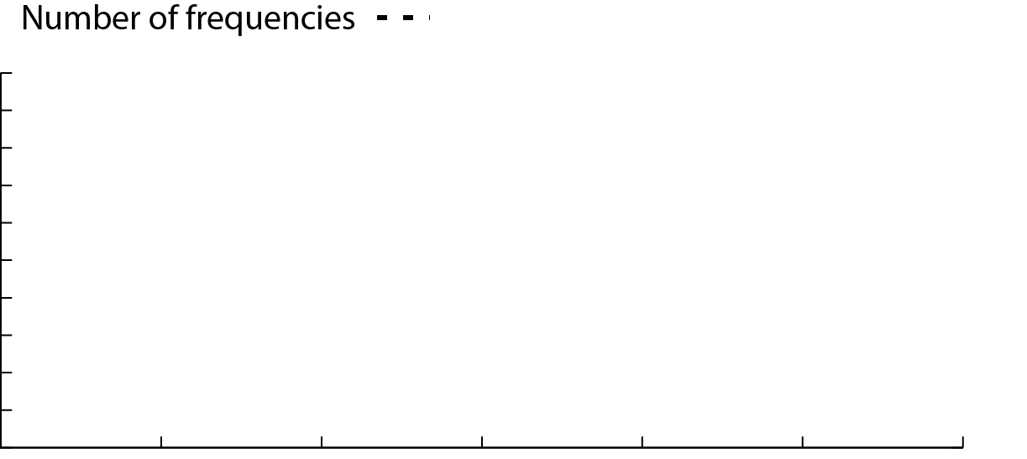
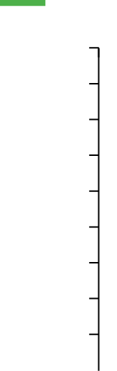

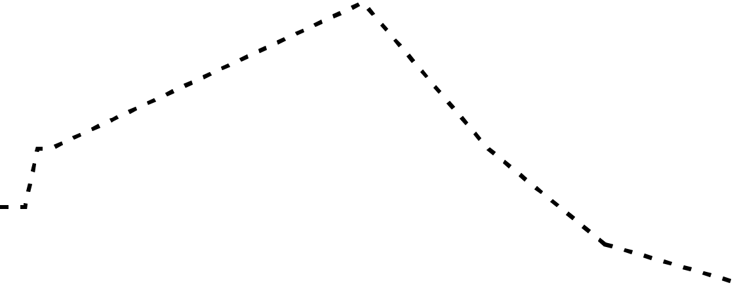
What is the latency for localizing?
Latency
28
24
20
16
12
8
65
55
45
35
25
Number of Frequencies
Latency (ms)
0 10 20 30 40 50 60
Range (m)
Latency <70 ms across whole range

Slide 23

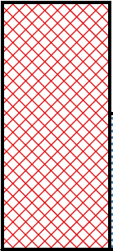
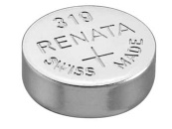
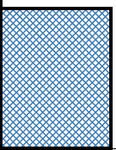
What is the power consumption?
Coin cell (CR2032)
2x Button cell
(LR64)
10
8
6
4
2
0
Battery Life (Years)
Button cell lifetime
@ 1% duty cycle >5 yrs
Microcontroller
@1% duty cycle

Slide 24
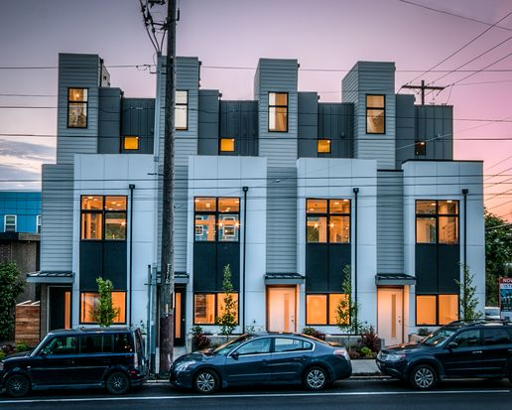





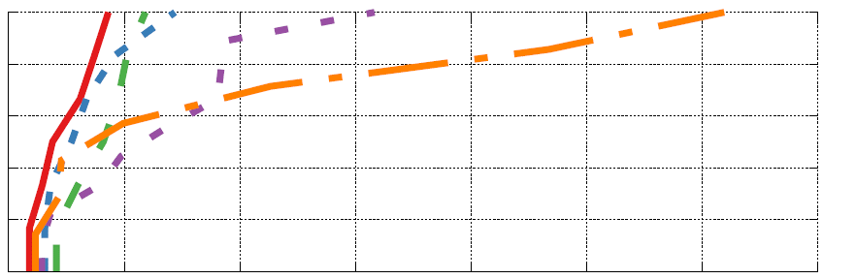
Real world deployment: Homes
Home 1 Home 2 Home 3 Home 4 Home5
1
0.8
0.6
0.4
0.2
0
CDF
0 20 40 60 80 100 120 140
Localization Error (cm)
Apartments <30 cm, Multi-story homes < 1.2m

Slide 25
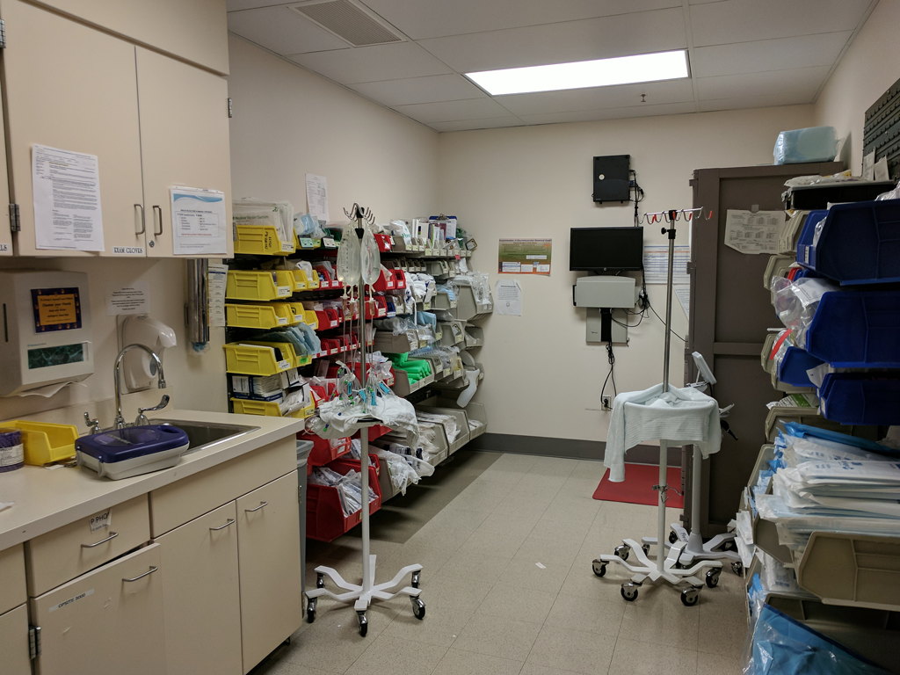
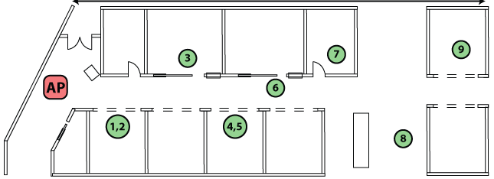
Real world deployment: Hospital surgery wing
20 m
Mean error: 35.1 cm, Max error: 70 cm

Slide 26
Conclusion
First uW localization system for mobile IoT devices that works across multiple rooms
Sub-centimeter programmable microcontroller based prototype that can be integrated with sensors
Real world deployments across 5 homes and a hospital

